Slide 1
Consumer Behaviour
…… An Introduction

Slide 2
What is Consumer Behavior?
Consumer Behavior investigates the manner that people interact with products and their marketing environment. This can include the purchase of products (a new stereo), the consumption of services (Disneyland), or the disposal of goods (eBay). Since we are all consumers in the market place in some form consumer behavior can also tell us something about ourselves. As a result, I think, consumer behavior (or CB) is one of the most interesting topics in Marketing. Understanding consumers enables marketers to more effectively meet the needs of buyers in the market, and be more successful in the market.

Slide 3
During this course we will explore, many social, cultural and marketing factors that influence the selection and usage of products and services. To understand this process, you will be exposed to perspectives on consumer behavior from marketing, psychology, sociology and anthropology. You will also learn about, and try to use, some of the techniques that marketers use to understand and influences consumers, and how these techniques contribute to our daily lives and the culture in which we live.

Slide 4
Course Outline
The course will explore three major themes in consumer behavior. Readings are assigned with each topic and you are expected to prepare for class by reading these chapters.
We will not necessarily cover all of the chapter material in class and we will cover additional material that is not in the textbook.
You are responsible for both the readings and class material for the tests.

Slide 5
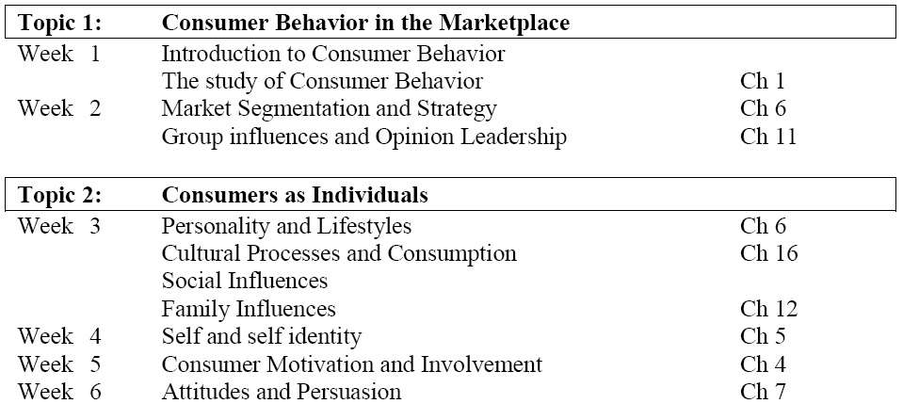

Slide 6
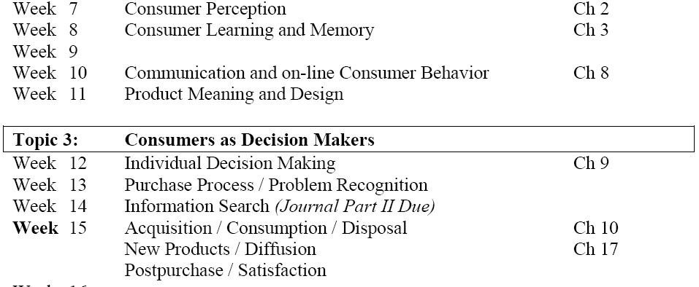

Slide 7
Do Marketers Create Artificial Needs?
Objective of marketing: create awareness that
needs exist, not to create needs
Need: a basic biological motive
Want: one way that society has taught us that the need can be satisfied
versus

Slide 8
Vodafone (exam_results)

Slide 9
Defining Consumer Behavior
Consumer Behavior is the Process Involved When Individuals or Groups Select, Use, or Dispose of Products, Services, Ideas or Experiences (Exchange) to Satisfy Needs and Desires.

Slide 10
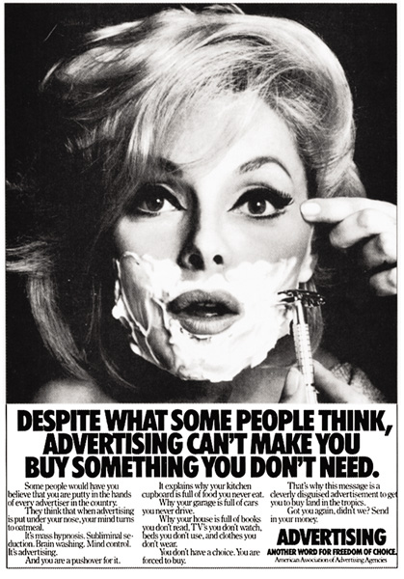

Slide 11
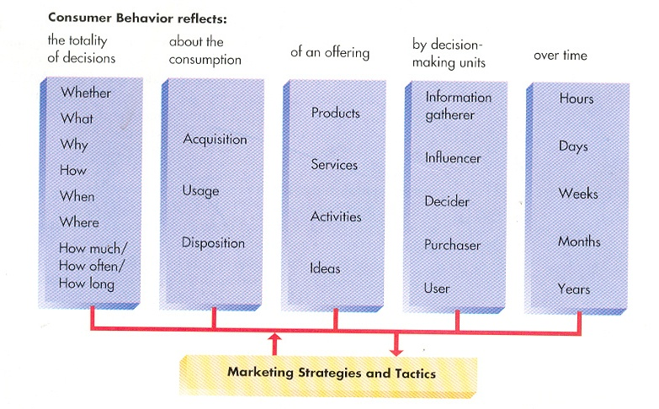
Identifies consumers as actors on the marketplace stage
ROLE THEORY

Slide 12
Heinz (1080)

Slide 13
Self-Concept Attachment
Helps to Establish the User’s Identity
The Meaning of Consumption
Nostalgic Attachment
Serves as a Link With a Past Self
Types of Relationships a Person May Have With a Product:
Interdependence
Part of the User’s Daily Routine
Love
Elicits Bonds of Warmth, Passion, or Other
Strong Emotion

Slide 14
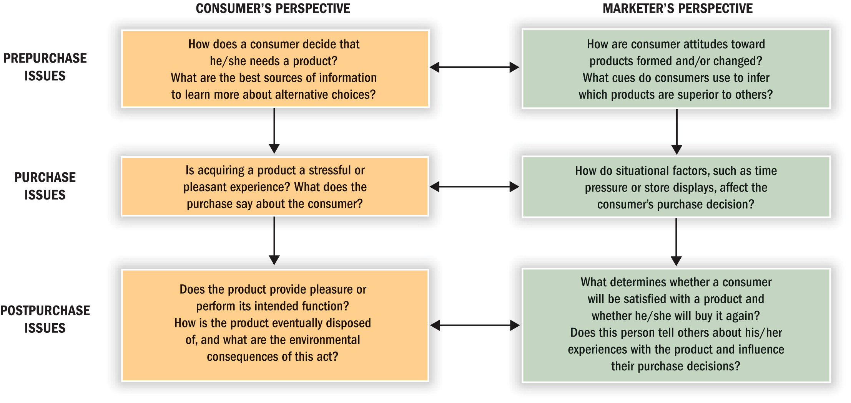
Consumer Behavior is a “Process”

Slide 15
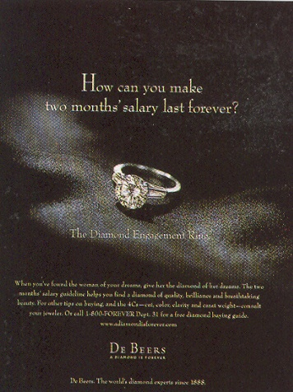

Slide 16
Segmenting Consumers:
Demographics: statistics that measure observable aspects of a population, such as:
Age
Gender
Family structure
Social class and income
Race and ethnicity
Geography
Psychographics
The way we feel about ourselves
The things we value
The things we do in our spare time

Slide 17
Ufone(hangman)

Slide 18
Zong(pagal)

