Slide 1
Strategic Management (MGT501)
Lecture 6
Dr Muhammad Mustafa Raziq

Slide 2
Summary of the topics covered in the previous lecture
Porter’s Five Forces Model
Competitive Profile Matrix
Strategies for competing in globalizing markets: impact of globalization, MNEs
Internet economy, e-commerce, and social networking sites
Changing Strategic Situations, Complexity, Turbulence, and Chaos: Institutional Strategy

Slide 3
Topics to be covered in this lecture
Industry Driving Forces
Organizational Appraisals: Firms as Value Creators
Value Chain Analysis and Value Creation

Slide 4
2.10. Industry Driving Forces
Driving forces are variables, both internal and external, which shape an industry, its growth, pace, and direction as drivers of change. Knowledge of the industry driving forces is essential to formulating a fitting strategy.
Industry driving forces can be:
  External
  Internal

Slide 5
2.10.1. External Driving Forces
Variables outside the industry periphery and beyond the industry control – these act powerfully in driving a change in an industry – these include:
Disruptive technologies and innovations outside the industry acting as threats or opportunities for growth. Innovation alters the pattern of competition by attracting more first time buyers
Government: government decision to open the domestic market to foreign participation drive competitive change. Certain industries get the patronage and support of the government with favorable policies, incentives, and protection.
Demographic changes drive growth of certain industries which fits a strategy in line with the changes in buying decisions, changing perceptions of value, where customers purchase, size of middle class, youth characteristics etc.
Globalization, privatization and liberalization: these change the competition scenario bringing in efficiency, improved product quality, and accessibility to global brands, creating new benchmarks of customer value

Slide 6
2.10.1. External Driving Forces (continued)
Internet applications are a driver of industry in many ways through online shopping, web marketing, online education etc.
Lifestyle of people drive industry changes, such as attitude change on tobacco use, red meat, organic food, calorie intake, exercise, use of fuel etc.
Growing concern on climate change and environment is an emerging great driving force for many industries. There are manufacturing and service industries in/using wind power, solar power, waste recycling etc.
Digital economy with interaction between data sets and speed in data generation offers opportunities to companies that have robust analytics process in using the big data to create better services and customer experiences.

Slide 7
2.10.2. Internal Driving Forces
Innovativeness of firms in an industry, labour force quality, firm’s norms, power of its mission, cohesiveness of the industry/trade association, use of business analytics in decision making and risk management (with contingency plans for rarest of circumstances), customer intelligence for customer value maximization, and perspective on which business strategy is built are a few internal driving forces

Slide 8
Chapter 3: Internal Analysis
3.1 Organizational Appraisals: Firms as Value Creators
The very purpose of an organization is to create value to its significant stakeholders – concepts like value, dimensions of value, value propositions, and value creation are therefore critical.
Any organization that ceases to create value will cease to exist eventually.
Firms focus on creating value for its shareholders by high margins or by low cost and for customers by high or better utility.
A sustainable organization will create value for the community in terms of economic (employment generation), environment (ecology) and social (philanthropy) aspects.

Slide 9
3.1.1. Perceptions of Value
Humans prefer some products over others due to certain judgments emanating from the psychological realm
Sometimes a community or group of persons show a favorable disposition to the products of a particular company due to cultural reasons or other sociological reasons.
Generally, the determinants of value perceptions are:
  Exchange Value (what quantity of other commodities it will exchange for, if traded at a point in time)
  Use Value (Value in terms of consumption benefits in relation to users’ needs)
  Real Value (sum of the costs e.g. inputs and labor time to produce and deliver a product or service) (Example: Restaurant food and price relation)
  Price (the advertised price shown in the price tag of a product)

Slide 10
3.1.2. Relationship of Value and Price of the Product
Values are subjective, independent, highly variable, and changeable, and hence for markets to function, market price is put on any commodity to express the terms of exchange, since price measures the value for no particular person.
Seller wants maximum profit and buyer tries to buy as cheap as possible – this drives all trades toward a ‘uniform price’, which is ‘just price’ emerging from the freely made decisions of all the market participants.

Slide 11
3.2. Value Chain Analysis and Value Creation
A value chain is a sequence of activities in the production of goods and services.
Products pass through all activities, from start till the end consumer, in an order and at each activity, the product gains some value.
The chain of activities gives the products added value and the final value of the product is the sum of added values to all activities.
The value chain consists of primary activities and support activities done in a firm as a chain to the end product, adding value in a cumulative fashion.

Slide 12
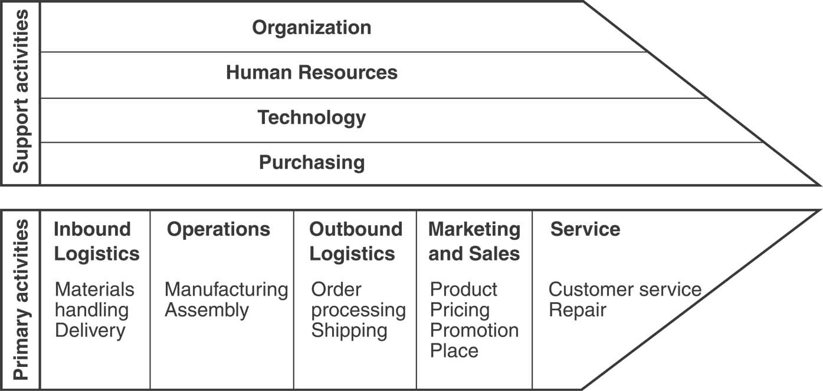
3.2. Value Chain Analysis and Value Creation (continued) – Value Chain Model by Porter (1985)

Slide 13
3.2.1. Internal and External Value Chains
While a resource may have a tremendous potential value, its value can only be realized when it is combined with a corresponding capability (Barney, 1991)
Combining resources in unique ways by firms is a source of competitive advantage
Resources and capabilities are therefore unproductive in isolation, and hence exploitation of a resource-capability combination provides competitive advantage to a firm.
Such a combination can be within the boundaries of the firm and/or in the extended boundary of alliances, partnerships, and supply chains.

Slide 14
3.2.1. Internal and External Value Chains (continued)
Value erosion of a product may happen if both the internal and the external value chains are not considered in tandem.
B2C firms have an internal value chain from its raw materials’ reception to the dispatch of the product or service and an external value chain the includes the delivery components, after sales services, and product take back reverse cycle.
For B2B firms the external value chain is simplistic as direct end-customer interaction is minimal, even though after sales services, and delivery components also have activities with potential for value creation.

Slide 15
3.2.2. Assessing Internal Environment Through Functional Approach and Value Chain
An activity in any functional area of the firm in the chain that does not add value is not likely to give competitive advantage.
  Firms need to innovate to reduce costs and to protect competitive advantage. Such as innovation in production technology, internet marketing activities, lean manufacturing, customer relationship management, and RFID and ERP applications etc.
An analysis of various activities of the organization with a view to assess whether each activity builds value or not is the function of value chain analysis.
Value chain analysis helps one to identify ways in which value can be created for the firm’s customers and how this value can be maximized.
The more value a firm creates, the more people will be prepared to pay a good price for the product or service.

Slide 16
3.2.3. Value System
The industry wise coordinated interactions of local value chains create an extended value chain, sometimes global in context. Such larger interconnected system of value chains is termed as the ‘value system’ (Porter)
A typical business value chain will include a firm’s suppliers, the firm itself, the firm’s distribution channels, and the firm’s buyers.

Slide 17
Summary of the topics covered
Industry Driving Forces
Organizational Appraisals: Firms as Value Creators
Value Chain Analysis and Value Creation

Slide 18
Topics for the next lecture
Value Chain Analysis and Value Creation
Elements of value proposition: analyzing a company’s resources and competitive position
Value Hierarchy, Value Shop, and Value Network
Assessing Market Value of a Business

