Slide 1
Strategic Management (MGT501)
Lecture 28
Dr Muhammad Mustafa Raziq

Slide 2
Topic Covered in the Previous Lecture
Marketing and Distribution Strategies
Production and Operations Management Strategies and Tactics

Slide 3
Topics to be covered in this lecture
R&D strategy or Innovation Strategy Creating Value Changing Processes
Learning Organization
Strategy Implementation Phase of the Strategic Management Process

Slide 4
7.9. R&D Strategy or Innovation Strategy Creating Value Changing Processes
A firm’s performance improvement comes not only from innovation in its offerings but also from innovations in the management process.
Research and development function to conceive, design, develop prototype, test and package a product can be done in-house or can be outsourced to specialized R&D organizations
Product enhancements in existing products and developing new products are thus part of the R&D strategy
Management innovation is the new way of organizing, leading, coordinating, controlling, and motivating
Innovation in management principles and processes can create long lasting advantage and produce dramatic shifts in competitive position (Hamel, 2006)

Slide 5
7.9. R&D Strategy or Innovation Strategy Creating Value Changing Processes (continued)
Hamel (2006) defines management innovation as a marked departure from traditional management principles, processes and practices or a departure from customary organizational forms that significantly alters the way the work of management is performed.
Any problem that is pervasive, persistent, or unprecedented is unlikely to be solved with the usual principles or practices of management. Some of notable management innovations are:
  Knowledge management; brand management; cost accounting; strategic analysis; sustainability strategy; decentralization; divisionalization; project management; capital budgeting; ROI analysis etc

Slide 6
7.9.1. Innovation Strategy Roadmap
Anthony et al (2006) propose the following principles for building competitive advantage through innovation:
  Pitch the playing field: before deciding how to play the innovation game, companies have to decide where to play, identify the market space the company wishes to target, and clarify what the company will not do
  Build the growth playbook: by developing a checklist through analyzing 10-15 major innovations in the market segment’s history. This checklist allows the firm to look at any opportunity from multiple perspectives, that is, customers, competitors, channel, and regulators.
  Build the company’s game plan: create a short list of innovation ideas for the identified target market and to assess whether those ideas adhere to the general pattern of success and the checklist.

Slide 7
7.9.1. Innovation Strategy Roadmap (continued)
Anthony et al (2006) propose the following principles for building competitive advantage through innovation (continued):
  Execute with Flexibility: with staged or phased investments, the new growth game plan is to be executed assessing the response. If the current strategy or innovation road map is not viable, then change the approach and revaluate or else move on to other projects.
  Manage the innovation process: with novel-innovation based growth initiatives, right strategy is probably to be unknown and unknowable, and hence, the senior managers may adopt a problem solving approach rather than a stage gate approach.

Slide 8
7.9.2. Innovation Capability as a Sustainable Competitive Advantage
Akman and Yilmaz (2008) conceptualize innovation capability in a framework with proactiveness as the most important factor of innovation capability followed by analysis and futurity.
Venkataraman (1989) suggest the innovation capability as a set of competitive strategies, which are:
  Aggressiveness: a combative posture in exploiting market opportunities
  Analysis: ability to monitor and understand events and trends in the environment
  Defensiveness: a firm need to defend its current position
  Futurity: determining future changes with a wide variety of views and plans
  Proactiveness: ability to recognize, anticipate, and act on opportunities
  Riskiness: seeking and transforming market opportunities

Slide 9
7.10. Learning Organization
With the changing environment the organization members need to learn continuously to update themselves about the technological advancements, demographic shifts, new legal structure, political trends, etc.
An organization where the members learn continuously and thereby transform the organization is called a learning organization.
A learning organization will be more innovative, competitive, and adaptive.

Slide 10
7.10.1. Knowledge Management
In an organizational life, its members gain experiences and insights while carrying out activities. These insights and experiences unique to situation are called knowledge that is embodied in individuals or embedded in processes or practices.
There are different types of knowledge in a organization such as tacit knowledge and explicit knowledge, content and relational knowledge, embedded knowledge and embodied knowledge, new knowledge (innovation), and established knowledge.
Knowledge helps in NPD, solving problems, and adaptive management.
Earlier, knowledge was managed through discussions, professional training, mentoring, and apprenticeship. Now the knowledge bases, expert systems, knowledge repositories, decision support systems, intranets, etc are used in knowledge management.

Slide 11
7.10.1. Knowledge Management (continued)
Knowledge management strategies for organizations include the following:
  Push Strategy
  Pull Strategy
  Cross-project or inter-project learning
  After action reviews
  Knowledge mapping
  Communities of practice
  Best practice transfer
  Knowledge fairs
  Expert directories
  Mentoring and apprenticeship
  Social networking.

Slide 12
7.10.2. Competitive Advantage through Learning
In a learning organization, people continually expand their capability to create the results that they desire, where new and expansive patterns of thinking are nurtured, where collective aspiration is the set free, and where people are continually learning to see the whole together (Senge, 1990)
The learning in an organization needs to be correlated to the long term competitive advantages to term the learning strategic. For example the orientation to learn what is the maximum value potential or volume potential of a product by asking questions and finding answers to the following questions is probably to lead to competitive advantages (Next Slide).

Slide 13
7.10.2. Competitive Advantage through Learning (continued)
Questions:
  Total consumers who consume the product
  Total consumers who consume the substitutes
  Total consumers who are aware of the product but not purchasing
  Total consumers who can not afford the price
  Total consumers who do not have the skill to use
  Total consumers who oppose the product

Slide 14
Chapter 9: Strategy Execution

Slide 15
9.1. Strategy Implementation Phase of the Strategic Management Process
If a firm wants to grow perpetually, the first step is taking a decision to apply the strategic management process
The initial steps in the strategic management process are to take a firm decision to change or to grow, which is followed by environmental monitoring and a performance audit for gap analysis. This is followed by a value scan to formulate the mission
The insights gained from environmental scan, value scan, resource audit, and gap analysis as part of the strategic analysis are likely to clarify intentions leading to strategic business modelling.

Slide 16
9.1.1. Implementation Models
There are a diversity of strategic implementation models depending on the type of actors, contexts, and existing systems in organizations. An example on next slide.

Slide 17
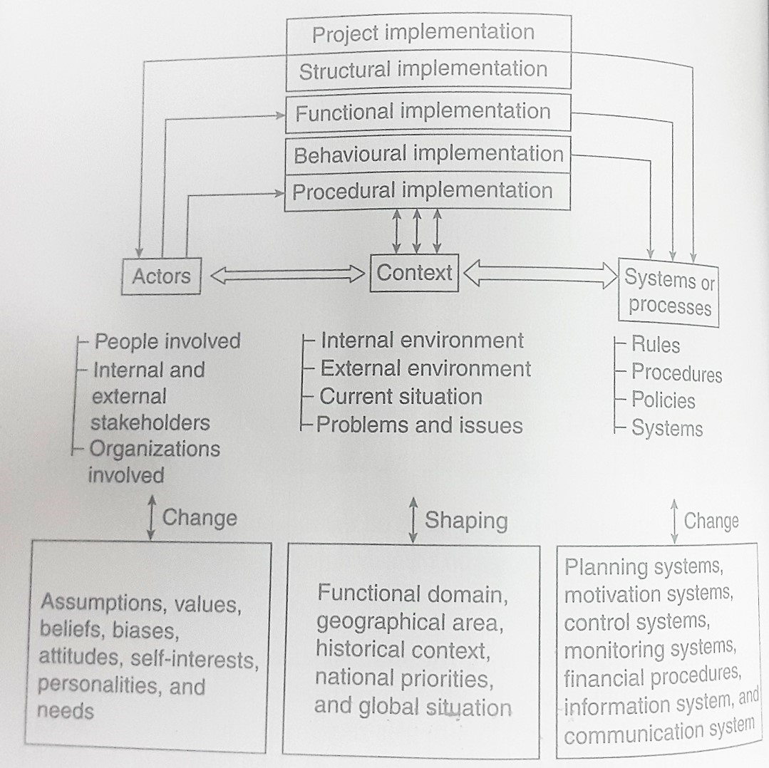
9.1.1. Implementation Models (continued)

Slide 18
9.1.1. Implementation Models (continued)
Strategy is implemented by individuals and groups as actors in specific contexts, acting within organizational systems.
Implementation of strategy has six basic components: structural, functional, behavioral, procedural, project implementation, and resource allocation.
Strategy implementation starts with extending the strategic vision and strategic objectives throughout all units of the organization, encompassing every system to impact all operational processes needed to produce expected outputs.
A thorough assessment of the organization’s capacities in areas such as managerial capability, power structure, culture, leadership, governance structure, organizational structure, communication systems, and performance management systems at the strategic planning stage will help in effective implementation of the formulated strategy.

Slide 19
Summary of the topics covered in this lecture
R&D strategy or Innovation Strategy Creating Value Changing Processes
Learning Organization
Strategy Implementation Phase of the Strategic Management Process

Slide 20
Topics for the next lecture
Strategy Implementation Phase of the Strategic Management Process
Operationalizing Strategy: Translating Intention to Action
Implementing Strategic Change

