Slide 1
Strategic Management (MGT501)
Lecture 15
Dr Muhammad Mustafa Raziq

Slide 2
Topic Covered in the Previous Lecture
Organizational Appraisal and Strategic Management Process

Slide 3
Topics to be covered in this lecture
Organizational Appraisal and Strategic Management Process
Strategic Planning
Strategic Thinking

Slide 4
5.1.2. Appraisal and Planning Tools (continued)
TOWS Matrix and SFAS Framework:
  TOWS matrix helps in determining the direction of the firm through matching external factors with the internal factors
  SFAS (Societal Factor Analysis Summary) framework divides the firm’s operating environment (into societal, task), and the internal environment for a quantitative SWOT analysis.
  Societal factors consist of the generic PESTELD factors and task environment consists of the industry domain, such as customers, suppliers, and competitors.
  The societal and task environment together constitute a firm’s external environment in SFAS framework of strategic analysis.

Slide 5
5.1.2. Appraisal and Planning Tools (continued)
TOWS Matrix and SFAS Framework:
Internal Factor Analysis Summary External Factor Analysis Summary | Strengths (S) A B C etc. | Weakness (W) A B C etc.
Opportunities (O) A B C etc. | SO Strategies using strengths to take advantage of opportunities. Leveraging strengths and matching opportunities with strengths to build competitive advantage | WO strategies by minimizing or overcoming a weakness, taking advantage of opportunities; usually by acquiring/developing new resources or capabilities
Threats (T) A B C etc. | ST strategies using strengths to avoid/neutralize threats or minimize the impact of threats | WT strategies that avoid or bye pass threats and minimize weaknesses. Some threats are converted as opportunities also, if not, exit is considered

Slide 6
5.2. Strategic Planning
Planning means that a firm commits resources to move towards a certain direction which will bring the firm to a desired position in the future
Planning requires data about the past, present, and the future (mostly guess work) of the firm and of the environment
Strategic planning is a systematic process of gathering information about the big picture and using it to establish a long-term direction and then translate that direction into achievable goals and actions.
A strategic plan creates a sense of direction among all organizational actors

Slide 7
5.2. Strategic Planning (continued)
However, many see strategy as more about intent than a written long-term plan (Smith and Hansen, 2002)
They see strategy as a gamble as ‘the firm bets on how it can achieve and maintain a high rate of return’.
This bet is based on the best prediction of the future environment using the qualitative and quantitative data collected through ‘investigation’, and ‘insight’ made out of the data
Others describe strategy as consisting of two parts: strategy formulation and implementation (see Kaplan and Norton, 2004; Anthony and Govindarajan 2004)
Managers decide on the organizational goals and the general strategies to achieve those goals in the formulation part and develop programs that will achieve the firm’s goals effectively during implementation.

Slide 8
5.2.1. Strategic Planning Pillars
Planning is a process of imagination that starts from any of the following resources/aspects:
  Human (capabilities)
  Technology (application for fulfilling a human need)
  Money
  Vision
  Opportunity (opportunity in the environment)

Slide 9
5.2.2. Key Features of Strategic Planning
The elements of the written documentation, which forms the strategic plan for a firm has certain key features as listed as follows:
  Applies to a number of years into the future usually three to five years and sometimes 10 or 20 years
  Plan has three or five year overall work plan and yearly plans. Yearly plans are again broken down to quarterly or monthly plans for ease of implementation
  Specifies overall objectives, targets, goals, risks, and assumptions
  Specifies activities with dates or time period (e.g. projects)
  Allocates resources to the activities
  Specifies other input needs in the form of raw materials, information and feedback

Slide 10
5.2.2. Key Features of Strategic Planning (continued)
Specifies outputs from each of the activities and who is responsible for the outputs
Development of alternative paths for each activity, resource use, and weighs costs and benefits
The environmental and social risks, costs, and assumptions for each activity or output.
Identifies future resource requirement and mobilization methods
Regular review of the plan for updation or modification of time, activity, targets, or objectives
Have milestones and performance indicators that are objectively verifiable and that are measuring the governance objectives or progress towards the vision
Phasing of implementation for learning purposes and resource use optimization

Slide 11
5.2.3. Long-term Objectives for Grand Strategies
Strategic planning involves setting long-term objectives, usually in seven areas, for achieving long-term corporate growth. The seven areas are as follows:
  Competitive position
  Profitability
  Productivity
  Public responsibility
  Employee development
  Technology leadership
  Employee relations

Slide 12
5.2.3. Long-term Objectives for Grand Strategies (continued)
Strategy Map: strategy map is a tool that can be used while developing the action plan to understand the process in implementation stage and through reverse thinking put in place the required activities in the action plan
It is an approach to improving strategy implementation through which the firm’s key objectives are depicted in a graphical and illustrative format
A strategy map is a diagram that is used to document the primary strategic goals being pursued by an organization or the management team.
The strategy map framework of developing the strategic plan can be started by asking the two questions as follows:
  What we want to accomplish (vision, strategic objectives)?
  How we plan to accomplish (the essence of strategic planning)

Slide 13
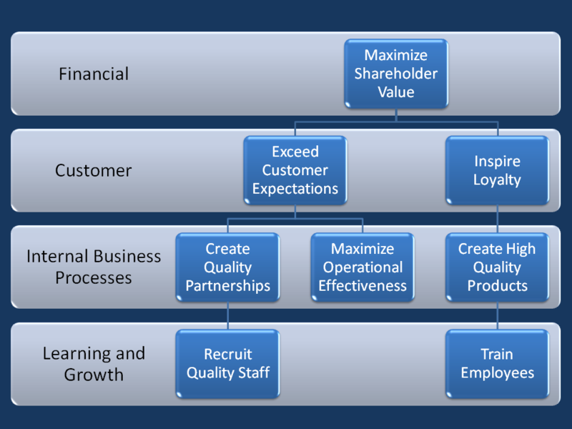
Strategy Map

Slide 14
5.2.3. Long-term Objectives for Grand Strategies (continued)
Steps in Creating Strategy Maps: after asking the two principal questions and finding answers to them through strategic thinking, the further steps in creating strategy map are as follows:
  Determining the prevailing objective – to be derived from looking both side of vision and strategic resources of the firm. Determine objectives as per the resources to reach the dream;
  Determining the dominant value proposition
  Choosing the key customer-related strategies
  Choosing the key internal business process strategies
  Choosing the key learning and growth strategies

Slide 15
Summary of the topics covered in this lecture
Organizational Appraisal and Strategic Management Process
Strategic Planning

Slide 16
Topics for the next lecture
Strategic Thinking
Scenario Planning or Building, Strategic Direction
Generic Competitive Strategies

