Slide 1
Strategic Management (MGT501)
Lecture 11
Dr Muhammad Mustafa Raziq

Slide 2
Summary of the topics covered in the previous lecture
Firm and Strategy
Elements of a Firm’s Strategy

Slide 3
Topics to be covered in this lecture
Elements of a Firm’s Strategy
Objectives and functions of a strategy
Developing Strategic Vision and Strategic Objectives
Levels of Objectives

Slide 4
4.2.3. Diamond framework of elements of strategy
A strategy has five elements, which provide answers to five questions (Hambrick and Fredrickson, 2001):
  Economic logic – how will we obtain our returns?
  Arenas – where will we be active?
  Vehicles – how will we get there?
  Differentiators – how will we win in the market place?
  Staging – what will be our speed and sequence of moves?

Slide 5
4.2.3. Diamond framework of elements of strategy (continued)
The fundamental element of strategy is a firm’s economic logic that determines how it will obtain its returns. There are only two types of logic:
  A firm achieves lower costs than its competitors or it offers a better perceived quality – customer value is created in the form of lower prices or better quality such as superior service or product features
  Arenas in which a firm choses to operate (product categories, market segments, and geographical areas).

Slide 6
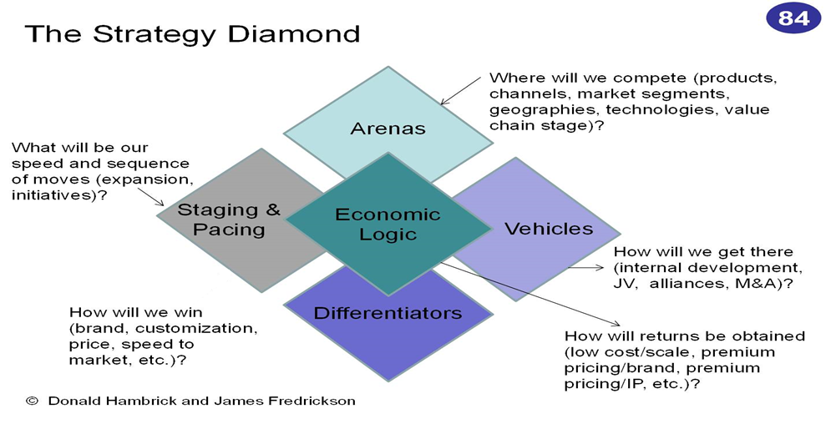
4.2.3. Diamond framework of elements of strategy (continued)

Slide 7
4.3. Objectives and Functions of Strategy
Strategy can have the following objectives:
  Aiming farther into the future
  Greater speed of advancement for the firm
  Maximum impact in the industry or business world
  Sustained reputation for superior performance
A firm with a strategy is valued higher than a firm without a deliberate strategy

Slide 8
4.3. Objectives and Functions of Strategy (continued)
The functions of strategy are as follows:
  Strategy defines and refreshes the direction of the firm and makes it invest in necessary capabilities and infrastructure
  Strategy as a vital source of integration provides sense to what the participants in a firm are doing together
  Strategy helps in allocating resources. Without strategy, time and resources are easily wasted.
  Strategy provides meaning to all actors. Managers at all levels are possibly to have similar interpretations of what the business should be doing if there is a strategy.
  Strategy provides a central integrated, externally oriented concept on how the business will achieve its objectives.

Slide 9
4.3.1. Quality of a Strategy
Hambrick and Fredrickson (2001) develop a six key evaluation criteria for testing the quality of a firm’s strategy:
  Does your strategy fit with what is going on in the environment?
  Does your strategy exploit your key resources?
  Will your envisioned differentiators be sustainable?
  Are the elements of your strategy internally consistent?
  Do you have enough resources to pursue this strategy?
  Is your strategy implementable?

Slide 10
4.3.1. Quality of a Strategy (continued)
Another method to test the goodness of fit of a strategy for a firm is the 3-way test as given below:
  Strategy provides superior performance
  It is difficult for the competitors to imitate /copy
  It makes a significant contribution to the perceived customer benefits
If the strategy fulfils the above three tests, then the strategy is possibly good for the firm.

Slide 11
4.4. Developing Strategic Vision and Strategic Objectives
Vision is a future state of being of a firm or organization. It starts as a mental picture which is an ideal state of the firm at a future date, when all the capital, labour, technology, and insights are utilized in right processes as systems.
Both mission and vision give direction to a firm and both are essential parts or antecedent conditions for crystalizing the strategy of the firm.
A vision is a final destination a firm hopes to reach through.
Firms articulate their vision in a statement form or in target figures or in terms of the geographic spread or role (e.g., leader) in the market.

Slide 12
4.4. Developing Strategic Vision and Strategic Objectives (continued)
Some examples of vision statements:
  Oxfam: A just world without poverty
  Feeding America: A hunger-free America
  Human Rights Campaign: Equality for everyone
  National Multiple Sclerosis Society: A World Free of MS
  Alzheimer’s Association: Our vision is a world without Alzheimer’s
  Habitat for Humanity: A world where everyone has a decent place to live
  San Diego Zoo: To become a world leader at connecting people to wildlife and conservation
  The Nature Conservancy: Our vision is to leave a sustainable world for future generations

Slide 13
4.4. Developing Strategic Vision and Strategic Objectives (continued)
A good vision is understandable, desirable, feasible, guiding, motivating, and flexible.
Development of a vision in a strategy promotes coherence and direction.
Strategy defines how the vision could be reached.
A strategic objective refers to the result for which a strategy aims, which is short term than the vision. A target is a quantitative objective. An action plan is the collection of measures or actions or activities and resources that a firm uses as per the schedule of time frame to achieve the target and objectives.

Slide 14
4.4.1. Functions of a Vision
Vision serves two functions:
  It gives direction to all the decisions and actions to everyone.
  It gives hope about a better future
With hope and direction, everyone gets charged to move towards the better situation with confidence and trust. People develop the competence required to undertake the journey in the new direction as they have trust in the outcome and confidence in achieving what is sought.

Slide 15
4.4.2. Characteristics of a Good Vision
A vision of a firm needs to have the following features if it has to deliver its intended results:
  It encapsulates the ideology or guiding principle of a business, thereby expressing values, purpose, and direction.
  It should be an output from a deliberate strategy crafting process
  It should be comprehensive, thereby considering all the aspects of the business
  It should be inclusive, thereby encompassing both inside and outside environment of the organization

Slide 16
4.4.2. Characteristics of a Good Vision (continued)
A vision of a firm needs to have the following features if it has to deliver its intended results:
  It should establish a trajectory for change or growth – what the firm would become, if the right moves at the right time are made
  It should be acceptable to all stakeholders

Slide 17
4.4.3. Setting Objectives
Objectives are generally written as a result to be achieved, not as an activity
It involves a process of investigation, gathering insight about what are the milestones of progress, evaluation, and objectively verifiable indicators of measurement
Objectives are specific steps that enable a firm to accomplish a goal
Objectives give responsibility to everyone within the organization, thereby providing milestones to check the performance on a continuous basis.
An objective has task, time, description of the result, and methods of achieving it.

Slide 18
4.4. Levels of Objectives
Objectives are categorized as strategic, tactical (functional), operational, and financial.
Strategic (or Corporate) Objectives: Strategic objectives are the translation or projection of the firm’s vision on the near future, for instance, one year or three years or five years.
  Strategic objectives are the tools for operationalizing the vision of the firm and aligning with the performance process.
  Strategic objective should be formulated by taking inputs from the vision, mission, values, products of environmental analysis, reflection on strategy, and critical performance measures of the organization (Gunter et al 1998).

Slide 19
4.4. Levels of Objectives (CONTINUED)
Strategic (or Corporate) Objectives (CONTINUED):
  It is a statement of intent in which a firm states the overall direction it will pursue.
  Example: increase firm market share; boost firm’s reputation with customers; attain lower production costs than rivals etc.
Tactical (or Functional) Objectives: These are set by line management focused on short-term results that are relatively low risk. It is less challenging and stressing than corporate objectives and is more realistic and flexible in nature. It needs fewer resources for example, to organize an advertisement campaign with the youth for next 12 years.

Slide 20
4.4. Levels of Objectives (continued)
Operational Objectives: At operational level, the functional objectives are broken down into daily, weekly, or monthly project benchmarks, for example, to conduct a survey in one month’s time with the youths in three districts to identify the best medium for the advertising campaign.
Financial Objectives: Objectives such as profits, assets, liabilities, return on assets, total sales turn over, costs, taxes, and expenses under different heads – these though not in the hierarchy of objectives as the above three, but it is important in all the three levels. For example, the investment decision taken at the corporate level is based on profits, assets, and liabilities, not only on market opportunities.

Slide 21
Summary of the topics covered
Elements of a Firm’s Strategy
Objectives and functions of a strategy
Developing Strategic Vision and Strategic Objectives
Levels of Objectives

Slide 22
Topics for the next lecture
Organizational mission and mission statements
Stakeholder’s Expectations, Cooperation and Ambition
Alignment of a Firm with Community
Elements of a Business Model and its Relationship with Strategy
Real and Virtual Organizations

