Slide 1
MGT492: Managing People & Organizations
Lecture 5:Chapter 3: The Global Environment
and Entrepreneurship
Instructor: Dr. Aisha Azhar
COMSATS Virtual Campus

Slide 2
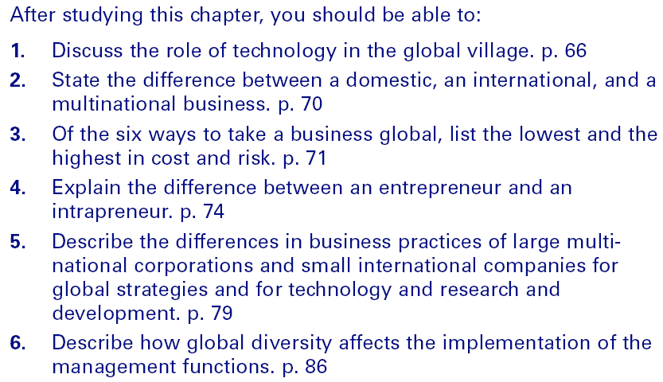
Learning Outcomes for Chapter

Slide 3
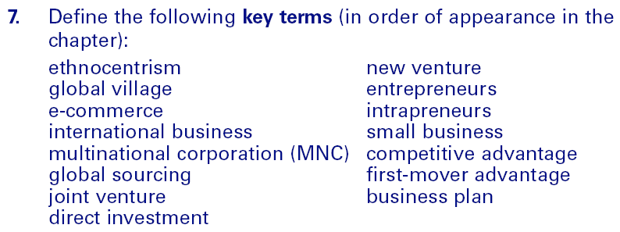
Learning Outcomes (cont’d)

Slide 4
The Global Borderless Environment
Ethnocentrism
  Regarding one’s own group or culture as superior to others (e.g., “Buy American”).
The Global Village
  Companies conducting business worldwide without boundaries
  E-Commerce/E-Business
    Any transaction that occurs when data are processed and transmitted over the Internet as in a business-to-business (b2b) approach.
  Wireless communication

Slide 5
The Global Borderless Environment (cont’d)
Economic Development
Infrastructure
Economic Environment
Exchange Rates

Slide 6
The Global Borderless Environment (cont’d)
Political Instability
Political Risk
Government
Environment
Government Trade Agreements

Slide 7
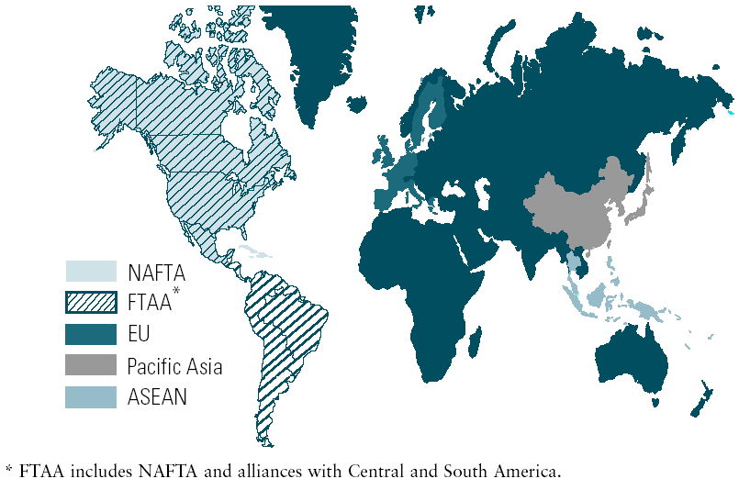
Trading Blocs
Exhibit 3–1

Slide 8
Taking a Business Global
Global Trade Agreements
  General Agreement on Tariffs and Trade (GATT)
  North American Free Trade Agreement
    United States, Canada, and Mexico
  Association of Southeast Asian Nations (ASEAN)
Trade Alliances
  European Union (EU)
    A single market without national barriers to travel, employment, investment, and trade
    Euro (€): single currency for the EU.

Slide 9
Classifying Global Village Businesses
Global Sourcing
  The use of worldwide resources (outsourcing).
Importing
  Domestic firm buys products from foreign firms and sells them in its home market.
Exporting
  Domestic firm sells its locally-made products to foreign buyers in overseas markets.

Slide 10
Classifying Global Village Businesses (cont’d)
Licensing
  One company allows another company to use its assets (intellectual property) for a fee.
    Brand name, trademark, technology, patent, and copyright
  Franchising
    For a fee, a franchiser provides the franchisee with the assets and support to conduct a business using the franchiser’s business model for its operations.

Slide 11
Classifying Global Village Businesses (cont’d)
Contracting
  A company has a foreign firm manufacture the goods while retaining the marketing process.
Joint Venture
  A enterprise that is created when firms agree to share in its ownership.
Direct Investment
  Investment that occurs when a company builds or purchases operating facilities (subsidiaries) in a foreign country.

Slide 12
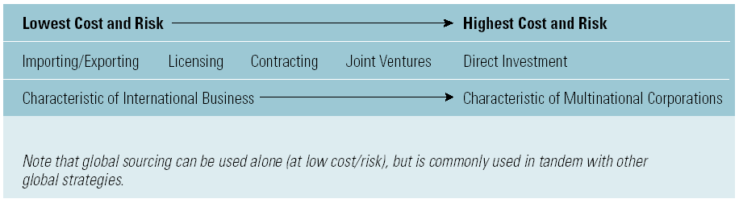
Taking a Business Global (cont’d)
Exhibit 3–2

Slide 13
