Slide 1
MGT492: Managing People & Organizations
Lecture 4:Chapter 3: Environment: Culture, Ethics, Social Responsibility(contd.)
Instructor: Dr. Aisha Azhar
COMSATS Virtual Campus

Slide 2
Last lecture overview
Management
Organizational environment
Five internal organizational factors
  Management and culture, mission, resources, systems approach, structure
Three levels of organizational culture

Slide 3
Organizational Culture
Learning the Organization’s Culture
  Heroes – Stories –Slogans –Symbols
  Ceremonies
Three Levels of Culture
  Level 1: Behavior is the visible level of
  cultural influence.
  Level 2: Values and beliefs are evident in actions.
  Level 3: Assumptions are values and beliefs that are deeply ingrained.

Slide 4
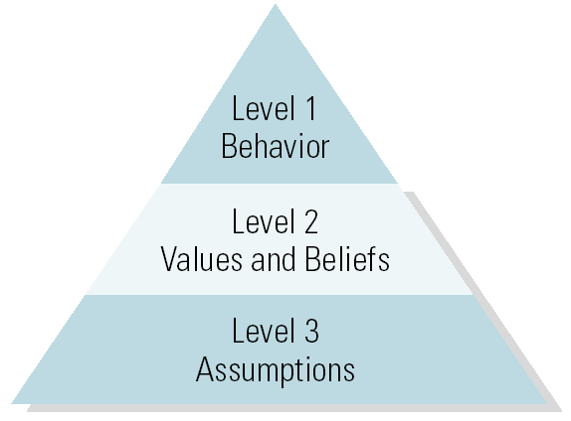
Three Levels of Culture

Slide 5
Organizational Culture (cont’d)
Strong Cultures
  Have employees who unconsciously know the shared assumptions; consciously know the values and beliefs and agree with them.
    Benefit from easier communications and cooperation; unity of direction and consensus.
    Danger is becoming stagnate.
Weak Cultures
  Have employees who do not behave as expected and do not agree with the shared values.

Slide 6
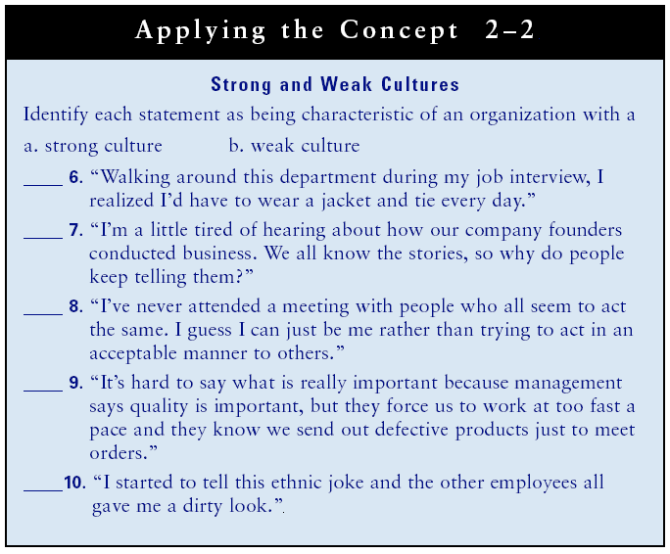

Slide 7
Organizational Culture (cont’d)
Managing, Changing, and Merging Cultures
  Symbolic Leaders
    Leaders who articulate a vision for the organization and reinforce the culture through slogans, symbols, and ceremonies.
Learning Organizations
  Organizations with cultures that value sharing knowledge to adapt to the changing environment and continuously improve.
    Strong adaptive cultures are created through leadership and open sharing of knowledge and information.

Slide 8
The External Environment
Customers
  Their needs decide what products businesses offer.
Competition
  Competitors’ business practices often have to be duplicated to maintain customer value.
Suppliers
  Poor quality suppliers mean poor quality products.

Slide 9
The External Environment (cont’d)
Labor Force
  Quality labor is needed to produce quality products.
Shareholders
  The board of directors monitors management and provide direction for the organization.
Society
  Businesses are pressured by societal forces to behave in an acceptable manner.

Slide 10
The External Environment (cont’d)
Technology
  Firms must stay current on technology to stay competitive and provide customer value.
Economy
  Economic activity has both short and long-term effects on an organization’s ability to provide customer value.
Government
  Policies, rules and regulations affect what, how much, and how business is conducted.

Slide 11
The External Environment (cont’d)
Technology
  Firms must stay current on technology to stay competitive and provide customer value.
Economy
  Economic activity has both short and long-term effects on an organization’s ability to provide customer value.
Government
  Policies, rules and regulations affect what, how much, and how business is conducted.

Slide 12
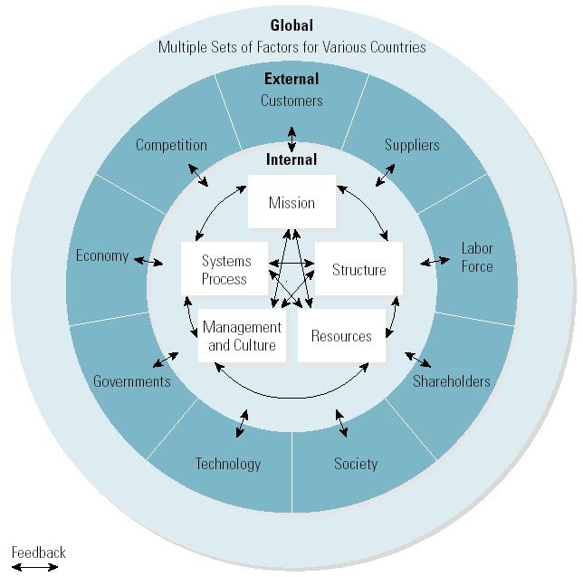
The Organizational Environment

Slide 13
Business Ethics
Simple Guides to Ethical Behavior
  Golden Rule
    “Do unto others as you would want them to do unto you.”
  Four-Way Test
    Is it the truth? • Is it fair to all concerned?
    Will it build goodwill and better friendship?
    Will it be beneficial to all concerned?
  Stakeholders’ Approach to Ethics
    Creating a win-win situation for all stakeholders so that everyone benefits from the decision.

Slide 14
Business Ethics (cont’d)
Managing Ethics
  Codes of ethics
    State the importance of conducting business in an ethical manner and provide guidelines for ethical behavior.
  Top management support and example
    The responsibility of top management to develop codes of ethics, train employees, and lead by example.
  Enforcing ethical behavior
    Whistle-blowers should not suffer negative consequences.

Slide 15
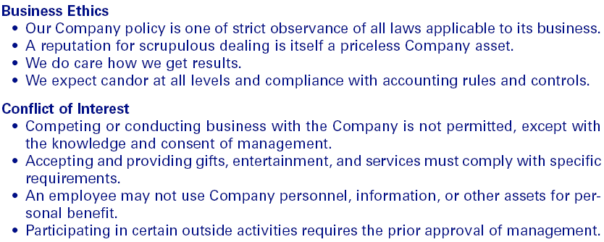
Summary Code of Ethics of Exxon Company, USA
Exhibit 2–7

Slide 16
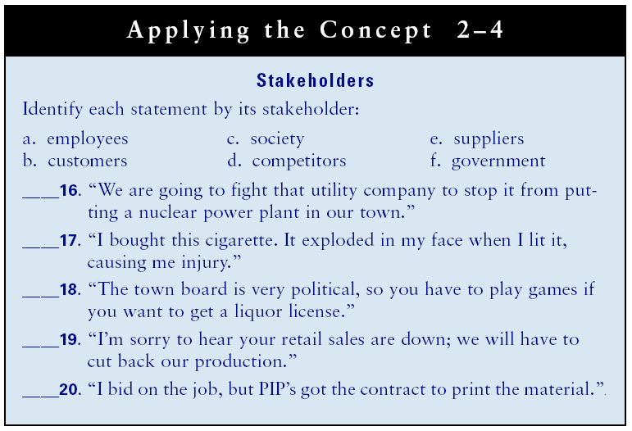

Slide 17
Reorganization and Social Responsibility
Downsizing
  The process of cutting organizational resources (e.g., human resources) to get more done with less as a means of increasing productivity.
Reengineering
  The radical redesign of work in a systematic manner to combine fragmented tasks into streamlined processes that save time and money by requiring fewer workers and far fewer managers.

