Slide 1
MGT492: Managing People & Organizations
Lecture 3:
Chapter 1: Management (contd.)
Chapter 2: Environment: Culture, Ethics, Social Responsibility
Instructor: Dr. Aisha Azhar
COMSATS Virtual Campus

Slide 2
Overview of Last Lecture
Management Skills &Functions
Management Roles
  Interpersonal, informational, decisional
Three levels of management
  Top, middle, first-line, non-management operative staff
Types of managers
  General, functional, project

Slide 3
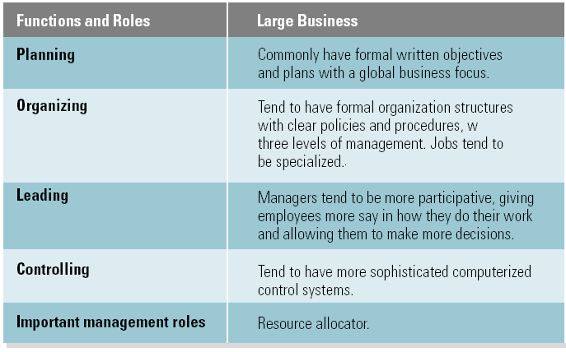
Large versus Small Business Managers

Slide 4
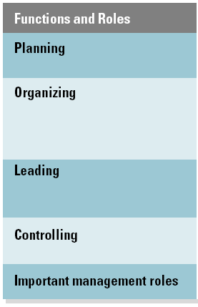
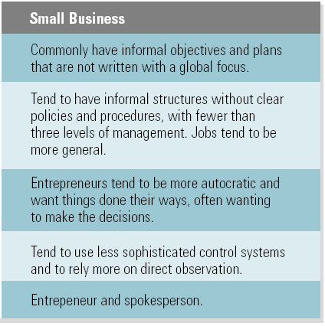
Large versus Small Business Managers (cont’d)

Slide 5
Differences among For-Profit and Non-Profit Organizations
For Profit
  Primary purpose is bottom-line profit
  Revenues: generated through sales
  Staffing: primarily all paid employees
Not-for-Profit
  Non-governmental Organizations
    Mission-driven
    Profits are the objective
    No individual owners
    Revenues: raised through donations, grants, memberships and investments as well as sales or fees
    Staffing: volunteer or paid workers

Slide 6
Not-for-profit (contd.)
  Governmental Organizations: mission driven
  Profits are not the goal
  Ownership is an entity of a function of government
  Revenues: raised through taxes, fees and sales
  Staffing: primarily all paid employees, with some entities relying on volunteers

Slide 7
Entrepreneurship:
  Creating new products or processes, entering new markets, or creating new business ventures and organizations.
Knowledge Management
  Involving everyone in an organization in sharing knowledge and applying it continuously to improve products and processes.

Slide 8
Chapter 2: Environment: Culture, Ethics, Social Responsibility

Slide 9
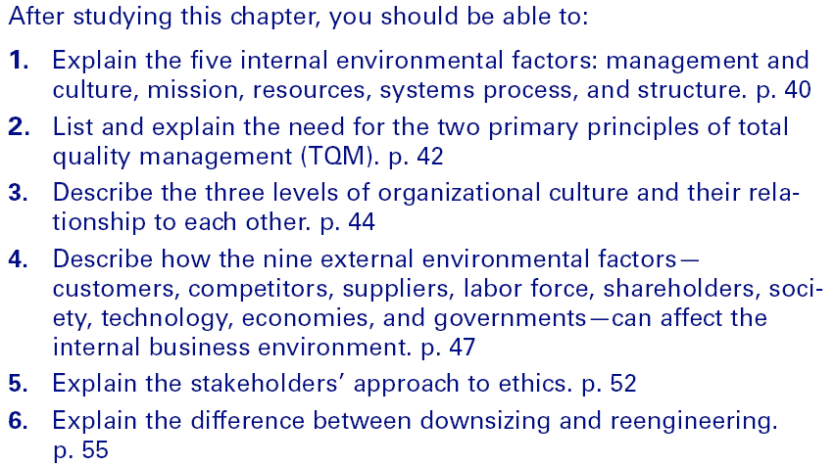
Learning Outcomes

Slide 10
The Internal Environment
Management and Culture
  Organizational culture
    The shared values, beliefs, and assumptions of how its members should behave.
Mission
  A organization’s purpose or reason for being
    Top management’s responsibility to develop a mission with clear measurable objectives.
    States the unique advantage the firm offers to customers that differentiates it from its competitors.
    Is relevant to all stakeholders’ interests.

Slide 11
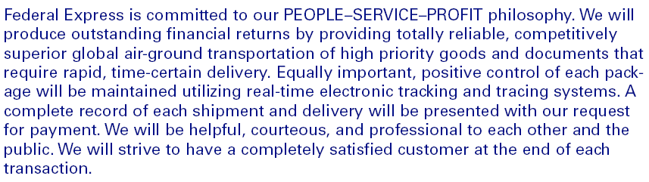

Federal Express Mission Statement

Slide 12
Internal Environment Means and Ends
Ends
Mission
Means (how mission is attained)
Management and culture
Resources
Systems process
Quality
  Total quality management
Structure

Slide 13
The Internal Environment (cont’d)
Resources
  Human resources
  Physical resources
  Financial resources
  Informational resources
Systems Process
  The method used to transform inputs into outputs.
  Process components
    Inputs • Transformation • Outputs • Feedback

Slide 14
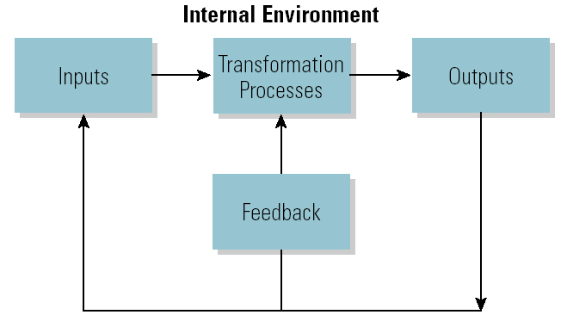
The Systems Process

Slide 15
The Internal Environment (cont’d)
Quality
  Comparing actual use to requirements to determine value.
Customer value
  The purchasing benefits used by customers to determine whether or not to buy a product.

Slide 16
The Internal Environment (cont’d)
Total Quality Management (TQM)
  Focusing the organization on the customer to continually improve product value.
Structure
  The way in which resources are grouped to effectively achieve the organization’s mission.

Slide 17
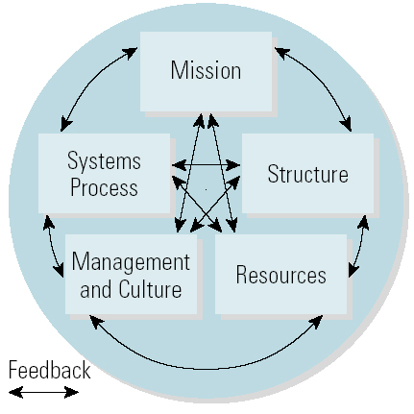
Internal Environment Components

Slide 18
Today’s lecture overview
Differences among for-profit and non-profit organizations
Characteristics of global competition
Organizational environment
Five internal organizational factors
  Management and culture, mission, resources, systems approach, structure

