Slide 1
MGT492: Managing People & Organizations
Lecture 2
Chapter 1: Management (contd.)
Instructor: Dr. Aisha Azhar
COMSATS Virtual Campus

Slide 2
Overview of last lecture
Course Overview
Evaluation Criteria
Introduction to Management (chapter 1)
  What is manager
  Manager resources
  Manager’s qualities & skills

Slide 3
What Do Managers Do?
Management Functions
  Planning
    Setting objectives and determining in advance exactly how the objectives will be met.
  Organizing
    Delegating and coordinating tasks and resources to achieve objectives.
  Leading
    Influencing employees to work toward achieving objectives.
  Controlling
    Establishing and implementing mechanisms to ensure that objectives are achieved.

Slide 4
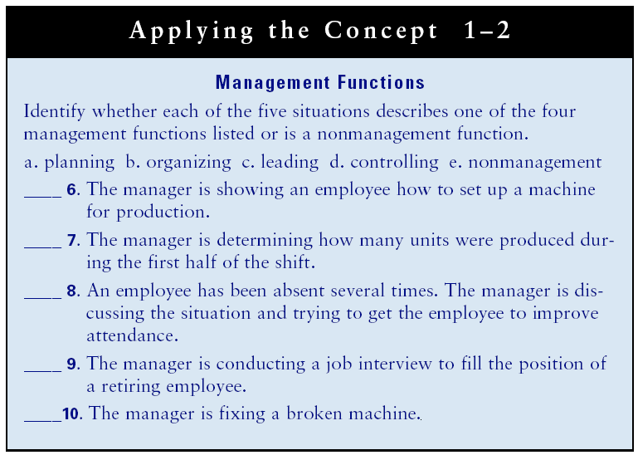

Slide 5
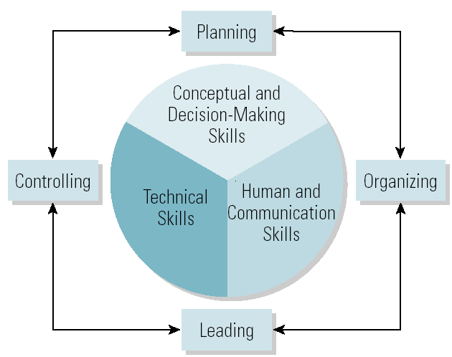
Management Skills and Functions

Slide 6
Management Roles
Management Role Categories (Mintzberg)
  Interpersonal
    Figurehead, leader, liaison
  Informational
    Monitor, disseminator, spokesperson
  Decisional
    Entrepreneur, disturbance handler, resource allocator, negotiator

Slide 7
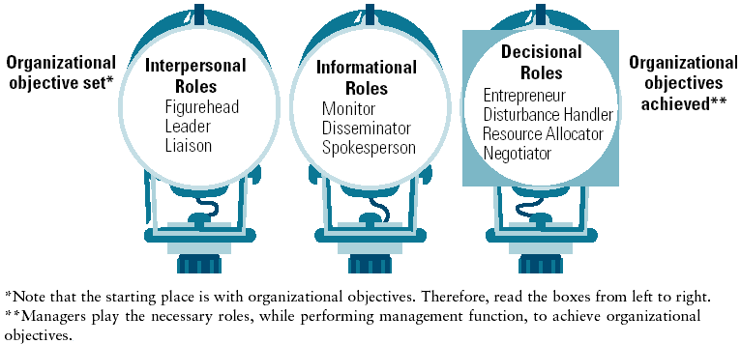
Ten Roles Managers Play

Slide 8
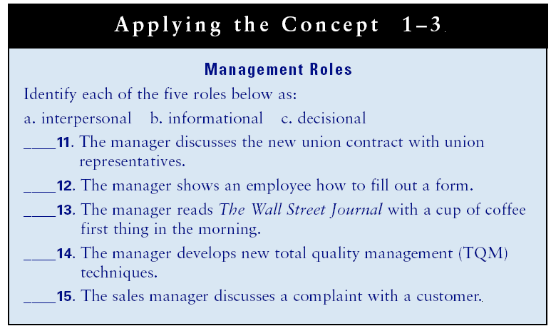

Slide 9
Differences Among Managers
The Three Levels of Management
  Top managers
    Chair of the board, CEO, president, vice president
  Middle managers
    Sales manager, branch manager, department head
  First-line managers
    Crew leader, supervisor, head nurse, and office manager
  Non-management operative employees
    Workers in the organization who are supervised by first-line managers.

Slide 10
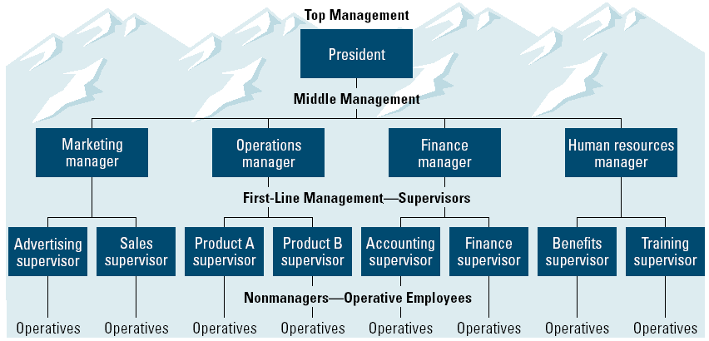
Management Levels and Functional Areas

Slide 11
Types of Managers
General Managers
  Supervise the activities of several departments.
Functional Managers
  Supervise the activities of related tasks.
  Common functional areas:
    Marketing • Operations/production
    Finance/accounting • Human resources management
Project Manager
  Coordinates employees across several functional departments to accomplish a specific task.

Slide 12
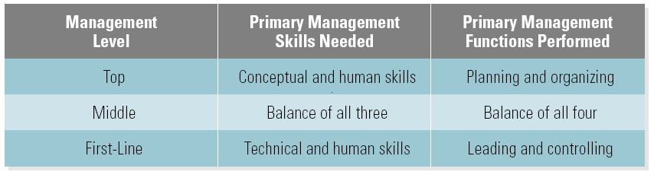
Management Skills and Functions
Differences among management levels in skill needed and the functions performed:

Slide 13
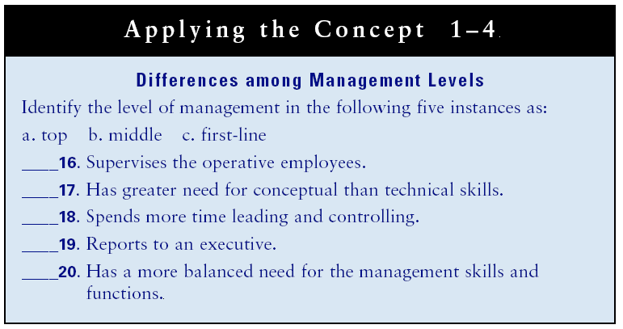

Slide 14
Overview of Today’s Lecture
Management Skills &Functions
Management Roles
  Interpersonal, informational, decisional
Three levels of management
  Top, middle, first-line, non-management operative staff
Types of managers
  General, functional, project

