Slide 1
MGT-491
QUANTITATIVE ANALYSIS AND RESEARCH FOR MANAGEMENT
Session 7
OSMAN BIN SAIF

Slide 2
Overview of Section ONE
Section 1; Introduction to Business Research and research design
  Nature and Scope of Business research
  Information based decision making
  The research process
  Basic approaches and terminologies used
  Defining research question
  Framing of Hypothesis

Slide 3
Overview of Section ONE
Section 1; Introduction to Business Research and research design (Contd.)
  Preparing research plan
  Qualitative research designs
  Sources of secondary data
  Case review and analysis

Slide 4
Overview of Section ONE
We have completed the first section of this course.
In Todays Session we will REVISE what we have already learnt in the previous sessions in terms of;
  Importance
  Usability

Slide 5
Overview of Section ONE
Business and management research involves undertaking systematic research to find out things.
It is trans disciplinary, and should engage with both theory and practice.

Slide 6
Research
Research in common parlance refers to a search for knowledge.
Research can also be defined as “An art of scientific investigation”.

Slide 7
Research Problem
A research problem refers to a diﬃculty which a researcher or a scientiﬁc community or an industry or a government organization or a society experiences. It calls for a thorough understanding and possible solution.

Slide 8
Steps in Formulation of Research Problem
7 – STEP PROCESS;
  Identify a broad field or subject area of interest to you
  Dissect the broad area into subareas
  Select what is of most interest to you
  Raise research questions
  Formulate Objectives
  Assess your objectives
  Double Check

Slide 9
Types of Research
The basic types of research are as follows:
  Descriptive vs. Analytical
  Applied vs. Fundamental
  Quantitative vs. Qualitative
  Conceptual vs. Empirical

Slide 10
Types of Research (Contd.)
  Some Other Types of Research
    One-time research or longitudinal research
    Field-setting research or laboratory research or simulation research
    Clinical or diagnostic research
    Historical research
    Conclusion-oriented research
    Decision-oriented research.

Slide 11
Research Process
Research is represented as a multi-stage process; however, this process is rarely straightforward and will involve both reflecting on and revising stages already undertaken and forward planning.

Slide 12
The RESEARCH PROCESS
An EIGHT Step Model;
Formulating a Research problem
Conceptualizing a research design
Constructing an instrument for data collection
Selecting a sample
Writing a research proposal
Collecting data
Processing data
Writing a research report

Slide 13
Characteristics of Research
Controlled;
  Cause and Effect relationship between the two variable is not effected by another independent variable. It is possible in physical experiments e.g. Laboratory experiments but not possible in social sciences.
Rigorous;
  It is ensured that the procedures followed to find answers to the questions are relevant, appropriate and just. A degree of rigor varies depending on the type of experiment.

Slide 14
Characteristics of Research (Contd.)
Systematic;
  This implies that the procedures adopted to undertake an investigation follows certain logical sequence.
Valid and Verifiable;
  This concept implies that, whatever you conclude on the basis of your findings is correct and can be verified by you and others.

Slide 15
Characteristics of Research (Contd.)
Empirical;
  This means that any conclusions drawn are based upon hard evidence gathered from information collected from real life experiences and observation.
Critical;
  Critical scrutiny of the procedures used and the methods employed is crucial to research inquiry.

Slide 16
Literature Review
A critical review of the literature is necessary to help you to develop a thorough understanding of and insight into previous research that relates to your research questions and objectives.

Slide 17
Literature Review
Your review will set your research in context by critically discussing and referencing work that has already been under-taken, drawing out key points and presenting them in a logically argued way, and highlighting those areas where you will provide fresh insights.

Slide 18
Literature Review
It will lead the reader into sub-sequent sections of your project report.

Slide 19
Literature Review
When planning your literature search you need;
  To have clearly defined research questions and objectives.
  To define the parameters of your research
  To generate key word and search terms
  To discuss your ideas as widely as possible.

Slide 20
Literature Review
Your literature search will be undertaken using a variety of approaches in tandem. These will include;
  Searching using secondary and tertiary resources and the internet.
  Following up references in articles you have already read.
  Scanning and browsing secondary literature in your library.

Slide 21
Literature Review
Once obtained, the literature must be evaluated for its relevance to your research questions and objectives.
This must include a consideration of each item’s currency.
Each item must be read and noted.
Bibliographic details, a brief description of the content and appropriate supplementary information should also be recorded.

Slide 22
Literature Review
Generating and refining research ideas makes use of a variety of techniques.
It is important that you use a variety of techniques including those that involve rational thinking, and those that involve creative thinking.

Slide 23
Research Question
Clear research questions, based on the relevant literature, will act as a focus for the research that follows.

Slide 24
Research Proposal
Writing a research proposal helps you to organize your ideas, and can be thought of as contract between you and the reader.

Slide 25
Writing a Research Proposal
Therefore a Research proposal should contain;
  Statement of objective
  List of hypothesis
  Study design
  Research instrument
  Sampling design
  Data processing procedures
  Outline of proposed chapters for report
  Research problems and limitation
  Time frame

Slide 26
Hypothesis
Hypothesis , though important, are not essential for a study.
However in formulating a hypothesis it is important to ensure that it is simple, specific and conceptually clear, is able to be verified, is rooted in the existing body of knowledge, and is able to be operationalized.

Slide 27
Research Design
Research design details how the project should be conducted.
Research design may broadly be classified as exploratory and conclusive.

Slide 28
Data Collection
Data that have already been collected for some other purpose, perhaps processed and subsequently stored, are termed as secondary data.
There are three main types of secondary data;
  Documentary
  Survey
  And from multiple sources

Slide 29
Case Study REVIEWS
Now we will quickly Review three Case studies.
  European Customs marketing Research
  Citi Bank Group
  Microsoft Experimenting usability research

Slide 30
Case 1: European Customs Marketing

Slide 31
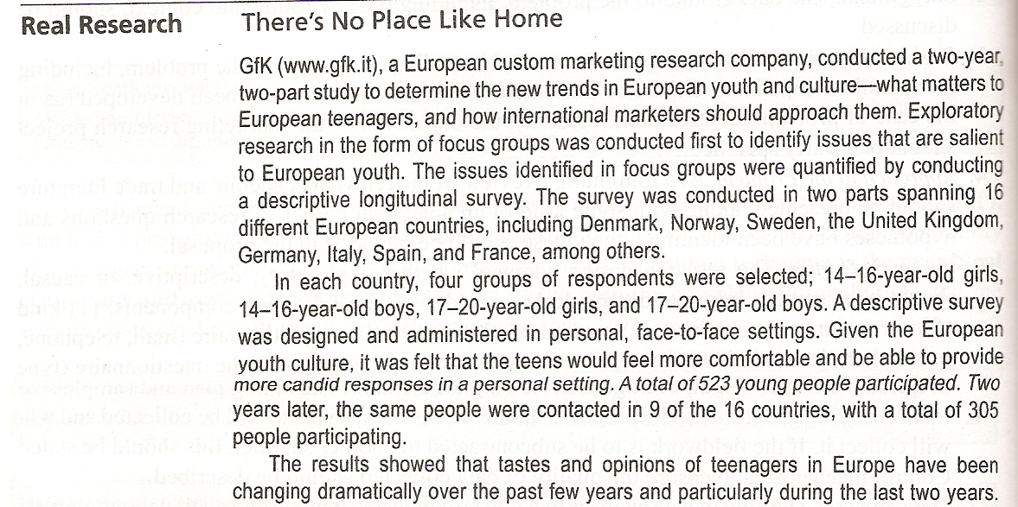

Slide 32
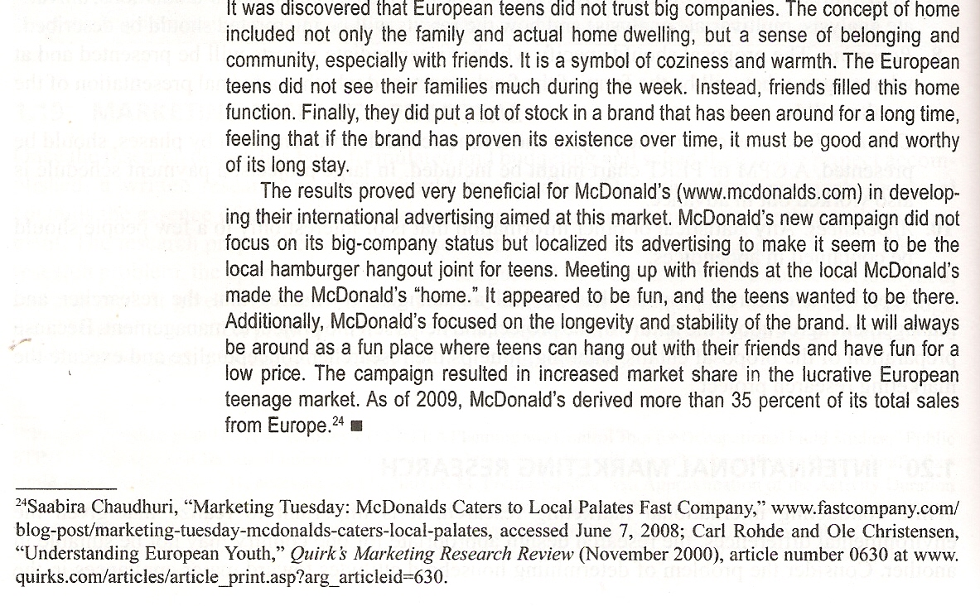

Slide 33
Case 2: Citi Bank research

Slide 34
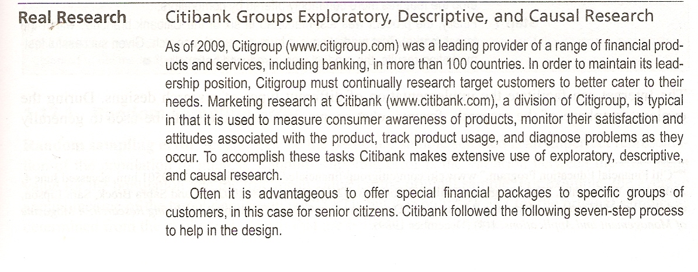

Slide 35
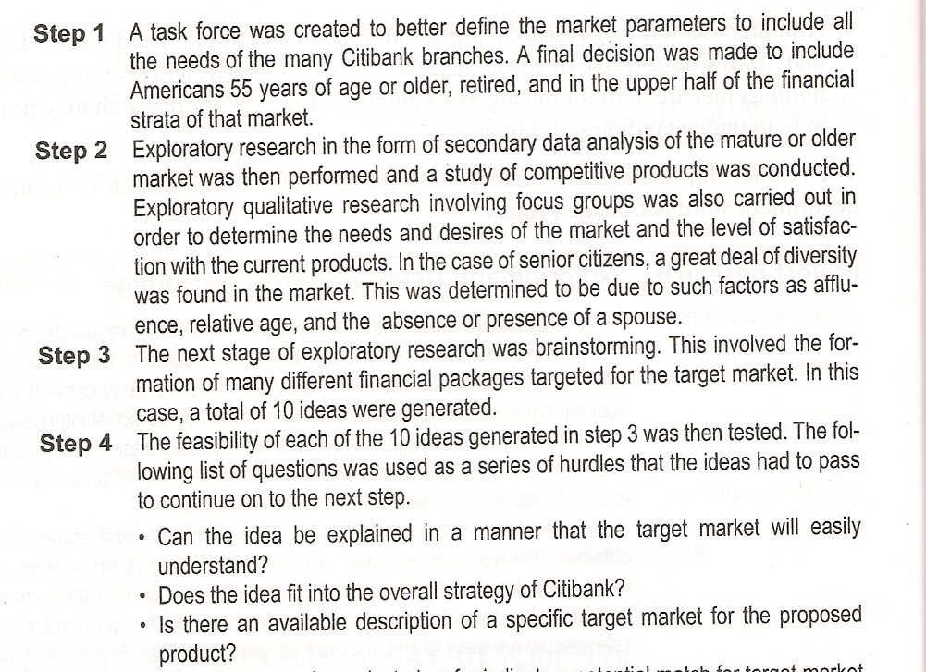

Slide 36
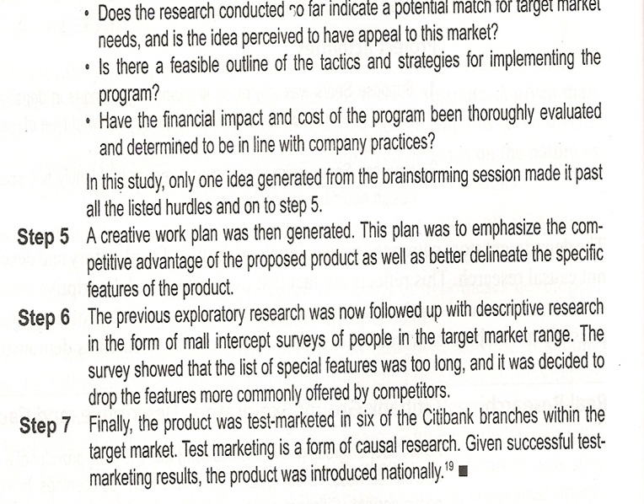

Slide 37
Case 3: Microsoft experimenting usability research

Slide 38
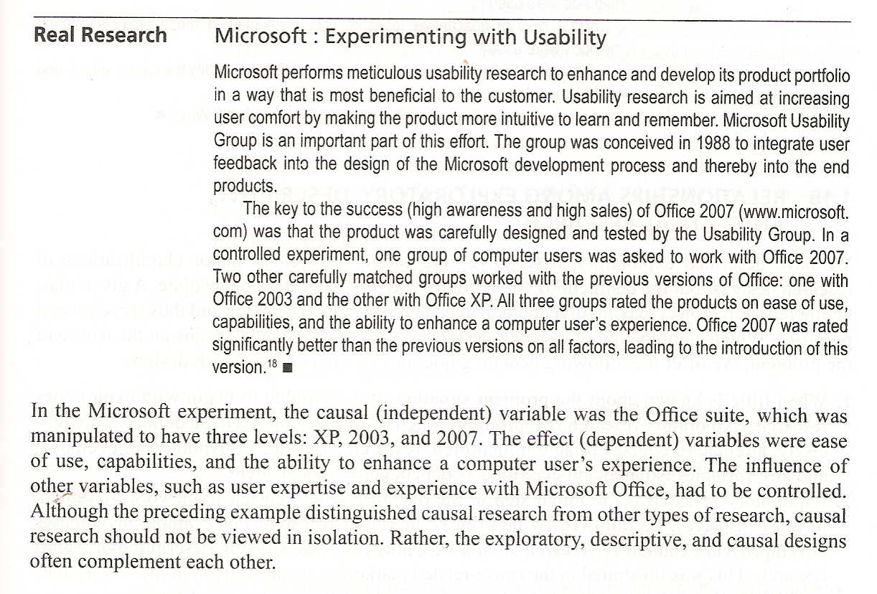

Slide 39
Thanks

