Slide 1
MGT-491
QUANTITATIVE ANALYSIS AND RESEARCH FOR MANAGEMENT
Session 32
OSMAN BIN SAIF

Slide 2
Section 3; Data Analysis and Presentation

Slide 3
The data preparation process (Contd.)
Preparing preliminary plan for Data Analysis
Questionnaire Checking
Editing
Coding
Transcribing
Data Cleaning
Statistically adjusting the data
Selecting a Data Analysis Strategy

Slide 4
Treatment of Missing Responses
Missing responses represent value of a variable that are unknown, either because respondents provided ambiguous answers or their answers were not properly recorded.

Slide 5
Item non Response
It occurs because the respondent refuses, or is unable to answer specific questions or items because of the content, form or the effort required.

Slide 6
Treatment of Missing Responses (Contd.)
There are two main options available for the treatment of missing responses;
  Substitute a neutral value.
  Substitute an imputed response.

Slide 7
Statistically adjusting the DATA
Procedures for statistically adjusting the data consists of ;
  Weighting
  Variable re-specification
  Scale transformation.

Slide 8
Selecting a data analysis strategy
The following steps are involved in selecting a data analysis strategy;
Earlier steps (I, II, III) of the Marketing research process
Known characteristics of the Data
Properties of Statistical techniques
Background and philosophy of the researcher
Data analysis strategy

Slide 9
Statistical definitions
Descriptive statistics –
  procedures to summarise, organise and simplify data
Inferential statistics
  techniques to study samples and make generalisations about the population
Sampling error
  discrepancy between a sample statistic and the population parameter

Slide 10
Classification of Statistical Techniques
Statistical techniques can be classified as;
  Uni-variate techniques
  Multivariate techniques

Slide 11
Univeriate Techniques
Statistical techniques appropriate for analyzing data when there is a single measurement of each element in the sample or if there are several measurements on each element, but each variable is analyzed in isolation.

Slide 12
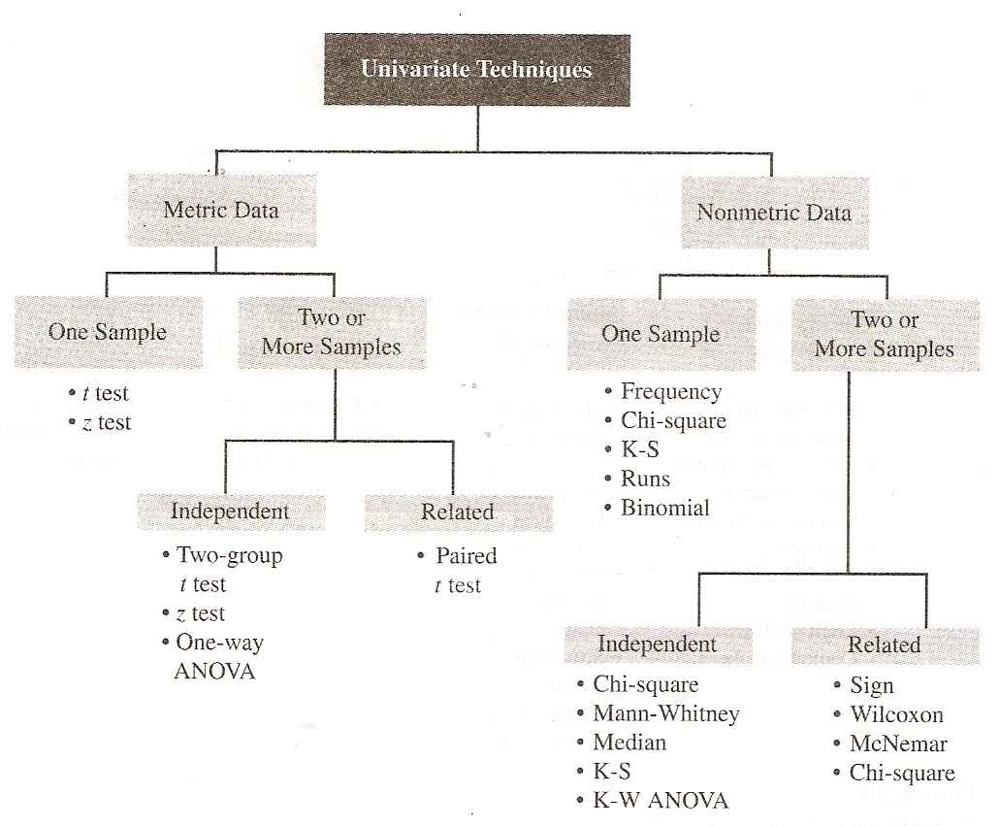

Slide 13
Classification of Univariate Techniques
They can be classified based on whether the data are metric or non-metric (Contd.).
  Independent
    The samples are independent if they are drawn randomly from different populations
  Paired
    The samples are paired when the data for the two samples relate to the same group of respondents

Slide 14
Multivariate Techniques
Statistical techniques suitable for analyzing data when there are two or more measurements on each element and the variables are analyzed simultaneously.
Multivariate techniques are concerned with the simultaneous relationships among two or more phenomenon.

Slide 15
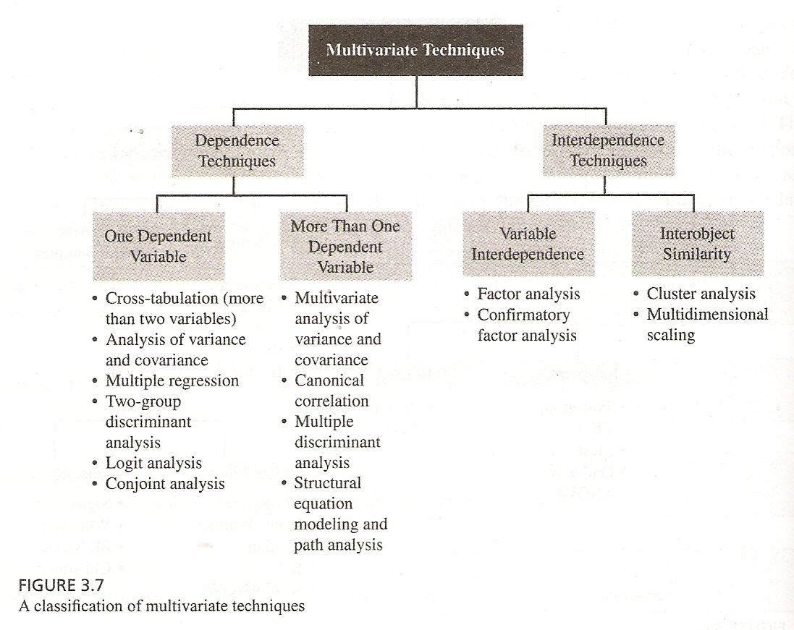

Slide 16
Classification of Multivariate Techniques
They can be classified as;
  Dependence Techniques;
    They are appropriate when one or more of the variables can be identified as dependent variables and the remaining as independent variables.

Slide 17
Classification of Multivariate Techniques
They can be classified as;
  Interdependence Techniques;
    That attempts to group data based on underlying similarity, and thus allow for interpretation of the data structures.
    No distinction is made as to which variables are dependent and which are independent.

Slide 18
FREQUENCY DISTRIBUTION
Marketing researchers often need to answer questions about a single variable.
For example:
  How many users of this brand may be characterized as brand loyal?
  What percentage of market consist of heavy users, medium users, light users, and nonusers?

Slide 19
GRAPHICAL PRESENTATION OF DATA
Once your data has been entered and checked for errors, you are ready to start your analysis.
Exploratory data analysis approach is useful in these initial stages.
This approach emphasis the use of diagrams to explore and understand your data.

Slide 20
GRAPHICAL PRESENTATION OF DATA(contd.)
Key aspects (Contd.)
  Trends over time;
  Proportions;
  Distribution;

Slide 21
Statistics associated with frequency distributions
The most commonly used statistics associated with frequencies are;
  Measures of location
    Mean, mode and median
  Measures of variability
    Range, interquartile range, standard deviation, and coefficient of variation
  Measures of shape
    Skewnesss and kurtosis

Slide 22
INTRODUCTION TO HYPOTHESIS TESTING(contd.)
Null hypothesis
A statement in which no difference or effect is expected.
If the null hypothesis is not rejected, no change will be made.

Slide 23
INTRODUCTION TO HYPOTHESIS TESTING(contd.)
Alternative hypothesis
A statement that some difference or effect is expected.
Accepting the alternate hypothesis will lead to changes in opinions or actions.

Slide 24
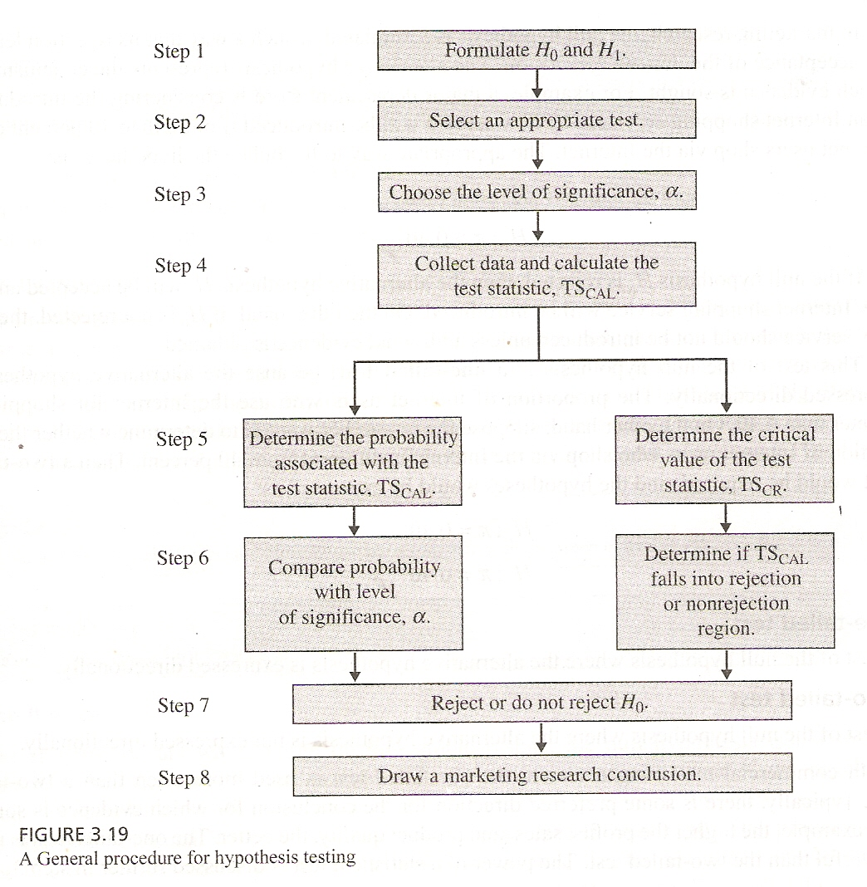

Slide 25
CROSS TABULATIONS(contd.)
Cross-tabulation
  A statistical technique that describes two or more variables simultaneously and results in tables that reflects the joint distribution of two or more variables that have a limited number of categories or distinct values.
Contingency table
  A cross tabulation table.it contains a cell for every combination of categories of the two variables.

Slide 26
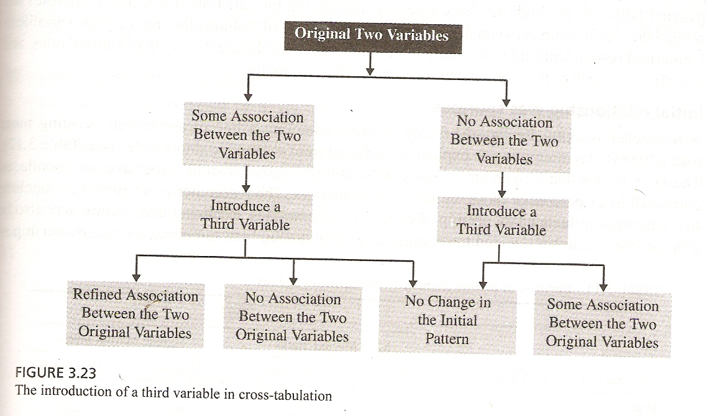

Slide 27
Testing of Hypothesis

Slide 28
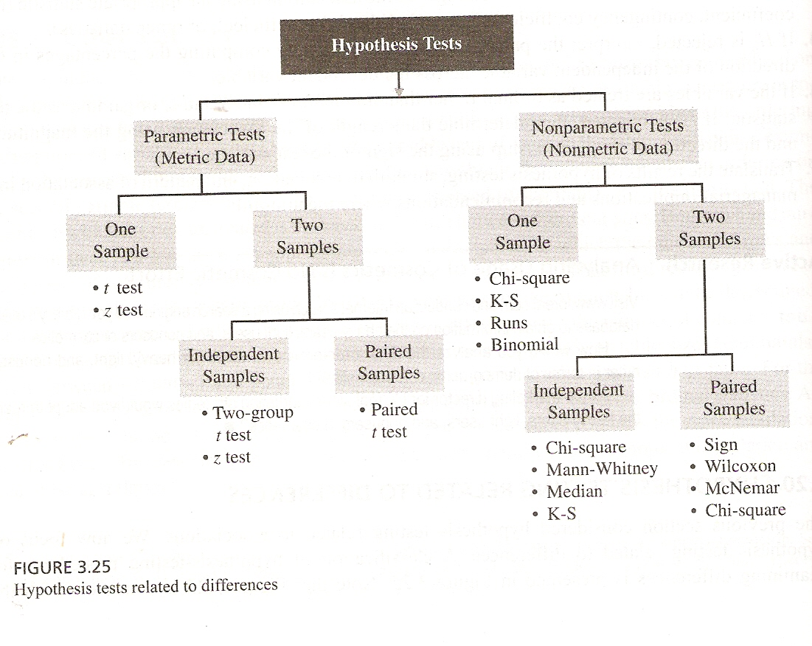

Slide 29
Correlation
Correlation is the degree of association among variables in a set of data.
Statistically speaking simple correlation, measures a linear relationship between two variables.
Correlation does not imply that any one of variables causes the other.

Slide 30
Regression
Linear regression
  Regression is used when we have reason to believe that changes in one variable cause the changes in the other. A correlation is not evidence for a causal relationship, but very often we are aware of a causal relationship and we design an experiment to investigate it further. The simplest kind of causal relationship is a straight-line relationship, and this can be analysed using linear regression.

Slide 31
A chi-square test
A chi-square test is used when you want to see if there is a relationship between two categorical variables.
let's see if there is a relationship between the type of school attended and students' gender

Slide 32
T test
An independent samples t-test is used when you want to compare the means of a normally distributed interval dependent variable for two independent groups.

Slide 33
A paired (samples) t-test
A paired (samples) t-test is used when you have two related observations (i.e., two observations per subject) and you want to see if the means on these two normally distributed interval variables differ from one another.

Slide 34
ANOVA
A one-way analysis of variance (ANOVA) is used when you have a categorical independent variable (with two or more categories) and a normally distributed interval dependent variable and you wish to test for differences in the means of the dependent variable broken down by the levels of the independent variable.

Slide 35
Designing a research project
Empirical Questions (what do we want to know?)
Statistical Considerations (analysing the data?)
How the Process Works:
World
Abstraction
Theory
Systematic
Observation &
Experimentation
Revision
Derivation
Data
Interpretation
Empirical
Hypotheses

Slide 36
Characteristics of Hypothesis
Should be CLEAR and PRECISE
Should be stated as far as possible in most SIMPLE TERMS
Should be CONSISTENT with most known facts

Slide 37
Critical procedure for Hypothesis Testing
State Ho as well as Ha
Specify the level of significance (or the a value)
Decide the correct sampling distribution
Sample a random sample and work out an appropriate value
Calculate the probability that sample result would diverge as widely as it has from expectation

Slide 38
Critical procedure for Hypothesis Testing
Is the probability equal to or smaller than a value in case of one tail test
YES
Reject
Is the probability equal to or smaller than a value in case of two tail test
NO
Accept

Slide 39
Research Process
(i) identify research questions,
(ii) design study,
(iii) collect data from sample,
(iv) use descriptive stats,
(v) use inferential stats,
(vi) discuss results

Slide 40
Summary Table of Statistical Tests
Level of Measurement
Sample Characteristics
Correlation
1 Sample
2 Sample
K Sample (i.e., >2)
Independent
Dependent
Independent
Dependent
Categorical or Nominal
Χ² or bi-nomial
Χ²
Macnarmar’s Χ²
Χ²
Cochran’s Q
Rank or Ordinal
Mann Whitney U
Wilcoxin Matched Pairs Signed Ranks
Kruskal Wallis H
Friendman’s ANOVA
Spearman’s rho
Parametric (Interval & Ratio)
z test or t test
t test between groups
t test within groups
1 way ANOVA between groups
1 way ANOVA (within or repeated measure)
Pearson’s r
Factorial (2 way) ANOVA

Slide 41
Calculating statistics in MS EXCEL

Slide 42
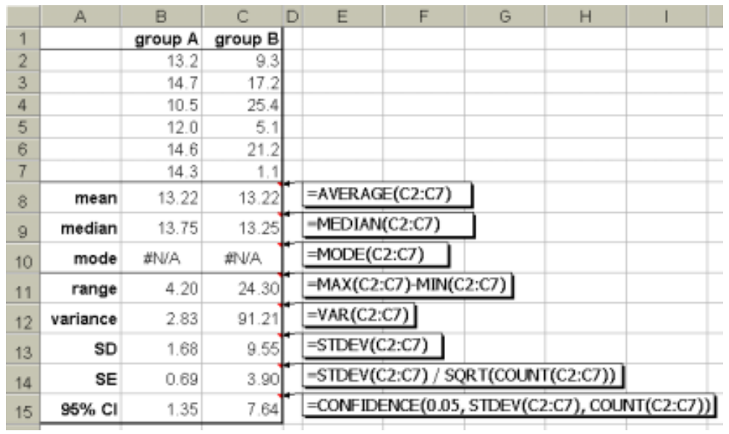

Slide 43
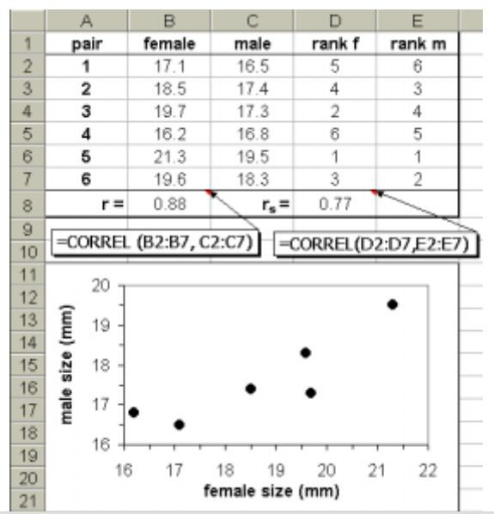

Slide 44
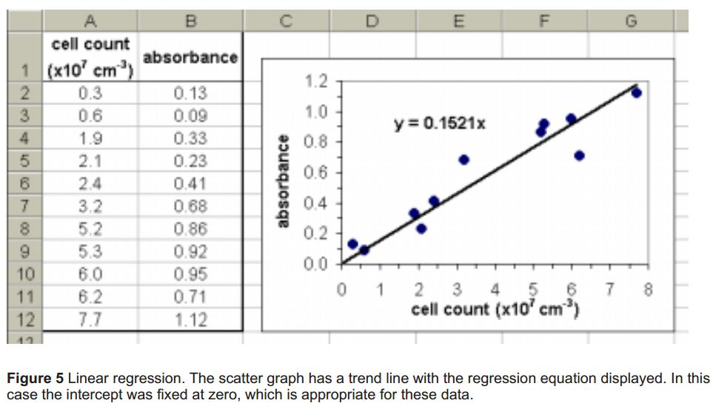

Slide 45
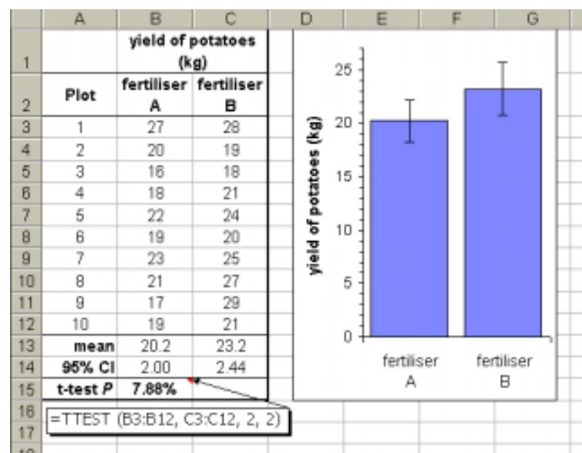

Slide 46
Calculating Statistics in SPSS

Slide 47
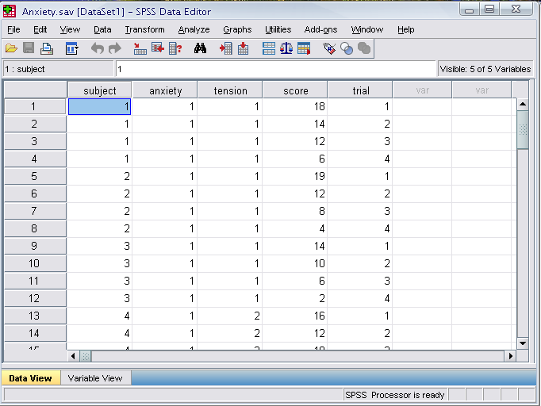
The Four Windows: Data Editor
Data Editor
Spreadsheet-like system for defining, entering, editing, and displaying data. Extension of the saved file will be “sav.”

Slide 48
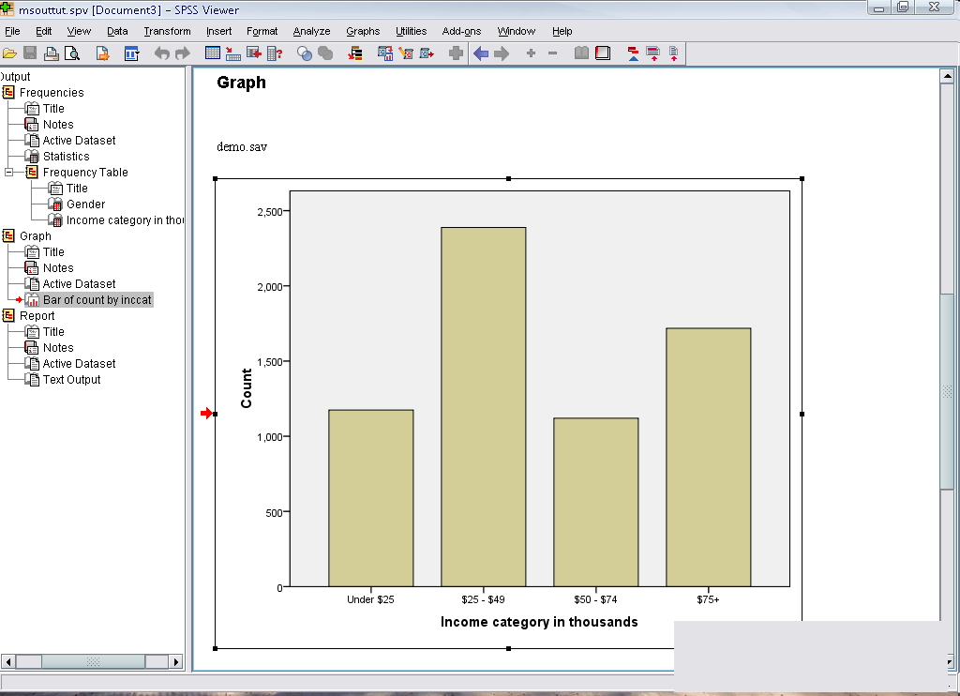
The Four Windows: Output Viewer
Output Viewer
Displays output and errors. Extension of the saved file will be “spv.”
Notes:
The graph shows that more people who receives wireless service tends to own PDA compared to people who doesn’t receive wireless service.

Slide 49
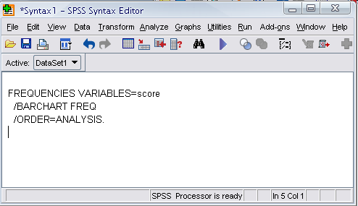
The Four Windows: Syntax editor
Syntax Editor
Text editor for syntax composition. Extension of the saved file will be “sps.”

Slide 50
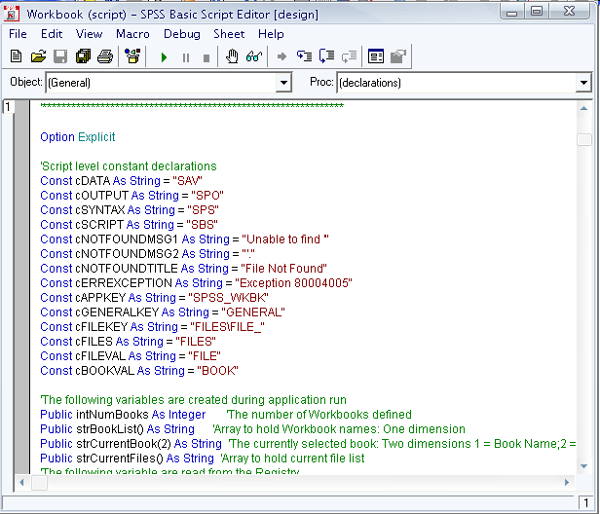
The Four Windows: Script Window
Script Window
Provides the opportunity to write full-blown programs, in a BASIC-like language. Text editor for syntax composition. Extension of the saved file will be “sbs.”

Slide 51
Classification of Research Reports
The broad classifications are;
  Dissertations
  Research reports to sponsors
  Research journal publications
  Contract research reports

Slide 52
Basic issues of reporting
The purpose of the report;
  What is being communicated must be well understood.
To whom is the report addressed;
  The answer to this question will help understanding the background, the needs, and the view points of the reader.
  The report can then be fashioned suitably in a proper style, with adequate elaborations, emphasizing the uses which the reader will be most interested in.
Time available for developing the report;
  Scope and detail will then be defined accordingly.

Slide 53
Principles of Report Writing
There are fifteen principles which will be helpful in developing a thesis. They relate to;
  Consistency, Connectivity, Indentation, Highlighting, Openness, Clarity, Ordering, Self sufficiency, Synthesis and Analysis.

Slide 54
Definition of Operations Research
Operations research or business research
“operations research is a scientific method of providing executive departments with a quantitative basis for decision s regarding the operations under their control”. – Morse and Kimball

Slide 55
Necessity of Operational Research in Industry
As already discussed, science of operational research came into existence in connection with war operations, to decide a strategy by which enemy could be harmed to the maximum possible extent with the help of the available warfare.
War situation required reliable decision making.

Slide 56
Linear programming
Linear programming is a technique for determining an optimum schedule of independent activities in view of the available resources.
Linear relationship between the two or more variables is the one in which the variables are directly or precisely proportional.
The general linear programming problem calls for optimizing (maximizing/minimizing) a linear function of the variables called ‘objective function’ subject to a set of linear equations and or inequalities called the constraints or restrictions.

Slide 57
Introduction to Sensitivity Analysis
After the linear programming problem is solved, it is useful to study the effects of changes in the parameters of the problem on the current optimal solution.
Sensitivity analysis is concerned with studying possible changes in the available optimal solution as a result of making changes in the original model.

Slide 58
Thank You

