Slide 1
MGT-491
QUANTITATIVE ANALYSIS AND RESEARCH FOR MANAGEMENT
Session 30
OSMAN BIN SAIF

Slide 2
Summary of Last Session
Excel practice
  Descriptive statistics
  Correlation
  T test (paired, unpaired)
  Annova
Report Writing
Principles of Report Writing
Formal Format
  Dissertation
  Report

Slide 3
Opening the sample data
Open ‘Employee data.sav’ from the SPSS
  Go to “File,” “Open,” and Click Data

Slide 4
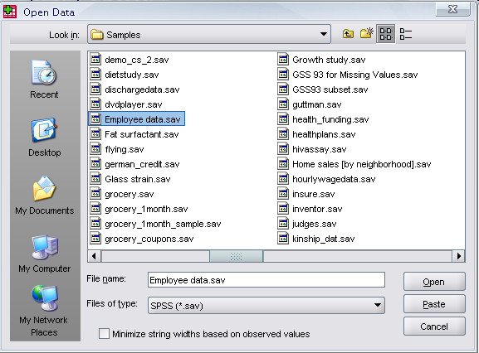
Opening the sample data
Go to Program Files,” “SPSSInc,” “SPSS16,” and “Samples” folder.
Open “Employee Data.sav” file

Slide 5
Frequencies
Click ‘Analyze,’ ‘Descriptive statistics,’ then click ‘Frequencies’

Slide 6
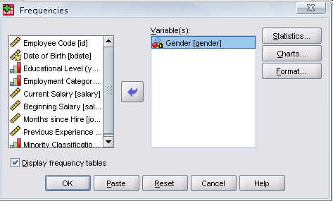
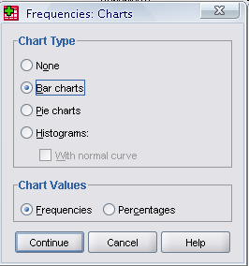
Frequencies
Click gender and put it into the variable box.
Click ‘Charts.’
Then click ‘Bar charts’ and click ‘Continue.’
Click
Click

Slide 7
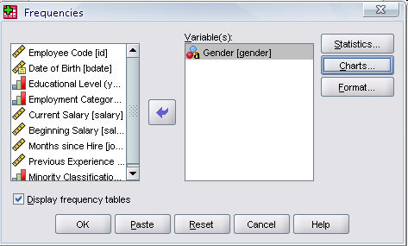
Frequencies
Finally Click OK in the Frequencies box.
Click

Slide 8
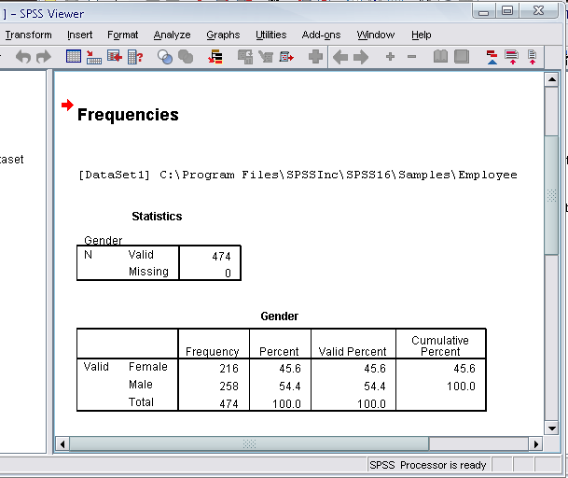
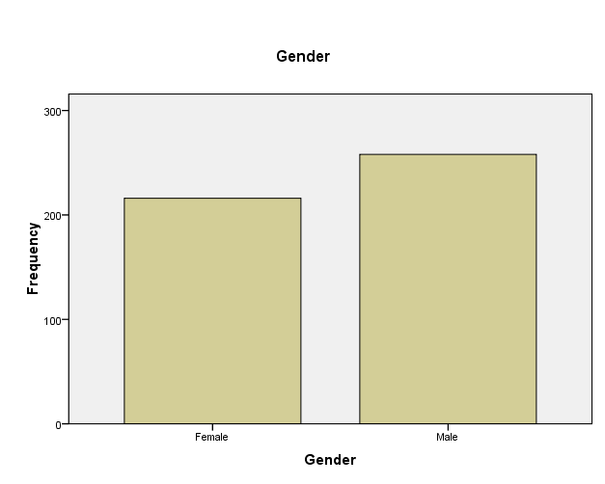

Slide 9
Regression Analysis
Click ‘Analyze,’ ‘Regression,’ then click ‘Linear’ from the main menu.

Slide 10
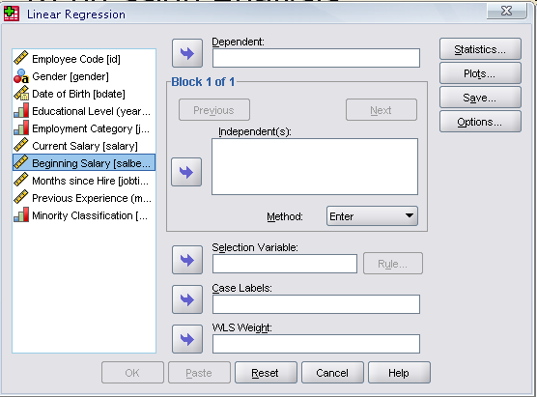
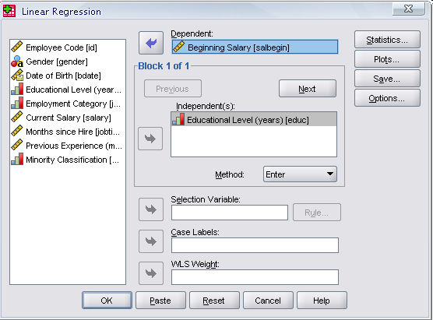
Regression Analysis
For example let’s analyze the model
Put ‘Beginning Salary’ as Dependent and ‘Educational Level’ as Independent.
Click
Click

Slide 11
Regression Analysis
Clicking OK gives the result

Slide 12
Section 4

Slide 13
Brief Course Contents
Section 4; Business Research Problems
  Nature of business research problems
  Steps in solving business research problems
  Solutions through graphical method
  Formulation of Linear programming equation
  Introduction to sensitivity analysis

Slide 14
Development of Operations Research
Operations research has its beginning in World War II.
The term, operations research, was coined by McClosky and Trefthen in 1940 in the U.K.
British scientists set up the first field installation of radars during the war and observed the air operations.

Slide 15
There analysis of these led to suggestions that greatly improved and increased the effectiveness of British Fighters and contributed to the success of British Defense.
Operations research was then extended to anti-submarine warfare and to all the phases of military, naval and air operations, both in Britain and United States.

Slide 16
The effectiveness of operations research was instrumental in spreading interest in it to other governmental departments and Industry.
In USA, the national research council formed a committee on operations research in 1951.
And the first book on the subject was published.
Success of Operations research in Military attracted the attention of industrial managers who were seeking solutions to their complex problems.

Slide 17
Today almost every organization or corporation has staff applying operations research or business research.
The general acceptance to operations research has come as the managers have learned the advantage of the scientific approach.

Slide 18
Definition of Operations Research
Operations research or business research
“operations research is a scientific method of providing executive departments with a quantitative basis for decision s regarding the operations under their control”. – Morse and Kimball

Slide 19
Necessity of Operational Research in Industry
As already discussed, science of operational research came into existence in connection with war operations, to decide a strategy by which enemy could be harmed to the maximum possible extent with the help of the available warfare.
War situation required reliable decision making.

Slide 20
The need of the business or operational research has been equally felt by the industry due to the following reasons’
  Complexity;
    In a big industry, the number of factors influencing a decision have increased.
    Situation has become big and complex because these factors interact with each other in a complicated manner.
    There is thus great uncertainty about the outcome of the interaction of factors like technology, environment, competition and so on.

Slide 21
  Scattered responsibility and Authority;
    In a big industry, responsibility and authority of decision making is scattered throughout the organization and thus the organization, if it is not conscious , may be following inconsistent goals.
  Uncertainty
    There is great uncertainty about economic and general environment.
    With economic growth, uncertainty is also growing.
    This makes each decision costlier and time consuming
    Operations research is thus, quite essential from reliability point of view.

Slide 22
  Knowledge Explosion
    Knowledge is increasing at a very fast rate.
    Majority of the industries are not up to date with the latest knowledge and are therefore at a disadvantage.
    Operations research teams collect the latest information for analysis purpose which is quite useful for the industries.

Slide 23
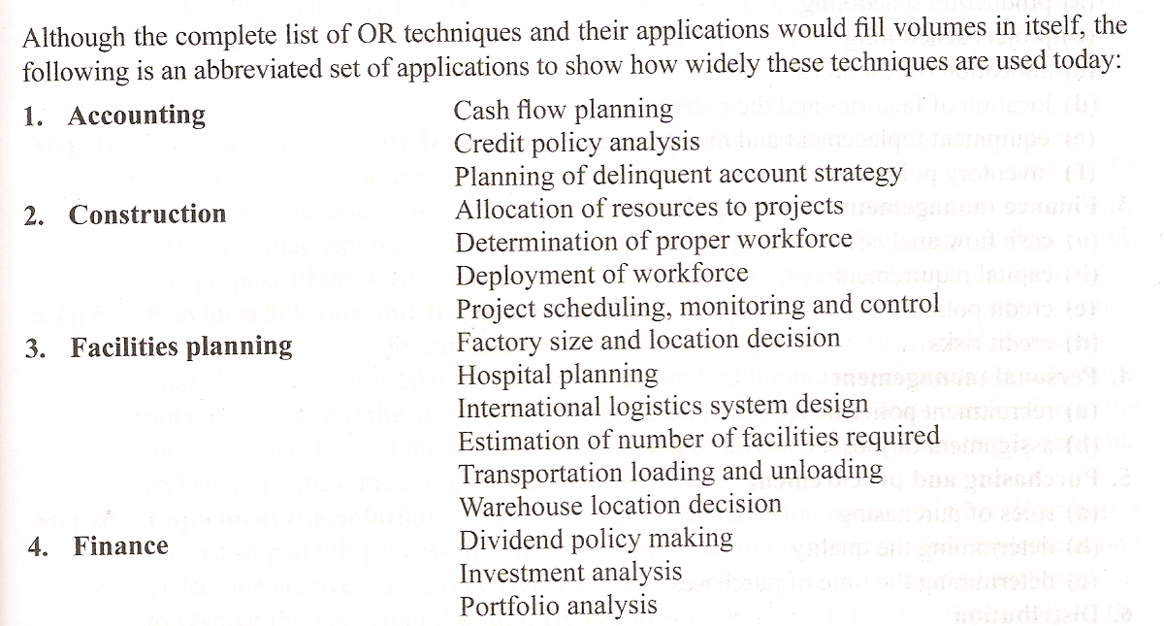
Scope / Applications of Operations Research

Slide 24
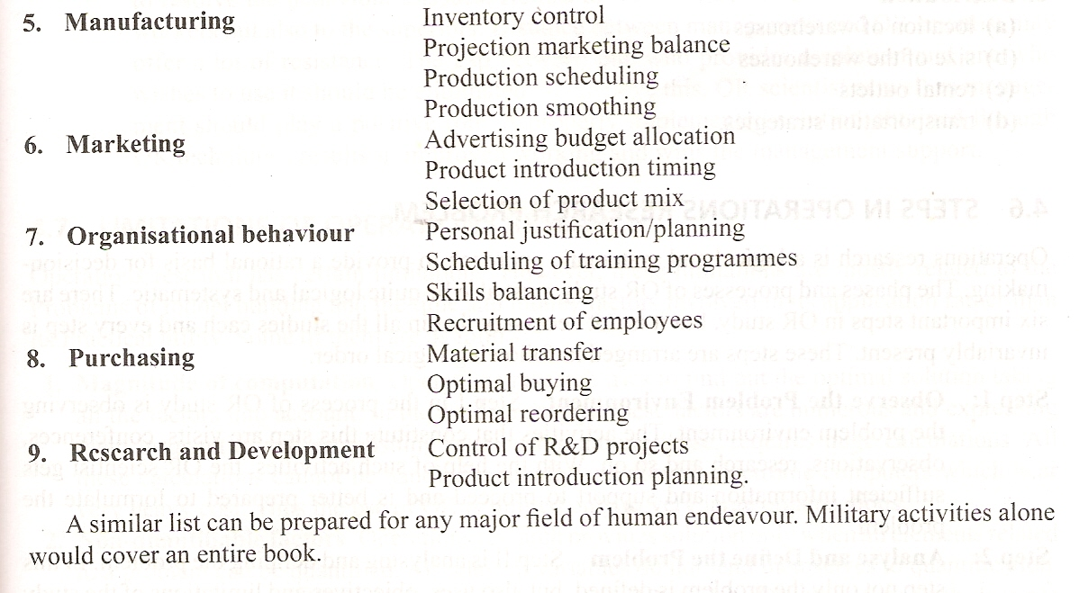

Slide 25
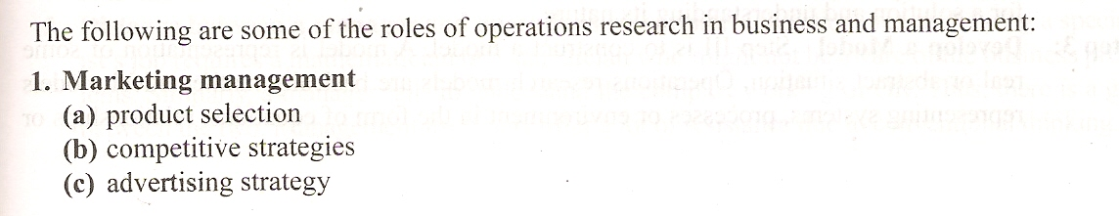
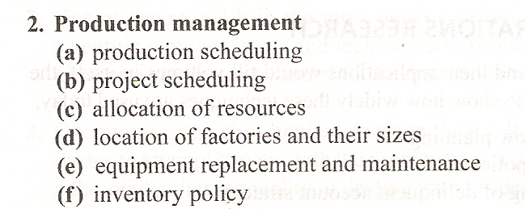
Operations Research in Modern Management

Slide 26
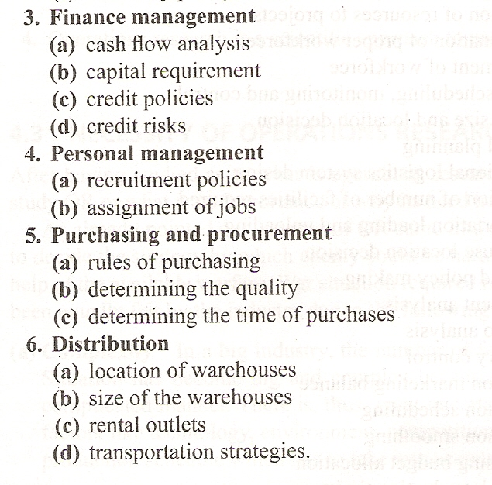

Slide 27
Steps involved in developing a Operational Research study
Operations research is a logical and systematic approach to provide a rational basis for decision-making.
There are six important steps in an operational research study, but it is not necessary that in all the studies each and every step is invariably present.
These steps are arranged in the following logical order.

Slide 28
Step 1. Observe the problem environment;
  The activities that constitute this step are visits, conferences, observations, research and so on.
  With the help of such activities, the Operational Research scientist gets sufficient information and support to proceed and is better prepared to formulate the problem.

Slide 29
Step 2. Analyze and Define the problem;
  In this step not only the problem is defined but also uses, objectives and limitations of the study are stressed in the light of the problem.
  The end result of this step is a clear grasp of need for developing a solution and understanding its nature.

Slide 30
Step 3. Develop a Model;
  A model is a representation of some real or abstract situation.
  Operations research models are basically mathematical models representing systems. Processes or environment in the form of equations, relationships or formulae.
  The activities in this step include defining, inter-relationship, among variables, formulating equations, using known Operational research models.

Slide 31
Step 4. Select an Appropriate Data Input;
  Garbage in and garbage out is a famous saying.
  No model will work appropriately if data input is not appropriate.
  Hence taping the right kind of data is the vital step.
  Important activity in this step are analyzing internal – external data and facts.

Slide 32
Step 5. Provide a Solution and test reasonableness;
  This step involves getting a solution with the help of a model and data input.
  Such a solution is not implemented immediately.
  First it is tested and limitations are found.
  If the solution is not reasonable or if the model is not behaving properly, updating and modifications of the model is considered.
  The end result of this step is a solution that is desirable and supports the current organizational objective.

Slide 33
Step 6. Implement the Solution;
  In operational research the decision making is scientific and implementation of decision involves so many behavioral issues.
  Therefore the implementation authority has to resolve the behavioral issues, sell the idea of use operational research not only to workers but also to superiors.

Slide 34
Limitations of Operational Research
Magnitude of Computation;
  Operations research tries to find out the optimal solution taking all the factors into account.
  In modern society, these factors are numerous and expressing them in quantity and establishing relationship among these, require huge calculations.

Slide 35
Non- quantifiable Factors;
  Operations research provides solution only when all elements related to a problem can be quantified.
  All relevant variables do not lend themselves to quantification.
  Factors which cannot be quantified, find no place in Operations research models.

Slide 36
Distance between a manager and operations researcher;
  Operation research being a specialist’s job requires a mathematician or a statistician who might not be aware of the business problem.
  Similarly a manager fails to understand the complex working of operations research.
  Thus there is a gap between the two.
  Management itself may offer a lot of resistance due to conventional thinking.

Slide 37
Money and Time Cost;
  When the basic data is frequently changed, incorporating them into the operations research model is a costly affair.

Slide 38
Implementation;
  Implementation of decision is a delicate task
  It must take into account the complexities of human relations and behavior.
  Sometimes resistance is offered only due to psychological factors.

Slide 39
Linear programming
Linear programming is a technique for determining an optimum schedule of independent activities in view of the available resources.
Linear relationship between the two or more variables is the one in which the variables are directly or precisely proportional.
The general linear programming problem calls for optimizing (maximizing/minimizing) a linear function of the variables called ‘objective function’ subject to a set of linear equations and or inequalities called the constraints or restrictions.

Slide 40
Mathematical formulation of Linear Programming problem
The procedure for mathematical formulation of LPP consists of the following steps;
Step 1;
  Identify the decision variable of the problem
Step 2;
  Formulate the objective function to be optimized (maximized/minimized) as a linear function of the decision variables.

Slide 41
Step 3;
  Formulate the constraints of the problem such as resource limitations, market conditions, interrelations between variables and others as linear equation or in-equations in terms of the decision variables.
Step 4;
  Add the non-negativity constraint so that negative values of the decisions variables do not have any valid physical interpretation.

Slide 42
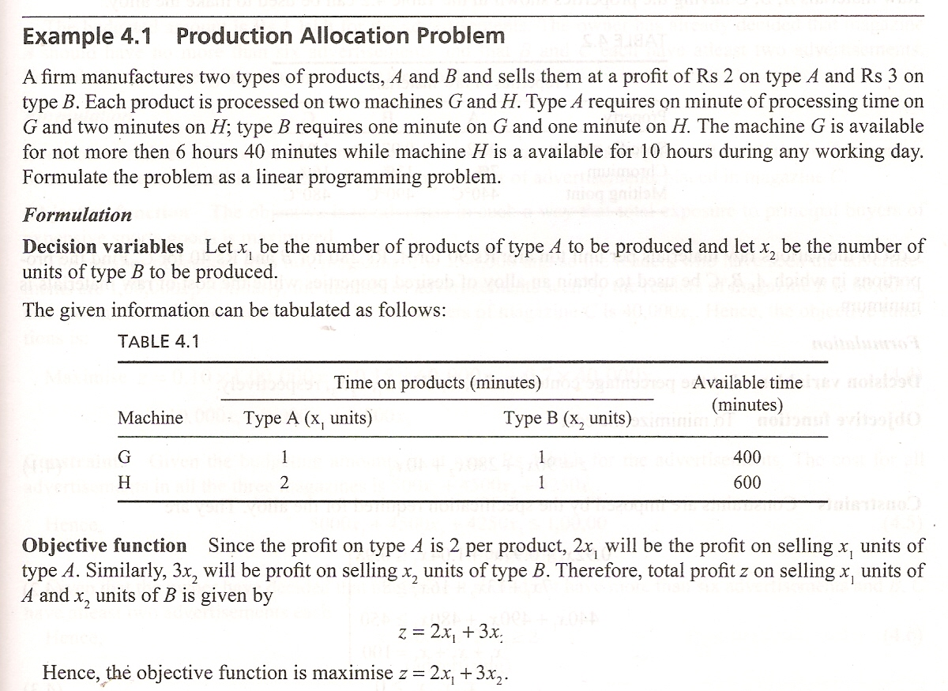

Slide 43
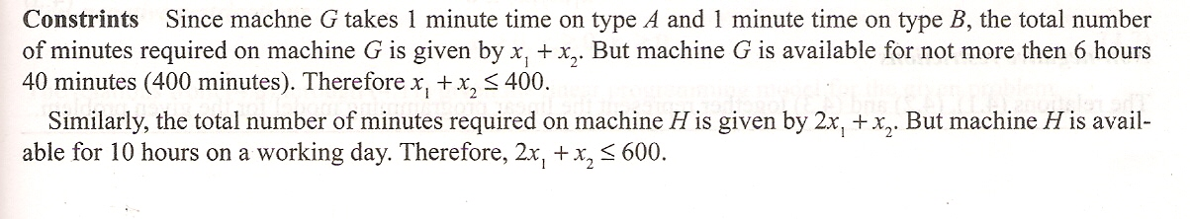
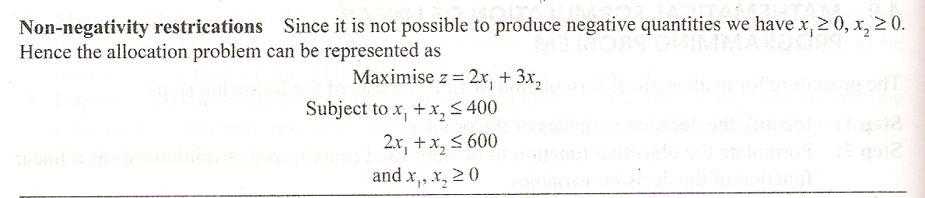

Slide 44
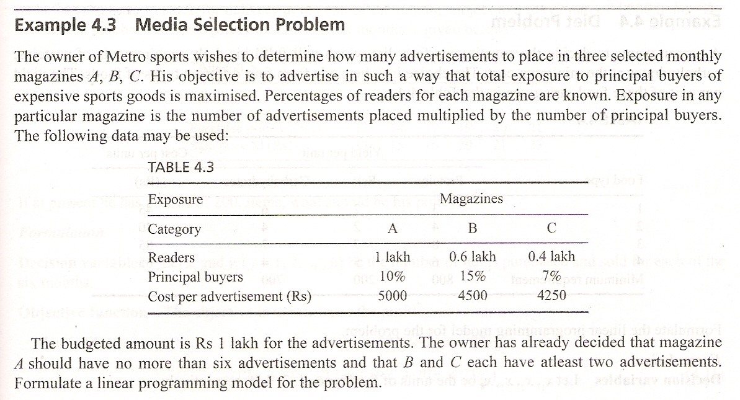

Slide 45
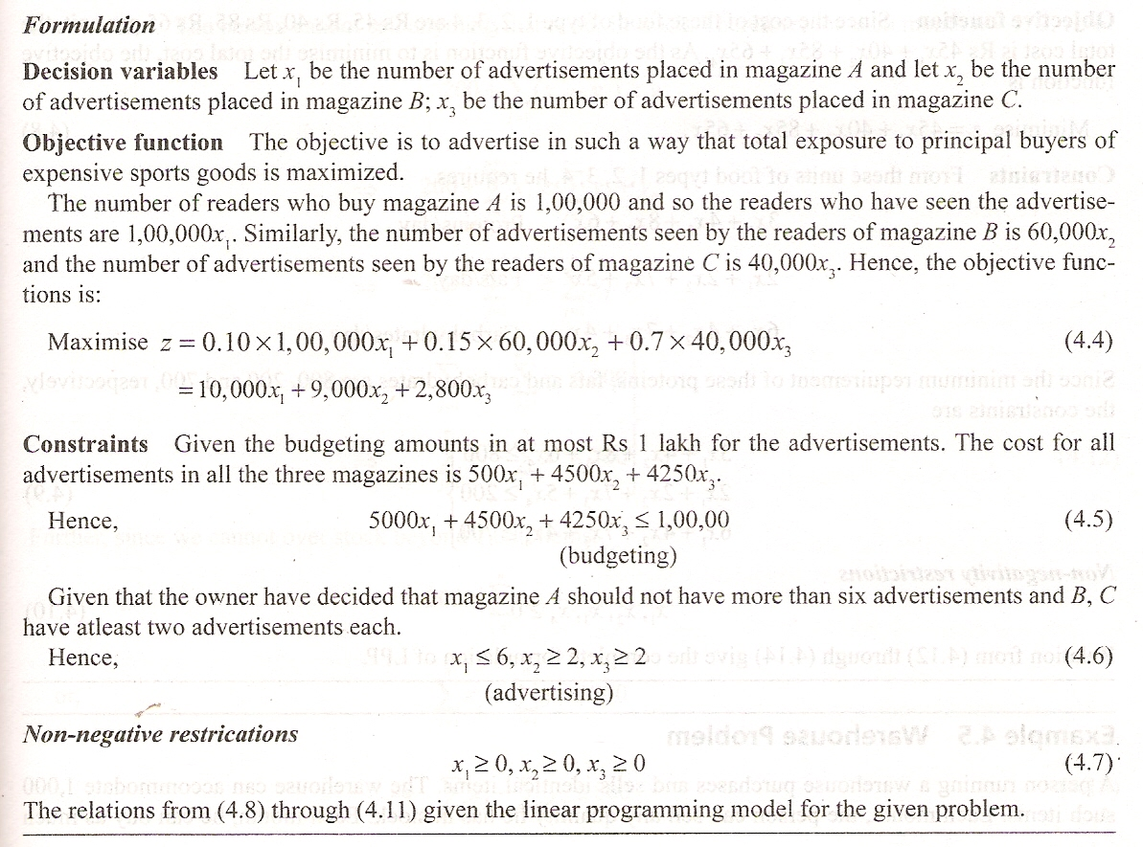

Slide 46
Introduction to Sensitivity Analysis
After the linear programming problem is solved, it is useful to study the effects of changes in the parameters of the problem on the current optimal solution.
Sensitivity analysis is concerned with studying possible changes in the available optimal solution as a result of making changes in the original model.

Slide 47
The change in the parameters of the problem may be discrete or continuous.
The study of the effect of discrete changes in parameters on the optimal solution is called sensitivity analysis or post optimality analysis.
One way to determine the effects of parameter changes is solve the new problem a new, which may be computationally inefficient.

Slide 48
Alternatively, the current optimal solution may be investigated, making use of the properties of the simplex criteria.
The second method reduces additional computations considerably and hence forms the sensitivity analysis.

Slide 49
Summary of This Session
Practice SPSS
  Examples
Section 4 of the Course
  Operation research
    Development
    Definition
    Necessity
    Scope / Applications
    Roles in Modern Management

Slide 50
  Steps involved in developing an operational study
  Limitations of Operational Research
  Linear Programming
    Mathematical form of LLP
  Sensitivity Analysis

Slide 51
Thank You

