Slide 1
MGT-491
QUANTITATIVE ANALYSIS AND RESEARCH FOR MANAGEMENT
Session 29
OSMAN BIN SAIF

Slide 2
Summary of Last session
Introduction to SPSS
The Four Windows:
  Data editor
  Output viewer
  Syntax editor
  Script window
Examples and Practice sets

Slide 3
Excel Practice
Descriptive statistics
Correlation
T test (paired , unpaired)
Annova

Slide 4
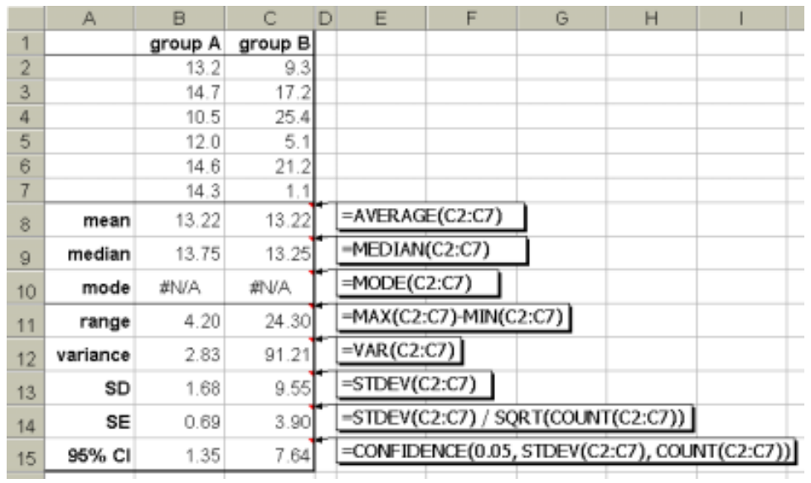

Slide 5
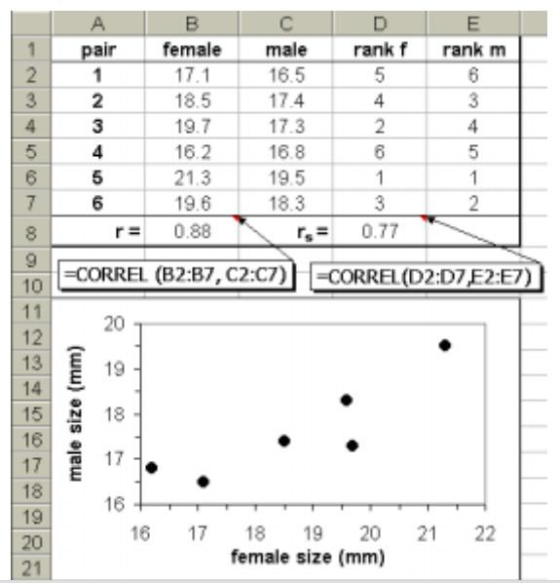

Slide 6
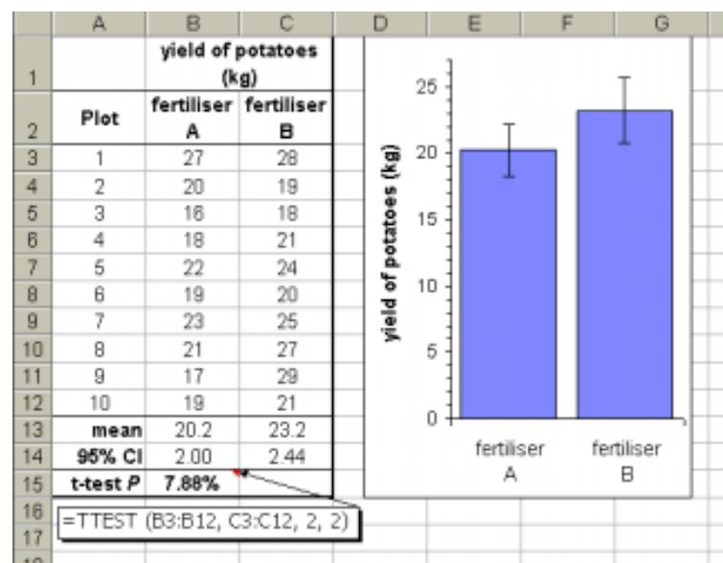

Slide 7
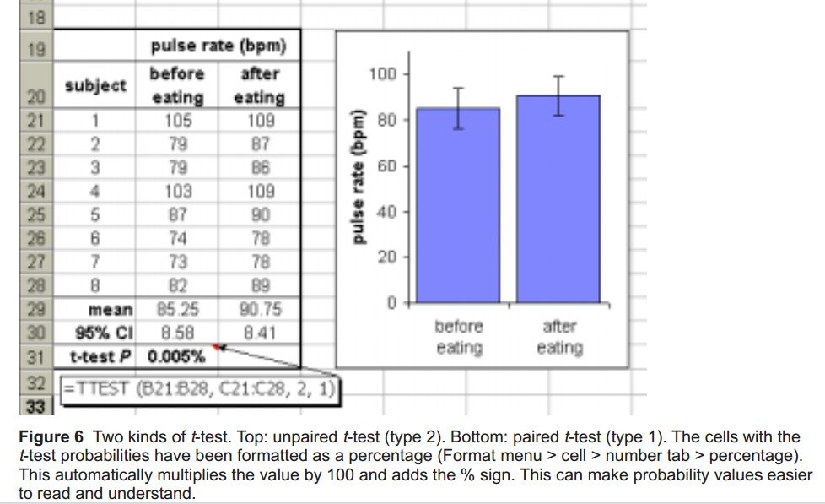

Slide 8
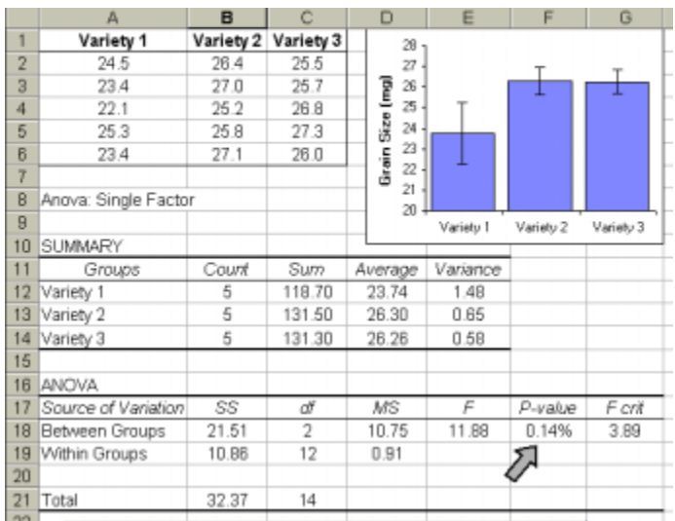

Slide 9
Research Report Writing
Research report vary in scope and treatment.
Each university might set its own format and style of thesis writing for its research students.
The funding organizations supporting research may demand a certain way of reporting.
The editorial board of each research journal may lay down guidelines for research papers published by them.

Slide 10
While there may be minor changes in these, their main intention is to enable the researcher to communicate his ideas and results efficiently to the readers.
In order to achieve efficient communication there are certain conventions followed in form and style.

Slide 11
Classification of Research Reports
The broad classifications are;
  Dissertations
  Research reports to sponsors
  Research journal publications
  Contract research reports

Slide 12
Basic issues of reporting
The purpose of the report;
  What is being communicated must be well understood.
To whom is the report addressed;
  The answer to this question will help understanding the background, the needs, and the view points of the reader.
  The report can then be fashioned suitably in a proper style, with adequate elaborations, emphasizing the uses which the reader will be most interested in.
Time available for developing the report;
  Scope and detail will then be defined accordingly.

Slide 13
Principles of Report Writing
There are fifteen principles which will be helpful in developing a thesis. They relate to;
  Consistency, Connectivity, Indentation, Highlighting, Openness, Clarity, Ordering, Self sufficiency, Synthesis and Analysis.

Slide 14
1. Consistency
There should be consistency;
  In the objective of the research stated, in the introduction, results obtained and conclusions drawn.
  In the location, typing, and format of captions for the tables and figures
  In the referencing format employed in the text
  In the structure of each reference under books, reports and journals, in bibliography
  The indentation used in each chapter.

Slide 15
2. Connectivity
The text of the report should not have abrupt beginnings and endings.
Section to section and chapter to chapter transition should be logical.
Linking sentences have to be developed.

Slide 16
3. Indentation
The report should be indented or cut into meaningful chapters and sections depending upon the structure and content of the various aspects of presentation.
This will help in writing the report in a modular way.

Slide 17
4. Continuity
The flow of the thoughts and ideas in each section (or sub-section or paragraphs if necessary) should be carefully maintained so that it becomes one continuous coherent bit of presentation, suitably linked to the next.

Slide 18
5. Highlighting
It is necessary for the researchers to emphasize and highlight the major aspects or points that are significant in his/her work.
This gives a proper perspective to researcher’s work
The most important objective should be dwelt upon in greater detail, likewise the most important result.

Slide 19
6. Openness
Every research has limitations and errors.
A tacit appreciation of this is a frank and open approach to putting down the errors and limitation in data, in method and even in the tools used.
Inadequacies of sample size and tentativeness or weakness of results should also be stated.
Defending these is one thing in science, but deliberately obliterating them is another.

Slide 20
7. Clarity
In a report, the researcher is trying to communicate, and not to impress or confuse the manger or reader.
Simple language, concise and direct statements should be used.
Ambiguous words, phrases, and sentences should be avoided.

Slide 21
8. Asserting
When assertions are made, particularly when they are strong, the researcher should enunciate the support of earlier research for such assertions or of the facts obtained and of the analysis made in the research work.

Slide 22
9. Ordering
When discussing objectives, variables and results, it is necessary that different objectives, variables and results are ordered in the same way even if they are chronologically different (in the sense of the students discovering them).

Slide 23
10. Compatibility
When discussing results and presenting conclusions, it is essential that the results are confided to the data or what the technique can give.
In other words, conclusions and inferences must be compatible with the data and technique of analysis, and must not transgress them.

Slide 24
11. Jargon
Every discipline has its own words, modes of expression and phraseology.
The researcher would do well to use them, that is, the jargon of the discipline, to let the reader know of his/ her ‘soaking’ in the knowledge-area or of his/her ‘immersion’, as a scholar in the subject matter.

Slide 25
12. Elaboration
One of the most difficult thing while developing a report is to appreciate where or at what point in the report the researcher has to compress a considerable amount of research material and where there is a need to elaborate.

Slide 26
13. Self Sufficiency
Whenever tables, graphs, figures and illustrations are presented in the text, it is desirable to make these as complete as possible, to be read and understood by themselves without the need to look into the text.
Details, captions, and legends should ensure this.

Slide 27
14. Enrichment
Usually the researcher collects wider information than is necessary to answer the research questions.
After the main objective of the report is achieved, researcher should exploit the opportunity of enriching his/her work by presenting by-products and related results from any additional data or information not directly relevant to the objective but which would add to the knowledge.

Slide 28
15. Synthesis-analysis-synthesis
In writing the report, the sine qua non is to employ synthesis and analytic approaches in cycles.
Draw an overview, outline of the report (synthesis)
Develve into details and structure the parts (analysis).
Then once again get an overview, by looking at the totality (synthesis).

Slide 29
Format of a Dissertation
The contents of all theses and dissertations are not uniformly the same.
There are many variants and orderings used.
A typical format for a dissertation is on the next slide.

Slide 30
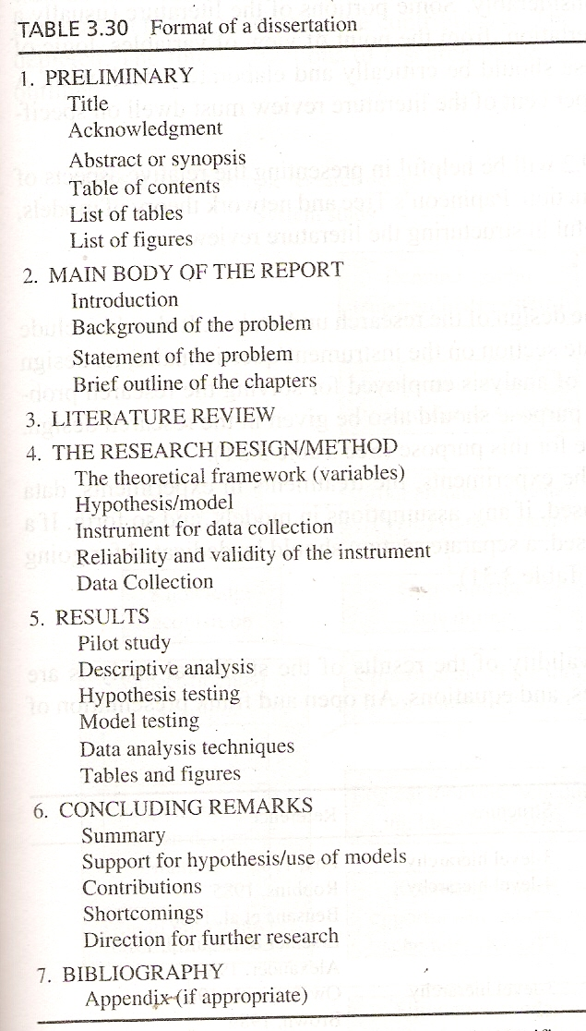

Slide 31
Format of a Research Report
In case of reporting research, either sponsored, in house or contract, the format shown in table 3.38 and 3.39 is used.

Slide 32
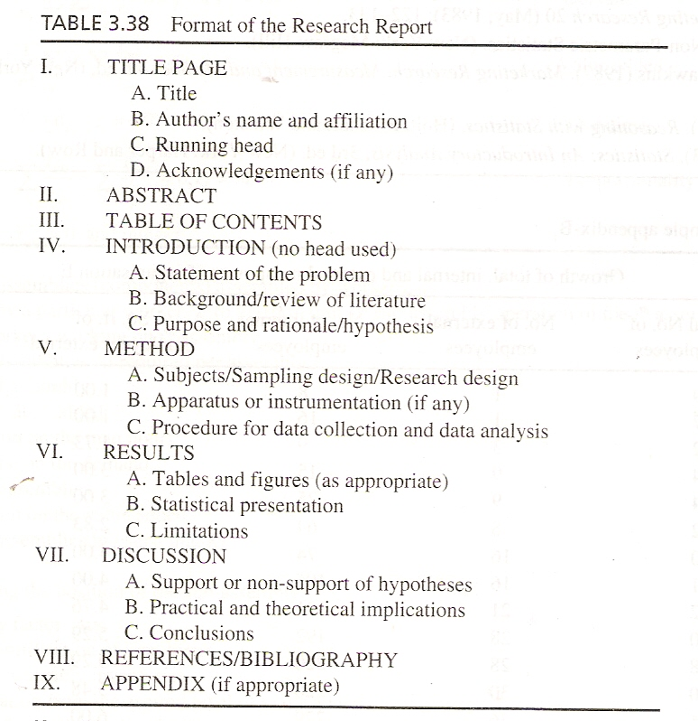

Slide 33
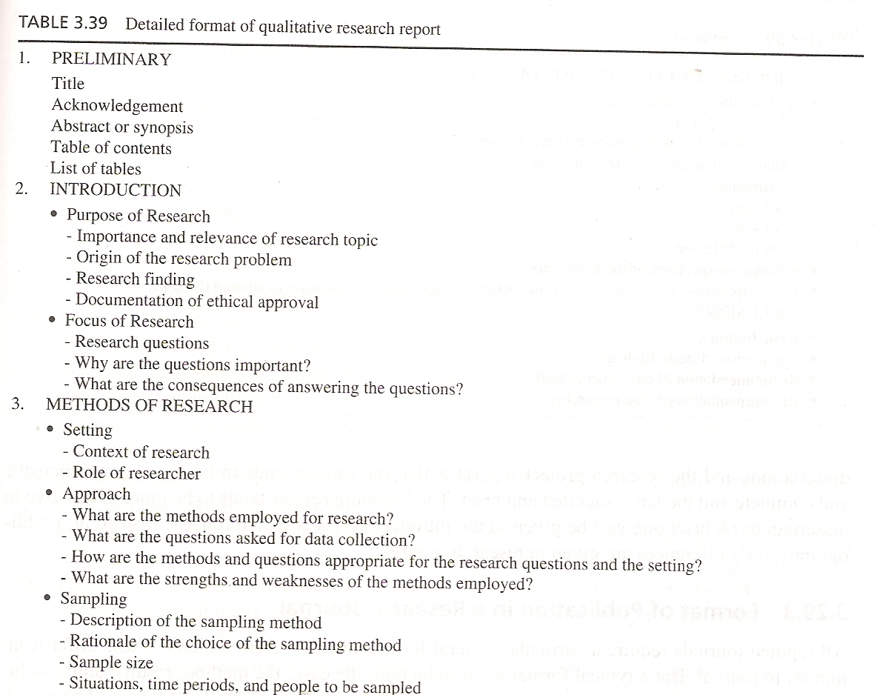

Slide 34
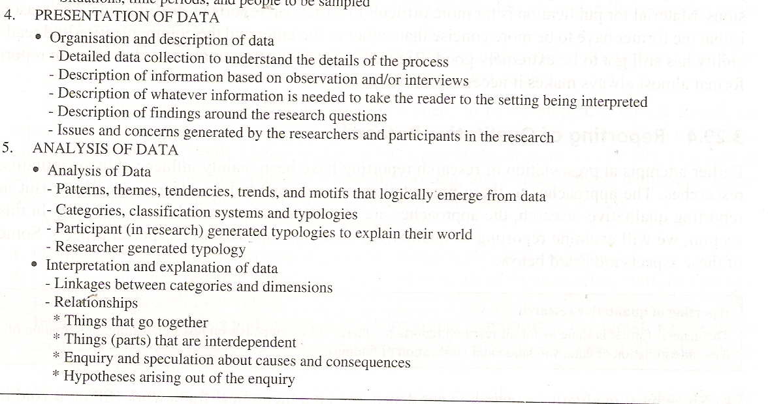

Slide 35
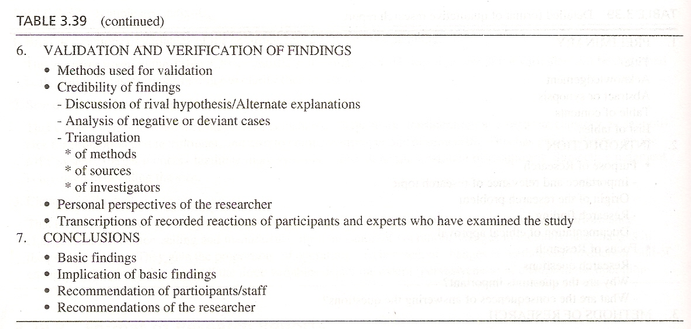

Slide 36
Summary of this session
Excel practice
  Descriptive statistics
  Correlation
  T test (paired, unpaired)
  Annova
Report Writing
Principles of Report Writing
Formal Format
  Dissertation
  Report

Slide 37
Thanks

