Slide 1
MGT-491
QUANTITATIVE ANALYSIS AND RESEARCH FOR MANAGEMENT
Session 27
OSMAN BIN SAIF

Slide 2
Summary of Last Session
One sample t test
One sample median
Binomial test
A chi square goodness of fit test
T test
Annova
Kruskal Wallis test
A paired sample t test
Wilcoxin rank sum test
Friedman test
Correlation
Regression
F- test

Slide 3
Statistics in Business research
Statistics is an area that most management and marketing students find difficult. The formulae are often complicated, the calculations tedious, degrees of freedom mysterious, and probability tables confusing. But in fact students need no longer grapple with any of these. In real life, business and statisticians rarely use calculation and tables these days, but instead use statistical packages such as SPSS. But it isn’t even necessary to buy an expensive statistics package, since spreadsheet software such as Excel has most of the common statistical tests built-in

Slide 4
When using statistics, the first hurdle is to decide which statistical test to use. Figure 1 is a flow chart showing when to use the various tests described.
There are many other possible statistical tests, but this flow chart should be more than sufficient for management science students. It briefly summarizes the Excel formulae and how to interpret the results, so it can be used as a handy guide on its own once the student is familiar with the tests.
This flow chart should be used when designing an experiment, not after the experiment is complete. This will ensure that the correct kind of data are collected so that the statistical test will be valid. It describes in detail how to carry out these tests using Excel and how to interpret the results.

Slide 5
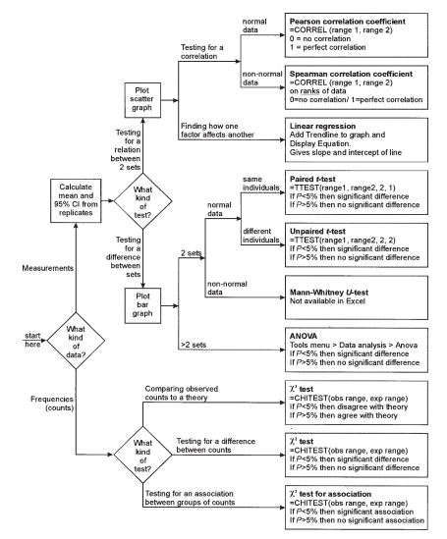

Slide 6
Sections by Type
It is divided into five sections:
1 Descriptive statistics mean, median, mode, standard deviation, standard error, confidence interval
2 Graphing data scatter graphs, bar graphs, error bars, lines
3 Association statistics Pearson coefficient, Spearman coefficient, linear regression
4 Comparative statistics paired and unpaired t-test, Mann-Whitney U-test, ANOVA
5 Frequency statistics , χ2-test, χ2-test of association

Slide 7
1. Descriptive Statistics
Most marketing experiments will involve some kind of measurement, such as time, length, mass, temperature, absorbance, etc., and in a well-designed experiment there should be a number of repeats (or replicates) of each measurement.
Once some measurements have been collected the first job is usually to summarize them using descriptive statistics. Excel has formulae for the three measures of the center of a distribution of replicates

Slide 8
These formulae are illustrated in Figure 2. In many cases the quantities measured in management science will show a normal distribution, and so the mean is the most appropriate statistic to use. It is also the one students are most likely to know already, and to be able to do by hand.
The median and mode are less likely to be needed for experimental data.
It is unfortunate that Excel uses the word ‘average’ for ‘mean’, as some textbooks use average as a general term to refer to any measure of the center of a distribution.
Figure 2 shows five different measures of the spread, and shows how easy they are to calculate using Excel.

Slide 9
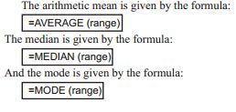
Mean, Median, Mode

Slide 10
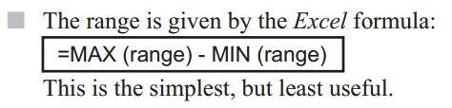
Range

Slide 11

Variance
This is used in calculations, but has little use as a descriptive statistic since it is not in the same units as the measurements.

Slide 12
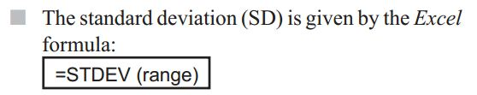
Standard Deviation
This is common (since it is fairly easy to calculate by hand) and it gives a good indication of the variability of a set of data.
However it is not the best statistic to use when comparing different sets of data, especially if the data sets are different sizes

Slide 13
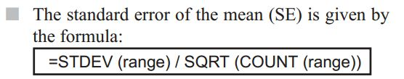
Standard Error
This gives an indication of the confidence of the mean, and is often used as an error measurement simply because it is small rather than for any good statistical reason.

Slide 14
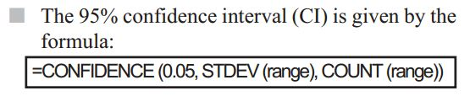
Confidence Interval
The value of 0.05 is used to give the 95% (0.95) confidence interval, and different values can be used for different levels of confidence, such as 0.01 for a 99% confidence interval.
There is a 95% probability that the true mean lies within ±CI from the measured mean, and the upper and lower values of this range are called the confidence limits.

Slide 15
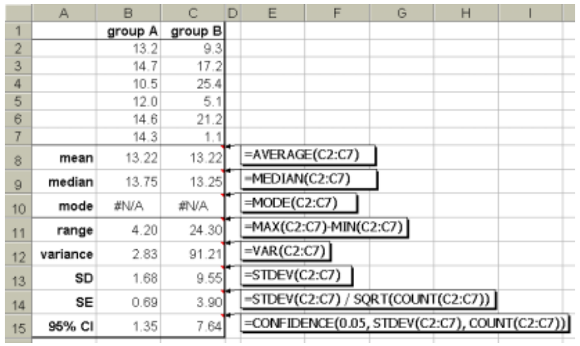

Slide 17
2 GRAPHING DATA
Graphs are an important part of data analysis and are closely connected to statistics, since the choice of graph is connected to the choice of statistical test, as the flow chart in Figure 1 shows.
If you are investigating an association between two variables, then you should plot a scatter graph;
if you are comparing different sets of data, you should plot a bar graph; and
if you are collecting frequency data, then you may plot a bar or pie chart, or a graph may not be appropriate.
In Excel it is quite easy to plot these graphs, as well as many other types. First enter the data into columns or rows, and select them. Then click on the chart wizard (or Insert menu > Chart).

Slide 18
This wizard has four steps:
  1 In Graph Type, select the type you want and press Next.
    Choose ‘Column’ for bar charts or ‘XY (Scatter)’ for line and scatter graphs.
    Do not choose ‘Line’, which plots the data against row number. This is a very common mistake

Slide 19
  2 In Source Data, if the sample graph looks about
    right, then just press Next.
    If it looks wrong, you can correct it by clicking on the series tab, and then the red arrow at the end of the X Values box.
    Then highlight the cells containing the X data in
    the spreadsheet and press the red arrow again.
    Repeat for the Y Values box

Slide 20
  3 In Chart Options, the most important tasks are to type in suitable titles for the graph and the two axes. You can also turn off gridlines and legend, which makes the chart look better.
  4 In Graph Location, just press Finish. This puts the chart beside the data so you can see both

Slide 21
Editing a Graph
Excel graphs are quite flexible and almost everything about them can be changed. Just double-click (or sometimes right-click) on the part you want to change.
For example, you can move and re-shape the graph; change the background colour (white is usually best); change the shape and size of the markers (points); join the points; change the axes scales and tick marks; or add a trend line or error bars.
It is worth taking some time to get the graph right, because you can use an existing graph as a template. Simply type the new data in place of the existing data, and the graph automatically changes. The sheet can then be saved as a new file.

Slide 22
Error Bars
If you are plotting averages on a scatter or bar graph, then error bars are a very good way to illustrate the confidence of the data on the graph.
Error bars usually show ± CI, although you could also plot them from SD or SE.
Double-click on any data point or bar to get the Format Data Series dialogue box, and choose the Y Error Bars tab.
Click in the Custom + box, and highlight the range of cells containing your confidence intervals.
Repeat for the Custom – box, and then press OK

Slide 23
Error bars are useful for the evaluation part of student investigations.
Small error bars suggest reliable data; large error bars suggest dubious data.
A line of best fit should pass through the error bars.
Figure 3 shows a graph where a curve has been drawn, but in fact a straight line would also pass through the error bars, so a linear relation is also supported by the data.

Slide 24
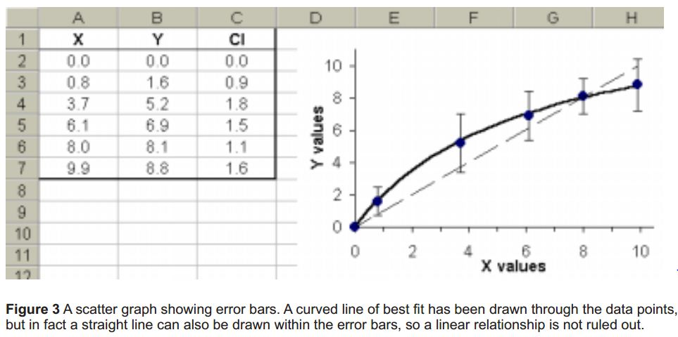

Slide 25
3. Association Statistics
A common task in data analysis is to investigate an association between two variables. This can be a correlation to see if two variables vary together, or a regression to see how one variable affects another.
We’ll see how to do each of these in Excel. In both cases a scatter graph should be plotted first.

Slide 26
Correlation
A correlation tells us whether the two variables vary together, i.e. as one goes up the other goes up (or goes down).
The most common tests for correlation are the Pearson product-moment correlation coefficient (r) for normally-distributed parametric) data, and the Spearman rank-order correlation coefficient (rs) for data that are not normally distributed (non-parametric data).
Both vary from +1 (perfect correlation) through 0 (no correlation) to –1 (perfect negative correlation).
In Excel the Pearson coefficient can be found by two alternative formulae:

Slide 27
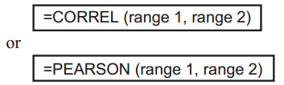

Slide 28
Spearman Coefficient
There is no direct formula for the Spearman coefficient, but it can be calculated by first making two new columns for the ranks of the original data. For each of the two variables the largest value is given a rank of 1, the next largest a rank of 2, and so on.
This can most simply be done by hand, or for large data sets, by using Excel’s =RANK command.
The Spearman coefficient is then simply the Pearson coefficient calculated on the rank data, ignoring the original data. Both coefficients are demonstrated in Figure 4.
This shows measurements on the size of breeding pairs of penguins to see if there is a correlation between the sizes of the two sexes.
The Spearman coefficient rs (0.77) is more conservative than the Pearson coefficient r(0.88), but both show a strong positive correlation.

Slide 29
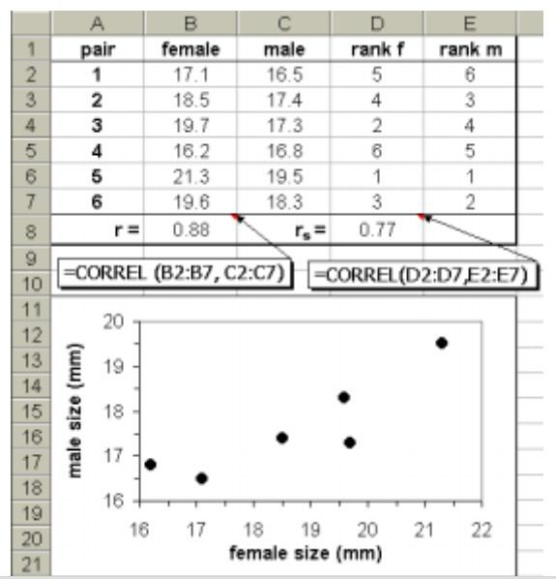

Slide 30
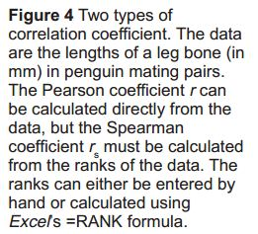

Slide 31
Regression
Linear regression
  Regression is used when we have reason to believe that changes in one variable cause the changes in the other. A correlation is not evidence for a causal relationship, but very often we are aware of a causal relationship and we design an experiment to investigate it further. The simplest kind of causal relationship is a straight-line relationship, and this can be analysed using linear regression.

Slide 32
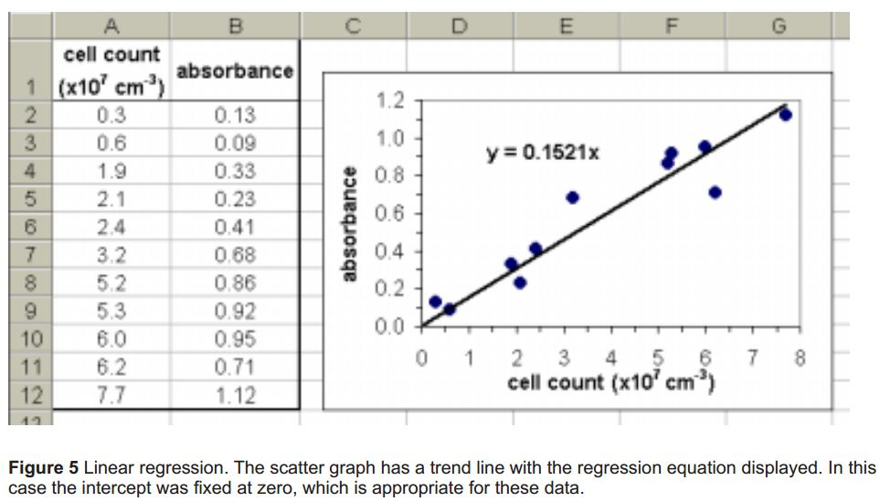

Slide 33
This fits a straight line to the data using a least squares method, and gives the values of the slope and intercept that define the line (m and c in the equation y = mx + c).
There are several different ways of calculating the slope and intercept of a linear regression line in Excel, but the simplest is to plot a scatter graph and use the ‘Trendline’ feature of the graph.
Right-click on any data point on the graph, select Add Trendline, and choose Linear. Click on the Options tab, and select Display equation on chart. You can also choose to set the intercept to be zero (or some other value), and to display r² (the square of the Pearson correlation coefficient).

Slide 34
The full equation with the slope and intercept values is now shown on the chart. This is demonstrated in Figure 5, which shows data obtained from counting a yeast cell suspension in a haemocytometer and in a colorimeter.
We expect a linear causal relationship between cell density and turbidity, so this is a good occasion to use regression, and we can use the equation to predict the cell count for a given absorbance.

Slide 35
4. Comparative Statistics
Another common task in data analysis is to compare two or more sets of data to determine whether they are basically the same (i.e. they could come from the same population) or one set is significantly different from the others.
To start with, it is good practice to calculate the means and CIs for the different groups and plot a bar chart with the CIs represented as error bars. This gives us a good visual idea of how different the groups are. It is sometimes thought that if the error bars don’t overlap, then there must be a significant difference between the data, but this is not necessarily true, and a statistical test of comparison is needed to test for significant differences.
The end result of such tests is a probability (P) that the ‘null hypothesis’ (which always states that there is no difference between the sets of data) is true. In management science we usually accept differences as being significant if P is less than 5%, so if P < 5% then we can say that there is a significant difference between the sets of data (i.e. reject the null hypothesis). If P > 5% then we can say that there is no significant difference between the sets of data (i.e. accept the null hypothesis).

Slide 36
T - test
The most common comparative statistical test is the t-test, which is used when there are just two sets of normally-distributed data to compare.
In Excel this is performed by the formula
=TTEST (range 1, range 2, tails, type)

Slide 37
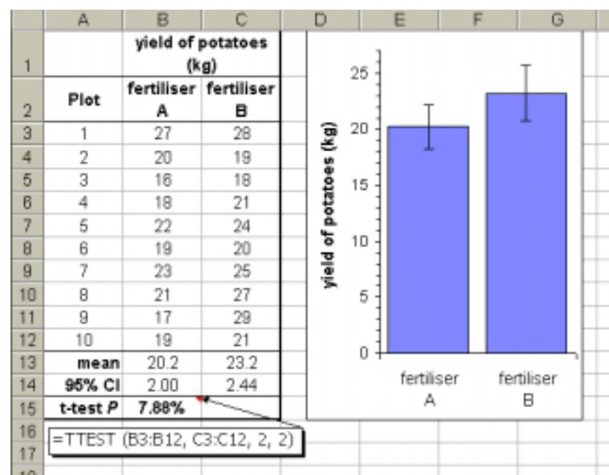

Slide 38
Both kinds of t-test are demonstrated in Figure 6.
In the unpaired test (type 2) the yield of potatoes in 10 plots treated with one fertiliser was compared to that in 10 plots treated with another fertiliser.
Fertiliser B delivers a larger mean yield, but the t-test P shows that there is an 8% probability that these two sets are not really different.
Since this is more than 5% we must conclude that fertiliser B is not significantly better than fertiliser A.

Slide 39
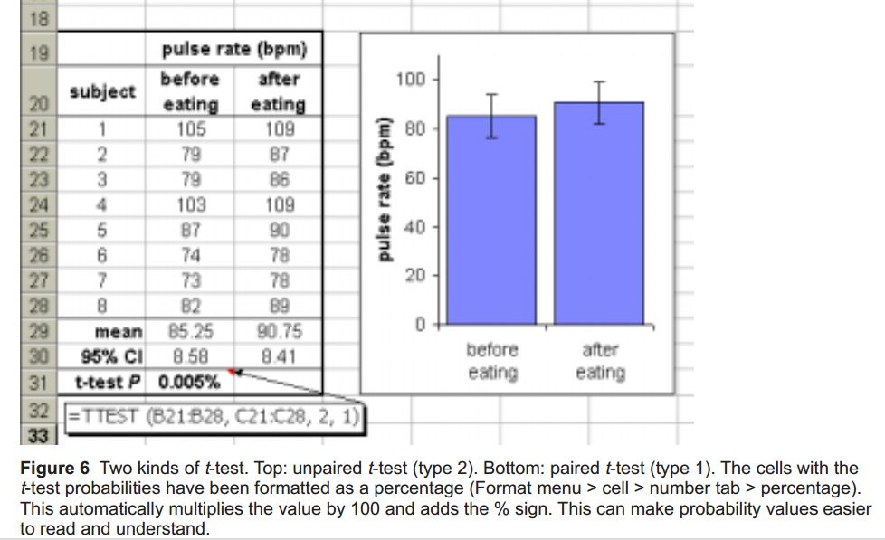

Slide 40
In the paired test (type 1), the pulse rate of 8 individuals was measured before and after a large meal.
The mean pulse rate is a little higher after the meal, and the t-test P shows that there is only a tiny 0.006% probability that the before and after data are the same. So the pulse rate does significantly increase after a meal.
This demonstrates the value of a paired test: although the data are quite varied, with quite a high CI, the pulse rate increased in each individual leading to the high significance of the conclusion.

Slide 41
Excel provides two more formulae involving the t-test. The formula
=TDIST (t, dof, tails)
can be used to replace a look-up table, since it returns the probability corresponding to the given t-value and degrees of freedom.
The formula
=TINV (P, dof)
does the reverse: it returns a t value corresponding to a given probability P. You shouldn’t normally need these formulae.

Slide 42
Mann-Whitney U-Test
The t-test requires that the data be continuous and normally distributed. Sometimes this is not possible, for example if the data are calculated rather than measured, or if the data are counted. In this case the Mann-Whitney U-test, which is the non-parametric equivalent of the t-test, should be used. Unfortunately Excel does not support this test. You could use Excel to calculate the U statistic, but you would still need probability tables to find the significance

Slide 43
ANOVA
The t-test is limited to comparing two sets of data, and to compare many groups at once you need analysis of variance (ANOVA). This is normally considered in the scope of a marketing researcher, since it is so difficult to calculate by hand, but in fact it is just as easy to perform with Excel as any other statistical test.

Slide 44
Since it is so useful (it can even replace the t-test) there is no reason not to include ANOVA in the repertoire of management science researchers. ANOVA is part of Excel’s Data Analysis Pack, which is part of normal Excel, but not always installed. (If there is no Data Analysis option on the Tools menu you need to run Excel set-up to install the ‘Analysis Tool pak add-in’.)

Slide 45
From the Tools menu select Data Analysis and then ANOVA Single Factor. This brings up the ANOVA dialogue box, as shown in the example in Figure 7, which concerns the grain yield from three different varieties of wheat. Enter the Input Range by clicking in the box and then selecting the range of cells containing the data, including the headings. Check that the columns/rows choice is correct (this example is in three columns), and click in Labels in First Row if you have included these.

Slide 46
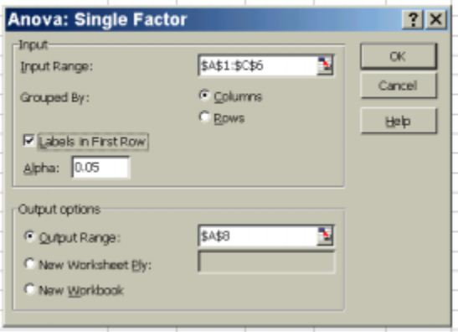

Slide 47
The column headings will appear in the results table. Leave Alpha at 0.05 (for the usual 5% significance level), then click in the Output Range box and click on a free cell on the worksheet, which will become the top left cell of the 8 × 15-cell results table. Finally press OK. The output is a large data table, and you may need to adjust the column widths to read it all.
The most important cell is the P value, which as usual is the probability that the null hypothesis (that there is no difference between any of the data sets) is true. This is the same as a t-test probability, and in fact if you try ANOVA with just two data sets, it returns the same P as a t-test. If P > 5% then there is no significant difference between any of the data sets (i.e. the null hypothesis is true), but if P < 5% then at least one of the groups is significantly different from the others.
In Figure 7 P is 0.14%, which is less than 5%, so there is a significant difference somewhere.

Slide 48
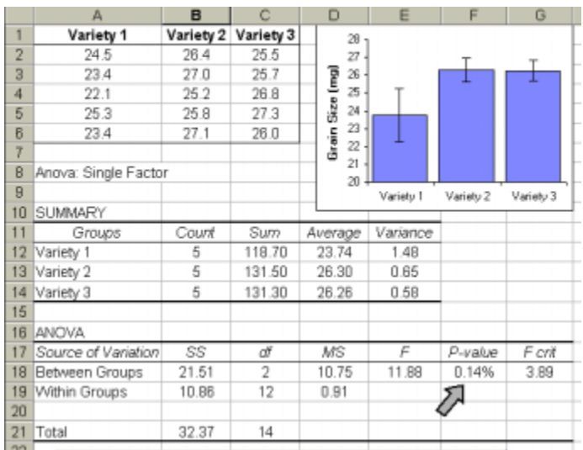

Slide 49
In Figure 7, for example, varieties 2 and 3 are very similar, but variety 1 is obviously different. So the conclusion would be that variety 1 has a significantly lower yield than varieties 2 and 3.
Figure 7 Comparing three sets of data using ANOVA. The most important value is the P value, which has been formatted as a percentage (cell F18, indicated by the arrow). The bar graph was drawn using the average values (cells D12:D14) for the bars and the variance values (cells E12:E14) for the error bars.

Slide 50
5. Statistics for Frequency data
χ2-test
The statistics so far have concerned measurement data. Sometimes in management sciences the results are not measurements but counts (or frequencies) of things, such as counts of different product in marketing experiments or counts of gender in different scenarios.
With frequency data you can’t usually calculate means, or SD, or do a t-test. Instead you do a ‘chi-squared’ (χ2) test, which is used to compare frequency data in different categories with some expected data.
The Excel formula is =CHITEST (observed range, expected range)
and it returns the probability P that the null hypothesis (which states that there is no difference between the observed and expected frequencies) is true.

Slide 51
There are three different uses of the χ2-test depending on how the expected data are calculated Sometimes the expected data can be calculated;
From a quantitative theory, in which case you are testing whether your observed data agree with the theory (if P < 5% then the data do not agree with the theory, and if P > 5% then the data do agree with the theory).
  An example of this is shown in Figure 8 (top), where we expect the results of a genetic cross to be a 3:1 ratio of red to white flowers. Simple Excel formulae can be used to calculate the expected counts given the total number of observations. The χ2 P is 53%, which is much greater than 5%, so the results are just too good to be true.

Slide 52
On other occasions the expected data are calculated by assuming that the counts in all the categories should be the same, in which case you are testing whether there is a difference between the sets (if P < 5% then the sets of data are significantly different from each other, and if P > 5% then there is no significant difference between the sets).
  An example of this is also shown in Figure 8 (bottom), where the gender of children born in a hospital over a period of time is compared. There are more boys than girls, but is the difference significant? The expected values are calculated by assuming there should be equal numbers, and the χ2 P of 6.4% is greater than 5%, so there is no significant difference between boys and girls.

Slide 53
χ2-test of association
The final use of the χ2-test is to investigate associations between frequency data in two separate groups. This is called the χ2-test of association (or χ2 contingency table), and the expected data are calculated by assuming that the counts in one group are not affected by the counts in the other group. In other words you are testing whether there is an association between the two groups, and if P < 5% then there is a significant association between the two groups, while if P > 5% then the two groups are independent.

Slide 54
  Figure 9 shows an example of this in which the flow rate of a stream (the two categories fast/slow) is compared to the type of stream bed (the four categories weed-choked/some weeds/shingle/silt) at 50 different sites to see if there is an association between them.
  Figure 9 The χ2 -test for association. The observed data were entered in the upper table, and the expected data in the lower table were calculated from the sums for each column and row. Only some examples of the formulae used are shown.
  E= column total × row total
grand total
  The χ2 P of 1.1% is less than 5%, so there is a significant association between flow rate and stream bed.

Slide 55
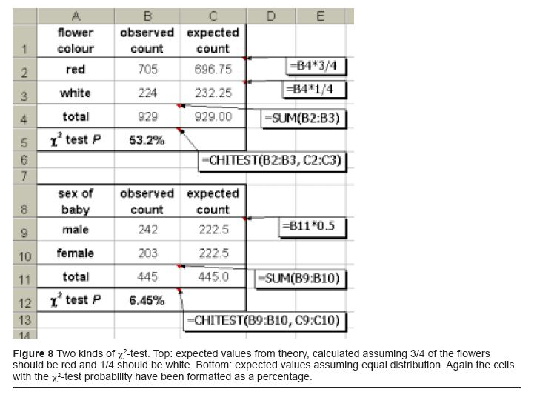

Slide 56
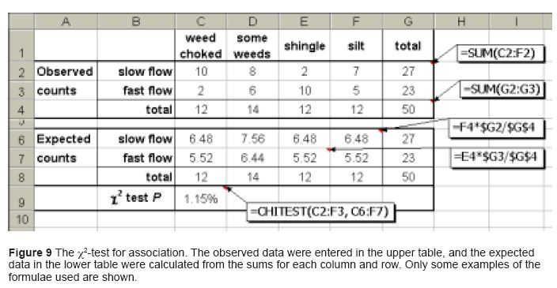

Slide 57
Conclusion
Simple descriptive statistics and graphs are required at Business and Marketing research level, while some of the association, comparative, frequency statistics and statistical test sometimes also required.
Microsoft Excel is a simple tool for conducting these tests.
The important skills are to choose the appropriate test, apply it correctly, and interpret the result correctly.

Slide 58
Summary of This Session
Statistics in Business research
Which test to use when and how to interpret chart
Descriptive statistics mean, median, mode, standard deviation, standard error, confidence interval
Graphing data scatter graphs, bar graphs, error bars, lines
Association statistics Pearson coefficient, Spearman coefficient, linear regression
Comparative statistics paired and unpaired t-test, Mann-Whitney U-test, ANOVA
Frequency statistics , χ2-test, χ2-test of association

Slide 59
Thank You

