Slide 1
MGT-491
QUANTITATIVE ANALYSIS AND RESEARCH FOR MANAGEMENT
Session 26
OSMAN BIN SAIF

Slide 2
Summary of Last Session
Between Distributions
- Chi-square for goodness of fit
- Chi-square for independence
• Between Variances
- F-Test – P

Slide 3
The DATA used in this session
Most of the examples in this session will use a data about, high school and beyond. This data file contains 200 observations from a sample of high school students with demographic information about the students, such as their gender (female), socio-economic status (ses) and ethnic background (race). It also contains a number of scores on standardized tests, including tests of reading (read), writing (write), mathematics (math) and social studies (socst).

Slide 4
one sample t-test
A one sample t-test allows us to test whether a sample mean (of a normally distributed interval variable) significantly differs from a hypothesized value. For example, say we wish to test whether the average writing score (write) differs significantly from 50.

Slide 5
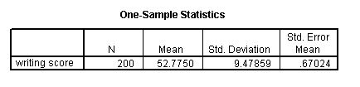
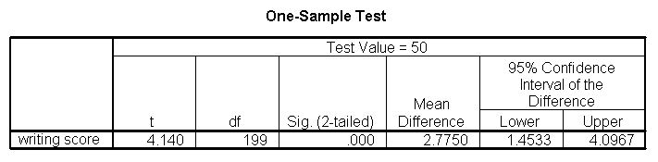

Slide 6
RESULT-Interpretation
The mean of the variable write for this particular sample of students is 52.775, which is statistically significantly different from the test value of 50. We would conclude that this group of students has a significantly higher mean on the writing test than 50.

Slide 7
one sample median
A one sample median test allows us to test whether a sample median differs significantly from a hypothesized value. We will use the same variable, write, as we did in the one sample t-test example, but we do not need to assume that it is interval and normally distributed (we only need to assume that write is an ordinal variable).

Slide 8
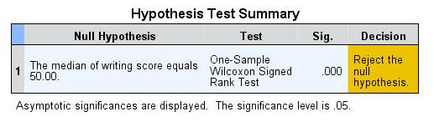
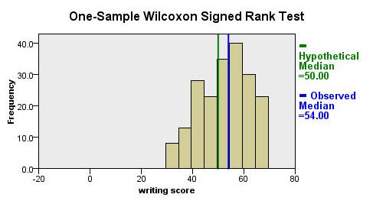

Slide 9
Binomial test
A one sample binomial test allows us to test whether the proportion of successes on a two-level categorical dependent variable significantly differs from a hypothesized value. For example, say we wish to test whether the proportion of females (female) differs significantly from 50%, i.e., from .5.

Slide 10
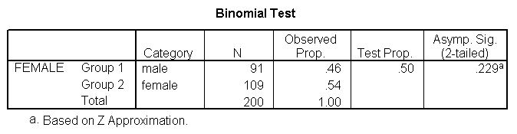

Slide 11
RESULT-Interpretation
The results indicate that there is no statistically significant difference (p = .229). In other words, the proportion of females in this sample does not significantly differ from the hypothesized value of 50%.

Slide 12
chi-square goodness of fit test
A chi-square goodness of fit test allows us to test whether the observed proportions for a categorical variable differ from hypothesized proportions. For example, let's suppose that we believe that the general population consists of 10% Hispanic, 10% Asian, 10% African American and 70% White folks. We want to test whether the observed proportions from our sample differ significantly from these hypothesized proportions

Slide 13
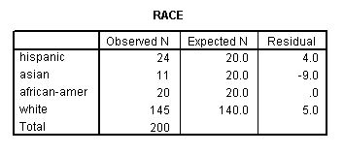
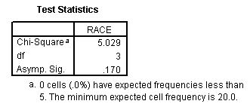

Slide 14
RESULT-Interpretation
These results show that racial composition in our sample does not differ significantly from the hypothesized values that we supplied (chi-square with three degrees of freedom = 5.029, p = .170).

Slide 15
T test
An independent samples t-test is used when you want to compare the means of a normally distributed interval dependent variable for two independent groups. For example, say we wish to test whether the mean for write is the same for males and females.

Slide 16
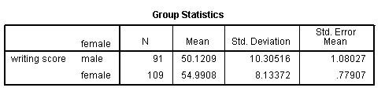
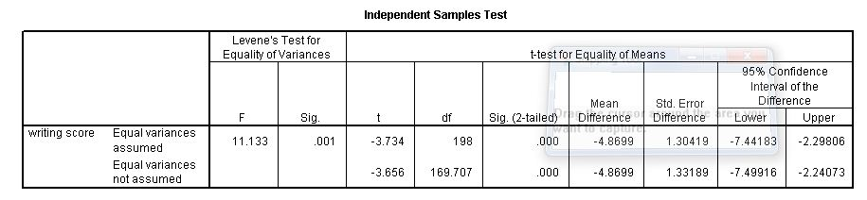

Slide 17
RESULT-Interpretation
Because the standard deviations for the two groups are similar (10.3 and 8.1), we will use the "equal variances assumed" test. The results indicate that there is a statistically significant difference between the mean writing score for males and females (t = -3.734, p = .000). In other words, females have a statistically significantly higher mean score on writing (54.99) than males (50.12).

Slide 18
A chi-square test
A chi-square test is used when you want to see if there is a relationship between two categorical variables.
let's see if there is a relationship between the type of school attended (schtyp) and students' gender (female).
Remember that the chi-square test assumes that the expected value for each cell is five or higher. This assumption is easily met in the examples below.

Slide 19
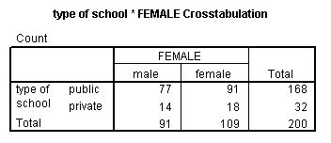
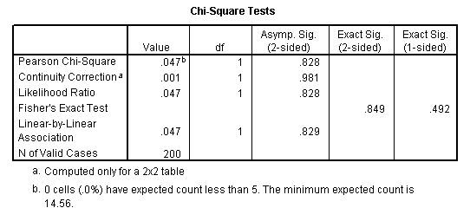

Slide 20
RESULT-Interpretation
These results indicate that there is no statistically significant relationship between the type of school attended and gender (chi-square with one degree of freedom = 0.047, p = 0.828).

Slide 21
RESULT-Interpretation
Let's look at another example, this time looking at the linear relationship between gender (female) and socio-economic status (ses). The point of this example is that one (or both) variables may have more than two levels, and that the variables do not have to have the same number of levels. In this example, female has two levels (male and female) and ses has three levels (low, medium and high).

Slide 22
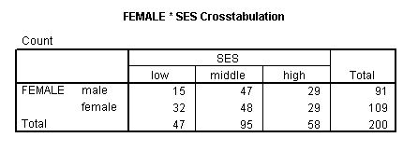
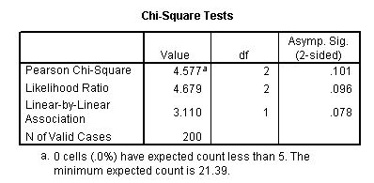

Slide 23
RESULT-Interpretation
Again we find that there is no statistically significant relationship between the variables (chi-square with two degrees of freedom = 4.577, p = 0.101).

Slide 24
ANOVA
A one-way analysis of variance (ANOVA) is used when you have a categorical independent variable (with two or more categories) and a normally distributed interval dependent variable and you wish to test for differences in the means of the dependent variable broken down by the levels of the independent variable. For example, say we wish to test whether the mean of write differs between the three program types (prog)

Slide 25
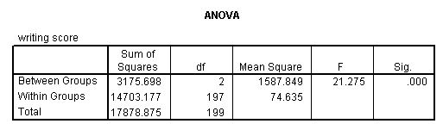
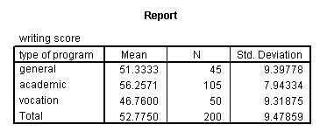

Slide 26
RESULT-Interpretation
From this we can see that the students in the academic program have the highest mean writing score, while students in the vocational program have the lowest.

Slide 27
The Kruskal Wallis test
The Kruskal Wallis test is used when you have one independent variable with two or more levels and an ordinal dependent variable. In other words, it is the non-parametric version of ANOVA and a generalized form of the Mann-Whitney test method since it permits two or more groups.
we will not assume that write is a normally distributed interval variable.

Slide 28
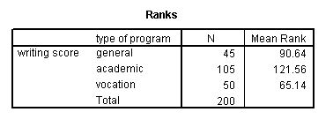
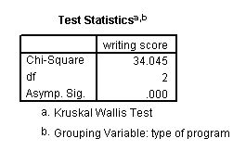

Slide 29
RESULT-Interpretation
If some of the scores receive tied ranks, then a correction factor is used, yielding a slightly different value of chi-squared. With or without ties, the results indicate that there is a statistically significant difference among the three type of programs

Slide 30
A paired (samples) t-test
A paired (samples) t-test is used when you have two related observations (i.e., two observations per subject) and you want to see if the means on these two normally distributed interval variables differ from one another. For example, we will test whether the mean of read is equal to the mean of write.

Slide 31
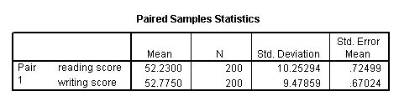
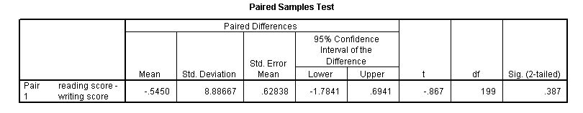

Slide 32
RESULT-Interpretation
These results indicate that the mean of read is not statistically significantly different from the mean of write (t = -0.867, p = 0.387).

Slide 33
The Wilcoxon signed rank sum test
The Wilcoxon signed rank sum test is the non-parametric version of a paired samples t-test. You use the Wilcoxon signed rank sum test when you do not wish to assume that the difference between the two variables is interval and normally distributed (but you do assume the difference is ordinal).
We will use the same example, but we will not assume that the difference between read and write is interval and normally distributed

Slide 34
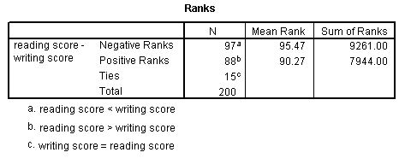
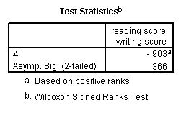

Slide 35
RESULT-Interpretation
The results suggest that there is not a statistically significant difference between read and write.
If you believe the differences between read and write were not ordinal but could merely be classified as positive and negative, then you may want to consider a sign test in lieu of sign rank test. Again, we will use the same variables in this example and assume that this difference is not ordinal.

Slide 36
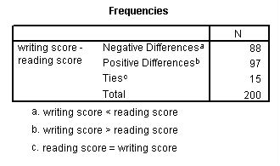
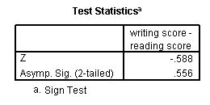

Slide 37
RESULT-Interpretation
We conclude that no statistically significant difference was found (p=.556).

Slide 38
Friedman test
You perform a Friedman test when you have one within-subjects independent variable with two or more levels and a dependent variable that is not interval and normally distributed (but at least ordinal). We will use this test to determine if there is a difference in the reading, writing and math scores. The null hypothesis in this test is that the distribution of the ranks of each type of score (i.e., reading, writing and math) are the same. To conduct a Friedman test, the data need to be in a long format. SPSS handles this for you, but in other statistical packages you will have to reshape the data before you can conduct this test.

Slide 39
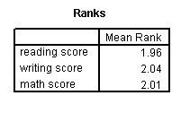
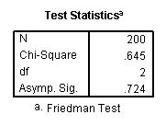

Slide 40
RESULT-Interpretation
Friedman's chi-square has a value of 0.645 and a p-value of 0.724 and is not statistically significant. Hence, there is no evidence that the distributions of the three types of scores are different

Slide 41
correlation
A correlation is useful when you want to see the relationship between two (or more) normally distributed interval variables. For example, we can run a correlation between two continuous variables, read and write.

Slide 42
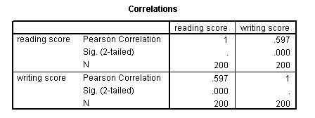

Slide 43
RESULT-Interpretation
In the example, we will run a correlation between a dichotomous variable, female, and a continuous variable, write. Although it is assumed that the variables are interval and normally distributed, we can include dummy variables when performing correlations.

Slide 44
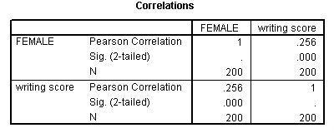

Slide 45
RESULT-Interpretation
In the first example above, we see that the correlation between read and write is 0.597. By squaring the correlation and then multiplying by 100, you can determine what percentage of the variability is shared. Let's round 0.597 to be 0.6, which when squared would be .36, multiplied by 100 would be 36%. Hence read shares about 36% of its variability with write. In the output for the second example, we can see the correlation between write and female is 0.256. Squaring this number yields .065536, meaning that female shares approximately 6.5% of its variability with write.

Slide 46
Simple linear regression
Simple linear regression allows us to look at the linear relationship between one normally distributed interval predictor and one normally distributed interval outcome variable. For example, say we wish to look at the relationship between writing scores (write) and reading scores (read); in other words, predicting write from read.

Slide 47
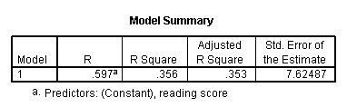
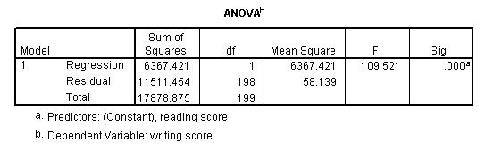

Slide 48
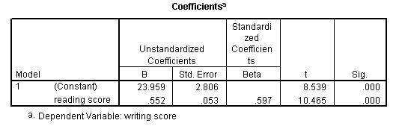

Slide 49
RESULT-Interpretation
We see that the relationship between write and read is positive (.552) and based on the t-value (10.47) and p-value (0.000), we would conclude this relationship is statistically significant. Hence, we would say there is a statistically significant positive linear relationship between reading and writing.

Slide 50
Levene’s Test for Equality (F-test)
This is a test that determines if the two conditions have about the same or different amounts of variability between scores. You will see two smaller columns labeled F and Sig. Look in the Sig. column. It will have one value. You will use this value to determine which row to read from. In this example, the value in the Sig. column is 0.26 (when rounded).

Slide 51
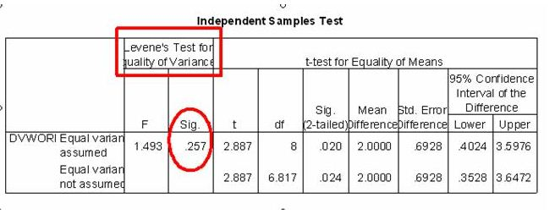

Slide 52
RESULT-Interpretation
A value greater than .05 means that the variability in your two conditions is about the same. That the scores in one condition do not vary too much more than the scores in your second condition. Put scientifically, it means that the variability in the two conditions is not significantly different. This is a good thing. In this example, the Sig. value is greater than .05.

Slide 53
Summary of This Session
One sample t test
One sample median
Binomial test
A chi square goodness of fit test
T test
Annova
Kruskal Wallis test
A paired sample t test
Wilcoxin rank sum test
Friedman test
Correlation
Regression
F- test

Slide 54
Thank You

