Slide 1
MGT-491
QUANTITATIVE ANALYSIS AND RESEARCH FOR MANAGEMENT
Session 25
OSMAN BIN SAIF

Slide 2
Summary of Last Session
Difference between means
  Descriptive statistics
  Distributions
  Frequency
  T sample test

Slide 3
Tests for Differences
• Between Means
- t-Test - P
- ANOVA - P
- Friedman Test
- Kruskal-Wallis Test
- Sign Test
- Rank Sum Test
• Between Distributions
- Chi-square for goodness of fit
- Chi-square for independence
• Between Variances
- F-Test – P
P – parametric tests

Slide 4
Differences Between Distributions
Chi square tests compare observed frequency distributions, either to theoretical expectations or to other observed frequency distributions.

Slide 5
Differences Between Distributions
E.g. The F2 generation of a cross between a round pea and a wrinkled pea produced 72 round individuals and 20 wrinkled individuals. Does this differ from the expected 3:1 round : wrinkled ratio of a simple dominant trait?
E
Frequency
E
Smooth
Wrinkled

Slide 6
Differences Between Distributions
E.g. 67 out of 100 seeds placed in plain water germinated while 36 out of 100 seeds placed in “acid rain” water germinated. Is there a difference in the germination rate?
Alternative Hypothesis
Null Hypothesis
Proportion
Germination
Proportion
Germination
Plain
Acid
Plain
Acid

Slide 7
Correlation
Correlations look for relationships between two variables which may not be functionally related. The variables may be ordinal, interval, or ratio scale data. Remember, correlation does not prove causation; thus there may not be a cause and effect relationship between the variables.
E.g. Do species of birds with longer wings also have longer necks?

Slide 8
Question – is there a relationship between students aptitude for mathemathics and for biology?
Student | Math score | Math Rank | Biol. score | Biology rank
1 | 57 | 3 | 83 | 7
2 | 45 | 1 | 37 | 1
3 | 72 | 7 | 41 | 2
4 | 78 | 8 | 84 | 8
5 | 53 | 2 | 56 | 3
6 | 63 | 5 | 85 | 9
7 | 86 | 9 | 77 | 6
8 | 98 | 10 | 87 | 10
9 | 59 | 4 | 70 | 5
10 | 71 | 6 | 59 | 4

Slide 9
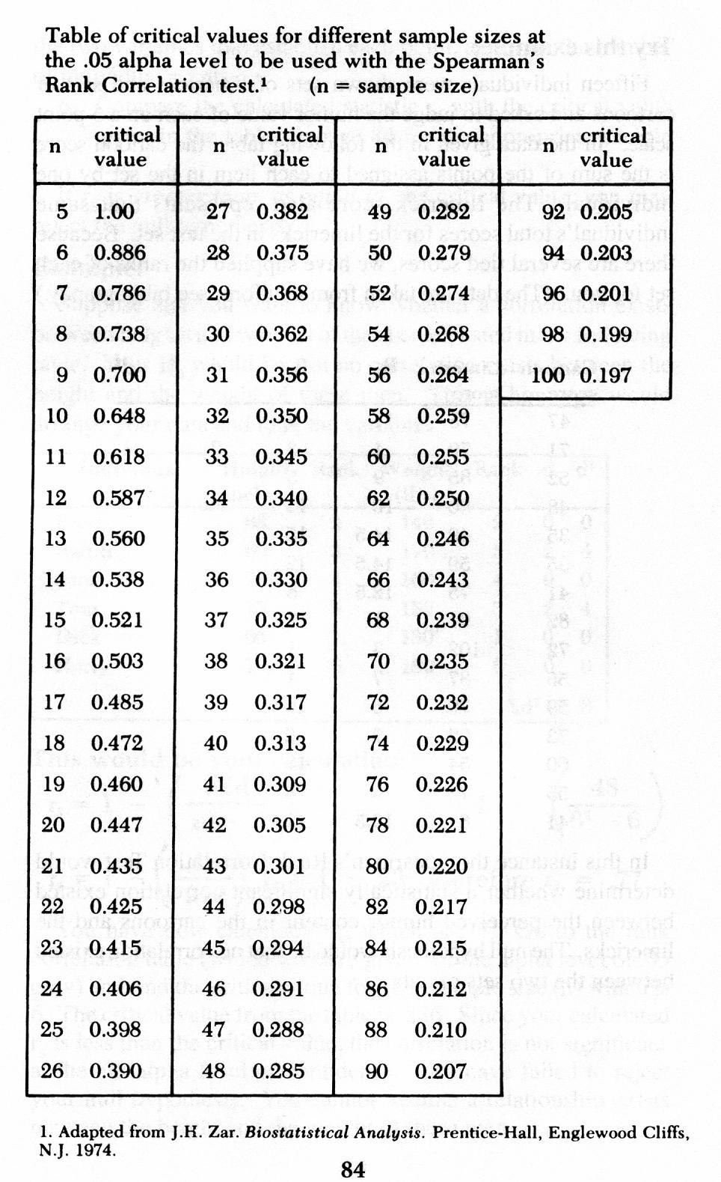

Slide 10
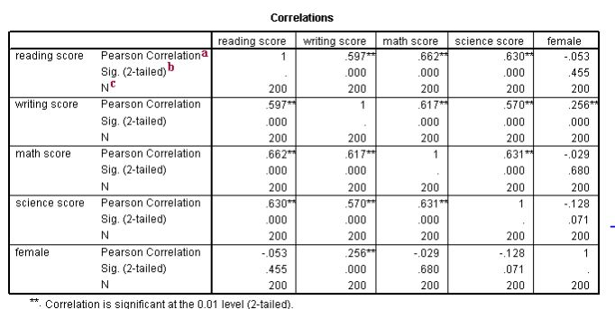

Slide 11
a. Pearson Correlation - These numbers measure the strength and direction of the linear relationship between the two variables. The correlation coefficient can range from -1 to +1, with -1 indicating a perfect negative correlation, +1 indicating a perfect positive correlation, and 0 indicating no correlation at all. (A variable correlated with itself will always have a correlation coefficient of 1.) You can think of the correlation coefficient as telling you the extent to which you can guess the value of one variable given a value of the other variable. The .597 is the numerical description of how tightly around the imaginary line the points lie. If the correlation was higher, the points would tend to be closer to the line; if it was smaller, they would tend to be further away from the line. Also note that, by definition, any variable correlated with itself has a correlation of 1.

Slide 12
b. Sig. (2-tailed) - This is the p-value associated with the correlation. The footnote under the correlation table explains what the single and double asterisks signify.
c. N - This is number of cases that was used in the correlation. Because we have no missing data in this data set, all correlations were based on all 200 cases in the data set. However, if some variables had missing values, the N's would be different for the different correlations.

Slide 13
Regression
Regressions look for functional relationships between two continuous variables. A regression assumes that a change in X causes a change in Y.
E.g. Does an increase in light intensity cause an increase in plant growth?

Slide 14
Regression
Looks for relationships between two continuous variables
Null Hypothesis
Alternative Hypothesis
Y
Y
X
X

Slide 15
Is there a relationship between wing length and tail length in songbirds?
wing length cm | tail length cm
10.4 | 7.4
10.8 | 7.6
11.1 | 7.9
10.2 | 7.2
10.3 | 7.4
10.2 | 7.1
10.7 | 7.4
10.5 | 7.2
10.8 | 7.8
11.2 | 7.7
10.6 | 7.8
11.4 | 8.3

Slide 16
Is there a relationship between age and systolic blood pressure?
Age (yr) | systolic blood pressure mm hg
30 | 108
30 | 110
30 | 106
40 | 125
40 | 120
40 | 118
40 | 119
50 | 132
50 | 137
50 | 134
60 | 148
60 | 151
60 | 146
60 | 147
60 | 144
70 | 162
70 | 156
70 | 164
70 | 158
70 | 159

Slide 17
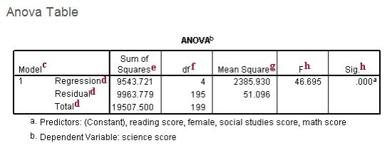

Slide 18
c. Model - SPSS allows you to specify multiple models in a single regression command. This tells you the number of the model being reported.
d. This is the source of variance, Regression, Residual and Total. The Total variance is partitioned into the variance which can be explained by the independent variables (Regression) and the variance which is not explained by the independent variables (Residual, sometimes called Error). Note that the Sums of Squares for the Regression and Residual add up to the Total, reflecting the fact that the Total is partitioned into Regression and Residual variance.

Slide 19
e. Sum of Squares - These are the Sum of Squares associated with the three sources of variance, Total, Model and Residual. These can be computed in many ways. Another way to think of this is the Regression is Total - Residual. Note that the Total = Regression + Residual. Note that Regression / Total is equal to .489, the value of R-Square. This is because R-Square is the proportion of the variance explained by the independent variables, hence can be computed by Regression / Total.

Slide 20
f. df - These are the degrees of freedom associated with the sources of variance. The total variance has N-1 degrees of freedom. In this case, there were N=200 students, so the DF for total is 199. The model degrees of freedom corresponds to the number of predictors minus 1 (K-1). You may think this would be 4-1 (since there were 4 independent variables in the model, math, female, socst and read). But, the intercept is automatically included in the model (unless you explicitly omit the intercept). Including the intercept, there are 5 predictors, so the model has 5-1=4 degrees of freedom. The Residual degrees of freedom is the DF total minus the DF model, 199 - 4 is 195.

Slide 21
g. Mean Square - These are the Mean Squares, the Sum of Squares divided by their respective DF. For the Regression, 9543.72074 / 4 = 2385.93019. For the Residual, 9963.77926 / 195 = 51.0963039. These are computed so you can compute the F ratio, dividing the Mean Square Regression by the Mean Square Residual to test the significance of the predictors in the model.

Slide 22
F and Sig. - The F-value is the Mean Square Regression (2385.93019) divided by the Mean Square Residual (51.0963039), yielding F=46.69. The p-value associated with this F value is very small (0.0000). These values are used to answer the question "Do the independent variables reliably predict the dependent variable?". The p-value is compared to your alpha level (typically 0.05) and, if smaller, you can conclude "Yes, the independent variables reliably predict the dependent variable".

Slide 23
You could say that the group of variables math, and female, socst and read can be used to reliably predict science (the dependent variable). If the p-value were greater than 0.05, you would say that the group of independent variables does not show a statistically significant relationship with the dependent variable, or that the group of independent variables does not reliably predict the dependent variable.

Slide 24
Note that this is an overall significance test assessing whether the group of independent variables when used together reliably predict the dependent variable, and does not address the ability of any of the particular independent variables to predict the dependent variable.

Slide 25
T-TEST INTERPRETATION
The Ns indicate how many participants are in each group (N stands for “number”). The bolded numbers in the first box indicate the GROUP MEANS for the dependent variable (in this case, GPA) for each group (0 is the No Preschool group, 1 is the Preschool Group).

Slide 26
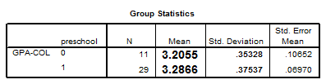

Slide 27
Now in the output TABLE, we can see the results for the T-test. Look at the enlarged numbers under the column that says “t” for the t-value, “df” for the degrees of freedom, and “Sig. (2-tailed) for the p-value. (Notice that the p-value of .539 is greater than our “.05” alpha level, so we fail to reject the null hypothesis. (if your p-value is very small (<.05), then you would reject the null hypothesis.

Slide 28
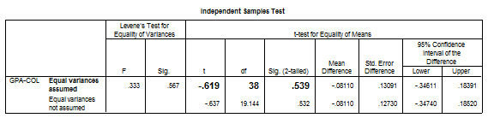
NOTE: Don’t be confused if your t-value is .619 (a positive number), this can happen simply by inputting the independent variable in reverse order.

Slide 29
If you were to have run the following analysis for a study, you could describe them in the results section as follows:
The mean College GPA of the Preschool group was 3.29 (SD = .38) and the mean College GPA of the No Preschool group was 3.21 (SD = .35). According to the t-test, we failed to reject the null hypothesis. There was not enough evidence to suggest a significant difference between the college GPAs of the two groups of students, t(38) = -.619, p > .05.

Slide 30
ANOVA INTERPRETATION (F-test)
The interpretation of the Analysis of Variance is much like that of the T-test. Here is an example of an ANOVA table for an analysis that was run to examine if there were differences in the mean number of hours worked by students in each ethnic Group. (IV = Ethnic Group, DV = # of hours worked per week)

Slide 31
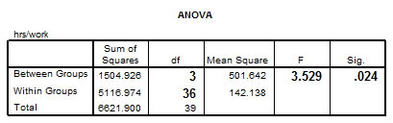

Slide 32
If you were to write this up in the results section, you could report the means for each group (by running Descriptives – see the first Lab for these procedures). Then you could report the actual results of the Analysis of Variance.
According to the Analysis of Variance, there were significant differences between the ethnic groups in the mean number of hours worked per week F(3, 36) = 3.53 p < .05.

Slide 33
Summary of This Session
Between Distributions
- Chi-square for goodness of fit
- Chi-square for independence
• Between Variances
- F-Test – P

Slide 34
Thank You

