Slide 1
MGT-491
QUANTITATIVE ANALYSIS AND RESEARCH FOR MANAGEMENT
Session 24
OSMAN BIN SAIF

Slide 2
Summary of Last Session
Designing a research Project
Basic statistical concepts and definitions
Hypothesis , Basics concepts concerning Hypothesis testing
Critical procedure for Hypothesis testing
Research Process
Organizing statistical tests
Inferential Statistics
  Parametric and non parametric testing

Slide 3
Tests for Differences
• Between Means
- t-Test - P
- ANOVA - P
- Friedman Test
- Kruskal-Wallis Test
- Sign Test
- Rank Sum Test
• Between Distributions
- Chi-square for goodness of fit
- Chi-square for independence
• Between Variances
- F-Test – P
P – parametric tests

Slide 4
Differences Between Means
Asks whether samples come from populations with different means
Null Hypothesis
Alternative Hypothesis
Y
Y
A
B
C
A
B
C
There are different tests if you have 2 vs more than 2 samples

Slide 5
Differences Between Means – Parametric Data
t-Tests compare the means of two parametric samples
E.g. Is there a difference in the mean height of men and women?

Slide 6
A researcher compared the height of plants grown in high and low light levels. Her results are shown below. Use a T-test to determine whether there is a statistically significant difference in the heights of the two groups

Slide 7
Example
The data used in these examples were collected on 200 high schools students and are scores on various tests, including science, math, reading and social studies (socst). The variable female is a dichotomous variable coded 1 if the student was female and 0 if male

Slide 8
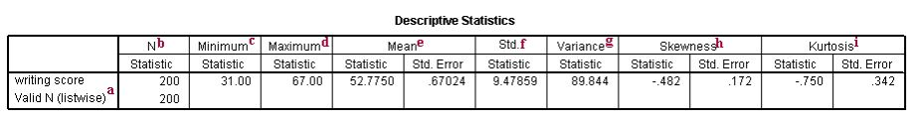

Slide 9
Explanation
Valid N (listwise) - This is the number of non-missing values.
N - This is the number of valid observations for the variable. The total number of observations is the sum of N and the number of missing values.
Minimum - This is the minimum, or smallest, value of the variable.
Maximum - This is the maximum, or largest, value of the variable.

Slide 10
Explanation (Contd.)
Mean - This is the arithmetic mean across the observations. It is the most widely used measure of central tendency. It is commonly called the average. The mean is sensitive to extremely large or small values.
Std. - Standard deviation is the square root of the variance. It measures the spread of a set of observations. The larger the standard deviation is, the more spread out the observations are.

Slide 11
Explanation (Contd.)
Variance - The variance is a measure of variability. It is the sum of the squared distances of data value from the mean divided by the variance divisor. The Corrected SS is the sum of squared distances of data value from the mean. Therefore, the variance is the corrected SS divided by N-1. We don't generally use variance as an index of spread because it is in squared units. Instead, we use standard deviation.

Slide 12
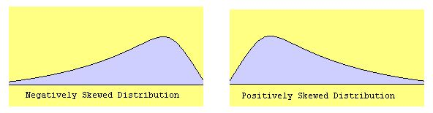
Explanation (Contd.)

Slide 13
Explanation (Contd.)
Skewness - Skewness measures the degree and direction of asymmetry. A symmetric distribution such as a normal distribution has a skewness of 0, and a distribution that is skewed to the left, e.g. when the mean is less than the median, has a negative skewness.

Slide 14
Explanation (Contd.)
Kurtosis - Kurtosis is a measure of the heaviness of the tails of a distribution. A normal distribution has kurtosis 0. Extremely non-normal distributions may have high positive or negative kurtosis values, while nearly normal distributions will have kurtosis values close to 0. Kurtosis is positive if the tails are "heavier" than for a normal distribution and negative if the tails are "lighter" than for a normal distribution

Slide 15
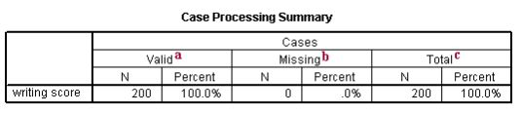
Table 2- Summary

Slide 16
Explanation
Valid - This refers to the non-missing cases. In this column, the N is given, which is the number of non-missing cases; and the Percent is given, which is the percent of non-missing cases.
Missing - This refers to the missing cases. In this column, the N is given, which is the number of missing cases; and the Percent is given, which is the percent of the missing cases.
Total - This refers to the total number cases, both non-missing and missing. In this column, the N is given, which is the total number of cases in the data set; and the Percent is given, which is the total percent of cases in the data set.

Slide 17
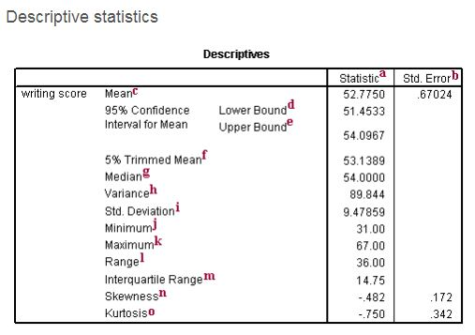
Table 3- Descriptive Statistics

Slide 18
Explanation (Contd.)
Statistic - These are the descriptive statistics.
Std. Error - These are the standard errors for the descriptive statistics. The standard error gives some idea about the variability possible in the statistic.
Mean - This is the arithmetic mean across the observations. It is the most widely used measure of central tendency. It is commonly called the average. The mean is sensitive to extremely large or small values.

Slide 19
Explanation (Contd.)
95% Confidence Interval for Mean Lower Bound - This is the lower (95%) confidence limit for the mean. If we repeatedly drew samples of 200 students' writing test scores and calculated the mean for each sample, we would expect that 95% of them would fall between the lower and the upper 95% confidence limits. This gives you some idea about the variability of the estimate of the true population mean.

Slide 20
Explanation (Contd.)
95% Confidence Interval for Mean Upper Bound - This is the upper (95%) confidence limit for the mean.
5% Trimmed Mean - This is the mean that would be obtained if the lower and upper 5% of values of the variable were deleted. If the value of the 5% trimmed mean is very different from the mean, this indicates that there are some outliers. However, you cannot assume that all outliers have been removed from the trimmed mean.

Slide 21
Explanation (Contd.)
Median - The median splits the distribution such that half of all values are above this value, and half are below.
Variance - The variance is a measure of variability. It is the sum of the squared distances of data value from the mean divided by the variance divisor. The Corrected SS is the sum of squared distances of data value from the mean. Therefore, the variance is the corrected SS divided by N-1. We don't generally use variance as an index of spread because it is in squared units. Instead, we use standard deviation.

Slide 22
Explanation (Contd.)
St. Deviation - Standard deviation is the square root of the variance. It measures the spread of a set of observations. The larger the standard deviation is, the more spread out the observations are.
Minimum - This is the minimum, or smallest, value of the variable.
Maximum - This is the maximum, or largest, value of the variable.
Range - The range is a measure of the spread of a variable. It is equal to the difference between the largest and the smallest observations. It is easy to compute and easy to understand. However, it is very insensitive to variability.

Slide 23
Explanation (Contd.)
Interquartile Range - The interquartile range is the difference between the upper and the lower quartiles. It measures the spread of a data set. It is robust to extreme observations.
Skewness - Skewness measures the degree and direction of asymmetry. A symmetric distribution such as a normal distribution has a skewness of 0, and a distribution that is skewed to the left, e.g. when the mean is less than the median, has a negative skewness.

Slide 24
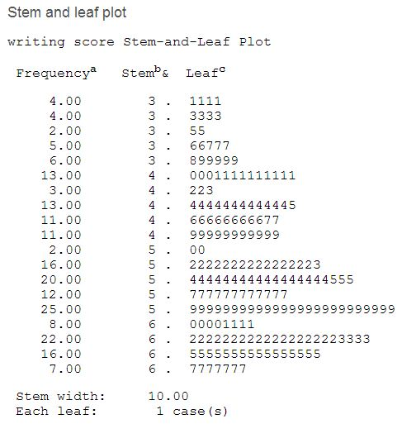
Table 4- Frequency

Slide 25
Explanation (Contd.)
Frequency - This is the frequency of the leaves.
Stem - It is the number in the 10s place of the value of the variable. For example, in the first line, the stem is 3 and leaves are 1. The value of the variable is 31. The 3 is in the 10s place, so it is the stem.
Leaf - It is the number in the 1s place of the value of the variable. The number of leaves tells you how many of these numbers is in the variable. For example, on the fifth line, there is one 8 and five 9s (hence, the frequency is six). This means that there is one value of 38 and five values of 39 in the variable write

Slide 26
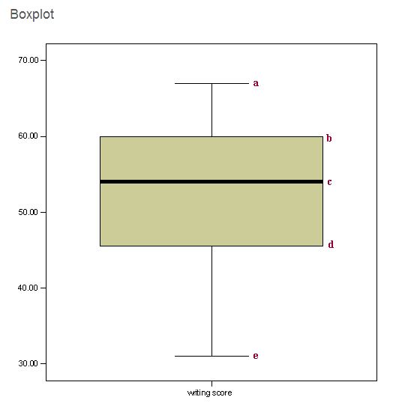
Explanation (Contd.)

Slide 27
Explanation (Contd.)
a. This is the maximum score unless there are values more than 1.5 times the interquartile range above Q3, in which, it is the third quartile plus 1.5 times the interquartile range (the difference between the first and the third quartile).
b. This is the third quartile (Q3), also known as the 75th percentile.
c. This is the median (Q2), also known as the 50th percentile.
d. This is the first quartile (Q1), also known as the 25th percentile.
e. This is the minimum score unless there are values less than 1.5 times the interquartile range below Q1, in which case, it is the first quartile minus 1.5 times the interquartile range.

Slide 28
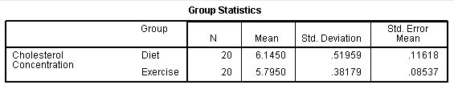
Table 5- Group Statistics

Slide 29
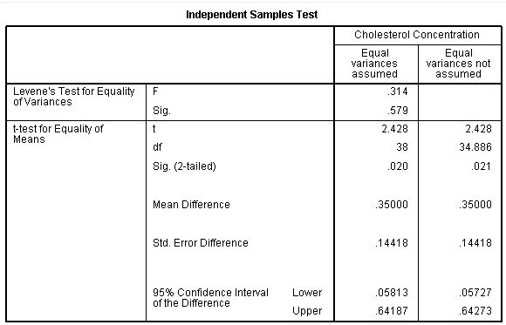
Table 6- Sample Test

Slide 30
Explanation (Contd.)
We can see that the group means are significantly different as the value in the "Sig. (2-tailed)" row is less than 0.05. Looking at the Group Statistics table, we can see that those people that undertook the exercise trial had lower cholesterol levels at the end of the programme than those that underwent a calorie-controlled diet
This study found that overweight, physically inactive male participants had statistically significantly lower cholesterol concentrations (5.80 ± 0.38 mmol/L) at the end of an exercise-training programme vs. after a calorie-controlled diet (6.15 ± 0.52 mmol/L), t(38) = 2.428, p = 0.020.

Slide 31
Differences Between Means – Parametric Data
ANOVA (Analysis of Variance) compares the means of two or more parametric samples.
E.g. Is there a difference in the mean height of plants grown under red, green and blue light?

Slide 32
A researcher fed cows on four different foods. At the end
of a month feeding, he weighed the cows. Use an ANOVA
test to determine if the different foods resulted in
differences in growth of the cows.
weight of cows fed different foods
food 1 | food 2 | food 3 | food 4
60.8 | 68.7 | 102.6 | 87.9
57.0 | 67.7 | 102.1 | 84.2
65.0 | 74.0 | 100.2 | 83.1
58.6 | 66.3 | 96.5 | 85.7
61.7 | 69.8 |  | 90.3

Slide 33
Differences Between Means – Non-Parametric Data
The Sign Test compares the means of two “paired”, non-parametric samples
E.g. Is there a difference in the gill withdrawal response of Aplysia in night versus day? Each subject has been tested once at night and once during the day –> paired data.

Slide 34
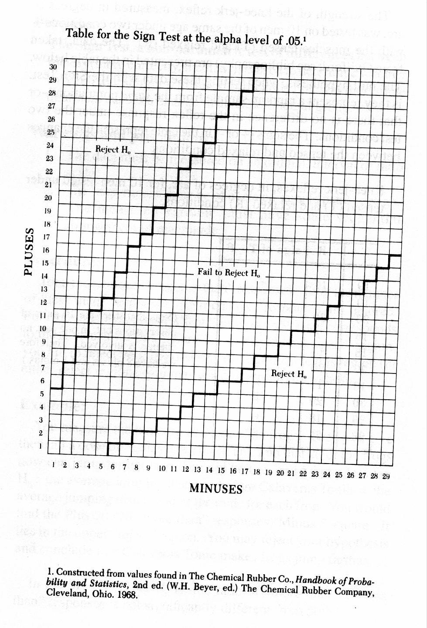

Slide 35
Differences Between Means – Non-Parametric Data
The Friedman Test is like the Sign test, (compares the means of “paired”, non-parametric samples) for more than two samples.
E.g. Is there a difference in the gill withdrawal response of Aplysia between morning, afternoon and evening? Each subject has been tested once during each time period –> paired data

Slide 36
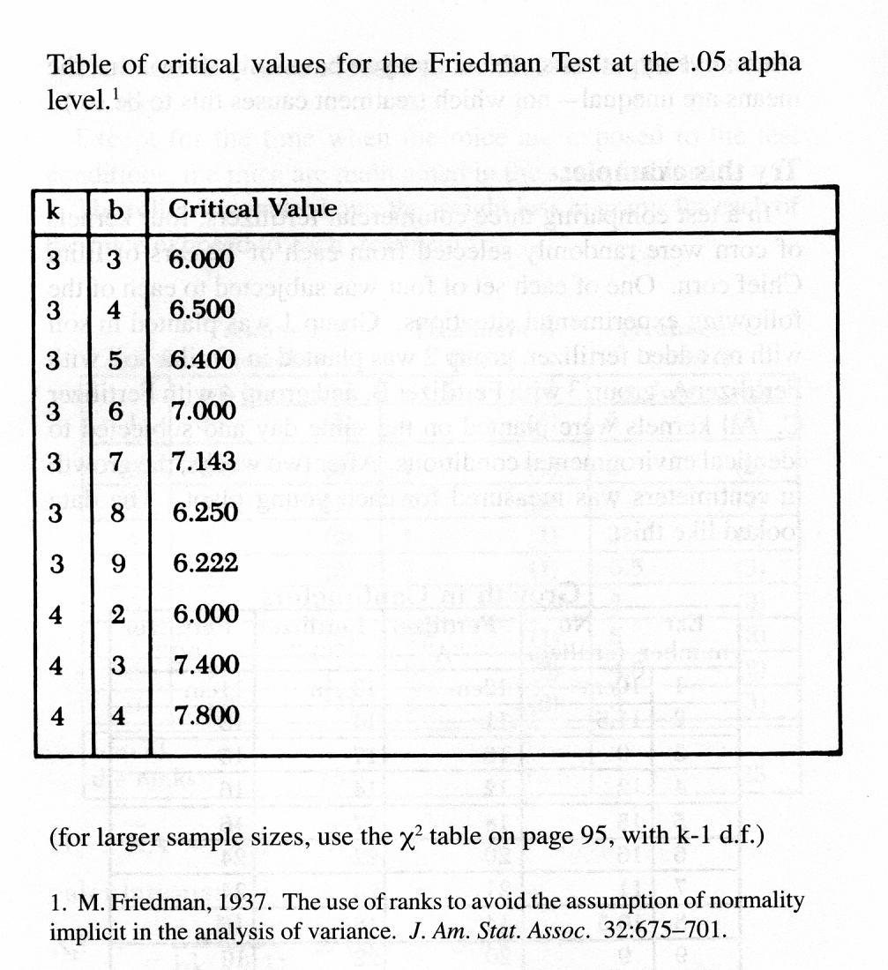

Slide 37
Differences Between Means – Non-Parametric Data
The Rank Sum test compares the means of two non-parametric samples
E.g. Is there a difference in the gill withdrawal response of Aplysia in night versus day? Each subject has been tested once, either during the night or during the day –> unpaired data.

Slide 38
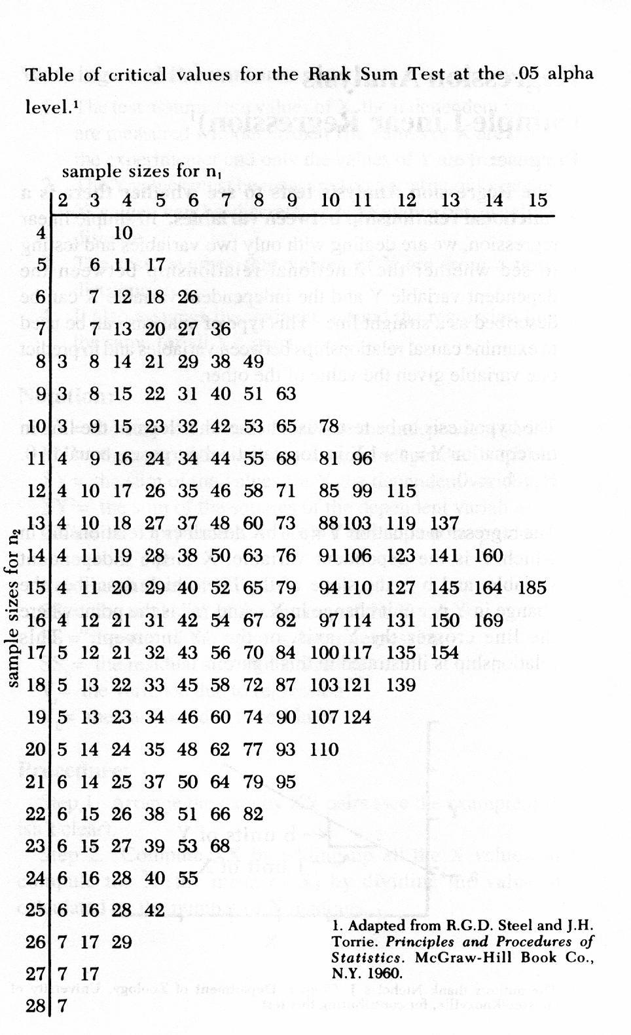

Slide 39
Differences Between Means – Non-Parametric Data
The Kruskal-Wallis Test compares the means of more than two non-parametric, non-paired samples
E.g. Is there a difference in the gill withdrawal response of Aplysia in night versus day? Each subject has been tested once, either during the morning, afternoon or evening –> unpaired data.

Slide 40
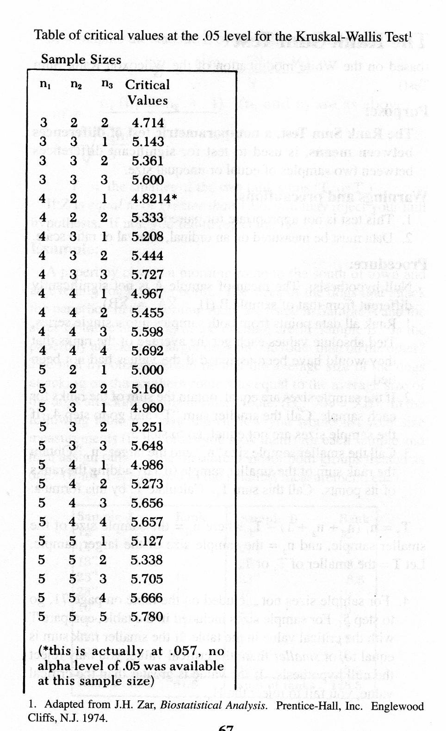

Slide 41
Summary of This Session
Difference between means
  Descriptive statistics
  Distributions
  Case Processing Summary
  Frequency
  T sample test

Slide 42
Thank You

