Slide 1
MGT-491
QUANTITATIVE ANALYSIS AND RESEARCH FOR MANAGEMENT
Session 23
OSMAN BIN SAIF

Slide 2
Summary of This Session
Simple Linear Regression
Correlation
Comparison of Both

Slide 3
Designing a research project
Empirical Questions (what do we want to know?)
Statistical Considerations (analysing the data?)
How the Process Works:
World
Abstraction
Theory
Systematic
Observation &
Experimentation
Revision
Derivation
Data
Interpretation
Empirical
Hypotheses

Slide 4
Statistical definitions
Descriptive statistics –
  procedures to summarise, organise and simplify data
Inferential statistics
  techniques to study samples and make generalisations about the population
Sampling error
  discrepancy between a sample statistic and the population parameter

Slide 5
Hypothesis
A hypothesis is a proposed explanation for a phenomenon. It is defined as a proposition or a set of proposition forth as an explanation for the occurrence of some specified group of phenomenon either asserted merely as a provisional conjecture to guide some investigation or accepted as highly probable in the light of established facts

Slide 6
Characteristics of Hypothesis
Should be CLEAR and PRECISE
Should be stated as far as possible in most SIMPLE TERMS
Should be CONSISTENT with most known facts

Slide 7
Basic Concept concerning Testing of Hypothesis
Null Hypothesis
It expresses no difference that the population mean is equal to the hypothesized mean
Alternative Hypothesis
That the population mean is not equal to hypothesized mean, it may be more or less.

Slide 8
Basic Concept concerning Testing of Hypothesis
Level of significance;
  The probability level below which we reject the hypothesis is known as the level of significance.
  In general we use two critical regions which cover 5% and 1% areas of the normal curve.

Slide 9
Basic Concept concerning Testing of Hypothesis
Type of Errors
Type I Error a: Type II Error b:
Your Statistical decision | True state of null hypothesis
 | Ho TRUE | Ho FALSE
Reject Ho | Type I Error (a) | Correct
Do not Reject Ho | Correct | Type II Error (b)

Slide 10
Basic Concept concerning Testing of Hypothesis
Two tailed
  In a double tailed test, the areas of both the tails of the curve represents the sampling distribution
One tailed tests
  Where as in the single tail test only the area on the right of an ordinate is taken into consideration.

Slide 11
Critical procedure for Hypothesis Testing
State Ho as well as Ha
Specify the level of significance (or the p value)
Decide the correct sampling distribution
Sample a random sample and work out an appropriate value
Calculate the probability that sample result would diverge as widely as it has from expectation

Slide 12
Critical procedure for Hypothesis Testing
Is the probability equal to or smaller than a value in case of one tail test
YES
Reject
Is the probability equal to or smaller than a value in case of two tail test
NO
Accept

Slide 13
Research Process
(i) identify research questions,
(ii) design study,
(iii) collect data from sample,
(iv) use descriptive stats,
(v) use inferential stats,
(vi) discuss results

Slide 14
Organising statistical tests
Organising by type of research question
Major division:
1) Relationships between variables:
  Examples: correlation; regression.
2) Discrimination between Variables:
  i.e. Testing for differences between groups or treatments
  Examples: t-test; Analysis of Variance (ANOVA).

Slide 15
Organising statistical tests
2. Organising by type of test
Major division: Parametric vs non-parametric tests
Parametric tests are based on assumptions about the distribution of measures in the population. A normal (Gaussian) distribution is usually assumed.
Parametric tests are powerful but can be abused: e.g. when data don’t meet the underlying assumptions of tests.

Slide 16
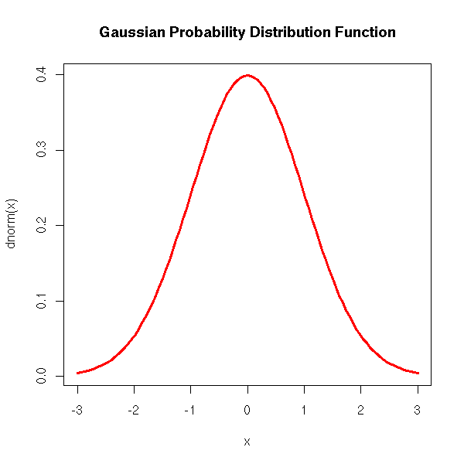

Slide 17
Organising statistical tests
2. Organising by type of test
Non-parametric tests do not make assumptions about population distributions (also called distribution free tests).
Lower in power and less flexible than parametric tests.
Recommendation:
Use parametric tests whenever possible.

Slide 18
Organising statistical tests
3. Organising by type of research design used
Major division: Experimental vs survey design
In Experimental research, the experimenter manipulates IVs and records effects on DVs.
IVs are stimulus variables and DVs are response variables.
Survey research is concerned either with relationships between variables or whether IVs predict variation in DVs.
Hypothesis testing and the Experimental/Survey distinction
  Experimental Research is (mostly) directly hypothesis driven.
  Survey Research may or may not be driven by explicit hypotheses
  In practice, studies may involve a mixture of both types of research…

Slide 19
Independent (IV) vs dependent (DV) variables
Independent Variables (IVs) are:
Experimental treatments (e.g. drug vs. placebo) or
Properties of groups of participants (e.g. gender, occupation).
Dependent Variables (DVs) are response or outcome measures.
An underlying causal model:
IVs assumed either to cause or predict variation in DVs.
  IVs are assumed to cause variation when IV is an explicit manipulation (e.g. drug causes memory deficit).
  IVs assumed to predict when not under direct experimental control (e.g. gender differences in hazard perception.)

Slide 20
Levels of measurement (the traditional classification)
Nominal Scales: values identify categories but magnitudes have no meaning (e.g. gender, nationality).
Ordinal Scales: values allow rank ordering but intervals between scale points may be unequal (e.g. occupational levels, university hierarchy).
Interval Scale: measures are continuous with equal intervals between points; arbitrary zero point (e.g. Fahrenheit vs. Celsius temperature).
Ratio Scale: has all the properties of Interval data but also has true zero point (e.g. reaction time; Kelvin temperature).

Slide 21
A simpler classification: Continuous vs Discrete variables
1) Continuous Variables:
  Vary (reasonably) smoothly across their range.
  Measured value of the variable proportional to the amount of the quantity being measured (e.g. GSR; Reaction Time).
2) Discrete Variables:
  Take a limited number of values.
  Often used to represent Categories (e.g. Gender, Nationality).
  Although numerically coded, value does not necessarily represent amount or importance of variable.
  Dichotomous Variables take 2 values (e.g. Female vs. Male or Young vs. Old).
N.B.: continuous variables can be reduced to discrete variables (but with loss of statistical power).

Slide 22
Data Analysis
Statistics - a powerful tool for analyzing data
1. Descriptive Statistics - provide an overview
of the attributes of a data set. These include
measurements of central tendency (frequency
histograms, mean, median, & mode) and
dispersion (range, variance & standard
deviation)
2. Inferential Statistics - provide measures of how
well your data support your hypothesis and if
your data are generalizable beyond what was
tested (significance tests)

Slide 23
Inferential Statistics

Slide 24
The Population: μ=5.314
Population size = 500

Slide 25
The Population: μ=5.314
The Sample: 7, 6, 4, 9, 8, 3, 2, 6, 1
mean = 5.111

Slide 26
The Population: μ=5.314
The Sample: 1, 5, 8, 7, 4, 1, 6, 6
mean = 4.75

Slide 27
Parametric or Non-parametric?
•Parametric tests are restricted to data that:
1) show a normal distribution
2) * are independent of one another
3) * are on the same continuous scale of measurement
•Non-parametric tests are used on data that:
1) show an other-than normal distribution
2) are dependent or conditional on one another
3) in general, do not have a continuous scale of
measurement
e.g., the length and weight of something –> parametric
vs.
did the bacteria grow or not grow –> non-parametric

Slide 28
Parametric Test
Z-test;
  Based on normal probability distribution and is used for judging the significance of several statistical measures, particularly the mean, mode and coefficient of correlation.

Slide 29
Parametric Test
T-Test;
  Based on t- distribution and is considered an appropriate test for judging the significance of a sample mean or difference between the means of two sample.

Slide 30
Parametric Test
Chi-square distribution;
  As a parametric test is used for comparing a sample variance to a theoretical population variance.

Slide 31
Parametric Test
F-test;
Is used to compare the variance of the two independent samples.

Slide 32
Non-Parametric Test
Sign Test;
  Test of Hypothesis concerning some single value for the given data.

Slide 33
Non-Parametric Test
Fisher-Irwin Test;
  Test of hypothesis concerning no difference among two or more sets of data.

Slide 34
Non-Parametric Test
Kendall’s Coefficient or Concordance Test;
  To test relationship between variables

Slide 35
Non-Parametric Test
Kruskal-Wallis test or ANNOVA;
  Concerning variations in the given data.

Slide 36
Non-Parametric Test
Chi-square test;
  To determine if categorical data shows dependency or if the classifications are independent.

Slide 37
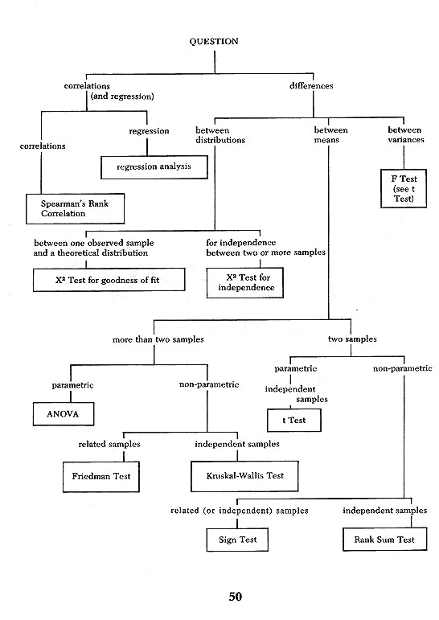

Slide 38
Summary Table of Statistical Tests
Level of Measurement
Sample Characteristics
Correlation
1 Sample
2 Sample
K Sample (i.e., >2)
Independent
Dependent
Independent
Dependent
Categorical or Nominal
Χ² or bi-nomial
Χ²
Macnarmar’s Χ²
Χ²
Cochran’s Q
Rank or Ordinal
Mann Whitney U
Wilcoxin Matched Pairs Signed Ranks
Kruskal Wallis H
Friendman’s ANOVA
Spearman’s rho
Parametric (Interval & Ratio)
z test or t test
t test between groups
t test within groups
1 way ANOVA between groups
1 way ANOVA (within or repeated measure)
Pearson’s r
Factorial (2 way) ANOVA

Slide 39
Summary of This Session
Designing a research Project
Basic statistical concepts and definitions
Hypothesis , Basics concepts concerning Hypothesis testing
Critical procedure for Hypothesis testing
Research Process
Organizing statistical tests
Inferential Statistics
  Parametric and non parametric testing

Slide 40
Thank You

