Slide 1
MGT-491
QUANTITATIVE ANALYSIS AND RESEARCH FOR MANAGEMENT
Session 22
OSMAN BIN SAIF

Slide 2
Summary of Last Session
Phi co-efficient
Cross tabulation in practice
Differences in Hypothesis testing
Parametric testing

Slide 3
SIMPLE LINEAR REGRESSION
In order to understand relationships of variable or factors to complex constructs such as productivity, motivation, social responsibility, and competitiveness, correlational studies are carried out.
Variables found to be related can be casual or associative.

Slide 4
SIMPLE LINEAR REGRESSION (Contd.)
When no association exists between a dependent variable (construct) and an independent variable, a causal study can be simplified by eliminating that particular variable.
This is the main advantage of studying an association.

Slide 5
SIMPLE LINEAR REGRESSION (Contd.)
Most constructs are complex variables and are multivariate in nature.
As a precursor to studying multivariate association, a bivariate association is studied and analyzed.

Slide 6
SIMPLE LINEAR REGRESSION (Contd.)
Bivariate association is useful in its own right for analysis of data, but it very often lays the foundation to a later more comprehensive multivariate study.

Slide 7
SIMPLE LINEAR REGRESSION (Contd.)
The direction of the relationship is not given by an analysis of association.
It has to be carefully obtained by the researcher using a substantive understanding of the problem and a good knowledge of the phenomena or related research developments.

Slide 8
SIMPLE LINEAR REGRESSION (Contd.)
Correlation ( or regression) analysis, as with any inferential study, is performed on a sample of data pertaining to the variables and the estimates of population measures are obtained in the usual methods of inferential statistics.

Slide 9
SIMPLE LINEAR REGRESSION (Contd.)
In general the relationship between the dependent variable Y and independent variable X can be expressed as;
Y= f (X)
The relationship may be causal or associative.
In most management research, it is typically hypothesized to be associative.

Slide 10
SIMPLE LINEAR REGRESSION (Contd.)
In a problem definition involving two variables, a researcher is usually faced with the questions of whether there is an association between them and, if so, what strength and functional form it has.
The form of relationship may be many in general and need to be approached in a variety of ways.

Slide 11
SIMPLE LINEAR REGRESSION (Contd.)
The form may be specified theoretically and tested statistically.
In most of the cases the form of relationship is assumed to be linear.

Slide 12
SIMPLE LINEAR REGRESSION (Contd.)
Simple correlations and simple regression are the two bivariate parametric measures of association.

Slide 13
CORRELATION
Correlation is the degree of association among variables in a set of data.
Statistically speaking simple correlation, measures a linear relationship between two variables.
Correlation does not imply that any one of variables causes the other.

Slide 14
CORRELATION(contd.)
Correlation analysis is closely related to regression analysis.
There is a misunderstanding about the relationship between correlation and causality.
Stating two variables are highly correlated does not necessarily mean that one of the variable causes the other.

Slide 15
CORRELATION(contd.)
Correlation coefficient(r)
Correlation coefficient(r) between two variables is the ratio of covariance of the two variables to corrections for the units in measurement and given by;
R= COVXY
SxSy
and is called Pearson Product Movement correlation coefficient. r lies between -1 and +1.

Slide 16
CORRELATION(contd.)
COVXY indicates how strongly x and y vary together and also gives the direction of relationship (positive or negative) SxSy, the standard deviations of x and y, and standardizes the value or r.

Slide 17
CORRELATION(contd.)
Coefficient of correlation is one of the many measures of association.
If the paired value of x and y fall on a straight line with a positive slope, then r=1.
If the line has a negative slope the r=-1.
If the points are scattered then r=0.
r lies between -1 and +1.

Slide 18
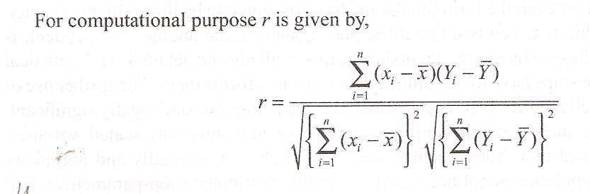
CORRELATION(contd.)

Slide 19
CORRELATION(contd.)
Scatter Diagram;
  This represents the plot of two variables on x – y coordinate axes and qualitatively gives the relationship.

Slide 20
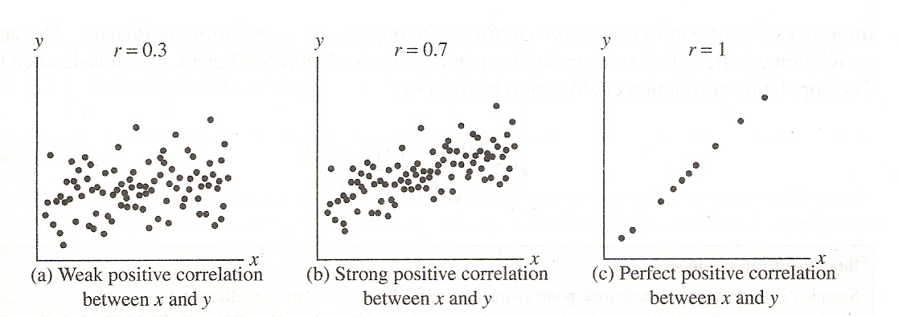

Slide 21
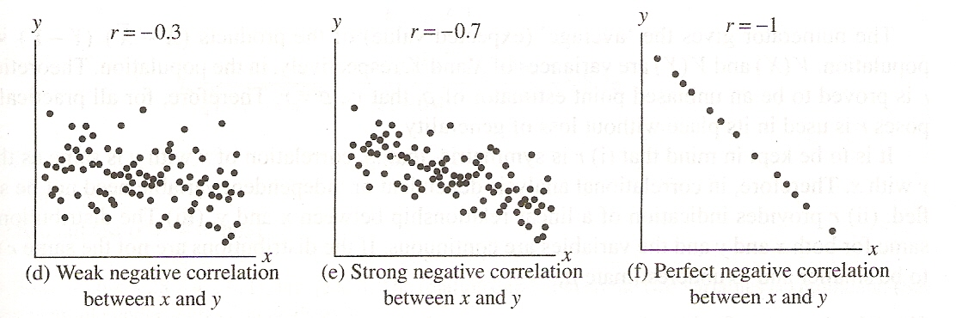

Slide 22
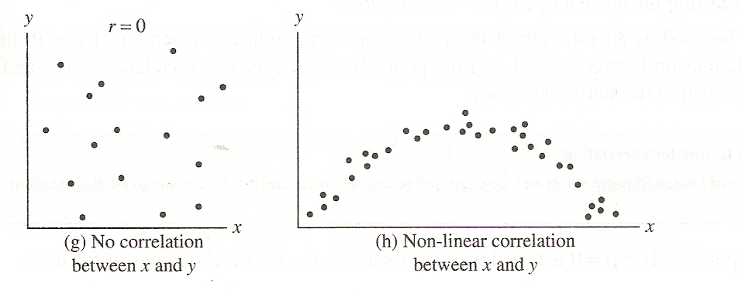

Slide 23
CORRELATION(contd.)
Inference from sample r
Sample r is theoretically an unbiased point estimator of population correlation coefficient p.
The sample correlation coefficient r has an analogous population correlation coefficient, which is denoted by p.

Slide 24
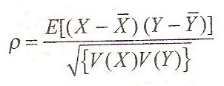
CORRELATION(contd.)
The population correlation coefficient is given by;

Slide 25
SIMPLE LINEAR REGRESSION MODEL
It is a mathematical way of stating the statistical relationship between two variables.

Slide 26
SIMPLE LINEAR REGRESSION MODEL (Contd.)
The two principal elements of statistical relationship are;
  The tendency of dependent variable Y to vary systematically with independent variable X.
  The scattering of points about the curve that represents the relationship between X and Y.

Slide 27
SIMPLE LINEAR REGRESSION MODEL (Contd.)
The two elements of statistical relationship are represented in a simple linear regression model by assuming that;
  There is a probability of distribution of Y for each value of X.
  The mean of the probability distribution of Y for each X falls on the line.

Slide 28
HETEROSCADISTICITY
This is a condition in regression where the scatter diagram about the regression line has a pattern indicating variations in the distributions of y for various values of x (the regression line is y=b_{o}+b₁) b is the regression coefficient.

Slide 29
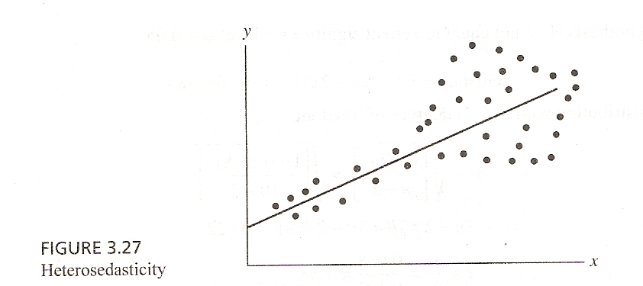

Slide 30
HETEROSCADISTICITY (Contd.)
It should be noted from the figure that the distance of points being homoscedastic i-e no clear pattern of the scatter diagram about the regression line.

Slide 31
SIMPLE LINEAR REGRESSION MODEL (Contd.)
The systematic way in which Y varies as a function of X is identified as a straight line or the regression line of Y on X.

Slide 32
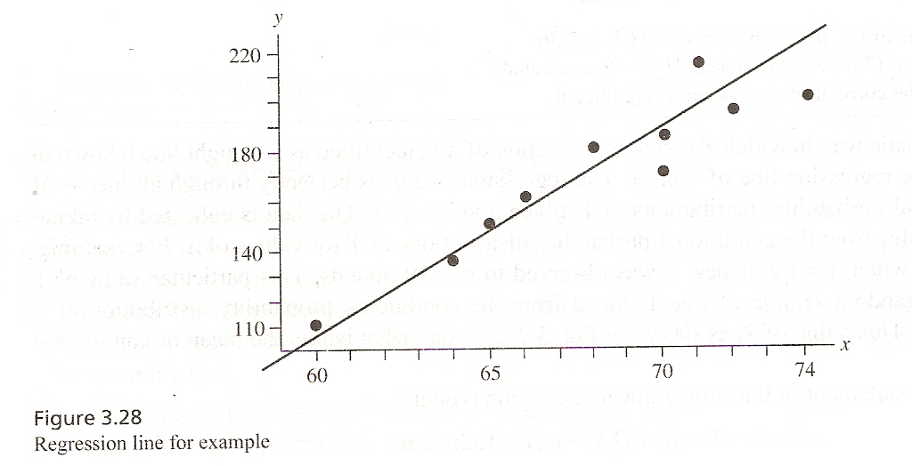

Slide 33
Coefficient of Determination R²
One measure of the strength of the linear relationship between X and Y is given by the coefficient of determination, R².
It gives the proportion of variability in the dependent variable Y, which is explained by the independent variable X through fitting of the regression line.

Slide 34
Coefficient of Determination R² (Contd.)
R² is a simple ratio of the amount of variation explained by the regression line to the total variation in Y, and the values of R² are bound between 0 and 1.

Slide 35
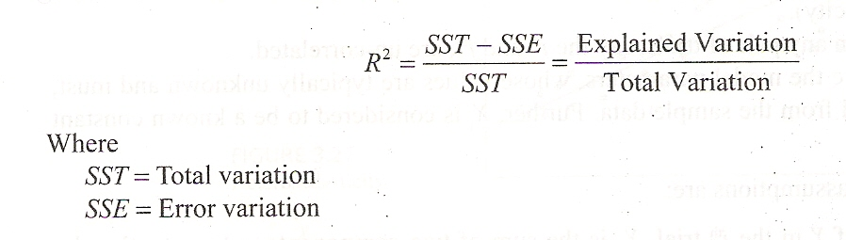
Coefficient of Determination R² (Contd.)

Slide 36
Coefficient of Determination R² (Contd.)
If R²=1 and Error variation=0, the observations fall perfectly on the fitted regression line.
If R²=0 fitted regression must have zero slope

Slide 37
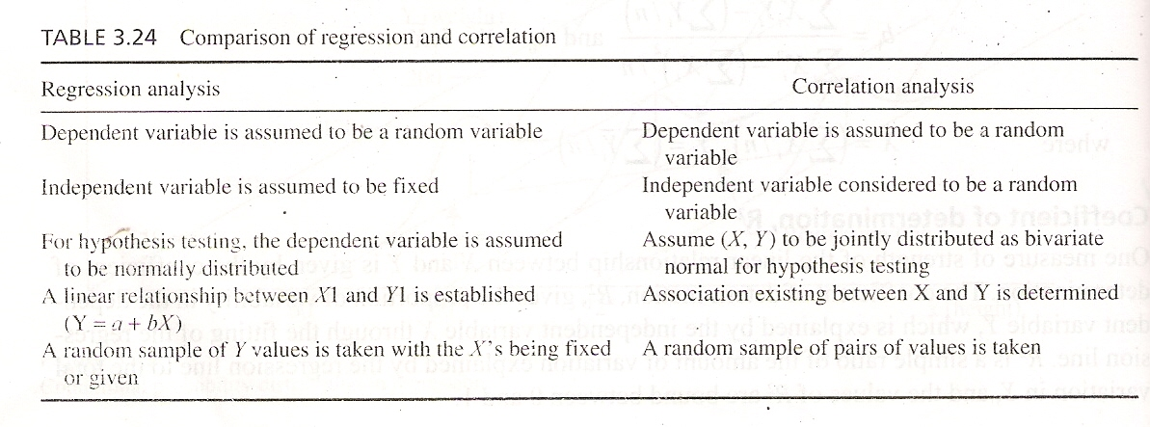
Comparison of regression and Correlation

Slide 38
Summary of This Session
Simple Linear Regression
Correlation
Comparison of Both

Slide 39
Thank You

