Slide 1
MGT-491
QUANTITATIVE ANALYSIS AND RESEARCH FOR MANAGEMENT
Session 21
OSMAN BIN SAIF

Slide 2
Summary of Last Session
Cross Tabulation
  Two variables
  Three variables
    Four resulting probabilities of three variables
Statistics associated with cross tabulations
  Chi square test

Slide 3
STATISTICS ASSOCIATED WITH CROSS-TABULATION(contd.)
Phi Coefficient
A measure of the strength of association in the special case of a table with two rows and two column(a2*2 table).
The phi coefficient is proportional to the square root of the chi-square statistic.

Slide 4
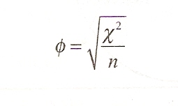

Slide 5
STATISTICS ASSOCIATED WITH CROSS-TABULATION(contd.)
It takes the value of 0 when there is no association, which would be indicated by a chi-square vale of 0 as well.
When the variables are perfectly associated, phi assumes the vale of 1
When there is perfect negative association then phi takes the value of -1.

Slide 6
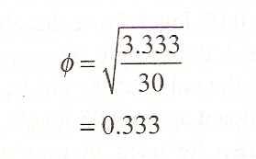

Slide 7
CROSS-TABULATION IN PRACTICE
When conducting cross-tabulation analysis in practice, it is useful to proceed along the following steps.
Test the null hypothesis that there is no association between the variables using chi-square statistic.
  If you fail to reject the null hypothesis, then there is no relationship.

Slide 8
CROSS-TABULATION IN PRACTICE(contd.)
If Ho is rejected, then determine the strength of the association using an appropriate statistic(phi coefficient or other statistics).
If Ho is rejected, interpret the pattern of relationship by computing the percentages in the direction of the independent variable, across the dependent variable.

Slide 9
CROSS-TABULATION IN PRACTICE(contd.)
Translate the result of hypothesis testing, strength of association, and pattern of association into managerial implications and recommendations where meaningful.

Slide 10
HYPOTHESIS TESTING RELATED TO DIFFERENCE
We have considered the hypothesis testing related to associations. We know focus on hypothesis testing related to differences.
It consist of following test
Parametric test
Nonparametric test

Slide 11
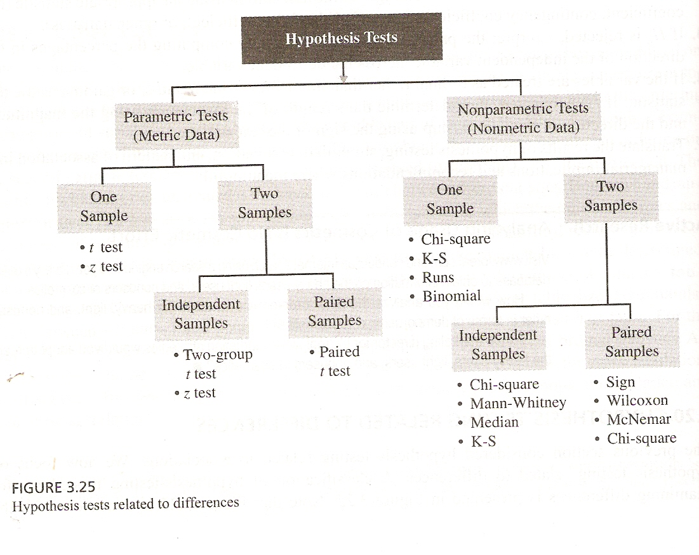

Slide 12
HYPOTHESIS TESTING RELATED TO DIFFERENCE(contd.)
Parametric tests
Hypothesis testing procedure that assumes that the variables of interest are measured on at least an interval scale.
Nonparametric tests
Hypothesis-testing procedures that assume that the variables are measured on a nominal ordinal scale.

Slide 13
PARAMETRIC TESTS
Parametric test provide inference for making statements about means of parent populations.
The following test are used for this purpose
t test
t statistic
t distribution

Slide 14
PARAMETRIC TESTS(contd.)
t test
A uni-variate hypothesis test using the t distribution, which is used when the standard deviation is unknown and sample size is small.
t statistic
A statistic that assumes that the variable has a symmetric bell-shaped distribution, the mean is known( or assumed to be known), and the population variance is estimated from the sample.

Slide 15
PARAMETRIC TESTS(contd.)
t distribution
A symmetric bell-shaped distribution that is useful for small sample(n<30)testing, when the mean is known and the population variance is estimated from the sample.

Slide 16
PARAMETRIC TESTS(contd.)
The procedure for hypothesis testing, when t statistics is used;
  Formulate the null and the alternate hypothesis
  Select the appropriate formula for t statistics
  Select a significance level. Typically 0.05
  Take one or two sample and calculate mean and standard deviations for them

Slide 17
PARAMETRIC TESTS(contd.)
The procedure for hypothesis testing, when t statistics is used (Contd.);
  Calculate t statistics assuming null hypothesis is true.
  Calculate critical value of t statistic.
  If the probability computed in the last step is smaller than the significance level, then reject null hypothesis.

Slide 18
PARAMETRIC TESTS(contd.)
The procedure for hypothesis testing, when t statistics is used (Contd.);
  Or if the probability is larger do not reject null hypothesis.
  Not rejecting null hypothesis does not mean that null hypothesis is true
  It only means that the true state is not significantly different from that assumed by null hypothesis.

Slide 19
PARAMETRIC TESTS(contd.)
The procedure for hypothesis testing, when t statistics is used (Contd.);
  Express the conclusion reached by the t test in terms of the marketing research problem.

Slide 20
PARAMETRIC TESTS(contd.)
One sample
In marketing research, the researcher is often interested in making statements about a single variable against a known or given standard.
z test
A uni-variate hypothesis test using the standard normal distribution.

Slide 21
PARAMETRIC TESTS(contd.)
Example:
  Market share for a new product will exceed 15 percent; at least 65% of customers will like a new package design; 80% of the dealers will like the new pricing policy.
  These statements can be translated to null hypothesis that can be tested using a one sample t test or z test.

Slide 22
PARAMETRIC TESTS(contd.)
Example:
  In the case of t test for a single mean, the researcher is interested in testing whether the population mean conforms to the given hypothesis.
  Suppose we want to test the hypothesis that the mean familiarity rating exceeds 4.0, the neutral value on a 7 point scale.
  A significance level of alpha is 0.05,
  The hypothesis may be formulated as ;

Slide 23
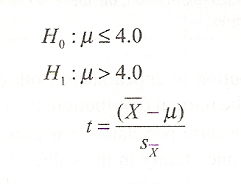

Slide 24
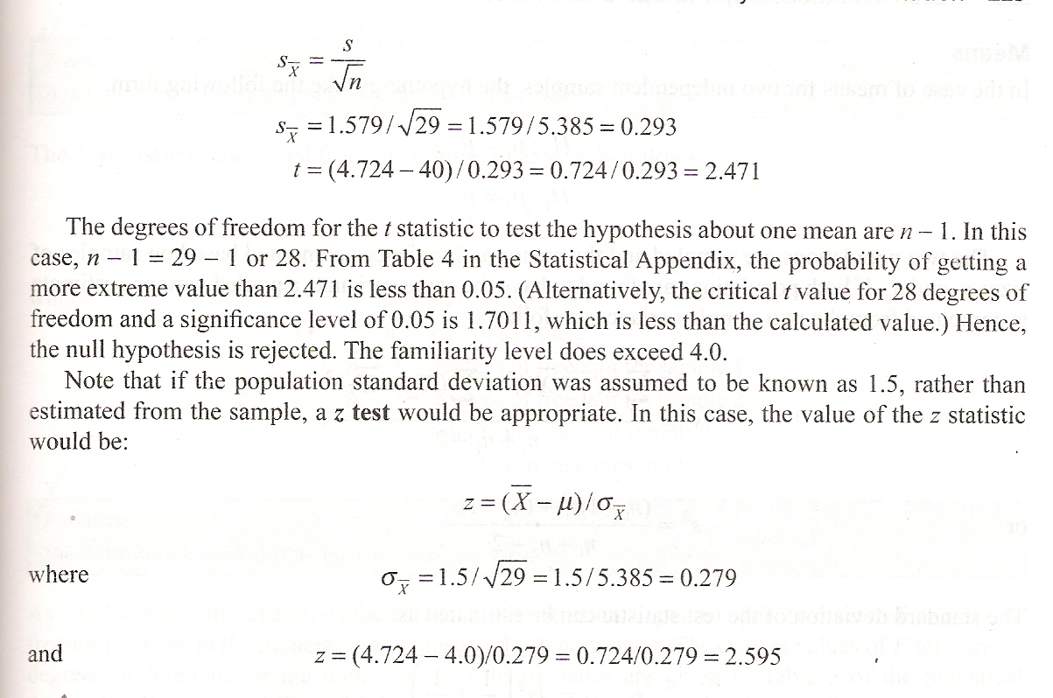

Slide 25
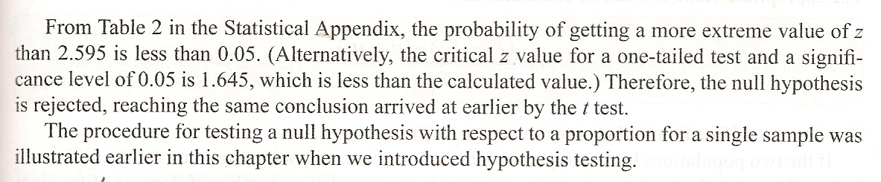

Slide 26
PARAMETRIC TESTS(contd.)
Two independent samples
Several hypothesis in marketing relate to parameters from two different populations.
Independent samples
Two samples that are not experimentally related.
The measure of one sample has no effect on the values of the second sample.

Slide 27
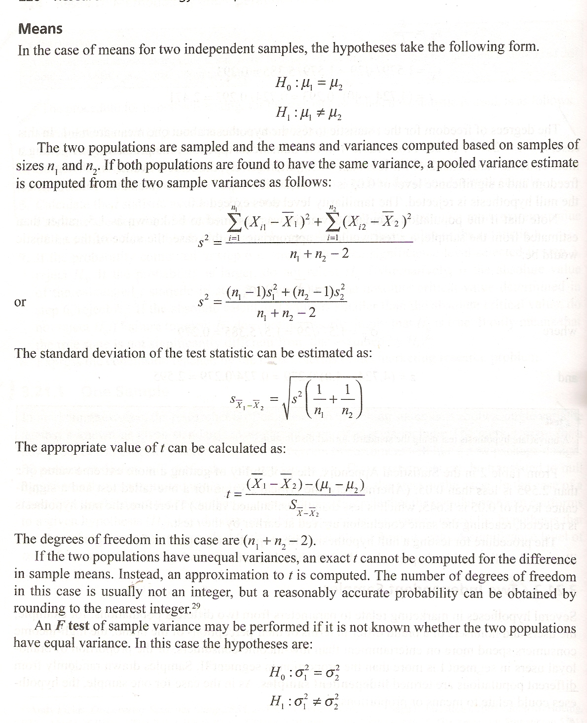

Slide 28
PARAMETRIC TESTS(contd.)
F test
A statistical test of the equality of the variance of two populations.
F statistic
The f statistic is computed as the ratio of two sample variances.

Slide 29
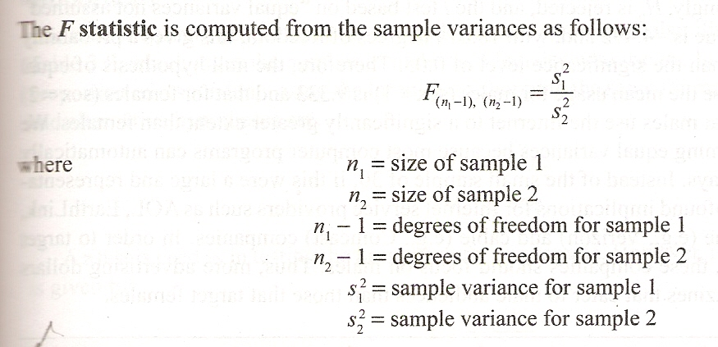

Slide 30
PARAMETRIC TESTS(contd.)
F distribution
A frequency distribution that depend upon two sets of freedom-the degree of freedom in the numerator and the degree of freedom in the denominator.

Slide 31
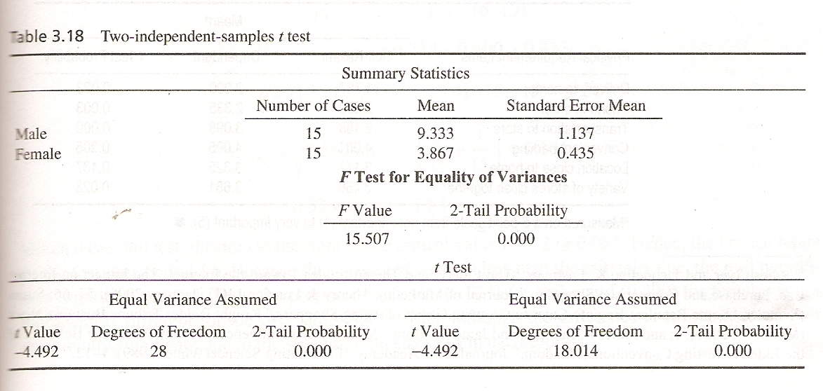

Slide 32
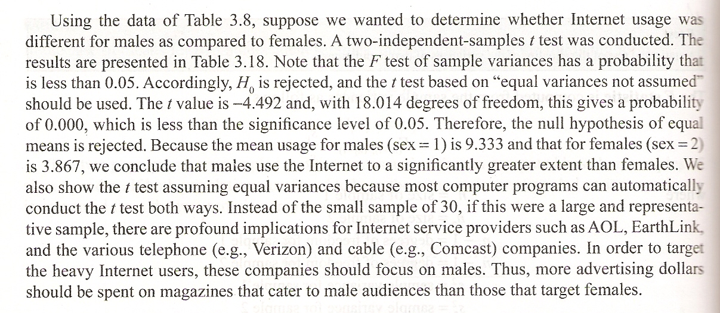

Slide 33
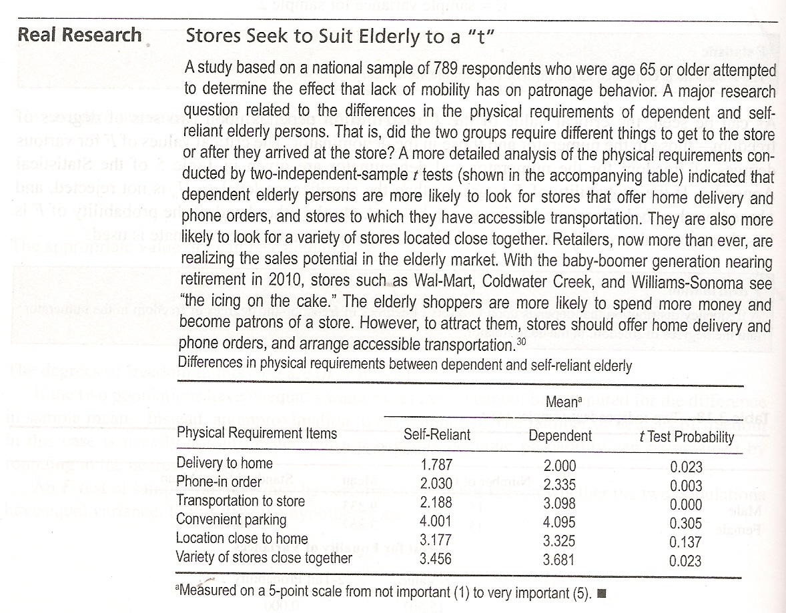

Slide 34
PARAMETRIC TESTS(contd.)
Paired samples
In many marketing research applications ,the observations for the two groups are not selected from independent samples.
Rather, the observation relate to paired samples in that the two sets of observation relate to the same respondents.

Slide 35
PARAMETRIC TESTS(contd.)
Paired sample
In hypothesis testing, the observation are paired so that two sets of observations relate to the same respondent.
Paired sample t test
A test for difference in the means of paired samples.

Slide 36
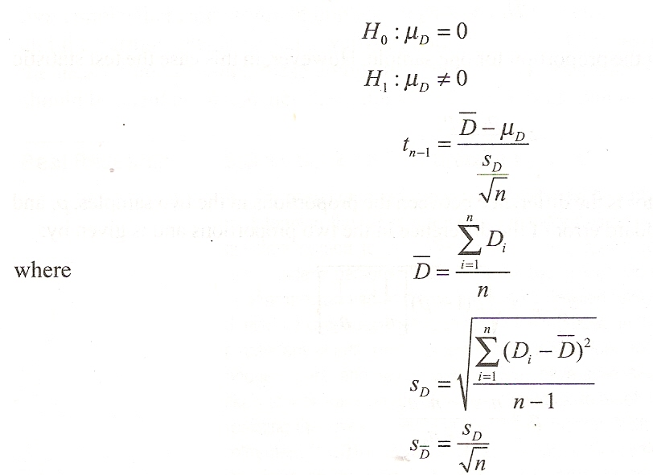
To compare t statistic for paired sample

Slide 37
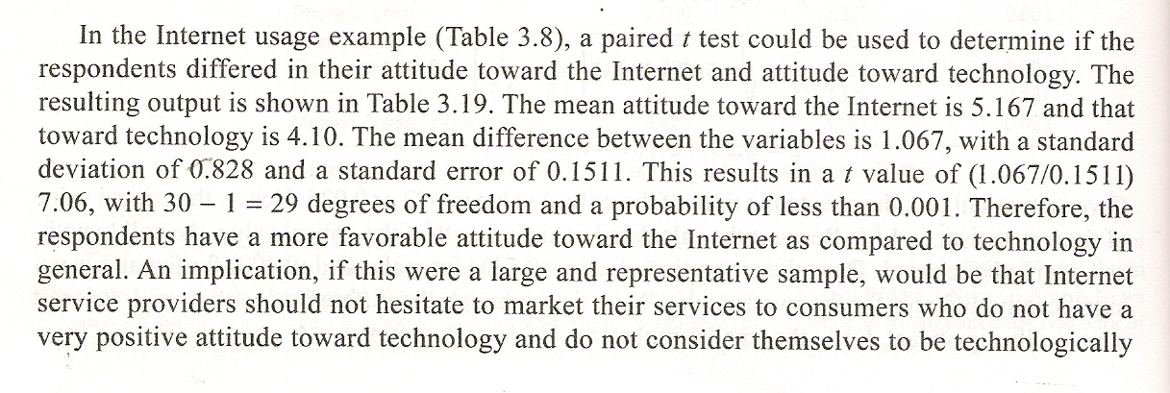

Slide 38
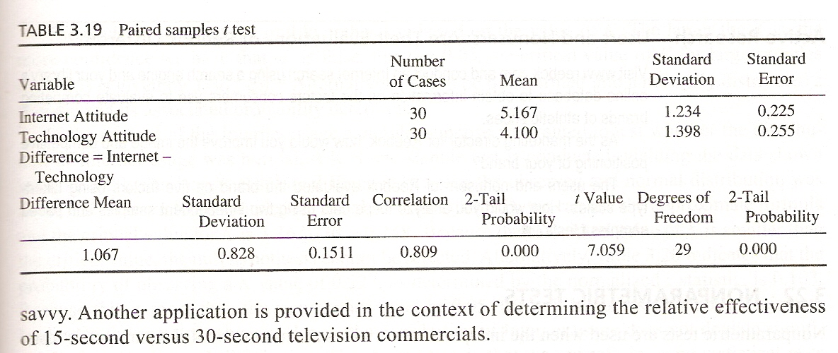

Slide 39
Summary of This Session
Phi co-efficient
Cross tabulation in practice
Differences in Hypothesis testing
Parametric testing

Slide 40
Thank You

