Slide 1
MGT-491
QUANTITATIVE ANALYSIS AND RESEARCH FOR MANAGEMENT
Session 20
OSMAN BIN SAIF

Slide 2
Summary of Last Session
Hypothesis Testing
  Introduction
  General Procedure
  Significance

Slide 3
CROSS TABULATIONS
In order to introduce the frequency distribution, we posed several representative marketing research questions.
Although answers to questions related to single variables are interesting, they often raise additional questions about how to link that variable to the other variables.

Slide 4
CROSS TABULATIONS
For example
  How many brand loyal users are male?
  Is product use(measured in terms of heavy users, medium users, light users, and nonusers) related to interest in outdoor activities(high, medium and low)?

Slide 5
CROSS TABULATIONS(contd.)
  Is familiarity with a new product related to age and education levels?
  Is product ownership relate to income (high, medium, low)?

Slide 6
CROSS TABULATIONS(contd.)
Cross-tabulation
  A statistical technique that describes two or more variables simultaneously and results in tables that reflects the joint distribution of two or more variables that have a limited number of categories or distinct values.
Contingency table
  A cross tabulation table.it contains a cell for every combination of categories of the two variables.

Slide 7
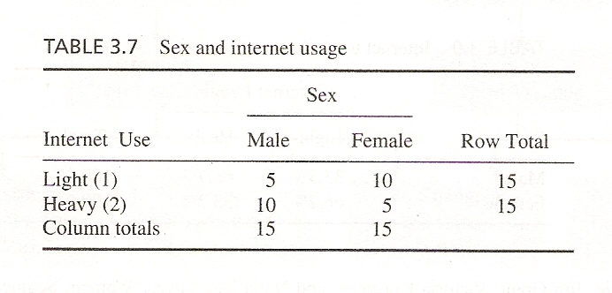

Slide 8
TWO VARIABLES
  Cross tabulation with two variables is also known as bivariate cross-tabulation.
  Consider again the cross-classification of Internet usage with sex given in table.
    Is usage relate to sex?
    It appears to be from table.

Slide 9
TWO VARIABLES(contd.)
We see that respondents who are males are heavy internet users as compare to females.

Slide 10
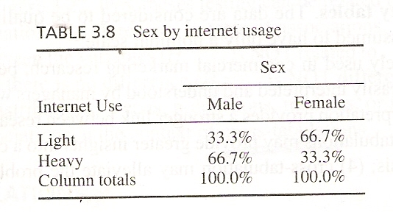

Slide 11
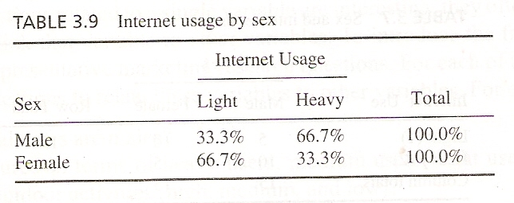

Slide 12
THREE VARIABLES
Often the introduction of third variable clarifies the initial association( or lack of it)observed between two variables.
The introduction of a third variable can results in four possibilities.
  It can refine the association observed between the two original variables.

Slide 13
THREE VARIABLES(contd.)
  It can indicate no association between the two variables, although as association was initially observed. In other words ,the third variable indicate that the initial association between the two variables was spurious.
  It can reveal some association between the two variables, although no association was initially observed.

Slide 14
THREE VARIABLES(contd.)
  In this case, the third variable reveals a suppressed association between the first two variable: a suppressor effect.
  It can indicate no change in initial association?

Slide 15
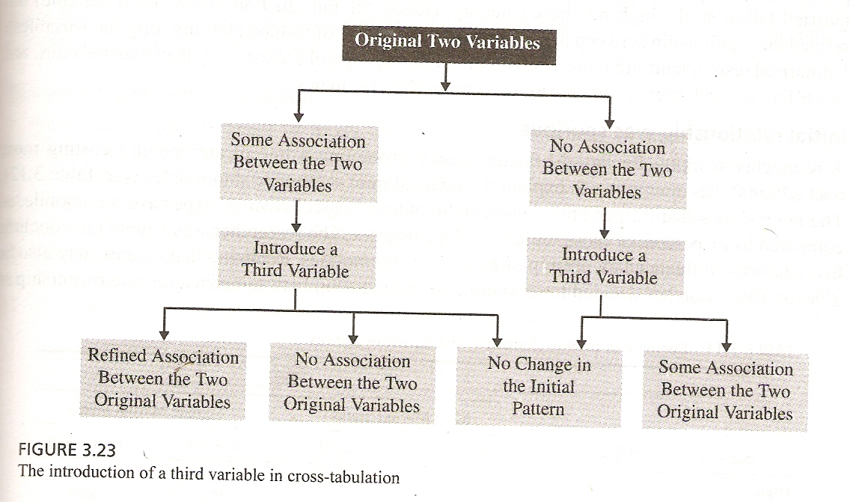

Slide 16
THREE VARIABLES(contd.)
Possibilities of results after introduction of third variable are now explained with examples on a sample of 1000 respondents.

Slide 17
Result of introduction of three variables
Refine an initial relationship
  The relationship between purchase of fashion clothing and marital status was reexamined in light of the third variable.
  In case of females. 60 % of the unmarried fall in the high purchase category and 25% married.
  For males 40% unmarried and 35% married fall in the high purchase category.

Slide 18
Result of introduction of three variables (Contd.)
Refine an initial relationship
  Hence the introduction of sex (3rd variable) has refined the relationship between marital status and purchase of fashion clothing.

Slide 19
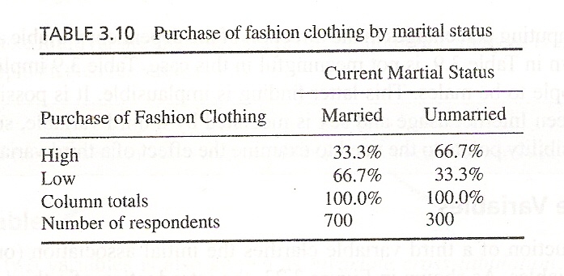

Slide 20
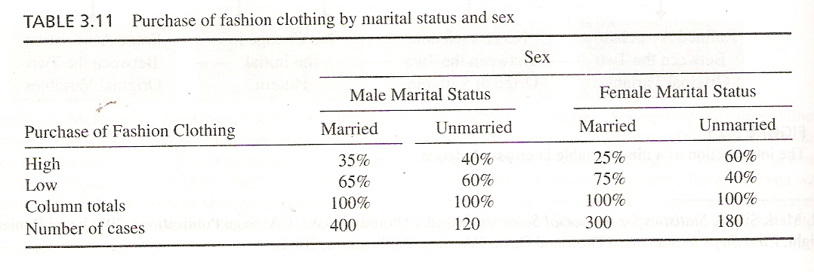

Slide 21
Result of introduction of three variables (Contd.)
Initial relationship was spurious
  32% of those with college degrees own an expensive automobile as compared to 21% who do not.
  Researcher was tempted to conclude that education influenced ownership of expensive automobiles.
  Later realizing that income may also be a factor, the researcher decided to re-examine in the light of income level.

Slide 22
Result of introduction of three variables (Contd.)
Initial relationship was spurious
  The result was that the association between education and ownership of expensive automobile disappeared
  Indicating that the initial relationship between the two variables was spurious.

Slide 23
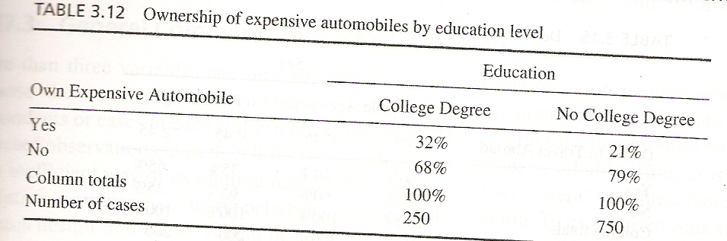

Slide 24
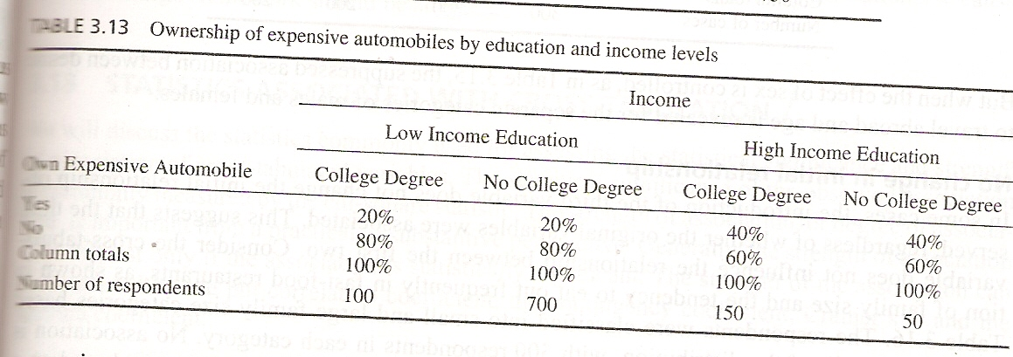

Slide 25
Result of introduction of three variables (Contd.)
Reveal suppressed association
  A researcher suspected desire to travel abroad may be influenced by age.
  However a cross-section of the two variables produced the results indicating no association.
  When sex was introduced as the third variable .
  Among men 60% of those under 45 indicated to travel abroad.

Slide 26
Result of introduction of three variables (Contd.)
Reveal suppressed association
  The pattern was reversed for women, where 35% of those under 45 indicated a desire to travel abroad.
  As opposed to 65% of those 45 or older.

Slide 27
Result of introduction of three variables (Contd.)
Reveal suppressed association
  Because the association between desire to travel abroad and age runs in opposite direction for males and females, the relationship between these two variables is masked when the data are aggregated across sex.

Slide 28
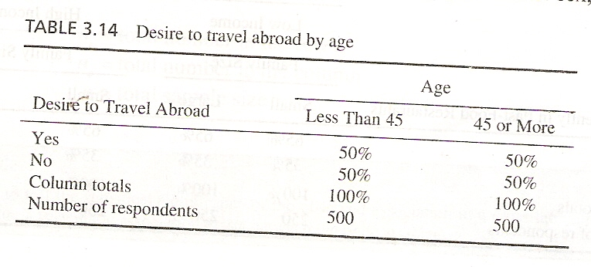

Slide 29
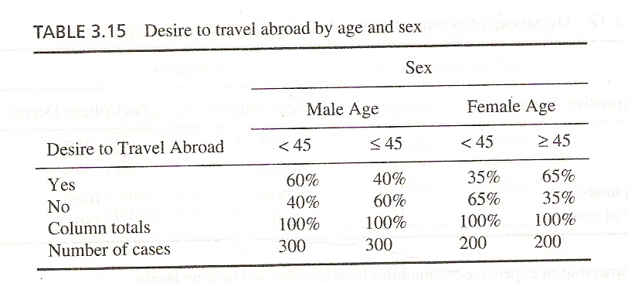

Slide 30
Result of introduction of three variables (Contd.)
No change in initial relationship
  In some cases, the introduction of the third variable does not change the initial relationship observed, regardless of whether the original variables were associated.

Slide 31
Result of introduction of three variables (Contd.)
No change in initial relationship
  The respondents were classified into small and large family size, based on a median split of the distribution, with 500 respondents in each category.
  No association is observed.

Slide 32
Result of introduction of three variables (Contd.)
No change in initial relationship
  The respondents were further classified into high or low income groups based on a median split.
  When income was introduced as a third variable in the analysis, again no association was observed.

Slide 33
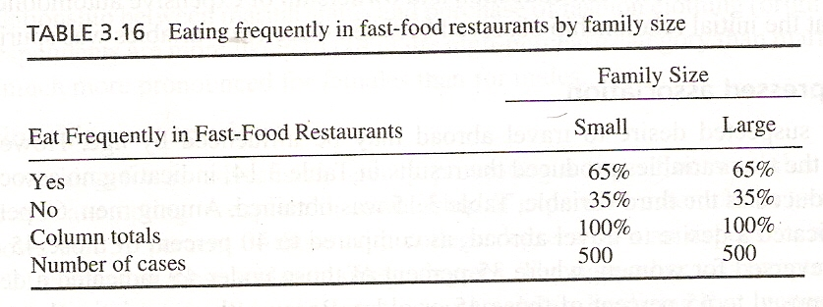

Slide 34
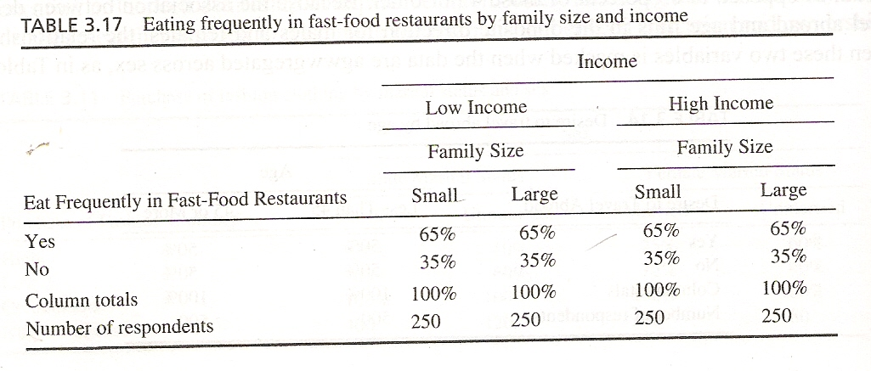

Slide 35
General Comments on Cross-Tabulation
More than three variables can be cross tabulated but the interpretation is quite complex.
Also because the number of cells increases multiplicatively, maintaining an adequate number of respondents or cases in each cell becomes problematic.

Slide 36
General Comments on Cross-Tabulation
As a general rule, there should be at least five expected observations in each cells for the statistical computed to be reliable.
Thus cross tabulation is an inefficient way of examining relationships when there are several variables.

Slide 37
STATISTICS ASSOCIATED WITH CROSS-TABULATION
The statistics commonly used for assessing the statistical significance and strength of association of cross-tabulated variables is measure by
Chi-square
Phi Coefficient

Slide 38
STATISTICS ASSOCIATED WITH CROSS-TABULATION(contd.)
Chi-square
Chi-square statistics
The statistic used to test the statistical significance of the observed association in a cross-tabulation.
It assist us in determining whether a systematic association exists between the two variables.

Slide 39
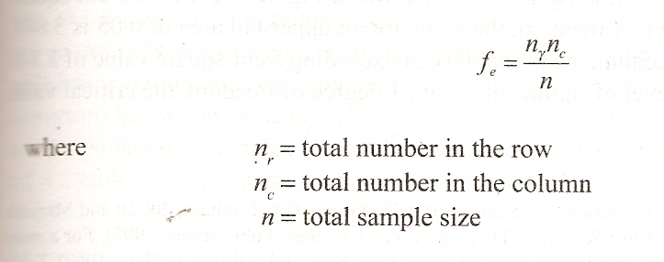

Slide 40
STATISTICS ASSOCIATED WITH CROSS-TABULATION(contd.)
Chi-square distribution
A skewed distribution whose shape depends solely on the number of degree of freedom.
As the number of degree of freedom increases, the chi-square distribution becomes more symmetrical.

Slide 41
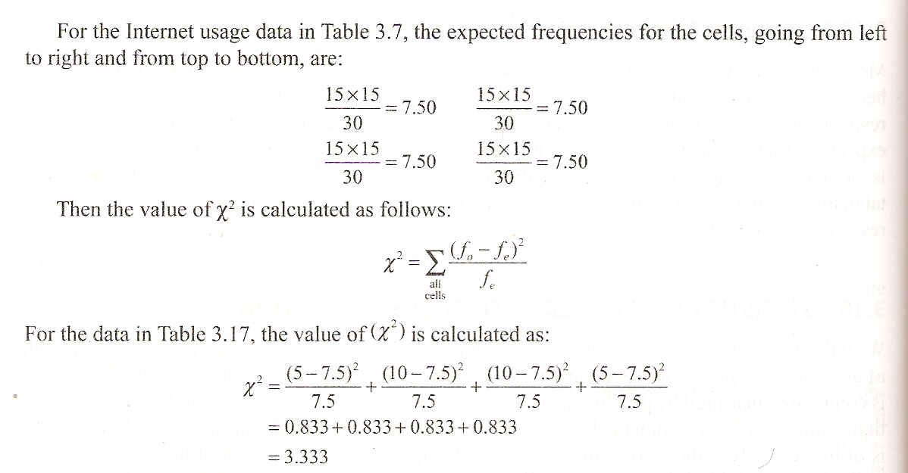

Slide 42
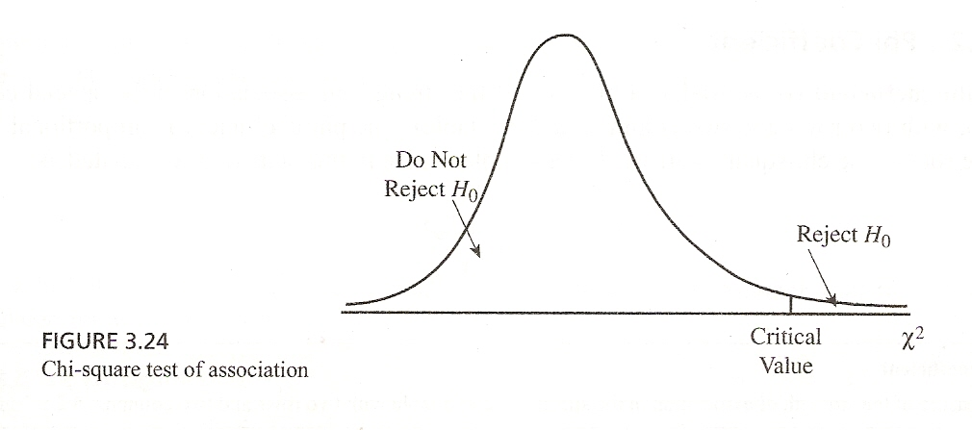

Slide 43
Summary of This Session
Cross Tabulation
  Two Variables
  Third variable
    Results – 4 possibilities
Statistics associated with Tabulation
  Chi Square

Slide 44
Thank You

