Slide 1
MGT-491
QUANTITATIVE ANALYSIS AND RESEARCH FOR MANAGEMENT
Session 19
OSMAN BIN SAIF

Slide 2
Summary of Last Session
Comparing variables
Measures of Location
Measures of Variability
Measures of Shape

Slide 3
INTRODUCTION TO HYPOTHESIS TESTING
Basic analysis invariably involves some hypothesis testing.
Examples of hypothesis generated in marketing research are:
  The department store is being patronized by more than 10 percent of the household.
  The heavy and light users of a brand differ in terms of psychographic characteristics.

Slide 4
INTRODUCTION TO HYPOTHESIS TESTING(contd.)
Further Examples;
  One hotel has a more upscale image than its close competitor.
  Familiarity with a restaurant results in greater preference for that restaurant.

Slide 5
INTRODUCTION TO HYPOTHESIS TESTING(contd.)
Null hypothesis
A statement in which no difference or effect is expected.
If the null hypothesis is not rejected, no change will be made.

Slide 6
INTRODUCTION TO HYPOTHESIS TESTING(contd.)
Alternative hypothesis
A statement that some difference or effect is expected.
Accepting the alternate hypothesis will lead to changes in opinions or actions.

Slide 7
GENERAL PROCEDURE FOR HYPOTHESIS TESTING
The following steps are involved in hypothesis testing.
  Formulate the null hypothesis and alternate hypothesis.
  Select an appropriate statistical technique and corresponding test statistic.

Slide 8
GENERAL PROCEDURE FOR HYPOTHESIS TESTING(contd.)
  Choose the level of significance.
  Determine the sample size and collect the data. Calculate value of test statistic.

Slide 9
GENERAL PROCEDURE FOR HYPOTHESIS TESTING(contd.)
  Determine the probability associated with test statistic under the null hypothesis, using the sampling distribution of the test statistic. Alternatively, determine the critical values associated with test statistic that divide rejection and non rejection regions.

Slide 10
GENERAL PROCEDURE FOR HYPOTHESIS TESTING(contd.)
  Compare the probability associated with the test statistic with the level of significance specified. Alternatively, determine whether the test statistic has fallen into rejection or non rejection region.

Slide 11
GENERAL PROCEDURE FOR HYPOTHESIS TESTING(contd.)
  Make the statistical decision to reject or not reject the null hypothesis.
  Express the statistical decision in terms of marketing research problem.

Slide 12
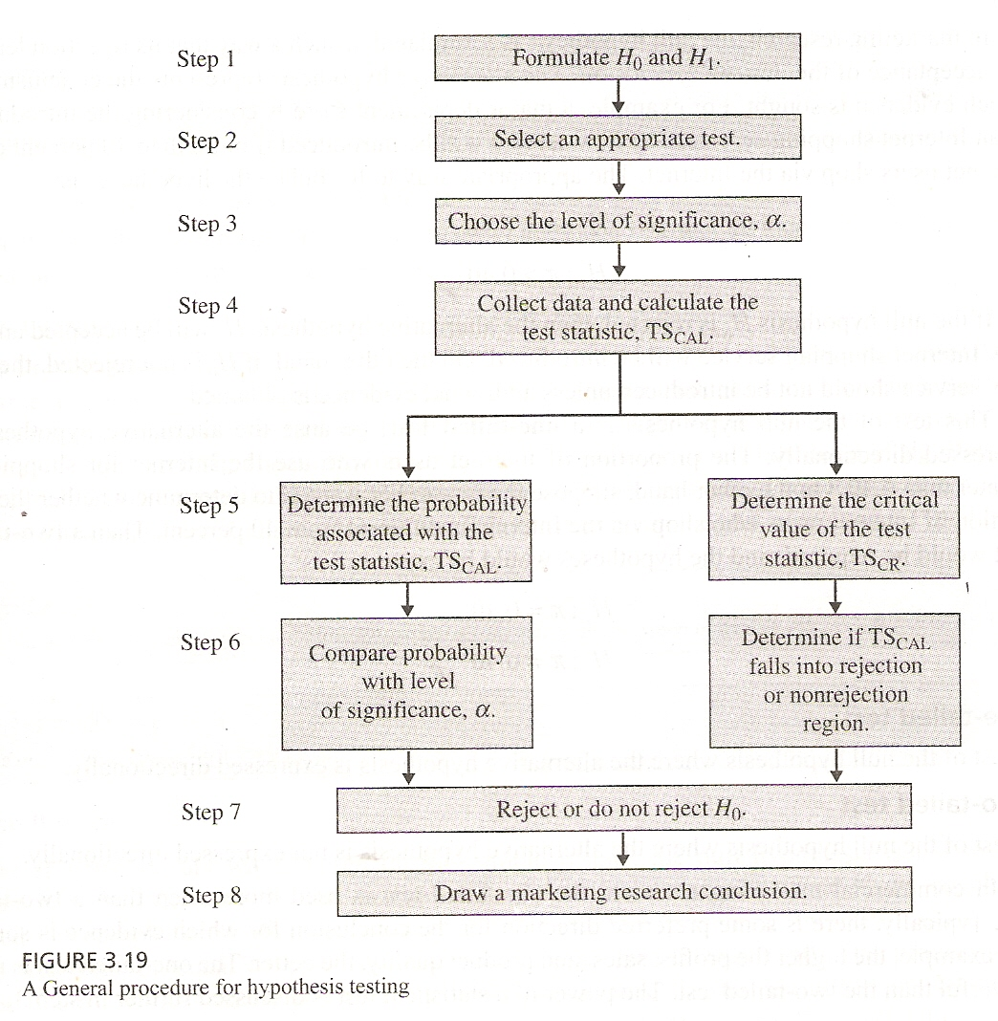

Slide 13
GENERAL PROCEDURE FOR HYPOTHESIS TESTING(contd.)
Step 1:Formulate the hypothesis
  The first step is to formulate null and alternative hypothesis.
  A null hypothesis is a statement of the status quo, one of no difference or no effect.
  If the null hypothesis is not rejected no changes will be made.

Slide 14
GENERAL PROCEDURE FOR HYPOTHESIS TESTING(contd.)
  An alternative hypothesis is one in which some difference or effect is expected.
  Accepting the alternative hypothesis will lead to changes in opinions or actions. Thus, the alternative hypothesis is the opposite of null hypothesis.

Slide 15
GENERAL PROCEDURE FOR HYPOTHESIS TESTING(contd.)
  The null hypothesis is always the hypothesis that is tested.
  The null hypothesis refers to a specified value of the population parameter, not a sample statistic.

Slide 16
GENERAL PROCEDURE FOR HYPOTHESIS TESTING(contd.)
  A statistical test can have one or two outcomes.
  One is that null hypothesis is rejected and alternative hypothesis is accepted.
  The other outcome is that null hypothesis is not rejected based on evidence.

Slide 17
GENERAL PROCEDURE FOR HYPOTHESIS TESTING(contd.)
  However, it would be incorrect to conclude that because the null hypothesis is not rejected, it can be accepted as valid.
  In classical hypothesis testing, there is no way to determine whether the null hypothesis is true.

Slide 18
GENERAL PROCEDURE FOR HYPOTHESIS TESTING(contd.)
  In marketing research, the null hypothesis is formulated in such of a way that is rejection leads to acceptance of desired conclusion.
  The alternate hypothesis represents the conclusion for which evidence is sought.

Slide 19
GENERAL PROCEDURE FOR HYPOTHESIS TESTING(contd.)
  For example a major department store is considering the introduction of an Internet shopping service.

Slide 20
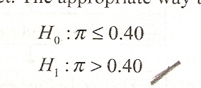
GENERAL PROCEDURE FOR HYPOTHESIS TESTING(contd.)
  The new service will be introduced if more than 40 percent of the Internet users shop via the internet.
  The appropriate way to formulate the hypothesis is

Slide 21
GENERAL PROCEDURE FOR HYPOTHESIS TESTING(contd.)
  If the null hypothesis Ho is rejected ,then the alternate hypothesis h1 is accepted and new Internet shopping service will be introduced.
  On the other hand if Ho is not rejected, then the new service should not be introduced unless additional evidence is obtained.

Slide 22
GENERAL PROCEDURE FOR HYPOTHESIS TESTING(contd.)
  The test of null hypothesis is one tailed test, because the alternative hypothesis is expressed directionally: the proportion of internet users who use internet for shopping is greater than .04.

Slide 23
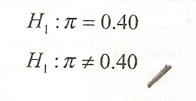
GENERAL PROCEDURE FOR HYPOTHESIS TESTING(contd.)
  On the other hand, suppose the researcher wanted to determine whether the proportion of internet users who shop via the internet is different from 40 percent. Then a two tailed test would be required, and hypothesis would be expresed as;

Slide 24
GENERAL PROCEDURE FOR HYPOTHESIS TESTING(contd.)
One tailed test
  A test of null hypothesis where alternative hypothesis is expressed directionally.
Two tailed test
  A test of null hypothesis where the alternate hypothesis is not expressed directionally.

Slide 25
GENERAL PROCEDURE FOR HYPOTHESIS TESTING(contd.)
  In commercial marketing research, the one tailed test is used more often than a two tailed test. Typically, there is some preferred direction for the conclusion for which evidence is sought.
For Example;
  The higher the profits, sales and the product quality, the better.
  One tailed test is more powerful than a two tailed test.

Slide 26
GENERAL PROCEDURE FOR HYPOTHESIS TESTING(contd.)
Step 2:Select an appropriate test
Test statistic
  A measure of how close the sample has come to the null hypothesis. It often follows a well-known distribution, such as the normal, t, or chi square distribution.

Slide 27
GENERAL PROCEDURE FOR HYPOTHESIS TESTING(contd.)
Step 2:Select an appropriate test
  The researchers should take into consideration how the test statistic is computed and sampling distribution that the sample statistic follows.
  To test the null hypothesis, it is necessary to select an appropriate statistical technique.

Slide 28
GENERAL PROCEDURE FOR HYPOTHESIS TESTING(contd.)
Step 3: Choose levels of Significance
  What ever we draw inference about a population, there is a risk that an incorrect conclusion will be reached. Two types of error can occur.
  Type 1 error
  Type 2 error

Slide 29
GENERAL PROCEDURE FOR HYPOTHESIS TESTING(contd.)
Type 1 error
  Also known as alpha error, it occurs when the sample results lead to the rejection of a null hypothesis that is in fact true.
  Type 1 error would occur if we concluded, based on sample data, that the proportion of customers preferring new service plan was greater than .04, when in fact it was less than or equal to .04.

Slide 30
GENERAL PROCEDURE FOR HYPOTHESIS TESTING(contd.)
Type 2 error
  Also known as beta error, it occurs when the sample results leads to the non rejection of a null hypothesis that is in fact false.
  It would occur if we concluded, based on sample data, that the proportion of customers preferring the new service plan was less than or equal to .04 when in fact, it was greater than .04

Slide 31
GENERAL PROCEDURE FOR HYPOTHESIS TESTING(contd.)
Power of a test
  The probability of rejecting the null hypothesis when it is in fact false and should be rejected.
  The risk of both alpha and beta can be controlled by increasing the sample size.
  For a given sample of alpha, increasing the sample size will decrease beta, thereby increasing the power of test.

Slide 32
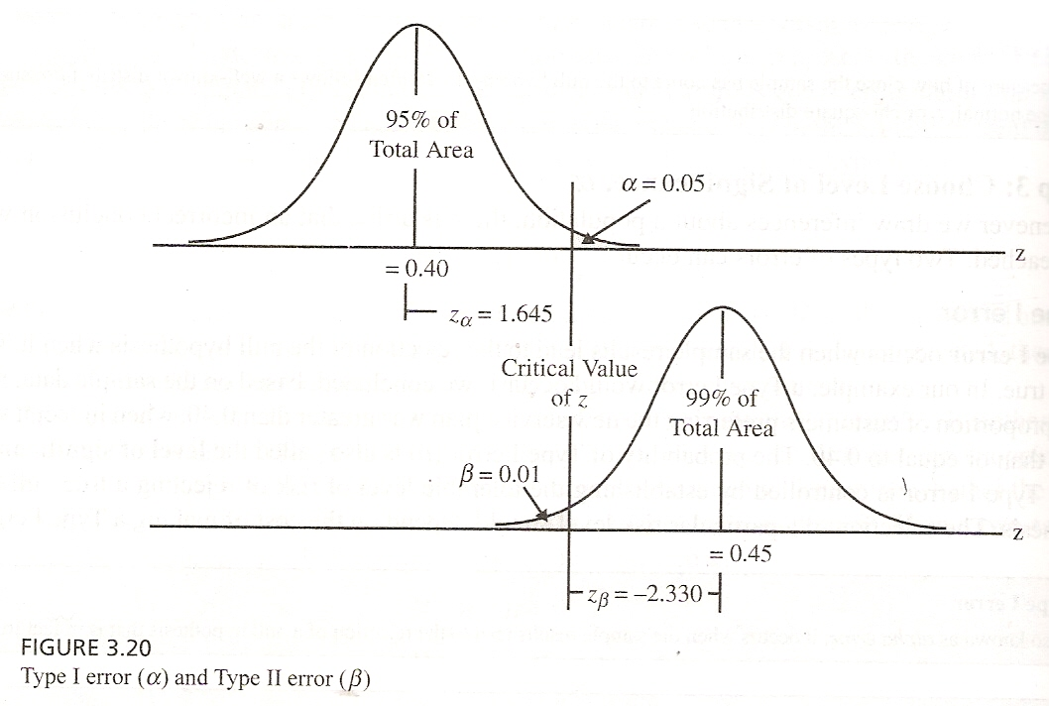

Slide 33
GENERAL PROCEDURE FOR HYPOTHESIS TESTING(contd.)
Step 4:Collect data and Calculate Test Statistic
  Sample size is determined after taking into account the desired alpha and beta errors and other qualitative considerations, such as budget constraints.
  Then the required data is collected and the value of test statistic computed.

Slide 34
GENERAL PROCEDURE FOR HYPOTHESIS TESTING(contd.)
Step 4:Collect data and Calculate Test Statistic
  In our example, 30 users were surveyed and 17 indicated that they used the internet for shopping. Thus the vale of sample proportion is p=17/30=0.567

Slide 35
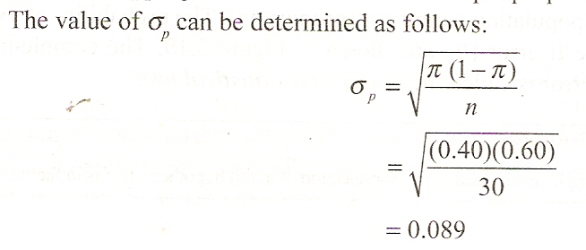

Slide 36
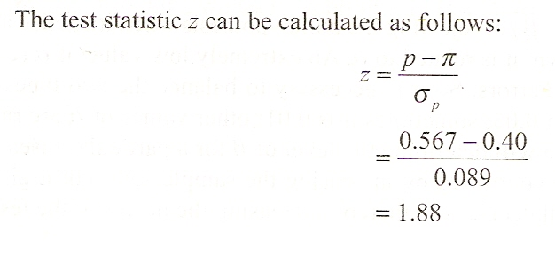

Slide 37
GENERAL PROCEDURE FOR HYPOTHESIS TESTING(contd.)
Step 5:Determine the Probability(or Critical Value)
p value
  This is the probability of observing a value of test statistic as extreme as, or more extreme than, the value actually observed, assuming the null hypothesis is true.

Slide 38
GENERAL PROCEDURE FOR HYPOTHESIS TESTING(contd.)
Step 5:Determine the Probability(or Critical Value)
p value
  Using standard normal statistical tables, the probability of obtaining a z value of 1.88 can be calculated.
  The shaded area between infinity and 1.88 is 0.9699.

Slide 39
GENERAL PROCEDURE FOR HYPOTHESIS TESTING(contd.)
Step 5:Determine the Probability(or Critical Value)
p value
  Therefore, the area to the right of z=1.88 is 1.0000-0.9699=0.0301 which is also called the p-value.

Slide 40
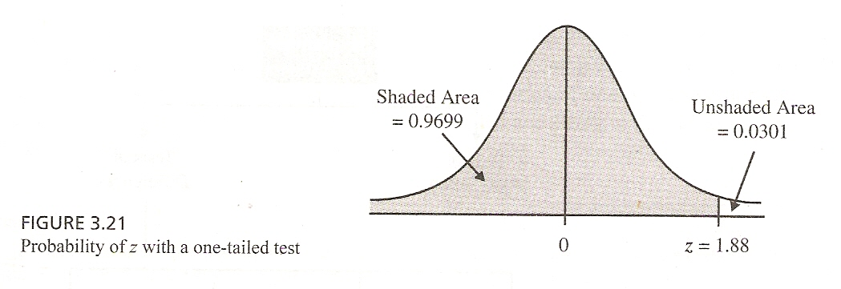

Slide 41
GENERAL PROCEDURE FOR HYPOTHESIS TESTING(contd.)
Step 6 and 7:Compare the Probability(or Critical Value) and Make the Decision.
  If the probability associated with the calculated or observed value of test statistic is less than the level of significance (0.05) ,the null hypothesis is rejected.
  However, if the absolute value of the calculated value of test statistic is greater than the absolute value of the critical value of the test statistic, the null hypothesis is rejected.

Slide 42
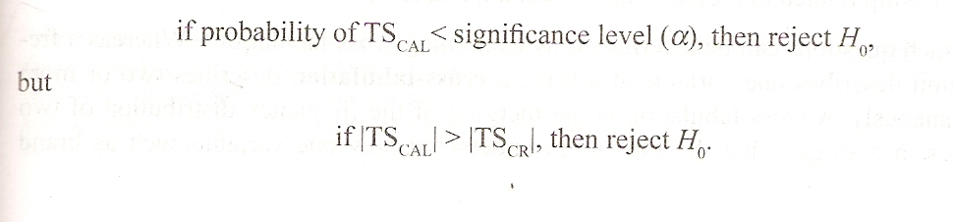

Slide 43
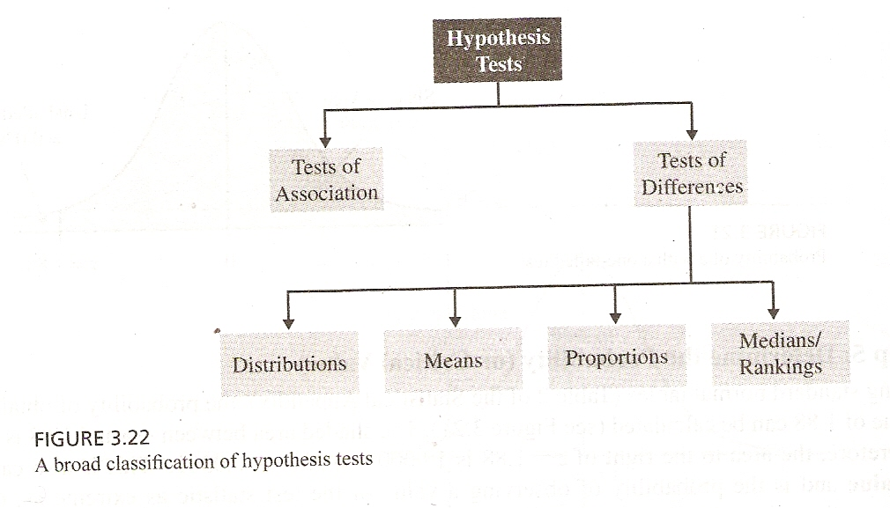

Slide 44
GENERAL PROCEDURE FOR HYPOTHESIS TESTING(contd.)
Step 8:Marketing research conclusion
  The conclusion reached by hypothesis testing must be expressed in terms of marketing research problem.
  In our example, we conclude that there is evidence that the proportion of Internet users who shop via the internet is significantly greater than 0.40.
  Hence, the recommendation to the department store would be to introduce the new internet shopping service.

Slide 45
Summary of This Session
Hypothesis testing
  Introduction
  General Procedure
  Significance

Slide 46
Thank You

