Slide 1
MGT-491
QUANTITATIVE ANALYSIS AND RESEARCH FOR MANAGEMENT
Session 18
OSMAN BIN SAIF

Slide 2
Summary of Last Session
Frequency Distribution
Graphical presentation of data
Exploring and Presenting Individual Variables

Slide 3
COMPAIRING VARIABLES
To show specific values;
  As with individual variables the best method of finding specific data values is a table.
  This is known as contingency table or cross-tabulation.

Slide 4
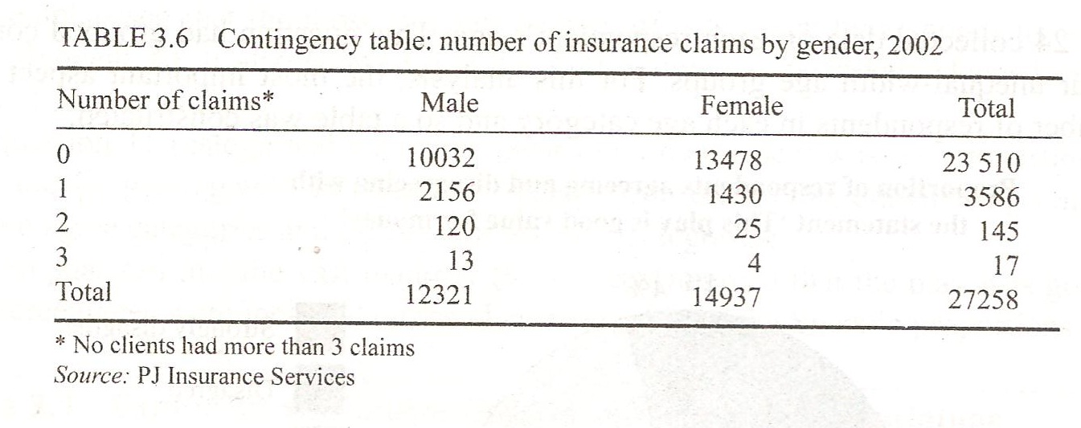

Slide 5
COMPARING VARIABLES
To compare highest and lowest values.
Comparisons of variables that emphasize the highest and lowest rather than precise values are best explored using a multiple bar charts, also known as compound bar chart.
As with a bar chart, continuous data- or data where there are many values or categories-need to be grouped.

Slide 6
COMPAIRING VARIABLES
To compare proportions;
  Comparison of proportions between variables uses either a percentage component bar chart or two or more pie charts

Slide 7
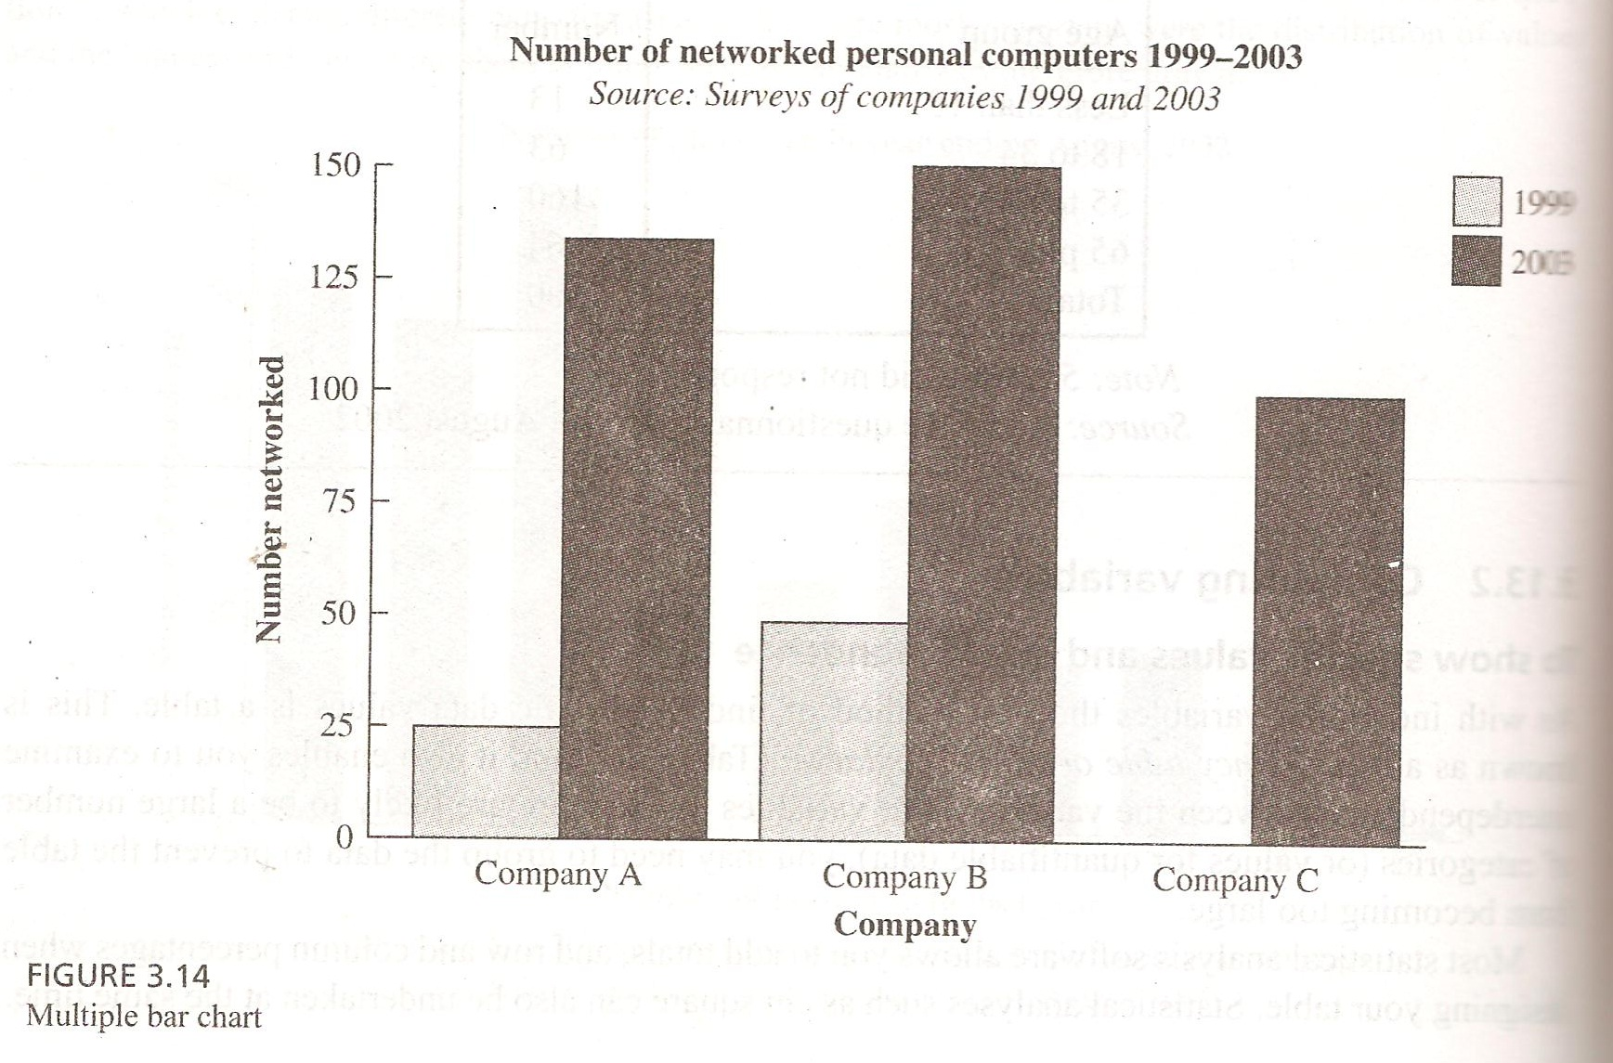

Slide 8
COMPAIRING VARIABLES
To compare trends and conjunctions;
  The most suitable diagram to compare trends for two or more quantifiable variables is a multiple line graph.

Slide 9
COMPAIRING VARIABLES
To compare totals;
  Comparison of totals between variables uses a variation of the bar chart.
  A stacked bar chart can be used for all types.

Slide 10
COMPAIRING VARIABLES
To compare proportions and totals;
  To compare both proportions of each category or value and the totals for two or more variables, it is best to use comparative proportional pie charts.

Slide 11
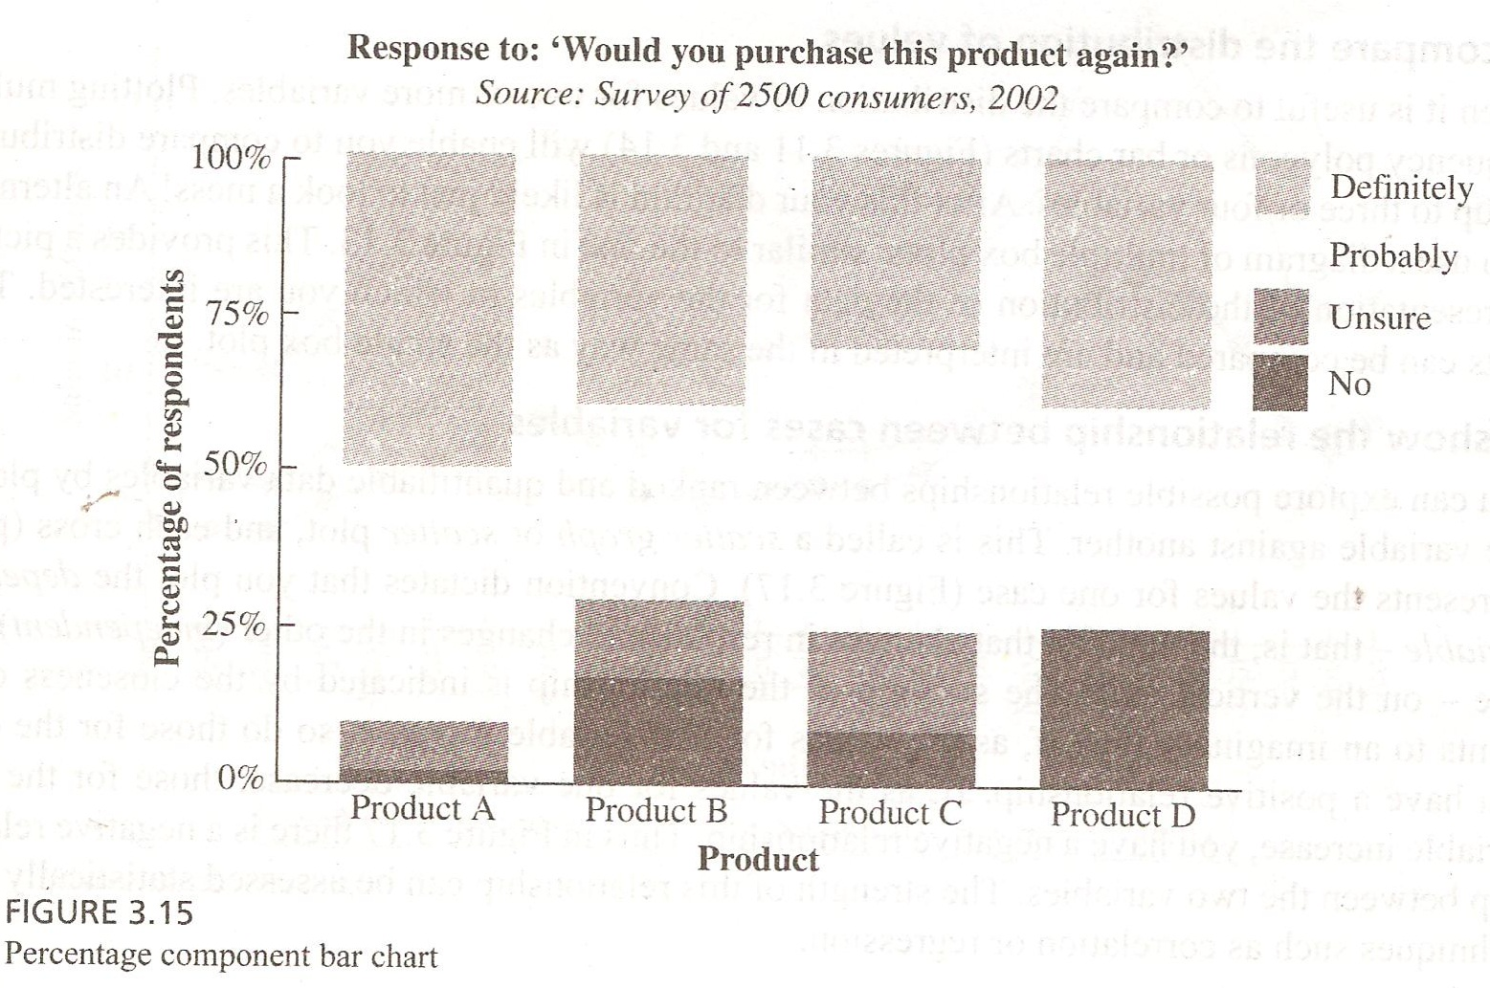

Slide 12
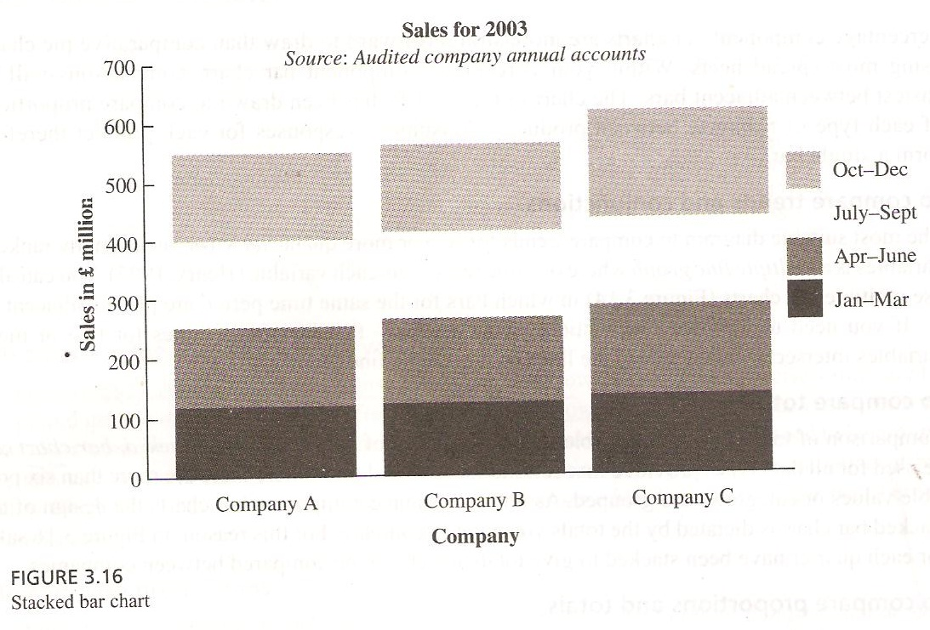

Slide 13
COMPAIRING VARIABLES
To compare the distribution of values;
  Often it is useful to compare the distribution of values for two or more variables

Slide 14
COMPAIRING VARIABLES
To show the relationship between cases for variables;
  You can explore possible relationships between ranked and quantifiable data variables by plotting one variable against another.
  This is called scatter graph or scatter plot.

Slide 15
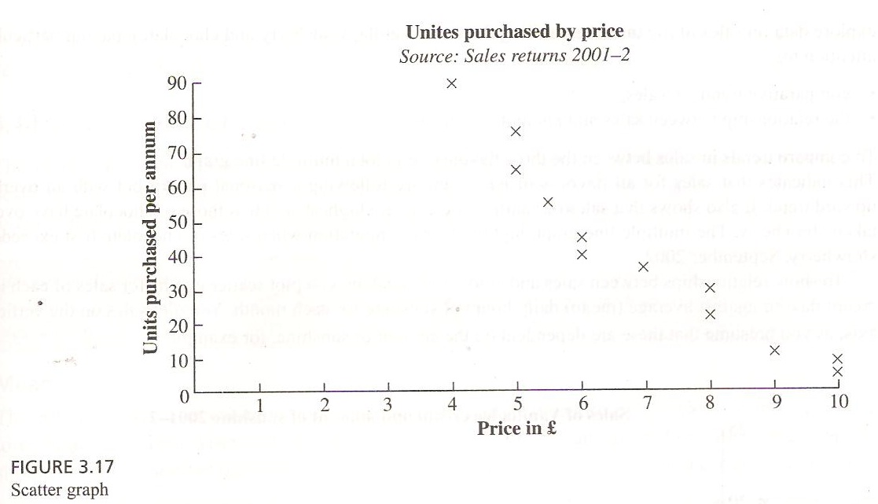

Slide 16
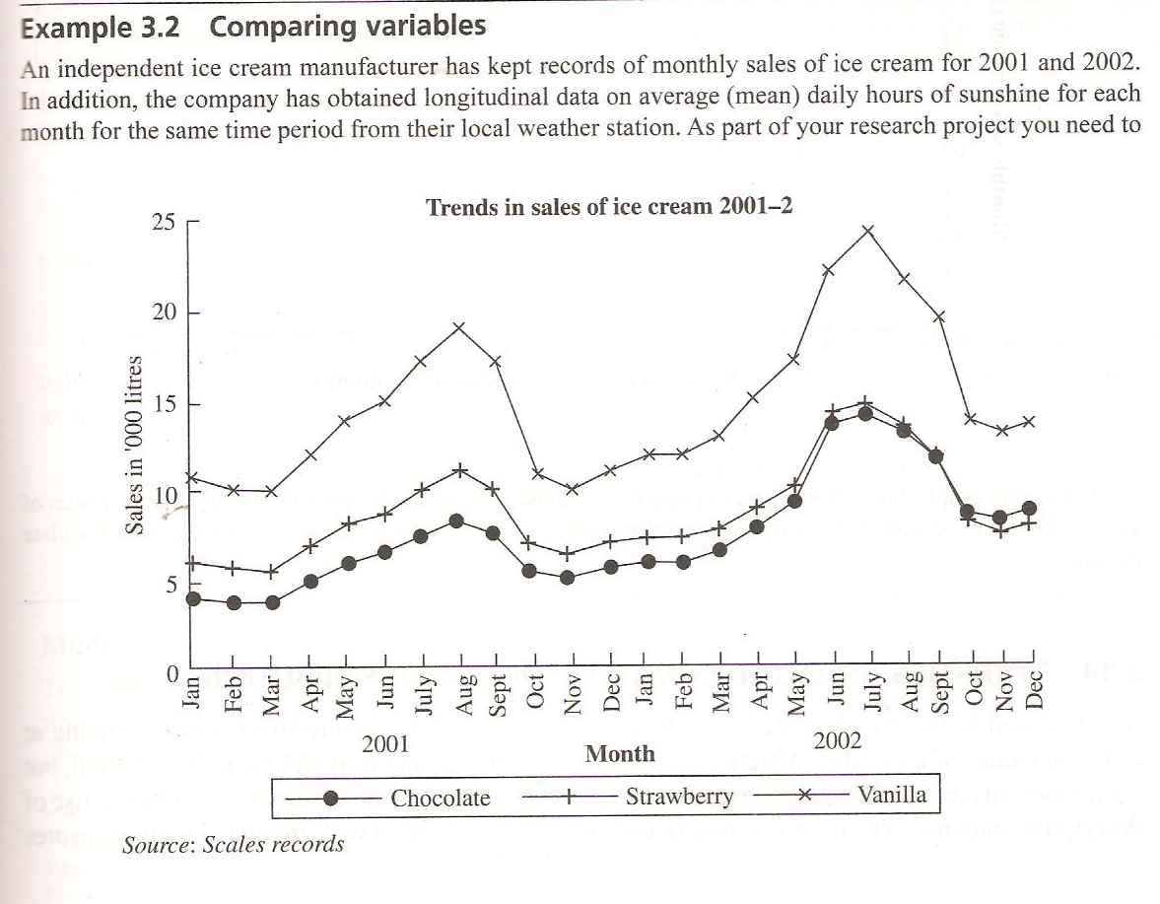

Slide 17
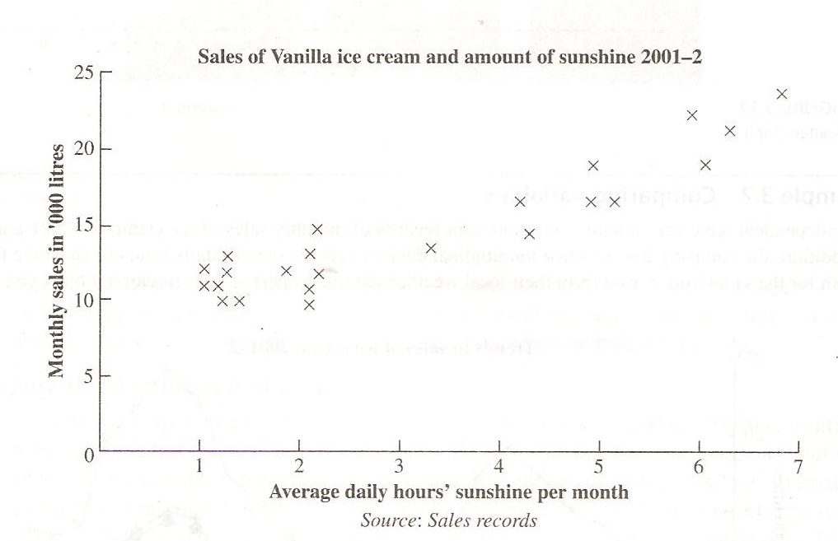

Slide 18
Statistics associated with frequency distributions
The most commonly used statistics associated with frequencies are;
  Measures of location
    Mean, mode and median
  Measures of variability
    Range, interquartile range, standard deviation, and coefficient of variation
  Measures of shape
    Skewnesss and kurtosis

Slide 19
MEASURES OF LOCATION
A statistic that describes a location within a data set.
Measure of central tendency describes the center of the distribution.

Slide 20
MEASURES OF LOCATION(contd.)
Mean
The average; that value obtained by summing all elements in a set and dividing by number of elements.
The mean, or average value, is the most commonly used measure of central tendency.

Slide 21
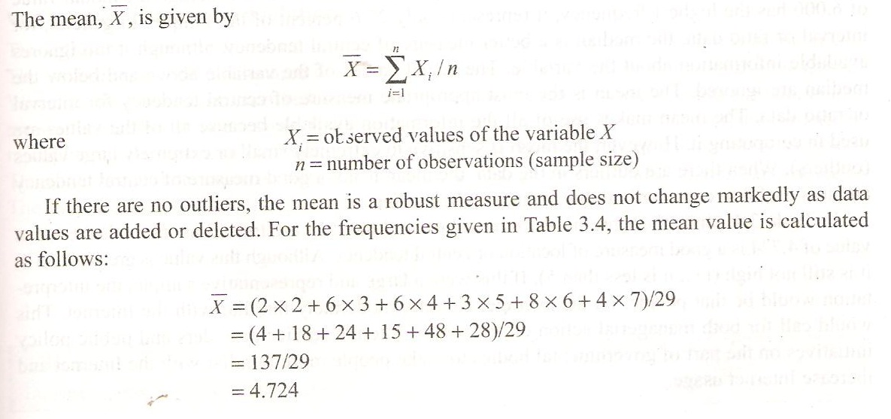

Slide 22
MEASURES OF LOCATION(contd.)
Mode
A measure of central tendency given as the value that occurs the most in a sample distribution.
The mode is the value that occurs most frequently.

Slide 23
MEASURES OF LOCATION(contd.)
It represents the highest peak of the distribution.
The mode is a good measure of location when the variable is inherently categorical or has otherwise been grouped into categories.

Slide 24
MEASURES OF LOCATION(contd.)
Median
A measure of central tendency given as the value above which half of the values fall and below which half of values fall.
The median of sample is the middle value when the data are arranged an ascending or descending order.

Slide 25
MEASURES OF LOCATION(contd.)
If the number of data is even, the median is usually estimated as the midpoint between the two middle values-by adding two middle values and dividing their sum by 2.
The median is the 50th percentile.

Slide 26
MEASURE OF VARIABILITY
Range
The difference between the largest and smallest values of a distribution.
The range measures the spread of data.

Slide 27


Slide 28
MEASURE OF VARIABILITY(contd.)
Interquartile range
The range of distribution encompassing the middle 50 percent of the observation.
The interquartile range is the difference between the 75th and 25th percentile

Slide 29
MEASURE OF VARIABILITY(contd.)
Variance and standard deviation
Variance
  The mean square deviation of all the values from the mean.
Standard deviation
  The square root of variance is standard deviation.

Slide 30
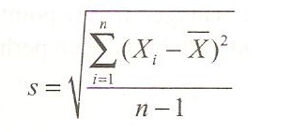

Slide 31
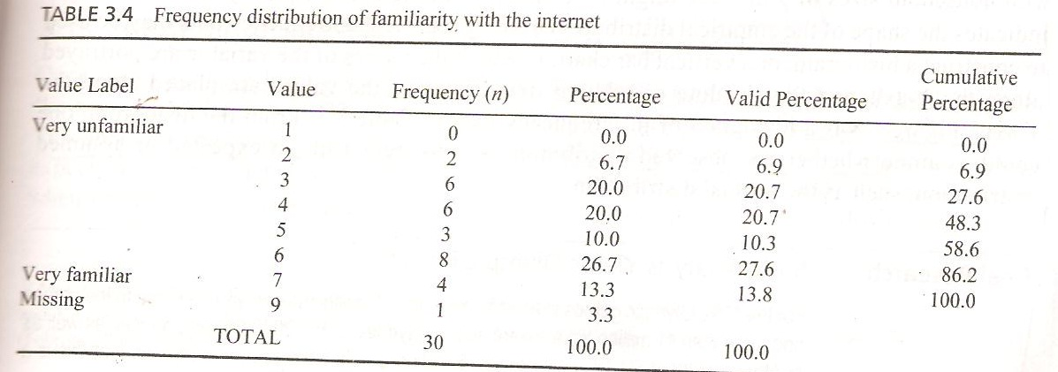

Slide 32
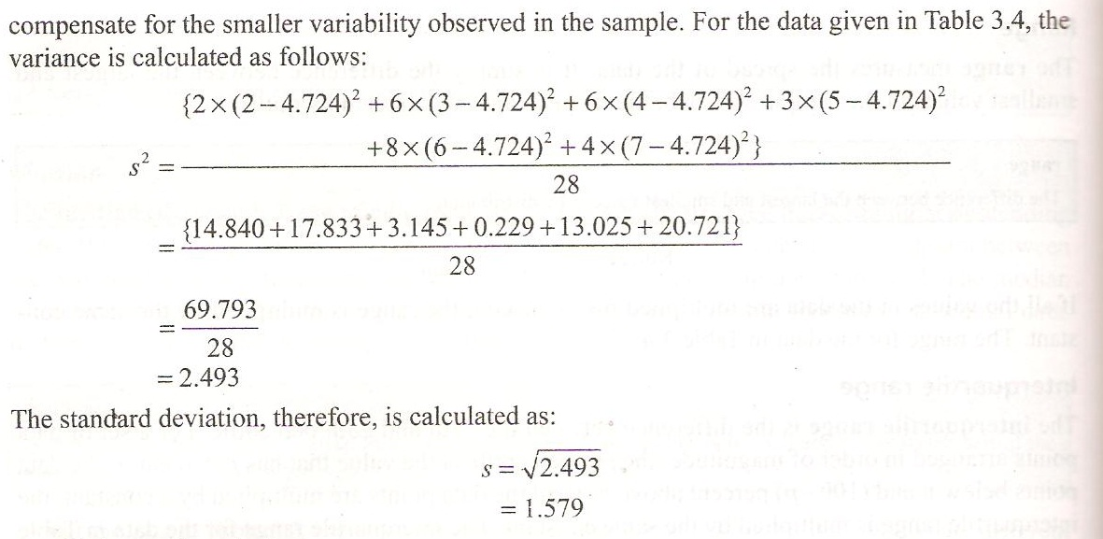

Slide 33
MEASURE OF VARIABILITY(contd.)
Coefficient of variation
A useful expression in sampling theory for standard deviation as a percentage of the mean.
It is the ratio of standard deviation to the mean, expressed as a percentage, and it is unit less measure of relative variability.

Slide 34


Slide 35
MEASURES OF SHAPE
Skewnesss
kurtosis

Slide 36
MEASURES OF SHAPE(contd.)
Skewness
Distribution can either be symmetrical or skewed.
It is the tendency of the deviation from the mean to be larger in one direction than in other direction.

Slide 37
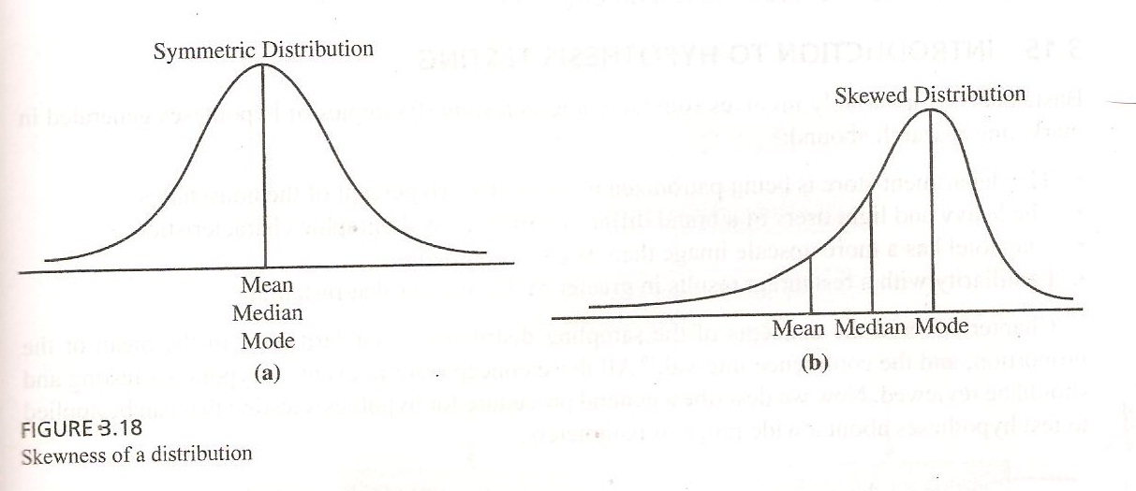

Slide 38
MEASURES OF SHAPE(contd.)
Kurtosis
It is the measure of relative peakdness or flatness of the curve defined by frequency distribution.
The kurtosis of a normal distribution is zero.

Slide 39
MEASURES OF SHAPE(contd.)
If the kurtosis is positive than the distribution is more peaked than a normal distribution.
A negative value means that distribution is flatter than a normal distribution.

Slide 40
Summary of This Session
Comparing variables
Measures of Location
Measures of Variability
Measures of Shape

Slide 41
Thank You

