Slide 1
MGT-491
QUANTITATIVE ANALYSIS AND RESEARCH FOR MANAGEMENT
Session 17
OSMAN BIN SAIF

Slide 2
Summary of Last Session
Treatment of missing response
Substitute a neutral value
Case wise deletion
Pair wise deletion
Weighting
Standardization
Statistical Techniques

Slide 3
FREQUENCY DISTRIBUTION
Marketing researchers often need to answer questions about a single variable.
For example:
  How many users of this brand may be characterized as brand loyal?
  What percentage of market consist of heavy users, medium users, light users, and nonusers?

Slide 4
FREQUENCY DISTRIBUTION(contd.)
Example (Contd.)
  How many customers are very familiar with a new product offering?
  How many are familiar, somewhat familiar, and unfamiliar with the brand?

Slide 5
FREQUENCY DISTRIBTION(contd.)
  What is the mean familiarity rating?
  Is there much variance in the extent to which customers are familiar with the new product?
  What is the income distribution of brand users?

Slide 6
FREQUENCY DISTRIBUTION(contd.)
The answer to these type of questions can be determined by examining frequency distribution.
In a frequency distribution, one variable is considered at a time.
The objective is to obtain a count of the numbers of responses associated with different values of the variable.

Slide 7
FREQUENCY DISTRIBUTION(contd.)
The relative occurrence, or frequency, of different values of this variable is then expressed in percentages.
A frequency distribution for a variable produces a table of frequency counts, percentages, and cumulative percentages for all the values associated with that variable.

Slide 8
FREQUENCY DISTRIBUTION(contd.)
A mathematical distribution whose objective is to obtain a count of number of responses associated with different values of one variable and to express these counts in percentage terms.

Slide 9
FREQUENCY DISTRIBUTION(contd.)
A frequency distribution helps determine the extent of item non-response;
  1 respondent out of 30
It also indicates the extent of illegitimate responses.
  Values of 0 and 8 would be illegitimate responses or errors.

Slide 10
FREQUENCY DISTRIBUTION(contd.)
The presence of outliers or cases with extreme values can also be detected.
The frequency data may be used to construct a histogram, or a vertical bar chart.

Slide 11
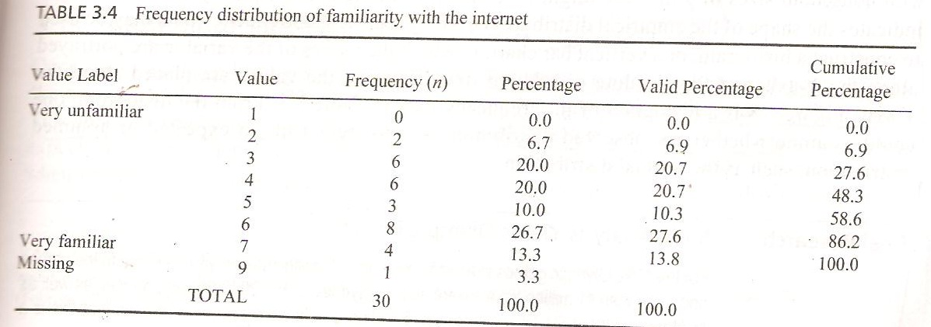

Slide 12
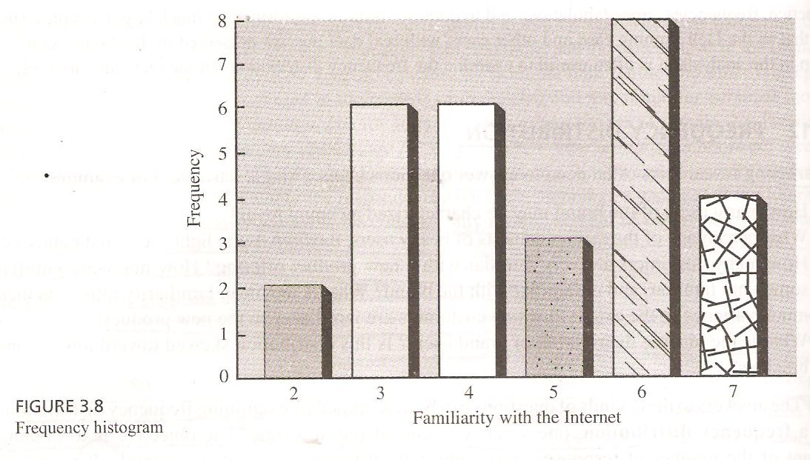

Slide 13
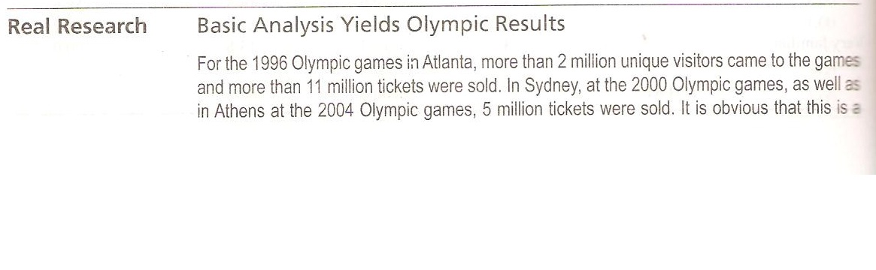

Slide 14
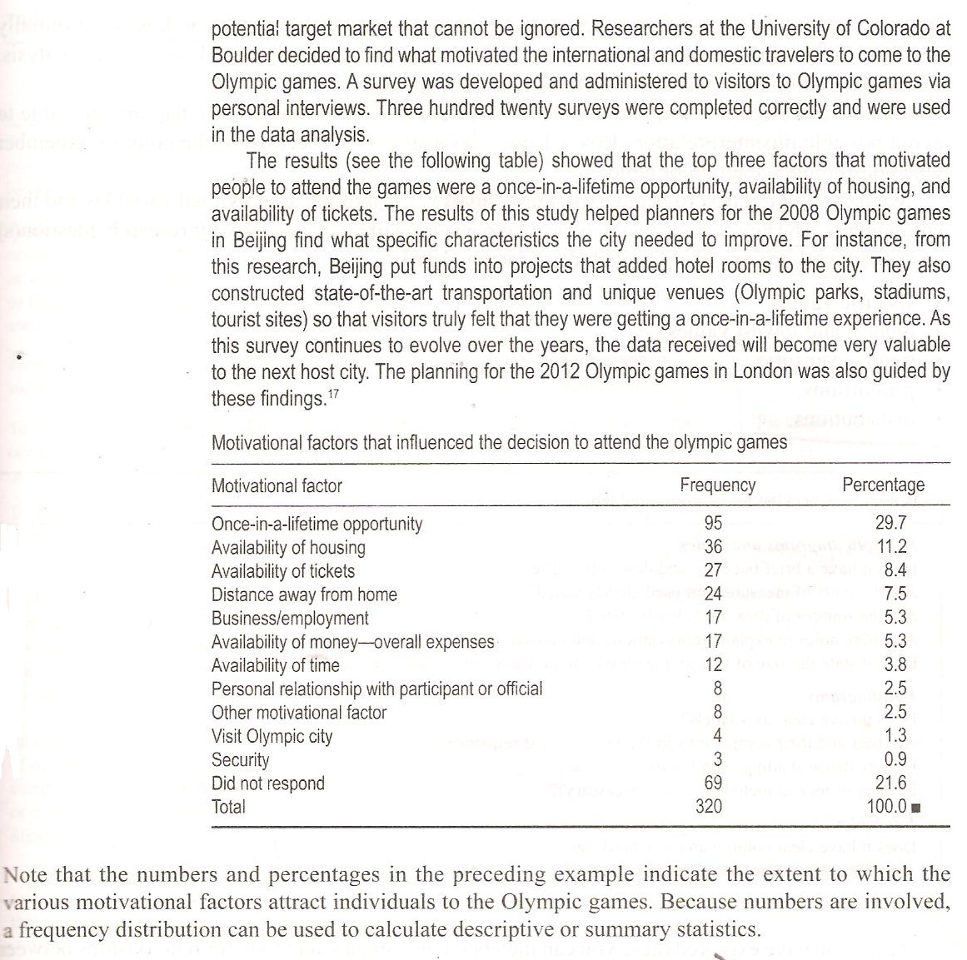

Slide 15
GRAPHICAL PRESENTATION OF DATA
Once your data has been entered and checked for errors, you are ready to start your analysis.
Exploratory data analysis approach is useful in these initial stages.
This approach emphasis the use of diagrams to explore and understand your data.

Slide 16
GRAPHICAL PRESENTATION OF DATA(contd.)
We have found it best to begin explanatory analysis by looking at individual variables and their components.
The key aspects you may need to consider will be guided by your research question(s) and objectives, and are likely to include:
  Specific values;
  Highest and lowest values;

Slide 17
GRAPHICAL PRESENTATION OF DATA(contd.)
Key aspects (Contd.)
  Trends over time;
  Proportions;
  Distribution;

Slide 18
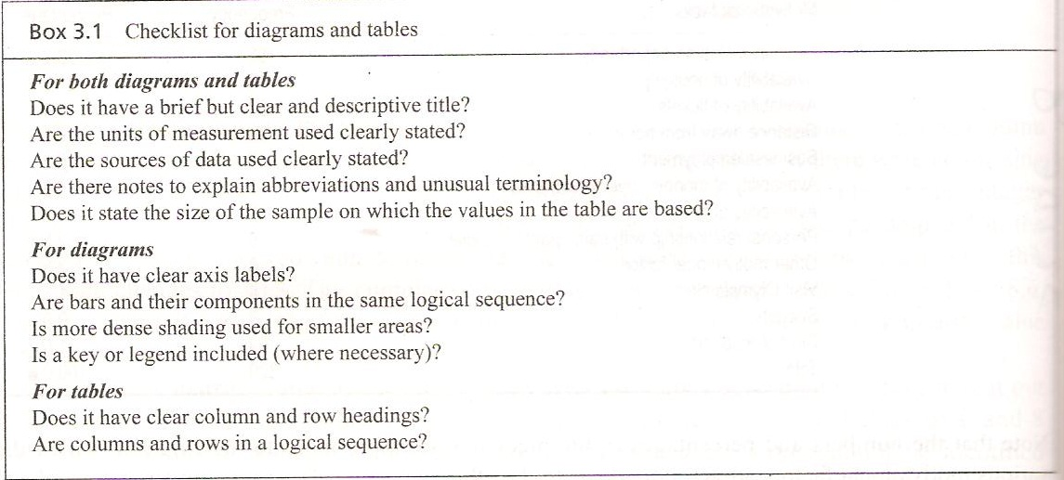

Slide 19
GRAPHICAL PRESENTATION OF DATA(contd.)
Once you have explored these you can then begin to compare and look for relationships between variables, considering in addition:
  Conjunctions(the point where value of two more variables intersect);
  totals;
  Interdependence and relationships.

Slide 20
EXPLORING AND PRESENTING INDIVIDUAL VARIABLES
To show specific values
To show highest and lowest values
To show proportions
To show the distribution of values

Slide 21
EXPLORING AND PRESENTING INDIVIDUAL VARIABLES(contd.)
To show specific values
The simplest way of summarizing data for individual variables is to use a table(frequency distribution).
For descriptive data, the table summarizes the number of cases (frequency) in each category.

Slide 22
EXPLORING AND PRESENTING INDIVIDUAL VARIABLES(contd.)
To show specific data
For variables where there are likely to be a large number of categories (or values for quantifiable data),you will need to group the data into categories that reflect your research question(s) and objectives.

Slide 23
EXPLORING AND PRESENTING INDIVIDUAL VARIABLES(contd.)
To show highest and lowest values
Diagrams can provide visual clues, although both categorical and quantifiable data may need grouping.
For categorical and discrete data, bar charts and pictograms are both suitable.
Most researchers use a histogram for continuous data. Prior to being drawn, data will be need to be grouped into class intervals.

Slide 24
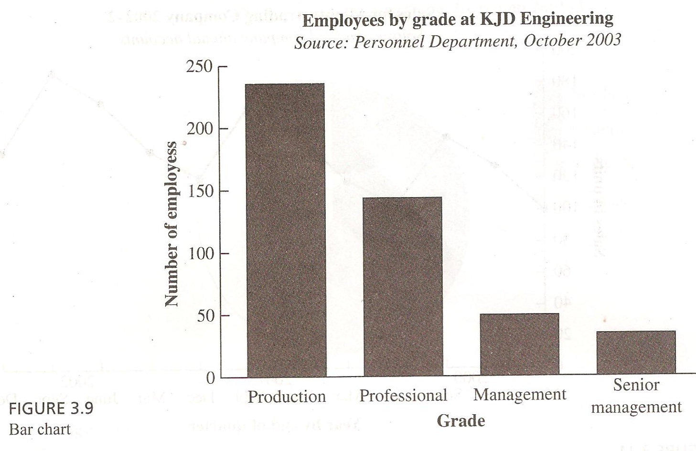

Slide 25
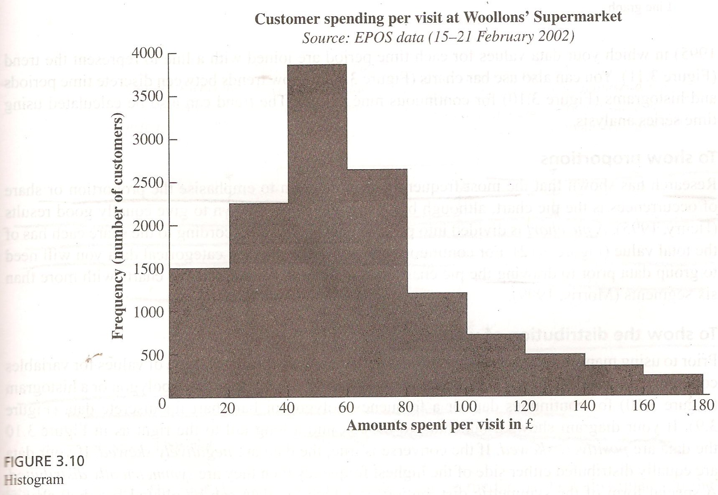

Slide 26
EXPLORING AND PRESENTING INDIVIDUAL VARIABLES(contd.)
To show trends
  Trends can be presented only for variables containing quantifiable longitudinal data.
  The most suitable diagram for exploring trends is a line graph.

Slide 27
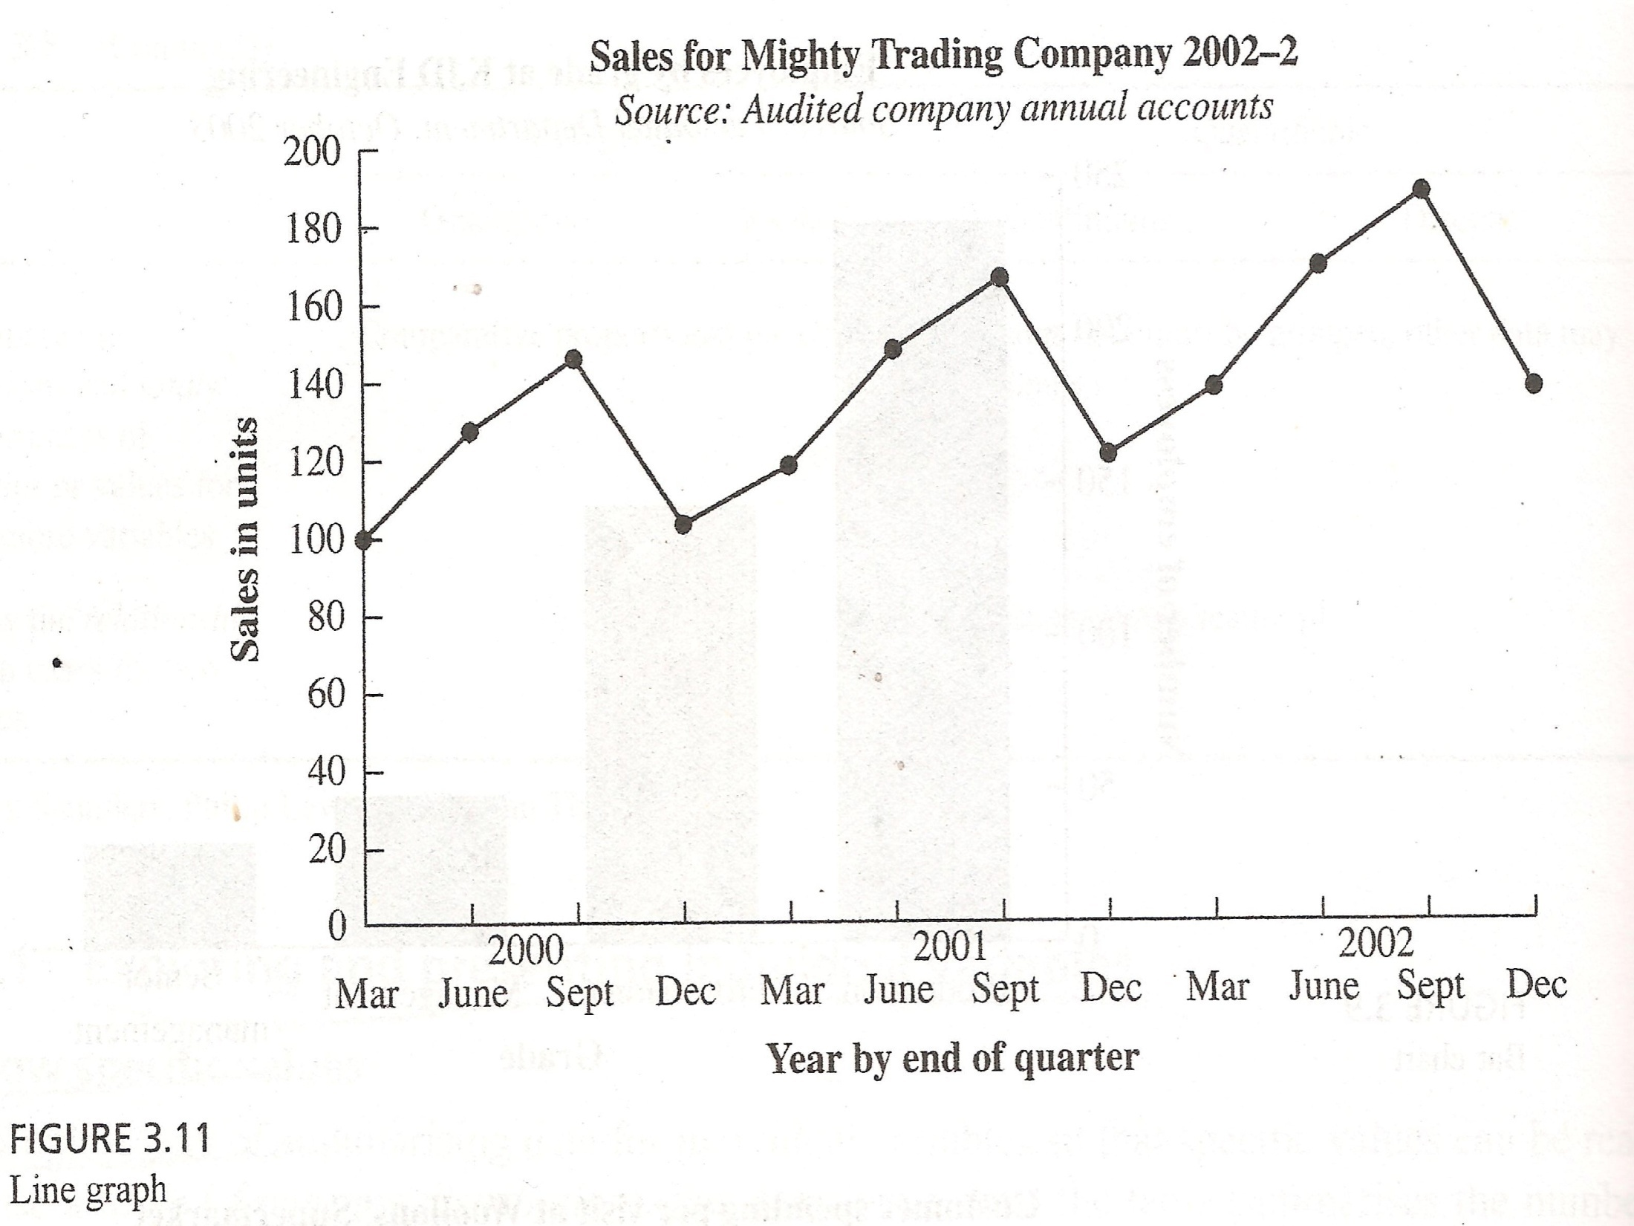

Slide 28
EXPLORING AND PRESENTING INDIVIDUAL VARIABLES(contd.)
To show proportions
Research has shown that most frequently used diagram to emphasize the proportions or share of occurrence is the pie chart.
Although bar charts have been shown to give equally good results.

Slide 29
EXPLORING AND PRESENTING INDIVIDUAL VARIABLES(contd.)
To show proportions
A pie chart is divided into proportional segments according to the share each has of the total value.
For continuous and some discrete and categorical data you will need to group data prior to drawing the pie chart, as it is difficult to interpret pie charts with more than six segments.

Slide 30
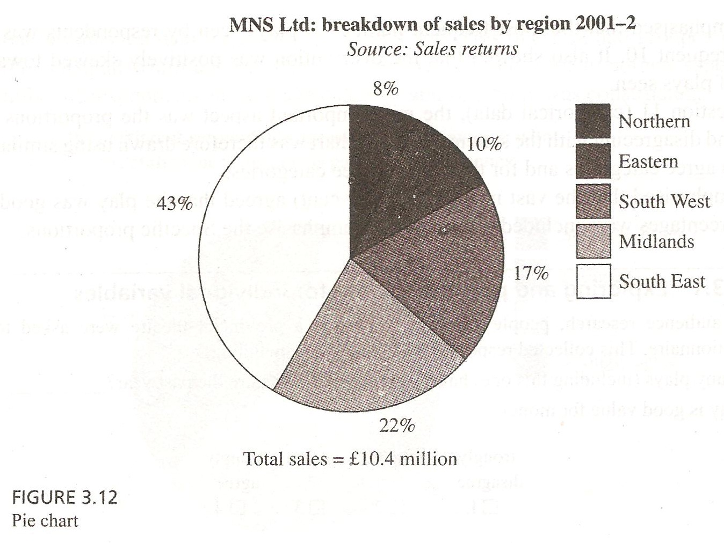

Slide 31
EXPLORING AND PRESENTING INDIVIDUAL VARIABLES(contd.)
To show the distribution of values
This can be seen by plotting either a frequency polygon or a histogram for continuous data or a frequency polygon or bar charts for discrete data.

Slide 32
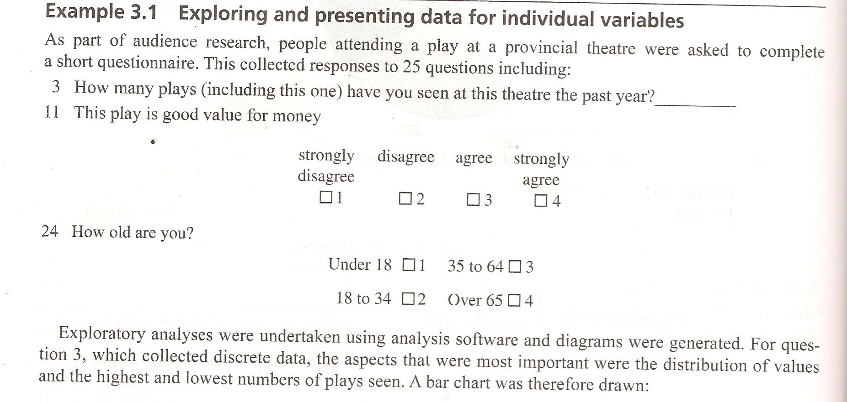

Slide 33
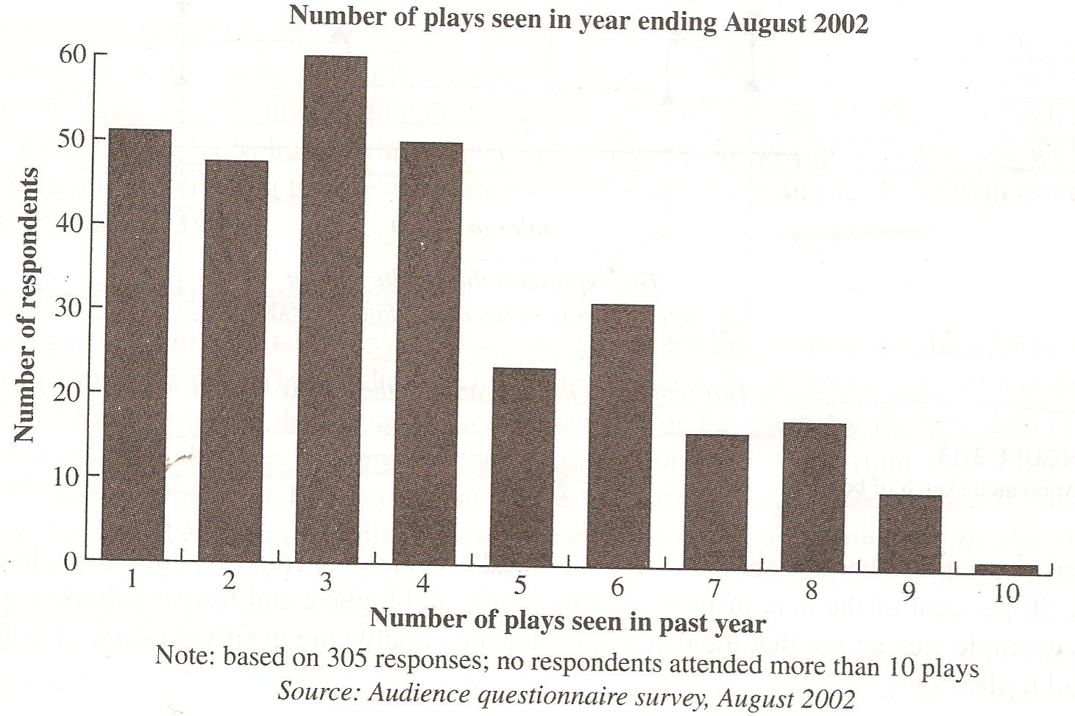

Slide 34
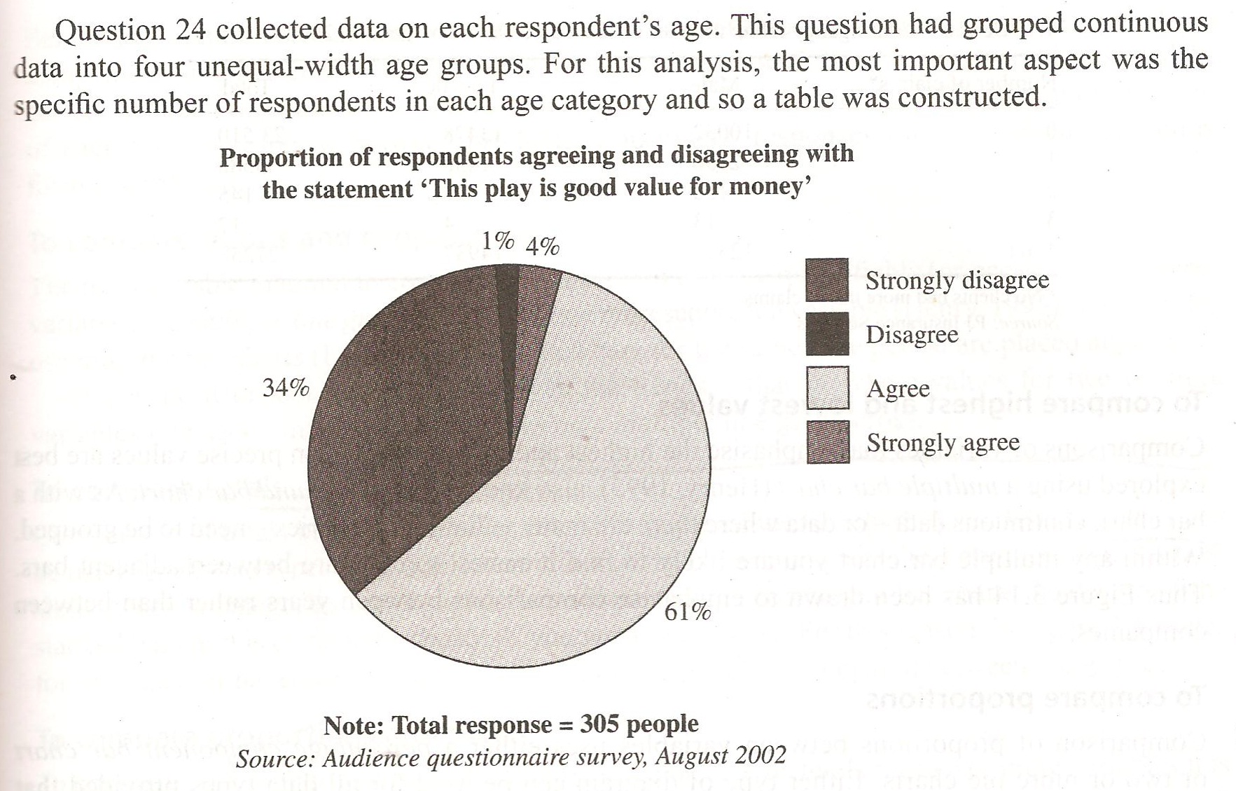

Slide 35
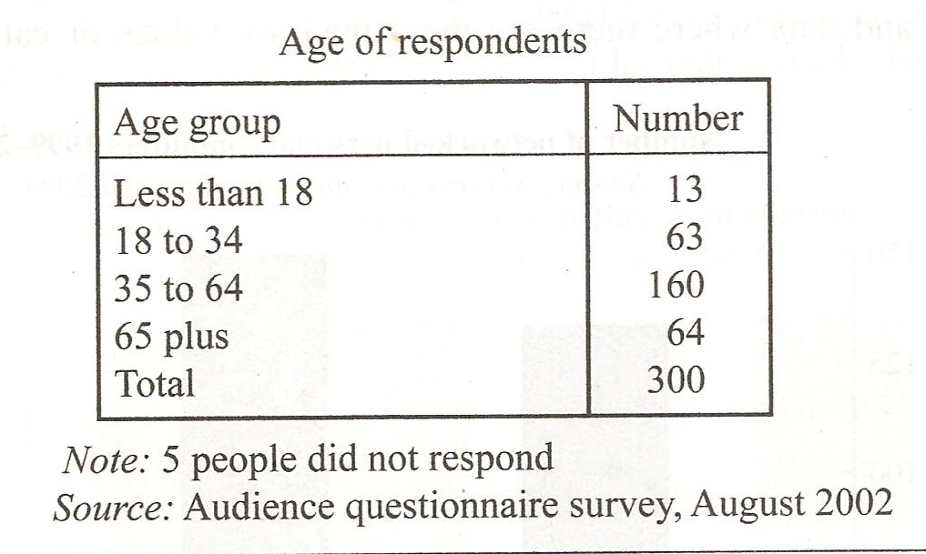

Slide 36
Summary of This Session
Frequency Distribution
Graphical presentation of data
Exploring and Presenting Individual Variables

Slide 37
Thank You

