Slide 1
MGT-491
QUANTITATIVE ANALYSIS AND RESEARCH FOR MANAGEMENT
Session 16
OSMAN BIN SAIF

Slide 2
Summary of last session
Preparation of data-process
Questionnaire checking
Editing
Coding
Data File
Consistency checks

Slide 3
Treatment of Missing Responses
Missing responses represent value of a variable that are unknown, either because respondents provided ambiguous answers or their answers were not properly recorded.

Slide 4
Item non Response
It occurs because the respondent refuses, or is unable to answer specific questions or items because of the content, form or the effort required.

Slide 5
Treatment of Missing Responses (Contd.)
There are two main options available for the treatment of missing responses;
  Substitute a neutral value.
  Substitute an imputed response.

Slide 6
Substitute a Neutral Value
A neutral value typically the mean response to the variable is substituted for the missing response.
Thus means of the variables remains unchanged
Other statistics such as correlations are not affected much

Slide 7
Substitute an Imputed Response
The respondents pattern of responses to other questions is used to impute or calculate a suitable response to the missing question.
The researcher attempts to infer from the available data the responses the individuals would have given, if they answered the question.

Slide 8
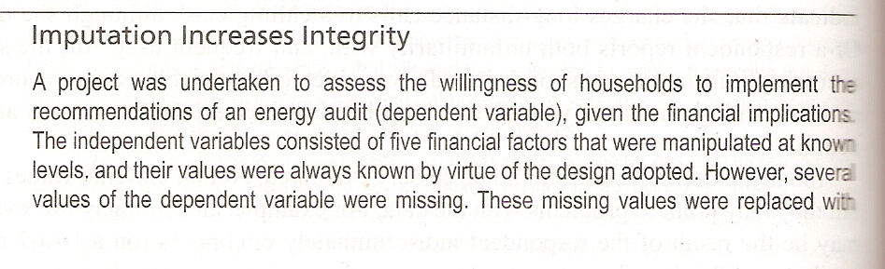

Slide 9
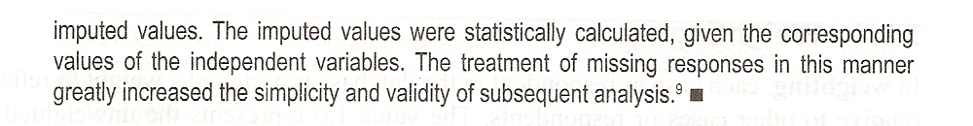

Slide 10
Case wise Deletion
Cases or respondents with any missing responses are discarded from the analysis.
This approach could result in a small sample.
Throwing away large amounts of data is undesirable, because it is costly and time-consuming to collect data.

Slide 11
Case wise Deletion (Contd.)
Furthermore, respondents with missing responses could differ from respondents with complete responses in systematic ways.

Slide 12
Pairwise deletion
Instead of discarding all cases with any missing values, the researcher uses only the cases or respondents with complete responses for the variable(s) involved in each calculation.

Slide 13
Pairwise deletion (Contd.)
As a result, different calculations in an analysis may be based on different sample sizes.
This procedure may be appropriate;
  The sample is large
  There are few missing responses
  The variables are not highly related.

Slide 14
Statistically adjusting the DATA
Procedures for statistically adjusting the data consists of ;
  Weighting
  Variable re-specification
  Scale transformation.

Slide 15
Weighting
A statistical adjustment to the data in which each case or respondent in the data base is assigned a weight to reflect its importance relative to other cases or respondents.

Slide 16
Weighting (Contd.)
It is most widely used to make the sample data more representative of a target population on specific characteristics.
Yet another use of weighting is to adjust the sample so that greater importance is attached to respondents with certain characteristics.

Slide 17
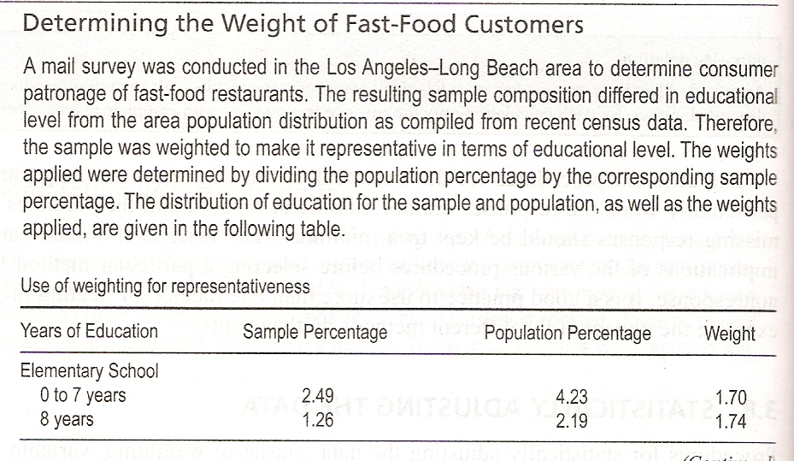

Slide 18
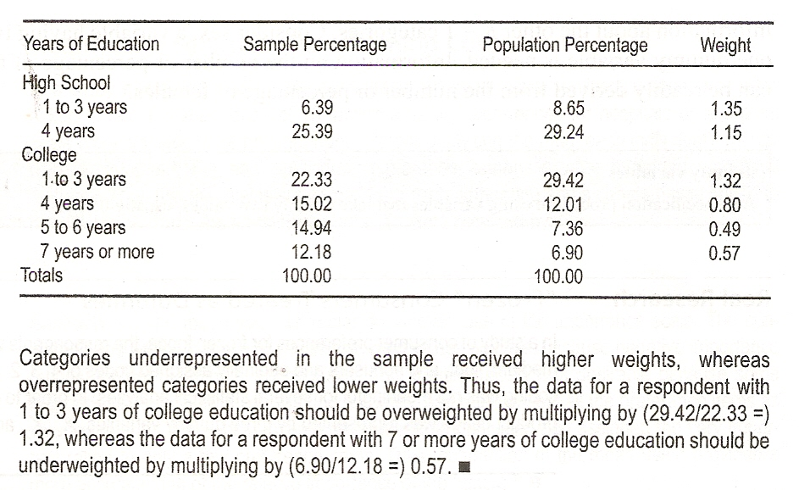

Slide 19
Variable Re-specification
The transformation of data to create new variables or the modification of existing variables so that they are more consistent with the objectives of the study.

Slide 20
Variable Re-specification (Contd.)
The purpose of the re-specification is to create variables that are consistent with the objectives of the study.
Example;
  Suppose the original variable was product usage with 10 response categories.
  These might be collapsed into four i-e heavy, medium, light, and non user.

Slide 21
Dummy Variable
A re-specification procedure using variable that take on only two values, usually 0 and 1.
These are also called binary and qualitative variables.
Example:
  Gender distribution prediction; Female= 1-Male

Slide 22
Scale Transformation
A manipulation of scale value to ensure comparability with other scales or otherwise make the data suitable for analysis.

Slide 23
Scale Transformation (Contd.)
Example;
  Some respondents consistently use the upper end of rating scale and vice versa.
  So different scales can be employed.
  Like for lifestyle a likert scale and for attitude a continuous rating scale.

Slide 24
Standardization
The process of correcting data to reduce them to the same scale by subtracting the sample mean and dividing by the standard deviation.
The standardized scale will have a mean of zero and standard deviation of 1.

Slide 25
Standardization (Contd.)
Standardization allows the researcher to compare variables that have been measured using different types of scales.

Slide 26
Selecting a data analysis strategy
The following steps are involved in selecting a data analysis strategy;
Earlier steps (I, II, III) of the Marketing research process
Known characteristics of the Data
Properties of Statistical techniques
Background and philosophy of the researcher
Data analysis strategy

Slide 27
Earlier Steps of Marketing Research process
Step 1;
  Problem definition
Step 2;
  Development of an Approach
Step 3;
  Research design

Slide 28
Known Characteristics of the Data
It is very important to know the characteristics of the data.
As the measurement scales used exert a strong influence on the choice of statistical technique.

Slide 29
Properties of Statistical Techniques
It is also very important to take into account the properties of the statistical techniques, particularly their purpose and underlying assumptions.
Some statistical techniques are appropriate for examining differences in variable, other for assessing the magnitudes of the relationships between variables, others for making predictions.

Slide 30
Background and Philosophy of the Researcher
It affects the choice of a data analysis strategy.
Researcher differs in their willingness to make assumptions about the variables and their underlying population.

Slide 31
Data Analysis Strategy
Researchers who are conservative about making assumptions will limit their choice of techniques to distribution-free methods.
Several techniques may be appropriate for analyzing the data.

Slide 32
Classification of Statistical Techniques
Statistical techniques can be classified as;
  Univeriate techniques
  Multivariate techniques

Slide 33
Univeriate Techniques
Statistical techniques appropriate for analyzing data when there is a single measurement of each element in the sample or if there are several measurements on each element, but each variable is analyzed in isolation.

Slide 34
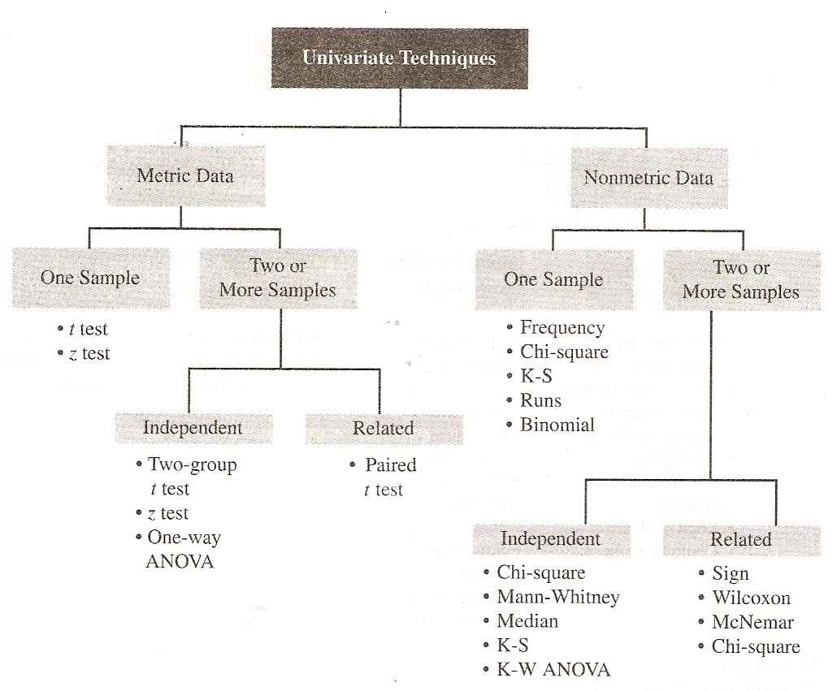

Slide 35
Classification of Univariate Techniques
They can be classified based on whether the data are metric or non-metric.
  Metric Data
    Data that are interval or ratio in nature
  Non-metric Data
    Data derived from nominal or ordinal scale

Slide 36
Classification of Univariate Techniques
They can be classified based on whether the data are metric or non-metric (Contd.).
  Independent
    The samples are independent if they are drawn randomly from different populations
  Paired
    The samples are paired when the data for the two samples relate to the same group of respondents

Slide 37
Multivariate Techniques
Statistical techniques suitable for analyzing data when there are two or more measurements on each element and the variables are analyzed simultaneously.
Multivariate techniques are concerned with the simultaneous relationships among two or more phenomenon.

Slide 38
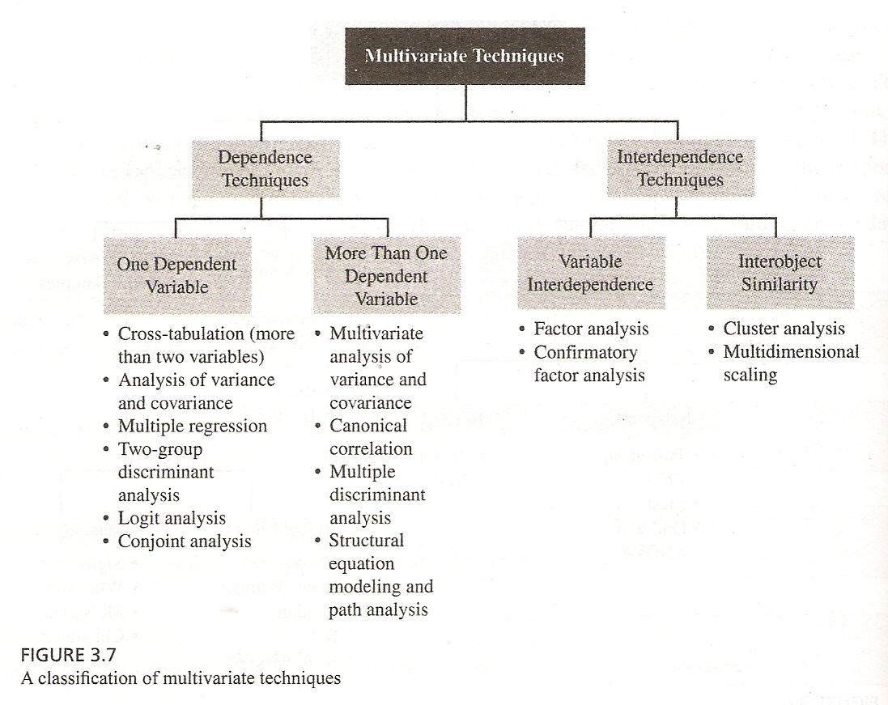

Slide 39
Classification of Multivariate Techniques
They can be classified as;
  Dependence Techniques;
    They are appropriate when one or more of the variables can be identified as dependent variables and the remaining as independent variables.

Slide 40
Classification of Multivariate Techniques
They can be classified as;
  Interdependence Techniques;
    That attempts to group data based on underlying similarity, and thus allow for interpretation of the data structures.
    No distinction is made as to which variables are dependent and which are independent.

Slide 41
Summary of This Session
Treatment of missing response
Substitute a neutral value
Case wise deletion
Pair wise deletion
Weighting
Standardization
Statistical Techniques

Slide 42
Thank You

