Slide 1
MGT-491
QUANTITATIVE ANALYSIS AND RESEARCH FOR MANAGEMENT
Session 15
OSMAN BIN SAIF

Slide 2
Brief Course Contents
Section 3; Data Analysis and Presentation
  Editing and Coding of Data
  Tabulation
  Graphic presentation
  Cross tabulation
  Testing of Hypothesis
  Type I and II errors

Slide 3
Brief Course Contents (Contd.)
Section 3; Data Analysis and Presentation (Contd.)
  One tailed and two tailed test of significance
  Test of association
  Simple Linear regression
  Research report Writing
  Case review and analysis

Slide 4
Data Preparation
First ;
  Data collection process;
    Checking the questionnaires
    Editing and handling of illegible, incomplete, inconsistent, ambiguous or unsatisfactory response data
    Coding, data cleaning, treatment of missing responses, statistical adjustment.
    Selection of data analysis strategy and statistical techniques.

Slide 5
The data preparation process
The entire process is guided by the preliminary plan of data analysis that was formulated in the research design phase.

Slide 6
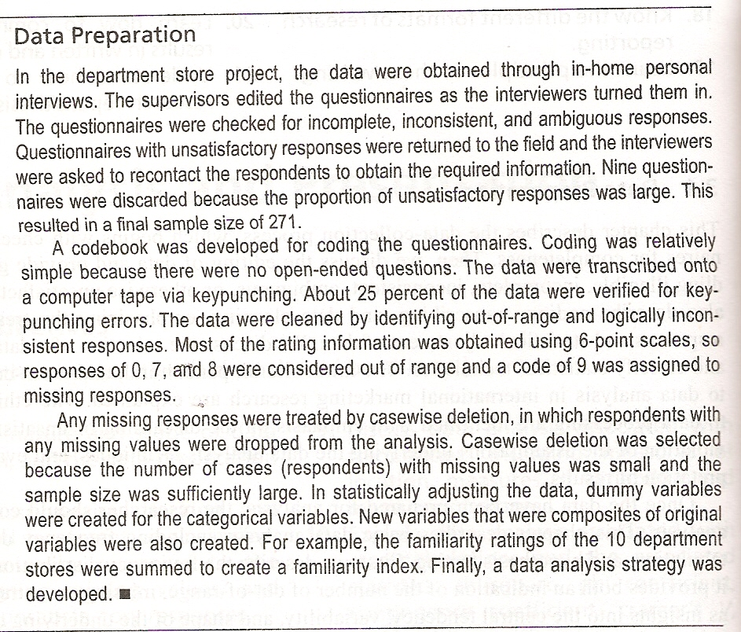

Slide 7
The data preparation process (Contd.)
Data preparation process should begin as soon as the first batch of questionnaires is received from the field, while the field work is still going on.
Thus if any problems are detected, the fieldwork can be modified to incorporate corrective action.

Slide 8
The data preparation process (Contd.)
Preparing preliminary plan for Data Analysis
Questionnaire Checking
Editing
Coding
Transcribing
Data Cleaning
Statistically adjusting the data
Selecting a Data Analysis Strategy

Slide 9
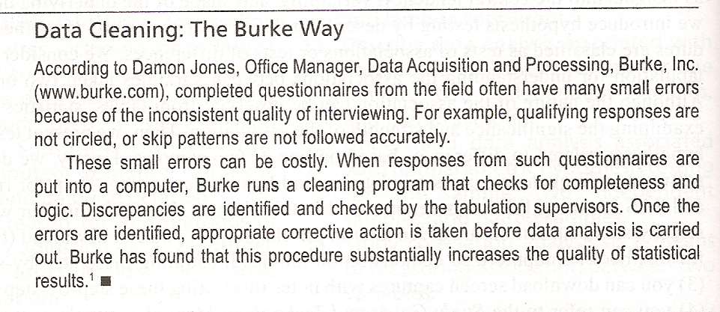

Slide 10
Questionnaire Checking
The initial step in questionnaire checking involves a check of all questionnaires for completeness and interviewing quality.
Often these checks are made while fieldwork is still underway.

Slide 11
Questionnaire Checking (Contd.)
A questionnaire returned from the field may be unacceptable for several reasons;
  Parts are Incomplete
  Patterns of responses indicate that respondent did not understand or follow the instructions.
  Physically incomplete – pages missing.
  Received after pre-established cut off date.
  Answered by someone who does not qualify for participation.

Slide 12
Editing
A review of the questionnaire with the objective of increasing accuracy and precision of the collected data.
Example;
  Responses may be illegible if poorly recorded.

Slide 13
Treatment of Unsatisfactory Responses
It involves three usual remedies.
  Returning to the field
  Assigning the missing value
  Discarding unsatisfactory respondents.

Slide 14
Returning to the field
Unsatisfactory response may be returned to the field where interviewers recontact the respondents.
This approach is particularly attractive for business and industrial marketing surveys because of small sample size.

Slide 15
Assigning missing value
If the previous remedy is not feasible then, editor may assign missing values to the unsatisfactory responses.

Slide 16
Assigning missing value (Contd.)
This approach is desirable if;
  The number of respondents with unsatisfactory responses is small.
  The proportion of unsatisfactory responses for each of these respondents is small.
  The variables with unsatisfactory responses are not key variables.

Slide 17
Discarding unsatisfactory respondents
The respondents with unsatisfactory responses are simply discarded.
This approach may have merit;
  The number of respondents with unsatisfactory responses are small
  The sample size is large
  The unsatisfactory respondents do not differ from satisfactory respondents in obvious ways e.g demographic.

Slide 18
Discarding unsatisfactory respondents (Contd.)
  The proportion of unsatisfactory responses for each of these respondents is large
  Responses on key variables are missing.

Slide 19
Coding
The assignment of a code to represent a specific response to a specific question along with the data record and column position that code will occupy.

Slide 20
Coding (Contd.)
If the questionnaire contains only structured questions or very few unstructured questions, it is precoded.
This means that codes are assigned before field work is conducted.

Slide 21
Coding questions
The respondent code and the following should appear on each record in the data;
  Project code
  Interviewer code
  Date and time codes
  Validation codes

Slide 22
Fixed Field Codes
It means that the number of records for each respondent is the same and the same data appear in the same columns for all the respondents.
Also standard codes should be used.
Example;
  Do you have a currently valid passport?
    1=YES , 2=NO

Slide 23
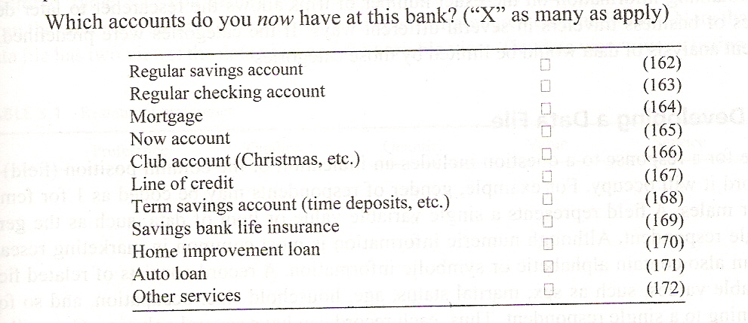

Slide 24
Code Book
A book containing coding instructions and the necessary information about the variables in the data set.

Slide 25
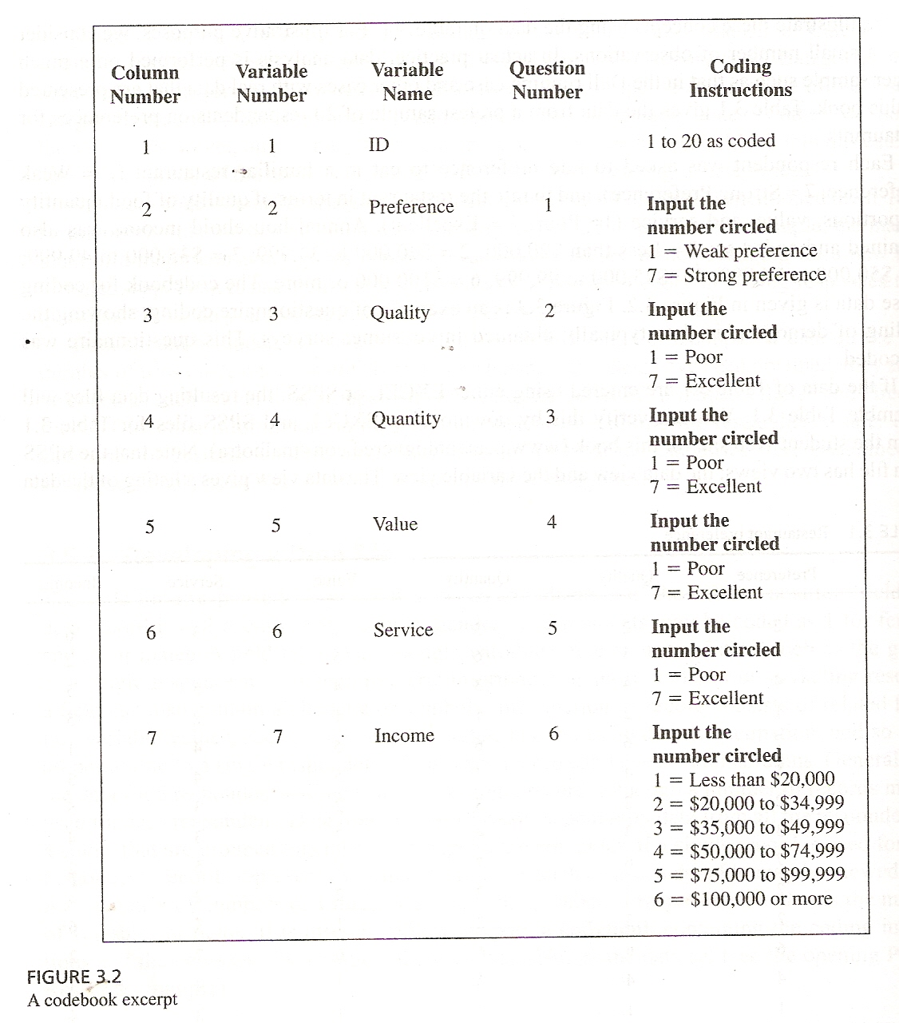

Slide 26
Developing a Data File
The code for a response to a question includes an indication of the column position and data record or row it will occupy.
A field represents a single variable or item of data.
A record consists of related fields.

Slide 27
Developing a Data File (Contd.)
Data files are sets of record, generally data from all the respondents in a study, that are grouped together for storage in the computer.
A spreadsheet program such as EXCEL is used to enter data, as most analysis programs can import data from a EXCEL spreadsheet.

Slide 28
Developing a Data File (Contd.)
CASE EXAMPLE;
  Data from a pretest sample of 20 respondents on preferences for restaurants.
  Each respondent was asked to rate preference to eat in a familiar restaurant (1=weak, 7=strong).
  Rate restaurant in terms of quality of food, quantity of proportions, value and service (1=Poor, 7=Excelent).

Slide 29
Developing a Data File (Contd.)
CASE EXAMPLE;
  Annual household income was also obtained and coded (1=less than Rs.20,000, 2=Rs.20,000 to Rs.34,999, 3=Rs.35,000 to Rs.49,999, 4=Rs.50,000 to Rs.74,999, 5=Rs.75,000 to Rs.99,999, 6=100,000 and more)

Slide 30
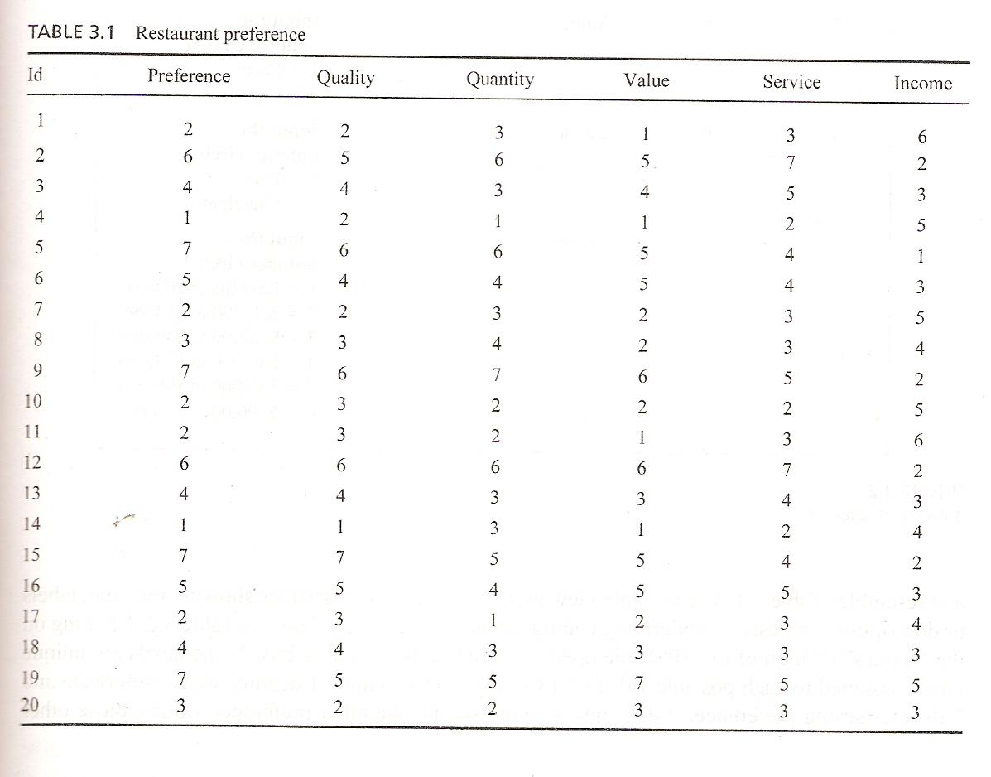

Slide 31
Transcribing
It involves transferring the coding data from the questionnaires or coding sheets onto disks or directly into computers by keypunching or any other means.

Slide 32
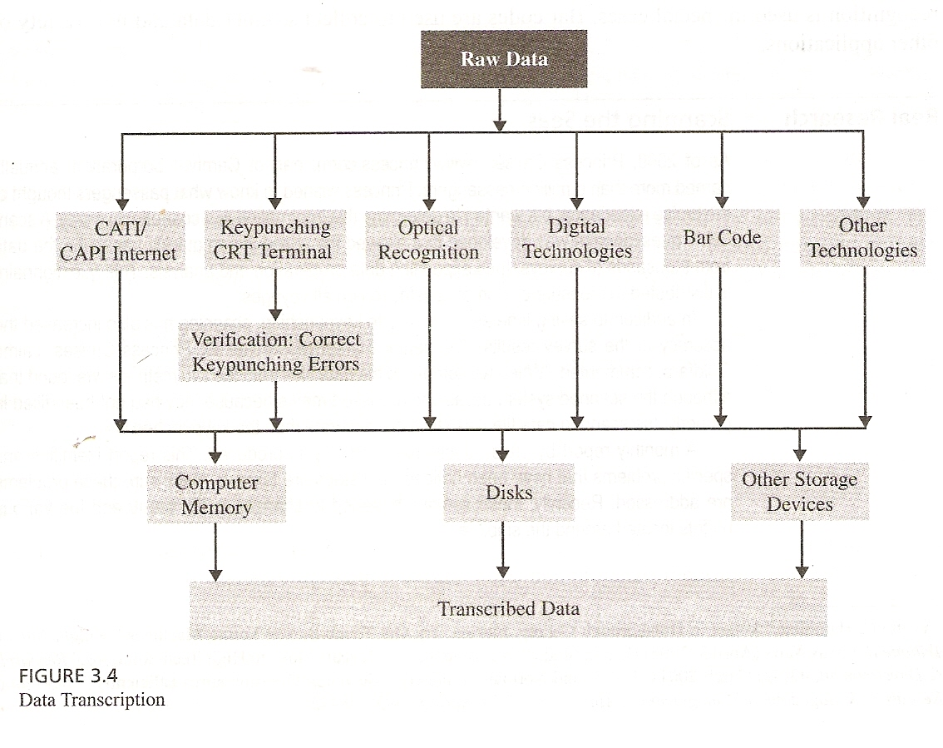

Slide 33
Data Cleaning
Thorough and extensive checks for consistency and treatment of missing responses.

Slide 34
Consistency Checks
A part of the data cleaning process that identifies data that are out of range, logically inconsistent, or have extreme values. Data with values not defined by the coding scheme are inadmissible.

Slide 35
Consistency Checks
Example;
  Responses can be logically inconsistent in various ways.
  A respondent may indicate that she charges long-distance calls through a calling card, although she does not have one.

Slide 36
Consistency Checks (Contd.)
Example;
  A respondent reports both unfamiliarity with and frequent usage of the same product.

Slide 37
Summary of this session
Preparation of data-process
Questionnaire checking
Editing
Coding
Data File
Consistency checks

Slide 38
Thank You

