Slide 1
MGT-491
QUANTITATIVE ANALYSIS AND RESEARCH FOR MANAGEMENT
Session 14
OSMAN BIN SAIF

Slide 2
Brief Course Contents
Section 2; Measurement and Scaling, data Source and Data Collection
  Primary Data Collection from observations
  Surveys and Experimentation
  Commonly used scales in business research
  Checking reliability and validity of scales

Slide 3
Brief Course Contents (Contd.)
Section 2; Measurement and Scaling, data Source and Data Collection
  Designing instrument for data collection
  Testing the instrument
  Data collection process
  Sampling methods and procedures
  Sample size decisions

Slide 4
Primary Data
The researcher using one or more tools like observation, questionnaire, interview and projective techniques, gather primary data.
The type of tool used depends upon research design.
A combination of different tools is generally preferred.

Slide 5
Field Research/ Primary data collection methods
The primary data relevant to a problem is collected by one of the standard methods of research;
  Experiments
  Surveys
  Field studies
  Case studies
  System studies
  Etc.

Slide 6
Field Research/ Primary data collection methods (Contd.)
The basic methods and tools for data collection for research include;
  Observation
  Questionnaire
  Interview
  Projective technique

Slide 7
Observation
It is the most direct method of primary data collection & is used when other methods are not feasible.
Facial expression and body language can give rich information to the observers.

Slide 8
Primary data collection from observations
Observation is the most direct form of data collection.
Usually data is gathered by observation when it can be gathered accurately only by this method.
Example;
  Behavior of children who cannot talk.

Slide 9
Survey
Questionnaires are preferred in most surveys because they are less expensive.
Skills required to administer them are also less than what is required for interviewing.
Large sample can be dealt with simultaneously as mailing is possible.
One great disadvantage is low response.

Slide 10
Designing instrument for data collection process and testing the instrument
A questionnaire is a formalized set of questions aimed at eliciting information regarding facts, level of knowledge, attitudes, needs and motivation.
At the current level of standardization of the design of questionnaires, it can be treated more as an art than a science.

Slide 11
Questionnaires
Are preferred when large sample needs to be handled and where more objectivity is required.

Slide 12
Interviews
Are best suited to obtain information on attitudes, behavior, needs and characteristics of people.

Slide 13
Interviews
Interviews can be used in all segments of the population whereas questionnaires can be used only with educated segments, particularly where the questions tend to become complex.
The sample for interviews tend to be more representative than in case of questionnaires as people are generally more inclined to talk than to write.

Slide 14
Interviews (Contd.)
Interview are more flexible in the sense a little more customer oriented than standard.
A skillful interviewer can overcome unwillingness on the part of the respondents to answer emotionally laden or complex questions.

Slide 15
Focused group Interviews
They are used to reflect a particular behavior or characteristics and is led by a moderator.
Focuses on a given experience and its effects.
Group is informed about the topic in advance.
Respondents are free to express their own lines of thought but are controlled only to the general discussion of the responses to the subject under focus.

Slide 16
Concept of Causality
Concept of Causality;
  Experimentation is commonly used to infer causal relationships.
  A statement such as ‘X causes Y’
  Or when the occurrence of X increases the probability of the occurrence of Y.

Slide 17
Measurement
Is the assignment of the numbers to objects or is the amount of the property possessed by objects.

Slide 18
Measurement and Scaling (Contd.)
Measurement;
  It has been defined as “the matching of an aspect of one domain to an aspect of another”.
Scaling;
  Is a procedure for attempting to determine quantitative measures of subjective abstract concepts.

Slide 19
Nominal scale
This is a measurement procedure to classify objects, events and individuals into categories.
Nominal scales are least restrictive and widely used in social sciences research.
Nominal means “in name only”.
Examples;
  Telephone numbers
  Departmental accounting codes

Slide 20
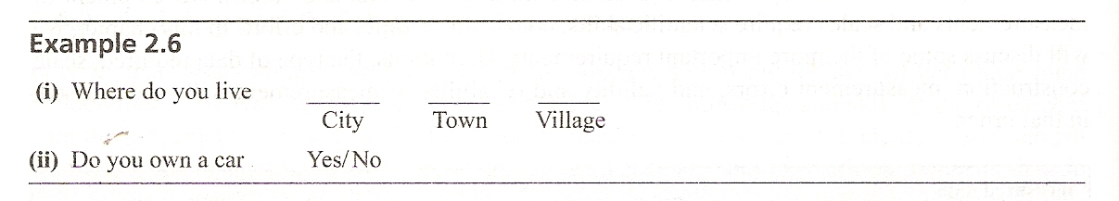

Slide 21
Ordinal scales
This scale is used to measure data having transitivity (if x>y, and y>z then x>z) property.
It includes the characteristics of nominal scales in addition to indicating order.

Slide 22
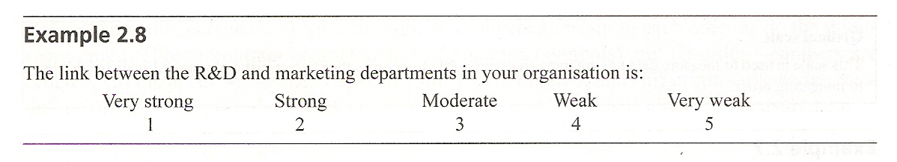

Slide 23
Errors in Measurement (Contd.)
Major of these errors are;
  Errors due to interviewer
  Errors due to instrument
  Errors due to respondents

Slide 24
Non Sampling Errors
These errors relate to the data collection procedures of observation interview and survey.
They are of two kinds;
  Non Observation errors
  Observation errors

Slide 25
Sources of Errors
The sources of Error are;
  Inadequate data specification
  Inadequate or faulty method of interview, observation, measurement
  Lack of trained investigators
  Inadequate scrutiny of basic data
  Errors in coding data entry and verifications
  Errors in presenting and printing
  Non Coverage errors
  Response errors

Slide 26
Non-Observation Errors
Which are due to some elements not having being studied.
These errors arise in sampling surveys because some population elements of interest are not studied.
Example:
  Missing out a company in the sample (non coverage)
  Duplication of company in the sample (Over coverage)

Slide 27
Observation Errors
Which are due to respondents not answering certain questions or answers deliberately wrongly.
Interviews are much better than questionnaires from the point of view of observation errors due to spontaneous answers.

Slide 28
Validity and Reliability
IN management & social sciences, the variables and constructs are highly abstract and the measurement tends to be indirect.
Therefore validity and reliability assume great importance.

Slide 29
Validity and Reliability in Measurement (Contd.)
Validity refers to the extent to which a test/ instrument measures what we actually wish to measure.
Reliability has to do with accuracy and precision of a measurement procedure.
Practicality is concerned with a wide range of factors of economy, convenience, interpretability.

Slide 30
Validity in Experiment
When conducting an experiment, A researcher has two goals;
  Draw valid conclusions about the effects of independent variables on the study group
  Make valid generalizations to a larger population of interest.
The first goal concerns internal validity
And the second goal concerns external validity

Slide 31
Quantitative Judgment Methods
These include;
  Direct Judgment methods
  Fractionation
  Constant sum method

Slide 32
Direct Judgment Method
The respondent is required to give a numerical rating to each stimulus, with respect to some designated characteristics.
In the unlimited type, the respondent may choose his or her own number in graphical method to position the rating on a line
  I-----------------------------------------I

Slide 33
Direct Judgment Method (Contd.)
In the limited type, the respondent has limited choice, as given by the researcher.
  I 1 I 2 I 3 I 4 I I I I I I I I 12 I

Slide 34
Fractionation Method
In fractionation method, a number denoting the ratio between two stimuli, with respect to some characteristics, is estimated.

Slide 35
Constant Sum Methods
Constant sum methods are used to standardize the scale across respondents by requiring them to allocate a given total score (say 100) among the stimuli ( total adds up to a constant and hence the name).

Slide 36
Sampling technique
Your choice of sampling technique is dependent on the feasibility and sensibility of collecting data to answer your research question(s) and to address your objectives from the entire population.

Slide 37
Sampling techniques
Choice of sampling technique is dependent on your research questions and objectives;
  Research questions and objectives that need you to estimate statistically the characteristics of the population from a sample require probability samples.
  Research questions and objectives that do not require such generalizations can make use of non-probability sampling techniques.

Slide 38
Confidence Factor
Factors such as the confidence that is needed in the findings, accuracy required and likely categories for analyses will affect the size of the sample that need to be collected.
  Statistical analyses usually require a minimum sample size of 30.
  Research questions and objectives that do not require statistical estimation may need far smaller samples.

Slide 39
Availability of resources
Sample size and the technique used are also influenced by the availability of resources, in particular financial support and time available to select the sample and to collect, enter into a computer and analyze the data.

Slide 40
Thanks

