Slide 1
MGT-491
QUANTITATIVE ANALYSIS AND RESEARCH FOR MANAGEMENT
Session 13
OSMAN BIN SAIF

Slide 2
Summary of Last Session
Factor Scales
Standardized instruments
Validity in Measurement
Reliability in Measurement
Stability
Equivalence
Practicality

Slide 3
SAMPLING
SAMPLING
SAMPLING METHODS
PROCEDURES
SAMPLE SIZE DECISIONS

Slide 4
SAMPLE
A sample is used when it is not possible or practical to make all possible observations of a phenomenon that is being studied.

Slide 5
SAMPLE (Contd.)
Measurements are made on the sample characteristics and are used to estimate the characteristics of the larger group.
Thus samples enable parsimony of data collection effort.

Slide 6
SAMPLE (Contd.)
Collectively the entire group of study objects is called the population.
These may be people, geographic area, organizations, product , services and so on.

Slide 7
SAMPLE (Contd.)
If the entire group of study objects are investigated, then its called census.
A sample may be one object (smallest sample) or one less than the population (largest sample).

Slide 8
Sampling method
This answers two questions;
  How many observations should be made or subjects should be selected (size)?
  Which subjects should be selected (design)?

Slide 9
Sample size
Sample size may be determined based on judgment or statistically on the requirements of error and confidence.

Slide 10
Sampling Design
There are two aspects in sampling design.
The first is the selection of elements from the population and the second is the basis on which representativeness of the sample is obtained.

Slide 11
Sampling Design (Contd.)
The selection of the elements individually from large population is called un-restricted sampling.
When the element selection is controlled, the sampling is restricted sampling.

Slide 12
Sampling Process
Steps involved in sampling process are as follows;
  Definition of population
  Specification of sampling frame
  Specification of sampling unit
  Selection of sampling method
  Determination of sample size

Slide 13
1.Definition of Population
A population is defined in terms of ;
  Elements
  Sampling units
  Extent
  Time

Slide 14
1.Definition of Population (Contd.)
Example;
  In a survey of manufacturing organization, the population was defined as;
Element | manufacturing, planning, control activity
Sampling unit | Batch manufacturing organizations in engineering, industries
Extent | Have been manufacturing engineering goods
Time | Past two years

Slide 15
2. Specification of sampling frame
For probability sampling one has to have a sampling frame. Errors may occur when researcher fails to access the elements through telephone or from industrial directories.

Slide 16
2. Specification of sampling frame (Contd.)
For non-probability sampling, convenience or referrals may suffice to specify the sample, the researcher always utilize his/her own sense of judgment.

Slide 17
2. Specification of sampling frame (Contd.)
Example;
  Government publication on industries
  List of batch manufacturing engineering firms listed in Karachi stock exchange.

Slide 18
3. Specification of the sampling unit
It is the basic unit containing the elements of the population.
Example;
  Heads of manufacturing divisions like Directors, Vice Presidents, or General managers.

Slide 19
4. Selection of Sampling method
Sampling method is the way in which the sample units are selected.
Example;
  Use of check sampling method in an exploratory study. The method includes the selection criteria or just availability, if the number in the population is not large.

Slide 20
5. Determination of sample size
The number to be sampled can be decided on statistical analysis when the sample size is large.
It can be modified by considerations of availability, cost and accessibility.

Slide 21
Classification of Sampling Methods
Broadly classified into the following;
  Non-probability sampling
    Quota sampling
    Convenience sampling
    Judgment sampling
    Purposive sampling
  Probability sampling

Slide 22
Classification of Sampling Methods (Contd.)
Broadly classified into the following (Contd.);
  Probability sampling
    Simple random sampling
    Stratified random sampling (proportionate)
    Stratified random sampling (disproportionate)
    Cluster sampling (systematic)
    Cluster sampling (area)

Slide 23
Non-Probability Sampling
This is a judgment based procedure. It can be representative but precision and confidence cannot be obtained.

Slide 24
Quota Sampling
This is the most commonly used non-probability sampling method.
Rough proportion of sub-classes (strata) in the population are estimated.
The individual units in each strata are chosen by researcher based on judgment.
Therefore selection bias will be present.

Slide 25
Judgment sampling
In this sampling procedure, a sample is obtained on the basis of sound judgment or experience on the part of the sampler who adopts a particular data collection strategy.

Slide 26
Snow ball sampling
This is a judgment sampling procedure used for studying special characteristics of a population.
Initial subjects with desired characteristics are randomly selected.
Additional respondents in the sample are obtained by referral.

Slide 27
Purposive sampling
This also is a non-probability sampling which serves an objective or purpose.

Slide 28
Convenience Sampling
These sampling procedures are adhoc procedures. They are also called accidental samples.
Whatever is easily available, subjects who are cooperative or subjects who can articulate are chosen.
Not recommended for research.

Slide 29
Probability sampling
In these procedures, one can calculate the likelihood of any population element being included in the sample.
In this method random sampling is employed.

Slide 30
Simple Random sampling
In this procedure each population element has an equal chance of being selected.
Any n units can be as likely a sample as any other n elements.
The sample statistics are computed and used to estimate the population parameters with a stated confidence and precision.

Slide 31
Stratified random sampling
This is a probability sampling method.
In this the population is stratified (partitioned) based on characteristics of the population.
A random sample is drawn from each stratum.
In this sampling error is considerably reduced.

Slide 32
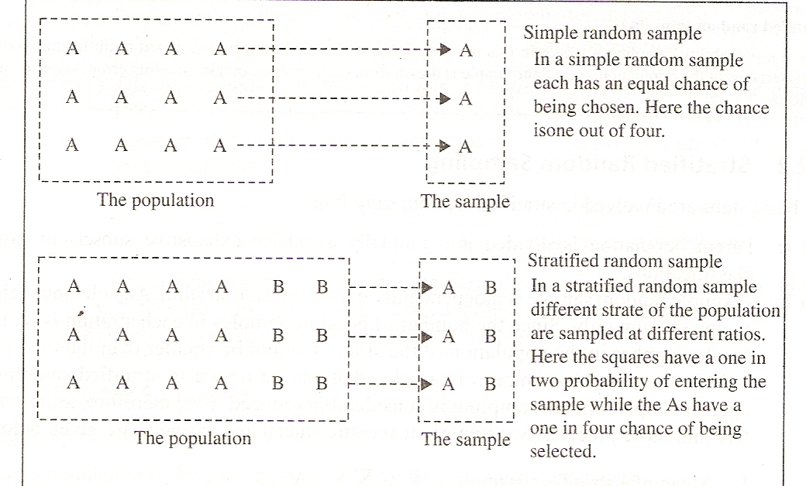

Slide 33
Cluster sampling
This is similar to stratified sampling.
In this population is divided into sub-groups, which are small scale populations.
Random sample is selected from each sub-group.

Slide 34
Systematic random sampling
A random beginning is made and every Lth item is starting from the first item is selected.
It is an easy sampling procedure and often can be more representative, since it cuts across the population.

Slide 35
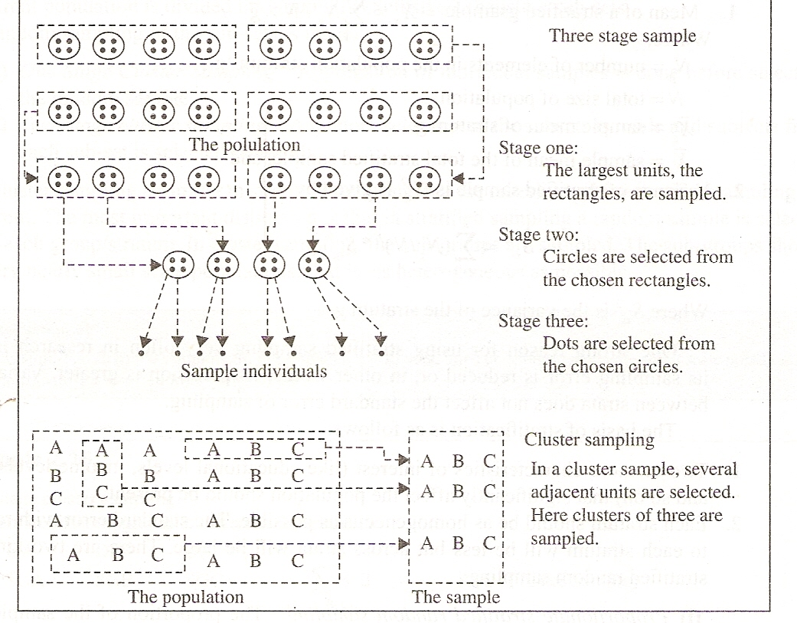

Slide 36
Area sampling
The sampling area is divided into sub areas at different levels.
Level wise successive random samples are chosen.
Example;
  States– districts—wards—houses.

Slide 37
Determination of sample size
There are several methods of determining sample size;
  Unaided Judgment
  All you can afford
  Average for samples of similar studies
  Required size for cell
  Use of statistical model

Slide 38
Required Size / Cell
In this method cells are formed using cross tabulation (e.g. strata vs. characteristics).
Minimum number for each cell is determined based on the type of analysis desired.
This minimum number is not violated in any cell.

Slide 39
Summary of This Session
SAMPLING
SAMPLING METHODS
PROCEDURES
SAMPLE SIZE DECISIONS

Slide 40
Thanks

