Slide 1
MGT-491
QUANTITATIVE ANALYSIS AND RESEARCH FOR MANAGEMENT
Session 12
OSMAN BIN SAIF

Slide 2
Summary of Last Session
Response methods / variability methods include;
  Rating techniques
  Ranking methods
  Paired comparisons
  Rank order scaling approach.
Quantitative Judgment Methods

Slide 3
Factor scales
The term factor scales Is used to identify a variety of techniques that have been developed to deal with two problems that have been glossed over so far.

Slide 4
Factor scales (Contd.)
These problems are ;
  How to deal more accurately with the universe of content that is multi dimensional
  How to cover under lying dimensions that have not been identified.

Slide 5
Factor scales (Contd.)
Some of the techniques used are ;
  Latent structure analysis
  Factor analysis
  Cluster analysis
  Metric and non-metric multidimensional scaling.

Slide 6
The Q-sort Technique
This is similar to the summated scale. The task required of respondents to sort a number of statements into a predetermined number of categories.

Slide 7
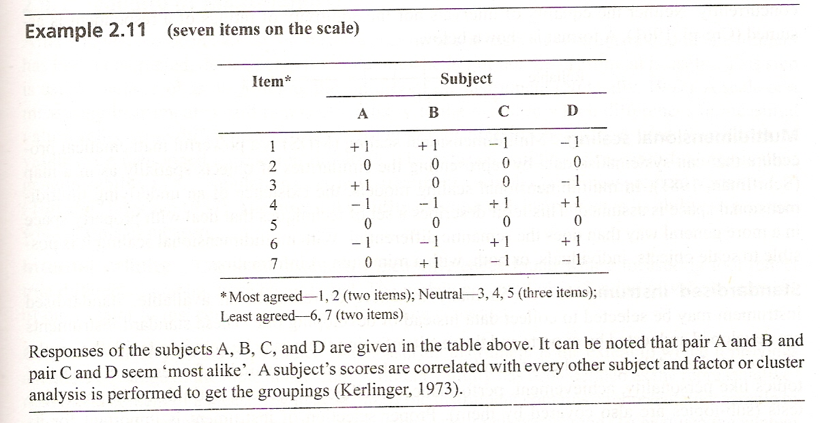

Slide 8
Semantic Differential
This is a quantitative judgment method that results in assumed interval scales.
Use bipolar adjectives like ‘extremely clear’ and ‘extremely ambiguous’. Measures images, effectiveness and attitudes.

Slide 9
Staple Scale
This is modified version of semantic differential. It is an even numbered non-verbal rating scale using single adjectives of bipolar opposites. Both intensities are measured co-currently.
I-----I—I—I-----I
+5 +1 -1 -5

Slide 10
Multidimensional Scaling
Multidimensional scaling is a powerful mathematical procedure that can systematize data by representing the similarities of objects spatially as in a map.

Slide 11
Multidimensional Scaling (Contd.)
Multidimensional scaling describes a set of techniques that deal with property space in a more general way.

Slide 12
Standardized Instruments
As in many instances of research, an available, standardized instrument may be selected to collect data instead of developing it.
These standard instruments are developed and tested by experts and the results of using them may be compared with the results of the other studies.

Slide 13
Standardized Instruments (Contd.)
A large number of standardized instruments are available for testing a variety of topics like;
  personality ,
  achievement ,
  performance ,
  intelligence ,
  general aptitudes.

Slide 14
Standardized Instruments (Contd.)
Proper selection of instrument is important for its use in a specific research.
For this purpose following should be considered carefully;
  Specifications
  Conditions for use
  Details regarding validity

Slide 15
Standardized Instruments (Contd.)
  Reliability
  Objectivity
  Directions for administrations
  Scaling
  Interpreting

Slide 16
Validity and Reliability in Measurement
Knowing that errors will creep into measurements in practice, it is necessary to evaluate the accuracy and dependability of the measuring instrument.

Slide 17
Validity and Reliability in Measurement (Contd.)
The criteria for such evaluations are;
  Validity
  Reliability
  Practicality

Slide 18
Validity and Reliability in Measurement (Contd.)
Validity refers to the extent to which a test/ instrument measures what we actually wish to measure.
Reliability has to do with accuracy and precision of a measurement procedure.
Practicality is concerned with a wide range of factors of economy, convenience, interpretability.

Slide 19
Validity and Reliability in Measurement (Contd.)
In any research, there are always measurement errors and non sampling errors.
There has been no accepted body of theory that may be used to predict either the direction or magnitude of these errors.

Slide 20
Validity of Measurement
After a model has been chosen for construction of a measuring instrument and the instrument has been constructed, the next step is to find out whether or not the instrument is useful.
This step is known as determining the validity of the instrument.

Slide 21
Validity of Measurement (Contd.)
A scale or a measuring instrument is said to posses validity to the extent to which differences in measured values reflect true differences in the characteristic or property being measured.

Slide 22
Validity of Measurement (Contd.)
There are two forms of validity in the research literature;
  Internal validity
  External validity

Slide 23
Internal validity
This is the extent to which differences found with a measuring tool reflect true differences among those being tested.
The widely accepted classification of validity consists of ;
  Content Validity
  Criterion related validity
  Construct validity

Slide 24
Content Validity
It is the extent to which the instrument provides adequate coverage of the topic under study.
This is judgmental in nature and requires a panel of judges and accurate definitions of the topic.

Slide 25
Face Validity
This is a basic and minimum index of content validity.
It indicates that the items that are supposed to measure a concept, on the face of it, do look like they are measuring the concepts.

Slide 26
Criterion related Validity
This form of validity reflects the success of measures used for some empirical estimating purpose.
One may want to predict some outcome or estimate the existence of some current behavior or condition.

Slide 27
Construct Validity
Construct validity testifies to how well the results obtained from the use of the measure fits the theory around which the test is diagnosed.

Slide 28
Construct Validity (Contd.)
It is concerned with knowing more than just that a measuring instrument works.
Attitude scales, aptitude and personality tests generally concern concepts are examples of construct validity.

Slide 29
Multi trait Multi Method
This method uses a matrix of correlations among the scores of the same trait or quality and the measurement methods.
The largest correlation coefficient establishes the construct validity.

Slide 30
Reliability in measurement
The reliability of a measure indicates the stability and consistency with which the instrument measures the concept and helps to access the ‘goodness’ of a measure.
A measure is reliable to the degree that it supplies consistent results.

Slide 31
Stability
The ability of a measure to maintain stability over time, despite uncontrollable testing conditions and the state of the respondents themselves, is indicative of its stability and low vulnerability to changes in the situation.

Slide 32
Test—retest Reliability
This is the reliability coefficient obtained by repeating an identical measure on a second occasion. It is the correlation coefficient of measures obtained in the test and the retest.

Slide 33
Parallel--form Reliability
When the responses on two comparable set of measures of the construct are highly correlated, there will exist parallel form of reliability of the instrument.

Slide 34
Equivalence
This is the kind of reliability which considers how much error is incurred when different investigators measure the same attribute in different conditions.

Slide 35
Practicality
The scientific requirement of the project call for the measurement process to be reliable and valid, while the operational requirements call for it to be practical in terms of economy, convenience and interpretability.

Slide 36
Summary of This Session
Factor Scales
Standardized instruments
Validity in Measurement
Reliability in Measurement
Stability
Equivalence
Practicality

Slide 37
Thanks

