Slide 1
MGT-491
QUANTITATIVE ANALYSIS AND RESEARCH FOR MANAGEMENT
Session 10
OSMAN BIN SAIF

Slide 2
Summary of Last Session
Projective Techniques
  Association tests
  Completion tests
  Construction techniques
  Expression techniques
Data Collection
Classification of experimental design
Validity in experiments

Slide 3
Measurement and Scaling
In any research, hypotheses and theories are tested using empirical data already available or specially collected.
In situations where data are collected specifically, the researcher exerts good control over the process of data collection to ensure good quality data.

Slide 4
Measurement and Scaling (Contd.)
A research is as good as the data that is used in it.
Data when used for some quantitative analysis, as in hypothesis testing, is as good as the measurement done on it.
Therefore that a research is as good as the measurements done on it.

Slide 5
Measurement and Scaling (Contd.)
Measurement is thus a vital part of any research study.
Measuring physical entities used in physical sciences is comparatively easier and less prone to errors and approximations than the conceptual entities so much used in management theories.

Slide 6
Measurement and Scaling (Contd.)
Measurement in respect of length, weight, inventory, number of rejections and so on are easier than measuring concepts like attitude, morale, job satisfaction, perceived product quality and so forth.

Slide 7
Measurement and Scaling (Contd.)
The second aspect related to measurement in management research is that many of the mentioned constructs and concepts are multidimensional in nature, where as physical entities (products , brands, consumers) are uni-dimensional.

Slide 8
Measurement and Scaling (Contd.)
Thus in management research measurement becomes more involved and complex.
Measurement is inalienably bound to scaling, which can be thought of as the continuum on which measurements are made and measured entity is located.

Slide 9
Measurement and Scaling (Contd.)
There are three major ways of obtaining measured data;
  Administering a standard instrument already developed. Tested and validated by others.
  Administering an instrument that is specially developed by the researcher (to be tested and validated)
  Record already measured data (such as inventory balances, absenteeism, numbers sold)

Slide 10
Measurement and Scaling (Contd.)
Development of measurements and scales requires scientific skills, considerable time and effort.
We will discuss;
  Important requirements
  Definitions
  The type of data required
  Scale construction
  Measurement errors
  Validity and reliability of measurement.

Slide 11
Measurement and Scaling (Contd.)
Measurement;
  It has been defined as “the matching of an aspect of one domain to an aspect of another”.
Scaling;
  Is a procedure for attempting to determine quantitative measures of subjective abstract concepts.

Slide 12
Nominal scale
This is a measurement procedure to classify objects, events and individuals into categories.
Nominal scales are least restrictive and widely used in social sciences research.
Nominal means “in name only”.
Examples;
  Telephone numbers
  Departmental accounting codes

Slide 13
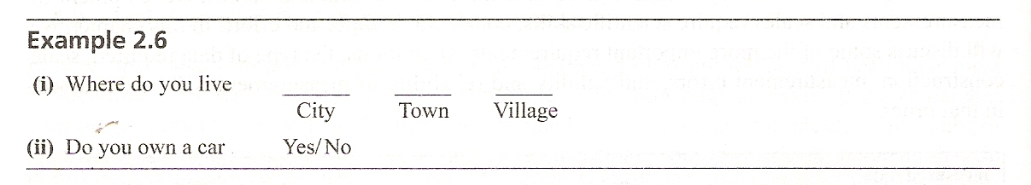

Slide 14
Ordinal scales
This scale is used to measure data having transitivity (if x>y, and y>z then x>z) property.
It includes the characteristics of nominal scales in addition to indicating order.

Slide 15
Ordinal scales (Contd.)
The task of ordering or ranking results in an ordinal scale, which defines the relative position of objects or individuals according to some single attribute or property.

Slide 16
Ordinal scales (Contd.)
There is no determination of distance between positions on the scale.
Therefore the investigator is limited to determination of ‘greater than’, ‘equal to’ or ‘less than’ without being able to explain how much greater or less.

Slide 17
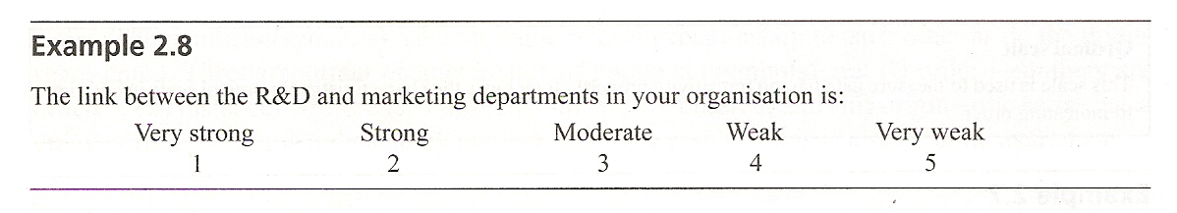

Slide 18
Interval Scales
The interval scales has all the characteristics of the nominal and ordinal scales and in addition, the units of measure (or intervals between successive positions) are equal.
This type of scale is of a form that is truly ‘quantitative’ in ordinary and usual meaning of the word.

Slide 19
Interval Scales (Contd.)
Almost all the usual statistical measures are applicable to interval measurement unless a measure implies knowing what the true zero point is.
Example;
  Centigrade or Fahrenheit degrees in temperature measurement.

Slide 20
Ratio Scales
A ratio scale is an interval scale with a natural origin (a true zero point) possessing all the characteristics of the number system.
Such a scale is possible only when empirical operations exists for determining all four relations;
  Equality
  Rank order
  Equality of intervals
  Equality of ratios

Slide 21
Ratio Scales (Contd.)
Ratio scales are found more commonly in the physical sciences than in the social sciences.
Examples;
  Measures of Weight, length
  Time interval
  Area
  Velocity

Slide 22
Ratio Scales (Contd.)
In the social sciences, we do find properties of concern that can be ratio scaled.
Example;
  Money
  Age
  Years of education

Slide 23
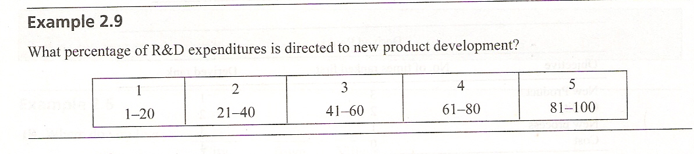

Slide 24
Errors in Measurement
Precise and unambiguous measurement of variables is the ideal condition for research.
In practice however, error creeps into the measurement process in various ways and at various stages of measurement.

Slide 25
Errors in Measurement (Contd.)
Major types of these errors are;
  Errors due to interviewer
  Errors due to instrument
  Errors due to respondents

Slide 26
Errors in Measurement (Contd.)
ORIGIN | TYPE OF ERROR
Researcher | Wrong question
 | Inappropriate answers
 | Misinterpretation
 | Experimenter expectation
 | Communication

Slide 27
Errors in Measurement (Contd.)
ORIGIN | TYPE OF ERROR
Sample | Wrong target
 | Wrong method
 | Wrong people

Slide 28
Errors in Measurement (Contd.)
ORIGIN | Type of ERROR
Interviewer | Interviewer bias
 | Interpretation
 | Carelessness

Slide 29
Errors in Measurement (Contd.)
ORIGIN | Type of EROR
Instrument (a) SCALE | Rounding off
 | Cutting off
Instrument (b) Questionnaire | Positional
 | Ambiguity
 | Evoked set
 | Construct Question Incogrence

Slide 30
Errors in Measurement (Contd.)
ORIGIN | Type of ERROR
Respondent | Consistency / Inconsistency
 | Fatigue
 | Lack of commitment
 | Random
 | Ego / Humility

Slide 31
Errors in Measurement (Contd.)
Major Errors of Concern are ;
  Errors due to interviewer bias;
    Bias on the part of interviewer may distort responses.
    Rewording and abridging responses may introduce errors.

Slide 32
Errors in Measurement (Contd.)
Major Errors of Concern are ;
  Errors due to interviewer bias;
    Encouraging or discouraging certain view points of the respondent, incorrect wording, or faulty calculation during preparation of data may also introduce errors.

Slide 33
Errors in Measurement (Contd.)
Major Errors of Concern are ;
  Errors due to instrument;
    An improperly designed (Questionnaire) instrument may introduce errors because of ambiguity, using words and language beyond the understanding of the respondent.
    And non coverage of essential aspects of the problem or variable

Slide 34
Errors in Measurement (Contd.)
Major Errors of Concern are ;
  Errors due to instrument;
    Poor sampling will also introduce errors in measurement.
    Whether the instrument is made at home or on site also may effect the measure.

Slide 35
Errors in Measurement (Contd.)
Major Errors of Concern are ;
  Respondents error;
    These may arise out of influence due to health problem, fatigue, hunger or undesirable emotional state of the respondent.
    The respondent may not be committed to the study and may become tentative and careless.

Slide 36
Errors in Measurement (Contd.)
Major Errors of Concern are ;
  Respondents error;
    There may be genuine errors due to lack of attention or care while replying, that is ticking a yes when no was meant.
    Further any errors may occur during coding, punching, tabulating and interpreting the measures

Slide 37
Commonly used scales in Business Research
There is no fixed way of classifying scales. From the view point of management research, scales can be classified as follows;
  Subject Orientation
  Response form
  Degree of subjectivity
  Scale properties
  Number of dimensions
  Scale of construction techniques.

Slide 38
Commonly used scales in Business Research
Subject Orientation;
  In this type of scaling variations across respondents are examined.
  The stimulus centered approach studies variations across different stimuli and their effect on the same individual

Slide 39
Commonly used scales in Business Research (Contd.)
Response Form;
  The variation across both stimulus and subject is investigated.
  This is the most generally used type of scaling in data collection methods for research.

Slide 40
Commonly used scales in Business Research (Contd.)
Degree of Subjectivity;
  This reflects the fact that judgments and opinions play an important part in responses.

Slide 41
Commonly used scales in Business Research (Contd.)
Scale Properties;
  The scale could be nominal, ordinal, interval or ratio type.

Slide 42
Commonly used scales in Business Research (Contd.)
Number of Dimensions;
  This reflects whether different attributes or dimensions of the subject area are being scaled.

Slide 43
Commonly used scales in Business Research (Contd.)
Scale construction technique;
  This indicates the technique of deriving scales.
  Example;
    Ad hoc
    Group consensus
    Single item
    Group of items

Slide 44
Summary of This Session
Measurement and Scaling
  Nominal scale
  Ordinal scale
  Interval scale
  Ratio scale
Errors in Measurement
Commonly used scales in business research

Slide 45
Thanks

