Slide 1
Lecture 06
Electronic Business (MGT-485)

Slide 2
Recap - Lecture 05
Payment Systems
  Standards of Payment Systems
    The Open Buying on the Internet; and
    The Open Trading Protocol.
E-Businesses Environment
  Economics of exchanging information
  Connectivity and Interactivity
  Network economies of scale
  Speed of change
  Economies of abundance
  Merchandize exchange
  Prosumption
E-Businesses Environment: Industrial Context
  Communications channels
  Transactions channels and
  Distribution channels
Advantages of internet in channel functions
e-marketplaces
Types of e-marketplaces
Key advantages of e-marketplaces

Slide 3
Contents to Cover Today
E-Business Models
  Brokerages
    E-shops
    E-Malls
    E-Auctions
    Trading communities
    Virtual communities
    Buyer aggregators
    Classifieds
  Infomediaries

Slide 4
Brokerages
Brokers are intermediaries who bring together buyers and sellers for transactions purposes.
There are several forms of brokerage models and they are operated across all e-business markets.
In a simple buy/sell fulfillment model, revenue is gained by the brokerage through charging a fee for each transaction completed.
In a market exchange model the broker charges the seller a fee based on the value of the sale.

Slide 5
Brokerages
There are many kinds of brokerage models. Few of them are: -
  e-shops
  e-malls
  e-auctions
  Trading communities
  Virtual communities
  Buyer aggregators
  Classifieds

Slide 6
Brokerages: e-Shops
Most e-businesses have gone beyond the basic marketing and promoting of their products and services via their website to incorporate facilities for transactions.
E-shops provide firms with a channel of communication to customers and provide valuable information about what products and services are sought by customers.
E-shops can also be a first step to competing in global markets since the cost of entry is small and there are economies of scale to be gained from extending the market reach.
For consumers, e-shops provide a quick, efficient and convenient route to accessing information on products and services and undertaking transactions.

Slide 7
Brokerages: e-Shops
E-shops are ubiquitous on the internet and cover a huge range of products and services.
Some of the many examples of e-shops include:
  Nurserygoods (www.nurserygoods.com) who specialise in baby clothes and accessories
  Empiredirect (www.empiredirect.co.uk) who specialise in electrical products;
  Onevillage (www.onevillage.com) an online shop for home accessories; and
  Spoilt4choice (www.spoilt4choice.co.uk) an online shop for the buying and delivery of gifts.

Slide 8
Brokerages: e-Malls
An electronic mall is a collection of e-shops.
e-shops that comprise the e-mall have some commonalities between them like the types of products or services offered, the type of payment system used or a common market segment targeted.
Customers benefit from the ease of access to a number of e-shops in the same business category.
Increasingly, brokers who organize e-malls are adding services that facilitate transactions, tracking down orders, billing and invoicing of customers.
Firms who combine these services with organizing e-malls are termed ‘metamediaries’.

Slide 9
Brokerages: e-Malls
E-malls have been set up by firms who have traditionally inhabited the bricks-and-mortar trading environment but who seek to expand their online services.
Examples include giant department stores such as
  Bloomingdales
  Costco and
  K-Mart in the USA.
Search engines such as AltaVista have also been active in setting up e-malls in partnership with a large number of retailers.
The e-mall run by AltaVista is called ‘shopping.com’ (www.shopping.com).

Slide 10
Brokerages: e-Auctions
Electronic auctions provide a channel of communication through which the bidding process for products and services can take place between competing buyers.
E-businesses gain income from the technology platform that facilitates the bidding process, from a percentage of the transaction fees and from advertising on the website.
Consumers benefit from ease of access to a large amount of information on a wide range of products, low transactions costs and efficiency in the transacting process.
E-auctions exist in several e-business markets.

Slide 11
Brokerages: e-Auctions
Some auction sites are industry-specific such as eutilia (www.eutilia.com), a European utility marketplace that auctions components in the energy sector.
Others focus attention on the consumer market such as onsale.com (www.onsale.com) who specialise in auctions for computer software, hardware, components and digital products.

Slide 12
Brokerages: e-Auctions
Online auction sites
  Act as forums through which Internet users can log-on and assume the role of either bidder or seller
  Collect a commission on every successful auction
  Sellers post items they wish to sell and wait for buyers to bid
Reserve price
  The minimum price a seller will accept in a given auction
Reverse auctions
  Allow the buyer to set a price as sellers compete to match or even beat it

Slide 13
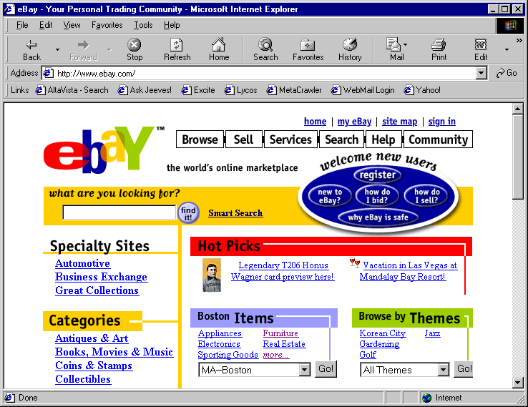
Brokerages: e-Auctions

Slide 14
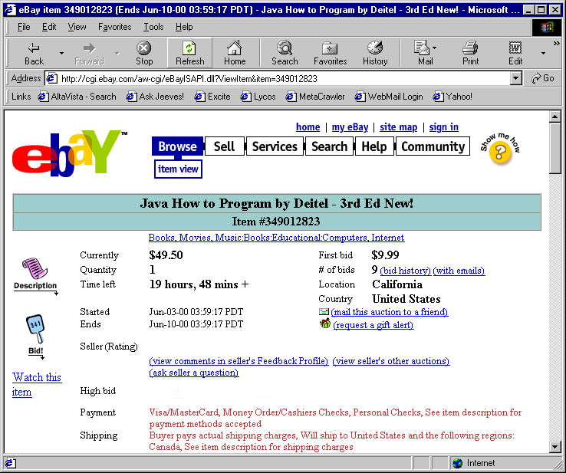
Brokerages: e-Auctions
Placing a bid on eBay.

Slide 15
Brokerages:
Trading Communities
Sometimes referred to as a ‘vertical web community’, trading communities provide a source of information and communication that is necessary for e-business activity to take place in a particular industry.
Members pay a subscription to the developers and operators of trading community sites.
VerticalNet.com (www.verticalnet.com) were pioneers of the trading community concept by providing sites for B2B exchanges of information.

Slide 16
Brokerages:
Virtual Communities
Customers are attracted to websites because of the added value they offer.
Specialist websites appeal to customers with a particular interest.
The shared interest of customers provides the basis for virtual communities to emerge.
This is a community of customers who share a common interest and use the internet to communicate with each other.
Amazon.com provides websites for the exchange of information on a wide range of subjects relating to their portfolio of products and services.
Virtual communities benefit from network externalities whereby the more people who join and contribute to the community the greater the benefits that accrue, but without any additional cost to participants.

Slide 17
Brokerages:
Buyer Aggregators
The buyer aggregator brings together large numbers of individual buyers so that they can gain the types of savings that are usually the privilege of large volume buyers.
Mercata (www.mercata.com) was the first American company to receive a patent for group buying over the internet.
As a group, buyers can potentially wield more economic power and gain discounts on large volume sales from sellers.

Slide 18
Brokerages:
Buyer Aggregators
Brokers who organise the collective bargaining of buyers in this way gain revenue by charging the seller a percentage of each sale made to the group of buyers.
Mercata, the first-movers as buyer aggregators, failed to sustain initial customer interest and folded after only two years because of a fatal flaw in their business model – the inability to achieve a critical mass of customers.

Slide 19
Brokerages:
Classifieds
Online classified advertisements run on the same principles as newspaper classifieds.
Content providers list items for sale by sellers and purchases wanted by buyers.
Revenue is gained by listing charges and is collected whether or not a transaction takes place.

Slide 20
Infomediaries
Infomediaries specialize in gathering valuable information about customers and selling it on to third parties.
These third parties analyze the data and use it to support marketing campaigns.
The simplest form of gathering data is through requiring users to register for access to free-to-view content sites.
This facilitates the monitoring of user’s site viewing patterns and the data generated can then be used for a more targeted marketing campaign.
Infomediaries may offer incentives to customers to divulge information about their profile and buying habits.
These may take the form of free software or hardware or free internet access for a specified time period.

Slide 21
Infomediaries
Infomediaries also serve consumers by offering a range of services including specific information about websites in a market segment and price comparisons.
Infomediaries also operate recommendation sites where users exchange information regarding the quality of products or services.
Some infomediaries integrate the recommendation site into a web browser.
The infomediary can then monitor users’ habits and, therefore, increase the relevance of its recommendations to the user’s needs whilst adding value to the data it then sells on to third parties.

Slide 22
Summary
E-Business Models
  Brokerages
    E-shops
    E-Malls
    E-Auctions
    Trading communities
    Virtual communities
    Buyer aggregators
    Classifieds
  Infomediaries

