Slide 1
Lecture 05
Electronic Business (MGT-485)

Slide 2
Recap - Lecture 04
Information Infrastructure
Electronic Data Interchange (EDI)
Program languages
  Machine Language
  Assembler Language
  High level Languages
  4th Generation Languages
Wireless technology
Developments in Wireless Technology
Other Emerging Technologies
  VOIP
  Voice Recognition
  IPTV

Slide 3
Contents to Cover Today
Payment Systems
E-Businesses Environment
E-Businesses Environment: Industrial Context
Advantages of internet in channel functions
e-marketplaces
Types of e-marketplaces
Key advantages of e-marketplaces

Slide 4
Payment Systems
There are many payment service providers such as WorldPlay and Kaji, but it is PayPal that leads the market.
One of the most important aspects of secure payment systems for e-business and e-commerce is the authenticity of transactions.
The most common software used for this purpose is Secure Sockets Layer (SSL) developed by Netscape.
SSL makes use of digital certificates to authenticate transactions.
Most credit card transactions are protected by SSL.

Slide 5
Payment Systems
Another authenticity system is Secure Electronic Transaction (SET).
This is a payment mechanism for confirming authenticity of both buyer and seller.
Each party to a transaction has to obtain a digital certificate from a registered certification authority
The certificate is contained within a relevant machine, and the credit card details contained within it can only be decrypted by the issuing card company.
There is no common standard in e-business, likewise there is a lack of standardization of payment systems.

Slide 6
Standards of Payment Systems
The two main standards are:
  The Open Buying on the Internet; and
  The Open Trading Protocol.

Slide 7
Standards of Payment Systems
The Open Buying on the Internet (OBI)
  The system managed by CommerceNet called ‘The Open Buying on the Internet’ (OBI) (www.openbuy.com) is, perhaps, the most advanced e-business standard available
  Aimed specifically at business-to-business (B2B) procurement.
  OBI provides an open architecture that brings buyers and sellers together for the transaction of high-volume, low value products between companies that form the majority of trade between businesses.
  Despite offering a detailed and comprehensive service that is easily used, OBI has failed to gain universal acceptance as a standard.
  The main reason for this lies not in the technology but the differing needs of buyers and sellers.

Slide 8
Standards of Payment Systems
The Open Trading Protocol (OTP)
  Leading developers of smart card digital money, Mondex, introduced the Open Trading Protocol (OTP) in 1997.
  OTP is designed to deliver a virtual analogue of the traditional trading environment across the supply chain from negotiation to delivery of products.
  OTP can support a range of payment systems including SET and Mondex.
  This means that consumers have a choice of payment systems and may take advantage of offers, discounts or price differentials between competing systems.

Slide 9
e-Businesses Environment
Internet has transformed the competitive environment for firms
Requires managers to understand its distinctive attributes in order to build effective models and exploit the opportunities
The internet economy works by a different set of rules from the traditional economy
Managers of both traditional bricks-and-mortar firms and internet-based firms have had to face the challenge of either transforming their business model or building their business model around the key attributes that the internet exhibits.

Slide 10
e-Businesses Environment
Economics of Exchanging Information
  Firms can take advantage of both richness and reach of information using the internet.
  The cost of sending additional units of information via the internet is practically zero and the reach is global.
Connectivity and Interactivity
  The number of people that have access to the internet is rising year on year on a global scale.
  Connectivity extends the reach of electronic communication and interactivity allows two-way communication in real-time among parties to electronic communication.

Slide 11
e-Businesses Environment
Network Economies of Scale
  The network effects are stronger in the internet economy.
  There are opportunities for achieving a critical mass of customers by accessing a wider customer base electronically at low cost.
  The marginal costs of sending information are close to zero so firms can achieve economies of scale by providing value-added products or services to customers cheaply, quickly and efficiently using the internet.

Slide 12
e-Businesses Environment
Speed of Change
  The internet has speeded up the transactions process and raised expectations of customers.
  Firms who are able to meet or exceed the raised expectations can create a brand loyalty and, hence, a competitive advantage over rivals.
Economies of Abundance
  Information is a valuable asset in the internet economy.
  Revenue can be created by the dissemination of information based on its value to consumers
  As noted previously, information can be reproduced and distributed at near zero marginal cost.
  This creates an abundance of information where the value can actually decline.

Slide 13
e-Businesses Environment
Merchandize Exchange
  The internet provides a mechanism for displaying a huge array of products and services without having to incur the costs of display that traditional stores incur.
  Compared to traditional forms of shopping the internet offers much greater convenience at lower cost and potentially better service delivery.
Prosumption
  Internet being a means of communicating with customers and enriching the relationship between buyer and seller can lead to customizing or personalizing products or services

Slide 14
e-Businesses Environment:
Industrial Context
In the traditional economy value is created within industrial sectors, such as manufacturing or retailing.
In the internet economy value generated in e-business communities transcends industrial sectors
E-business models adopted by companies are designed to exploit the advantages that using the internet can bring.
There are three types of channels through which e-business activity takes place
  Communications channels
  Transactions channels and
  Distribution channels

Slide 15
e-Businesses Environment:
Industrial Context
  Communications channels
  The efficient exchange of information between buyers and sellers is the most important advantage offered by the internet.
  Internet is an effective medium for accessing, organizing and communicating information.
  The key characteristics of the internet that improve the communications channel include:
    The ability to store vast amounts of information
    The ease of access to information
    The scope for interactivity
    The ability to provide information on demand
    The improved visual presentation of material.

Slide 16
e-Businesses Environment:
Industrial Context
  Transactions channels
  The internet smoothes the whole transactions process between buyers and sellers, increases efficiency and can lower costs.
  Transaction costs for customers are reduced because of the ease of access to market information on a wide range of products including, price, quality, availability and discounts.
  The time and effort expended searching for products and comparing prices is significantly reduced.
  Companies can also increase internal efficiency by using the internet to:
    reduce the amount of paperwork and administrative tasks associated with traditional forms of transacting
    manage inventory and stock control
    reduce the procurement cycle time of inputs.

Slide 17
e-Businesses Environment:
Industrial Context
  Distribution channels
  Companies who produce digital products can use the internet as a distribution channel to offer instant supply at significantly reduced delivery cost.
  Products and services such as financial information, news, music, software, ticketing and reservations, and consultancy services are some of the examples that can be delivered quickly and cheaply to online customers.

Slide 18
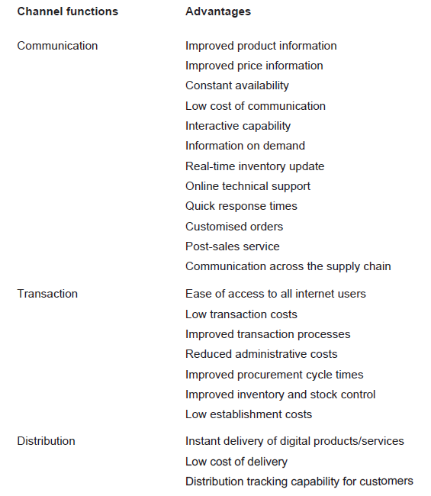
Advantages of Internet in Channel Functions

Slide 19
e-Marketplaces
Electronic marketplaces (e-marketplaces) are electronic exchanges where firms can register as buyers or sellers and undertake business activities using the internet.
Typically, e-marketplaces attract firms from each element of an industry supply chain to enhance the efficiency of communications and to undertake transactions.
There are many different types of e-marketplaces and each one operates a business model that suits the aims and objectives of the proprietor.
Some may be set up as a business offering with an intermediary providing an added-value service such as payment systems.
Others may operate on a cost-recovery basis by an industry third-party.

Slide 20
Types of e-Marketplaces
Public exchanges
  independently-operated B2B trading platforms for facilitating online transactions between trading partners.
  These are open to any business or group of businesses.
Consortium exchanges
  an exchange owned and operated by a group of competing businesses who combine their buying power to gain group-wide savings on the supply of materials.
Private exchanges
  an exchange owned and operated by a single firm to link its trading system directly to that of its suppliers.

Slide 21
Key Advantages of e-Marketplaces
Much greater scope for firms to form trading partnerships
Opportunities for lower costs associated with the negotiation and transactions of products and services through the use of automated systems
Benefits from a more open and transparent pricing environment
Opportunities presented by access to value-adding services using electronic systems
Opportunities for access to global markets, particularly for small and medium sized enterprises (SMEs).

Slide 22
Summary
Payment Systems
  Standards of Payment Systems
    The Open Buying on the Internet; and
    The Open Trading Protocol.
E-Businesses Environment
  Economics of exchanging information
  Connectivity and Interactivity
  Network economies of scale
  Speed of change
  Economies of abundance
  Merchandize exchange
  Prosumption

Slide 23
Summary
E-Businesses Environment: Industrial Context
  Communications channels
  Transactions channels and
  Distribution channels
Advantages of internet in channel functions
e-marketplaces
Types of e-marketplaces
Key advantages of e-marketplaces

