Slide 1
Lecture 32
Electronic Business (MGT-485)

Slide 2
Review of Lecture 16 - 30

Slide 3
Lecture 16
E-Customer Relationship Management
  Intelligent Agents
  Personalization versus privacy
  Contact centers
  FAQs
  E-mail
  Online text chatting
  Speech Synthesis and Recognition; Natural Language Processing
  Microsoft Agent Feature
  Voice communication
  Sales force automation
  B2B e-CRM
  Complete e-CRM solutions

Slide 4
Lecture 17
Building an e-Business: Design, Development and Management
  Introduction
  Getting Started
  Generating Business Ideas
  Business Plan Layout
  Growth of e-Business: Evaluating Risk
  Finding Funding and Going Public
  Putting your Plan into Action
  Choosing a Domain Name
  Supply Chain Management
  Website Hosting

Slide 5
Lecture 18
Building an e-Business: Design, Development and Management
  Website Hosting
  Web Design
  Enhancing the User Experience
  Protecting your e-Business
  Streaming Media
  Preparing for New Technologies
  e-Business Solutions
    End-to-End e-Business Solutions
    Other e-Business Solutions
  Maintaining & Monitoring your Website
  e-Commerce Consulting

Slide 6
Lecture 19
Strategic Management Approach
Traditional and Modern Flow of Strategic Management
Strategic Management and Objective Setting

Slide 7
Lecture 20
Vision
Mission
Goals and Objectives

Slide 8
Lecture 21
E-Business Strategy: Formulation
  Internal Assessment
    Nature of Internal Audit
    Key Internal Forces
    Internal Audit
    Integrating Strategy and Culture
    Technology Audit
    Internal Analysis

Slide 9
Lecture 22
E-Business Strategy: Formulation
  Internal Assessment
    Value Chain Analysis
    Linkages within the Value Chain
    Value Chain Linkages in the Supply Chain
    Linkages with Supplier Value Chain
    The Buyer’s Value Chain

Slide 10
Lecture 23
E-Business Strategy: Formulation
  External Assessment
    Key External Factors
    Relationships between key external factors and an organization
    Performing an External Audit
    Michael Porter’s Five Forces Model

Slide 11
Lecture 24
E-Business Strategy: Formulation
  External Assessment
    Competitive Strategies for e-business (Michael Porter’s Generic Strategies)
E-Business Strategy: Implementation
  Strategic Control
  Organizational Learning

Slide 12
Lecture 25
E-Business Strategy: Implementation
  Organizational Culture and e-Business
  Organizational Structure and e-Business

Slide 13
Lecture 26
E-Business Strategy: Implementation
  Organizational Structure and e-Business
    The Boundary-less organization
    The virtual organization
  Change Management
  Organizational Change Management

Slide 14
Lecture 27
E-Business Strategy: Evaluation
  The Evaluation Process
  Organizational Control and Evaluation
  Financial Evaluation

Slide 15
Lecture 28
E-Business Strategy: Evaluation
  Technology Evaluation
  Human Resource Evaluation
  Website Evaluation
  Business Model Evaluation
  E-Business Strategy Evaluation

Slide 16
Lecture 29
Affiliate Programs
  How an Affiliate Program Works
  Selecting an Affiliate Program Reward System
    Pay-per-click
    Pay-per-lead
    Pay-per-sale
    CPM (cost-per-thousand)
    Multi-level, or multi-tiered
    Hybrid model
  Attracting Affiliates
  Monitoring an Affiliate Program
  Affiliate Solution Providers
  Costs and Taxation of Affiliate Programs
  Affiliate Program Directories and Search Engines

Slide 17
Lecture 30
Globalization
  Accounting for Legal and Cultural differences
  International Internet Regulations
  Creating an e-Business with Global Capabilities
  Choosing an International Market
  Obtaining a local Internet address
  Internationalization and Localization
  Partnering and Hiring
  Distribution
  Promotions

Slide 18
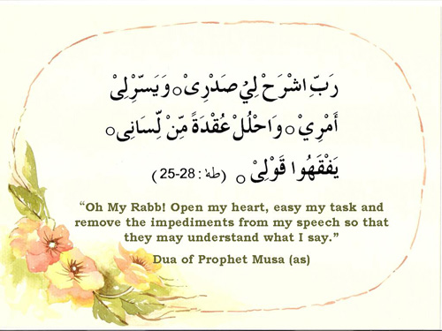
Prayer for Success!

