Slide 1
Lecture 30
Electronic Business (MGT-485)

Slide 2
Review of Lecture 29:
  Affiliate Programs
Topic to Cover Today (Lecture 30)
  Globalization

Slide 3
Introduction
Faster international communication speeds
Unprecedented ability to conduct business globally
Larger customer bases
International laws
Cultural differences

Slide 4
Accounting for Legal and Cultural Differences
Government regulation
  Affects the growth of the Internet
  Has the potential to cause major problems as the volume of international e-business transactions increases
International organizations must decide when national governments can apply or create laws that will affect parties and transactions that fall partially or completely outside their jurisdiction

Slide 5
International Internet Regulations
Businesses and legal experts are calling for the creation of worldwide e-commerce laws and standards
Address cybercrimes such as copyright infringement, cybersquatting, cyber terrorism, fraud, hacking and computer viruses
World Intellectual Property Organization (WIPO)
  A United Nations’ organization that created an international forum for regulating Internet issues
The Organization for Economic Cooperation and Development
  A forum for 29 member countries to communicate ideas, share experiences and develop policy

Slide 6
International Internet Regulations
European Union Directive on Data Protection
  An agreement among its members on the regulations that apply to information exchange
  Mandates that personal information be kept current and used in a lawful manner for its designated purpose
Extensive international regulation may conflict with national laws and impede the growth of e-business

Slide 7
International Internet Regulations
Internet Content Summit (2000)
  “Self-regulation of Internet Content”
  Report favors self-rating and filtering over third-party regulation
  Suggests that Web content providers rate their sites, that filters for possibly offensive content be made available and that a network of national hotlines be established so that Internet users can register complaints about site content

Slide 8
Creating an e-Business with Global Capabilities
Opportunity for expansion
An ambitious and expensive investment that does not guarantee increased revenue
Potential global businesses must review expected revenues vs. expected cost
Linguistic and cultural barriers

Slide 9
Choosing an International Market
Focus time and money in one or two key markets initially
Research competitors and visitors in foreign markets
When choosing an international market consider:
  The number of people online
  Internet usage growth rates
  Per capita income
  The consumers’ expectations of your business

Slide 10
Obtaining a Local Internet Address
.com domain name is the most universally recognized address on the Web
Domain-name registration in foreign countries is often complex
May require owning a trademark or incorporating your business in the foreign country
Organizations offering domain name registration services:
  Internet Assigned Numbers Authority (IANA)
  NetNames

Slide 11
Internationalization and Localization
Internationalization
  Restructuring the software used by your e-business so that it can process foreign languages, currencies, date formats and other variations involved in conducting business globally
Localization
  Includes the translation and cultural adaptation of your site’s content and presentation
Online translation services
  Enterprise Translation Server
  Alis Technologies
  Logos
  AltaVista’s Babelfish

Slide 12
Internationalization and Localization
Online translators are not 100 percent reliable
Consider the context of the message in a foreign culture
Translate META tags and text within graphic images
Adaptation of site layout to accommodate translations
Color scheme and logo translation
Conversion rates

Slide 13
Internationalization and Localization
Consider downloading capabilities in foreign markets
Global content
  Refers to information and design that requires translation, but is essentially the same for all cultures
Regional content
  Product and marketing information that is usually written once in English and then adapted for various markets
Local content
  Material on specific regional pages that appears only on that Web site, such as regional promotions, pricing, delivery and store or office locations

Slide 14
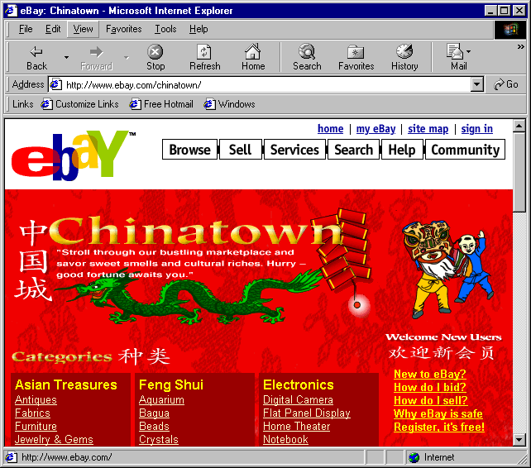
Internationalization and Localization
eBay’s Chinatown site uses a red background signifying celebrationand good
luck. (These materials have been reproduced with the permission of eBay Inc.
COPYRIGHT EBAY INC. All Rights Reserved.

Slide 15
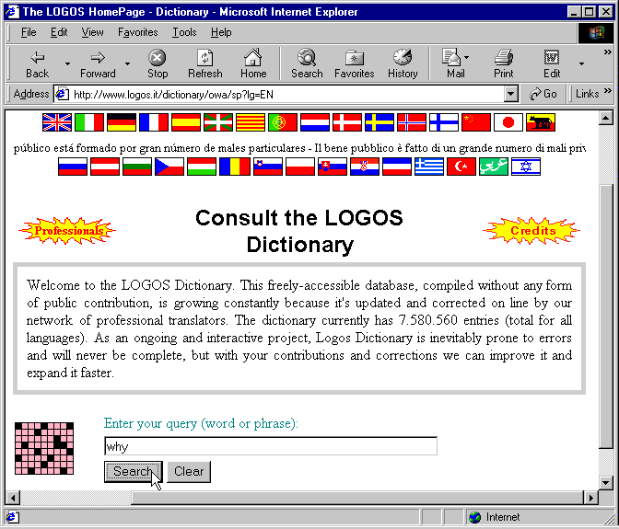
Internationalization and Localization
Logos Dictionary query page with sample query. (Courtesy of Logos
Group, Italy.)

Slide 16
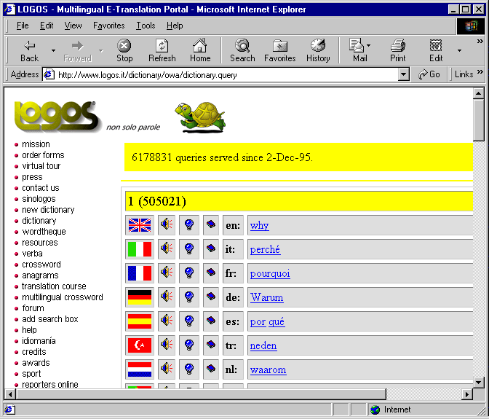
Internationalization and Localization
Logos query results page with sample query result. (Courtesy of Logos
Group, Italy.)

Slide 17
Partnering and Hiring
Choosing a local partner in a foreign market offers several benefits
  Physical presence in the target country
  A recognized brand
  Extensive knowledge of the target market
  Localized content and customer service

Slide 18
Distribution
Shipping from a local distribution center
National postal services
  British Post Office
  Deutsche Post
International shipping and handling companies
  UPS
  Federal Express
  The United States Postal Service
Businesses must consider the additional time needed for packages to pass through customs

Slide 19
Promotions
Investigate the interpretation of your company and product names in the language or languages in which you are advertising
Research acceptable marketing tactics
Choose an appropriate medium for reaching target audience
Evaluate the success of your campaign
  MMXI
  NetValue
  ACNielsen

Slide 20
Canada
Increased amount of time spent online
Addressing the French and English speaking populations
U.S. and Canadian presence
  eToys
  Sympatico-Lycos portal
  America Online
  HomeGrocer.com
  Petopia.com
  Book4golf.com
Ahead of U.S. in the development of wireless technology

Slide 21
Mexico and Central and South America
Fastest growth rate of Internet usage in the world
Will generate opportunities for entrepreneurs and workers during the coming years
Relatively high cost of computer equipment
High cost of communication media
Free access is a growing trend
Access through the school systems is on the rise

Slide 22
Europe
Hailed by many as the next Internet and e-commerce frontier
Much of the needed infrastructure is in place
Many European countries have taken steps to make their national stock exchanges more e-business friendly
High cost-per-minute of local phone calls in most parts of Europe
Markets should be strategically chosen within Europe, and one or more localized Web sites should be created to service these regions

Slide 23
Africa
Internet access in Africa is rising, but its growth is challenged by regulation and limited infrastructure
African Information Society Initiative
  Created in 1996
  Adopted to build national communication standards
  Reduce the number of regulations limiting the development of communications
  Increase accessibility, particularly in rural areas
  Provide human resources in the development and implementation of Internet access

Slide 24
Middle East
Countries such as Egypt, Kuwait, Israel, Jordan and the United Arab Emirates have already begun growing their Web presence
Iran and Saudi Arabia are extending full Internet capabilities to government institutions and educational facilities
Libya, Syria and Iraq have yet to establish Internet access
Most Internet access in the Middle East is government regulated

Slide 25
Asia
Internet access in China is limited
Most Chinese and Japanese citizens do not own credit cards, reducing the number of online transactions
Internet taxation is carefully monitored in China
Fewer Japanese Internet users than American users
Wireless technology is advanced
High levels of Internet regulation

Slide 26
Australia
Internet presents an opportunity for national communication
Currently among the most connected nations in the world
Australia’s Internet presence is largely designed to accommodate the farming industry
Connection costs are high in rural areas

Slide 27
Future of Global e-Commerce
The Internet was initially an American medium
The vast majority of Web sites catered to English-speaking audiences
E-businesses that do not accommodate international users exclude as many as half their potential visitors
Using the Internet, businesses can communicate quickly and efficiently with suppliers and customers anywhere in the world

