Slide 1
Lecture 03
Electronic Business (MGT-485)

Slide 2
Recap - Lecture 02
Historical events of electronic world
How Internet works?
Relationship between e-business and e-commerce
Development of new economy

Slide 3
Contents to Cover Today
Growth of e-business
Advantages of using internet
Key people in development and use of internet

Slide 4
Growth of e-business
The most significant factor that transformed the internet into a global communications phenomenon was the development of the World Wide Web (WWW) in the early 1990s.
The Web was the catalyst for huge changes in the business environment as more and more firms sought to integrate their traditional business models with those online.
By the mid 1990s firms ‘born on the net’ emerged, whose function was to exploit the opportunities in the marketplace by using the internet.

Slide 5
Growth of e-business
From 1993 to 1996 the number of computer users with access to the internet and the Web rose from zero to 10 million.
In 2004 the figure stood at around half a billion.
The internet has created a new communications channel and provides an ideal medium for bringing people together cheaply, efficiently and for a wide range of different reasons.
It has also presented opportunities and challenges for the business community.

Slide 6
Growth of e-business
One of the key characteristics of e-commerce is the ease of entry for firms.
The cost of entry and exit is low relative to traditional industries, as firms do not require large sales teams, costly investment in infrastructure or high sunk costs in order to compete effectively.
Importantly, the internet does away with geographical boundaries thereby increasing yet further the extent of competitive rivalry.
Intense competition is a characteristic of the internet economy and has spread across all e-business and e-commerce sectors.

Slide 7
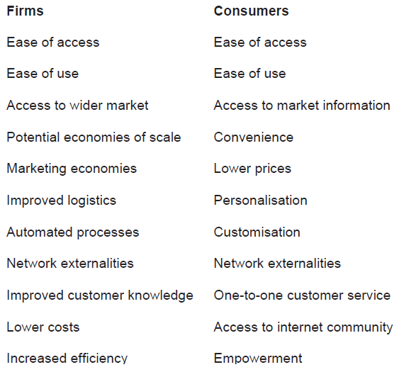
Advantages of using internet

Slide 8
Key People in development & use of internet
1. Tim Berners Lee
In 1984 physicist and computer buff Tim Berners Lee was working at CERN, the European particle physics laboratory in Switzerland, when he developed the idea of linking all the information stored on computers to other computers on a global scale.
Berners Lee’s ambition was to create a single, global information space that would be freely available to anyone with access to a computer.

Slide 9
Key People in development & use of internet
1. Tim Berners Lee
By 1990 enough progress had been made to name the project the World Wide Web (WWW).
The WWW was located on the internet and consisted of
  a computer language for formatting hypertext files (Hypertext Markup Language – HTML);
  a method for moving between files (Hypertext Transfer Protocol – HTTP) and
  a web address for each file (Universal Resource Locator – URL).

Slide 10
Key People in development & use of internet
2. Marc Andreeson
In the early 1990s Marc Andreeson was a young programmer at the National Center for Supercomputing Applications in the USA.
In 1993 he released the first Web browser called Mosaic.
The browser was easy to install, easy to use and could be operated on numerous systems including Microsoft Windows and Apple Mackintosh.
The popularity of Mosaic grew quickly with around half a million users in the first year.

Slide 11
Key People in development & use of internet
2. Marc Andreeson
Andreeson later teamed up with Jim Clark, an associate professor at Stanford University and founder of personal computer company Silicon Graphics.
Between them they commercialized Mosaic and later called the browser Mosaic Netscape. After a legal wrangle with the University of Illinois over licensing fees Andreeson and Clark changed the name to Netscape.
The Netscape Navigator browser was launched in December 1994
Netscape was to become the world’s most popular Web browser.

Slide 12
Key People in development & use of internet
3. Bill Gates
In 1975 Bill Gates and business partner Paul Allen began writing software for computers and created a company called Microsoft.
The company is now one of the world’s most recognized brands and is a multi-billion dollar enterprise
The basis for the success of Microsoft lies in recognizing the huge potential that personal computers would have as technology developed and demand grew.
Today Microsoft enjoys a huge market share in computer software and related products
The influence of Microsoft on the internet, and computers generally, cannot be underestimated.

Slide 13
Key People in development & use of internet
4. Michael Dell
Michael Dell started his computer business when still an undergraduate at the University of Texas.
Dell is now the world’s leading direct-sale personal computer company.
Dell built the success of the company around the concept of direct ordering through mail order, telephone and online by using the internet.
Dell takes orders amounting to around £20 million per day and is valued at around £20 billion.

Slide 14
Key People in development & use of internet
5. Jerry Yang
Jerry Yang and business partner David Filo created internet search engine Yahoo!.
The concept began when the two Stanford University PhD students started compiling lists of their favorite websites.
This so-called ‘hotlist’ formed a database that web users could access to quickly find web pages.
By the late 1990s Yahoo! had grown into one of the world’s leading search engines.

Slide 15
Key People in development & use of internet
6. Pierre Omidyar
Pierre Omidyar is the son of French-Iranian immigrants to America and is famous for creating the world’s biggest and most well-known internet firm, e-Bay.
Omidyar had a vision for the internet that centered on providing the perfect market for trading.
He decided that an online auction website would be the nearest thing to perfect competition as it would bring buyers and sellers together to negotiate transactions in the quickest and most efficient way possible.

Slide 16
Key People in development & use of internet
7. Jeff Bezos
Jeff Bezos left his job on Wall Street to start a new business from his garage in Seattle.
His idea was to use the internet to take orders for books and deliver them to customers quickly.
His company, which he called Amazon.com, quickly built up a reputation and customer base that ensured growth.
The Amazon.com website now caters for a wide range of different products and services including toys, garden implements, healthcare products, media products, business services and so on.

