Slide 1
Lecture 29
Electronic Business (MGT-485)

Slide 2
Affiliate Programs

Slide 3
Recap – Lecture 28
E-Business Strategy: Evaluation
  Technology Evaluation
  Human Resource Evaluation
  Website Evaluation
  Business Model Evaluation
  E-Business Strategy Evaluation

Slide 4
Introduction
Affiliate program
  A form of partnership in which a company pays affiliates (other companies or individuals) for pre-specified actions taken by visitors who click-through from an affiliate site to a merchant site

Slide 5
How an Affiliate Program Works
New income streams
Merchant
  The company that advertises on another company’s site
Affiliate
  The company hosting the advertising in return for a reward based on predetermined terms
  Affiliates act as an extended sales force
How it works
  Merchant places banner on affiliate’s Web site
  When a person clicks through to the merchant’s site via the advertisement on the affiliate’s site and makes a purchase, a commission on the sale is typically awarded to the affiliate
“Win-win" situation

Slide 6
Selecting an Affiliate-Program Reward Structure
Program reward structures
  Pay-per-click
  Pay-per-lead
  Pay-per-sale
  CPM (cost-per-thousand)
  Multi-level, or multi-tiered
  Hybrid model
Implementation of appropriate reward structure(s) depends on the type of site and its product mix

Slide 7
Pay-Per-Click Model
Pay-per-click model
  Rewards an affiliate for each click-through that is generated from a banner ad hosted by the affiliate
    A click-through is when a person clicks on the banner advertisement on the affiliate site and is taken to the merchant site
  Easy for affiliates to generate dishonest click-throughs to “run up the numbers”
  Sites that depend on advertising rates use this model to increase traffic
  GoTo and Lycos

Slide 8
Pay-Per-Lead Model
Pay-per-lead model
  Rewards affiliates based on the number of qualified leads generated
    Potential customers that have expressed interest in a product or service and meet requirements determined by the company
    Can include new customer registrations and having visitors sign up to receive a newsletter or use a free demo
    Mailsweeps.com

Slide 9
Pay-Per-Sale Model
Pay-per-sale model
  Also known as the commission-based model
  Compensates its affiliates for each sale resulting from affiliate-hosted advertisements
  Rewards to the affiliates based on sales are typically larger
  express.com
  Virtual store
    Allows affiliates to sell merchant’s products without requiring visitor to leave the affiliate’s site

Slide 10
Multi-Tiered Model
Multi-tiered model
  Also known as the multi-level model
    New affiliates are recruited by current affiliates, who are then rewarded with a percentage of the new affiliates’ revenues
  Two-tiered model involves only the original affiliate and its recruits, also known as subaffiliates
    ValueClick

Slide 11
Hybrid Model
Hybrid model
  Combines features of multiple models
  Can make an affiliate program more competitive
  Can increase the cost for the merchant
  FreeShop.com

Slide 12
CPM (Cost-Per-Thousand) Model
CPM (cost-per-thousand) model
  Requires the merchant to pay the affiliate a fee for every 1000 visitors that simply view the merchant’s banner on the affiliate site
  Not used as often as the other models because merchants prefer to pay for actions
  CPM is often used to price traditional advertising methods

Slide 13
Attracting Affiliates
Grow affiliate program and increase profits
Try posting announcements on message boards
Newsgroups
  Online discussion groups
  Spamming and unwanted advertising are unwelcome and can against rules
  Deja.com
Directory
  A site that provides aggregated information and links to sites relevant to specific topics
Determine reward structures and commission amounts of competitors

Slide 14
Monitoring An Affiliate Program
Use tracking information
  To analyze effectiveness of programs, make improvements, monitor payment schedules and identify strongest affiliates
Creating tracking solutions
  By creating duplicates of every Web page, each affiliate can link to an individually assigned page
    Referred visitors will click through to only the mirror page (the duplicate page) designated for that specific affiliate, allowing companies to record these visits separately
    Costs include time, hosting and updating mirror pages, payments, marketing, credit-card processing and customer service
Affiliate program software
  AffiliateZone.com, My Affiliate Program and Pro-TRACK

Slide 15
Affiliate Solution Providers
Affiliate solution providers
  Companies that can provide end-to-end solutions for a company’s affiliate program
  Recruit affiliates and merchants to participate in programs, conduct accurate tracking, provide detailed reporting for merchants and affiliates and distribute commissions
  Fees may be required for affiliate solution services

Slide 16
Becoming an Affiliate
Low barriers to entry
Usually free
Joining too many programs may make the site look cluttered and unprofessional
Identify a target market
Sign up directly at the merchant’s site or join through an affiliate solution provider or affiliate directory
Adbility
  Offers information on various forms of marketing, including affiliate programs

Slide 17
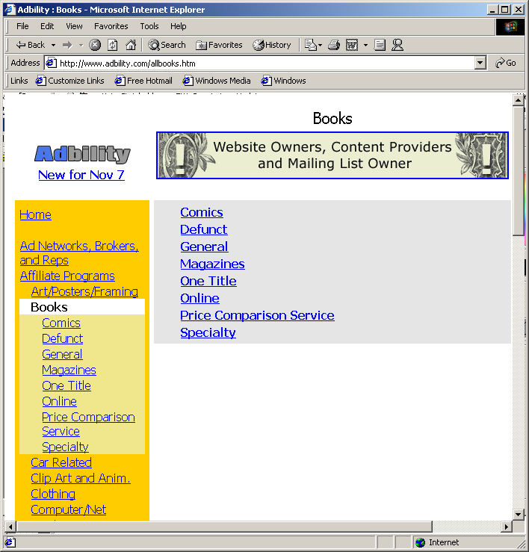
Becoming an Affiliate
    Adbility’s specific segments within an industry. (Courtesy of Adbility.com.)

Slide 18
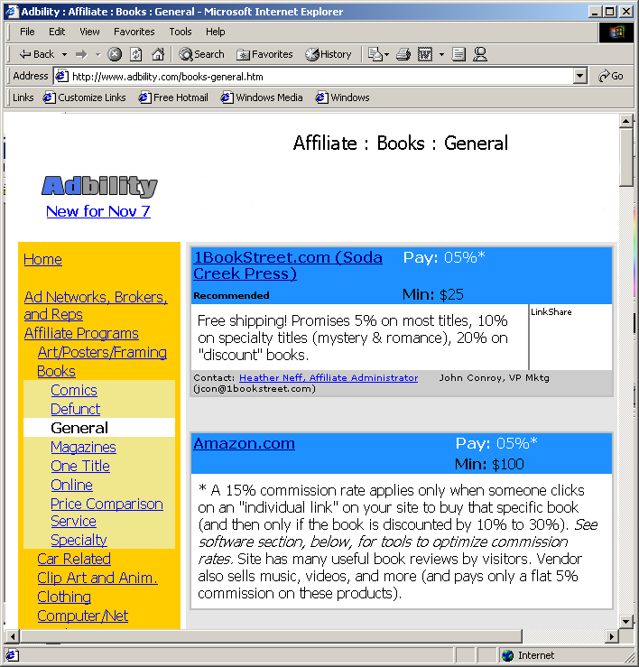
Becoming an Affiliate
    Adbility’s listing of affiliate programs for books in the “general” segment. (Courtesy of Adbility.com.)

Slide 19
Becoming an Affiliate
Some programs have requirements to become an affiliate
  Site statistics, information about visitors and a tax identification number
Hidden fees and restrictions in some affiliate contracts
Note the reputation of the merchant
Most affiliate programs require a person or company to have a Web site to participate
Some programs allow individuals to join by placing affiliate links on their personal sites

Slide 20
Examples of Affiliate Programs
Amazon.com Associate Program
  Pioneer in affiliate marketing
  Sites will be rejected if they contain “amazon” or variations of the word in the domain names, promote violence, are discriminatory or contain sexual material or other content deemed inappropriate
  Associates Central
    provides graphics, links, earnings and traffic information
  Affiliates can provide an Amazon.com search box on its site or link to the home page or recommended books
  Joining is free and pays up to 15 percent in referral fees

Slide 21
Examples of Affiliate Programs
BabyCenter offers a commission-based affiliate program
Pays members for all sales originating from their sites
Pays affiliates for their own personal shopping through the links on their sites
Affiliates are paid on a quarterly basis
BabyCenter Affiliate Gateway provides earning reports, images and links that can be downloaded to connect to the merchant site

Slide 22
Costs and Taxation of Affiliate Programs
Costs
  Merchant is required to pay the affiliate, with the amount depending on the prespecified terms of the program
    Costs can rise with increases in the number of click-throughs, purchases or other specified actions
  Losing visitors through affiliate links
  Developing and implementing the program
Internet affiliate program taxation
  Commissions collected by affiliates are considered income and will be taxed
  State taxation on sales made through affiliates in states other than the state where the merchant is located has not been settled

Slide 23
Affiliate-Program Directories and Search Engines
Affiliate-program directories and search engines
  Provide parties who are interested in becoming affiliates with programs that match their interests, and parties who are interested in finding affiliates with the different options available to them
    Associate-It, AssociatePrograms.com, Refer-it and AffiliateFind.com

