Slide 1
Lecture 27
Electronic Business (MGT-485)

Slide 2
Recap – Lecture 26
E-Business Strategy: Implementation
  Organizational Structure and e-Business
    The Boundary-less organization
    The virtual organization
  Change Management
  Organizational Change Management

Slide 3
Contents to Cover Today
E-Business Strategy: Evaluation
  The Evaluation Process
  Organizational Control and Evaluation
  Financial Evaluation

Slide 4
The Evaluation Process
After implementation, the strategic process includes the evaluation of the performance of the chosen strategy.
The actions that are implemented need to be monitored, assessed and evaluated to determine the effectiveness and efficiency of the strategy.
The evaluation should reveal whether or not the organization's strategy is achieving the stated objectives.
The most common feature of evaluation is comparing set targets with performance achieved.
This is likely to include quantitative measures on sales, profit, turnover and market share.
Firms in e-business and e-commerce evaluate the performance of the website in attracting customers and transforming ‘hits’ into sales (conversion rate).

Slide 5
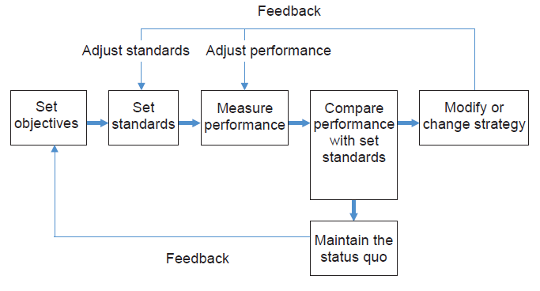
Organizational evaluation and control process: Key Elements

Slide 6
The Evaluation Process
Evaluation is part of a control process within organizations.
Once the performance of a strategy has been measured, the evaluation needs to address the reasons for the performance outcome in relation to the set target.
This will reveal competitive strengths or weaknesses and help to inform future strategy.
Evaluation combines both internal and external factors.
The use of the organization's resources and capabilities will be scrutinized alongside any changes to market and competitive conditions.

Slide 7
The Evaluation Process
The strategy evaluation should reveal whether or not change is necessary.
If change is necessary then the evaluation should also point to the extent to which change should be implemented.
Change can range from minor alterations to the business model or the way the internal functions are carried out, to radical change management or even a paradigm shift in thinking about what the business is all about.
Redesigning strategy is likely to prove risky, expensive and time-consuming since it requires the redeployment of resources and capabilities. More often than not, organizations will modify their strategic actions.

Slide 8
Organizational Control and Evaluation
Organizational control is a systematic process that allows managers to regulate internal activities and match their performance with set targets.
The control function within an organization is dependent on the information generated on performance standards and performance achieved.
Consequently, it is necessary for managers to determine what information is required, how it is to be generated and the appropriate response to the outcomes based on analysis of the information.

Slide 9
Organizational Control and Evaluation
There are three main ways of looking at the control process in organizations.
  Feedforward control
  Concurrent control
  Feedback control

Slide 10
Organizational Control and Evaluation:
Feedforward control
Feedforward control refers to controlling human, material and financial resources flowing into the organization.
The focus is on anticipating problems.
An example is in e-recruitment where firms use the internet to set tests for a large number of prospective employees.

Slide 11
Organizational Control and Evaluation:
Concurrent control
Concurrent control attempts to solve problems as they happen.
For example, concurrent control may focus on monitoring the activities of employees to ensure that they consistently match set standards.
The monitoring of activities of operators in call centers is an example of concurrent control.

Slide 12
Organizational Control and Evaluation
Feedforward and Concurrent control are the two types of control that may feature as part of developing and operating a strategy,
However, in terms of evaluating strategy, the most commonly used type is feedback control.

Slide 13
Organizational Control and Evaluation:
Feedback control
Feedback control focuses on an organization's outputs with an emphasis on the quantity and quality of products and services produced.
Also, feedback control is used as a basis for matching actual performance against set targets.
In e-business, targets may include financial, customer satisfaction, sales, quality, number of ‘hits’ on the website, advertising revenue, or number of new customers.
The feedback information helps managers make decisions and undertake the appropriate course of action to ensure the organization achieves its objectives.

Slide 14
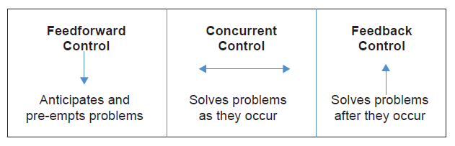
Organizational Control and Evaluation

Slide 15
Organizational Control and Evaluation:
Set standards of performance
Organizations have to develop a strategic plan and establish objectives for each of the functional areas.
In each of the functional areas a standard of performance will be set, against which actual performance can be measured.
The set standards should contribute to the organization's strategy for achieving its objectives.
It is important that the set standards are clearly defined and are achievable.
In some instances it may be necessary to adjust the set standards to better reflect the resources and capabilities within the organization.

Slide 16
Organizational Control and Evaluation:
Measure actual performance
There are activities that take place within organizations that can be measured quantitatively.
Managers can monitor the performance of the functional activities by preparing formal reports on the actual outputs achieved over a set timescale.
Not all performance criteria can be quantified.

Slide 17
Organizational Control and Evaluation:
Measure actual performance
Managers need to gain an understanding of the value of resources and assets that are not easily measured. For example, gaining competitive advantage may stem from the intellectual capital within an organization.
Managers need to use their skills and experience to recognize and value a host of qualitative information that contributes to achieving established set standards of performance.
Both the quantitative and qualitative information are noted and will form the basis for the compilation of formal reports on performance.

Slide 18
Organizational Control and Evaluation:
Compare performance to set standards
Over time, the formal reports will reveal trends that help managers to identify areas where change or modification is required to realign performance with set standards.
The actual performance may meet, or exceed, set standards in which case no change may be necessary.
When comparing actual performance with set standards it is important that managers use a combination of quantitative information and their own experience to determine the meaning of any variance.
The type of change or modification undertaken will depend on managers’ ability to correctly interpret what the information is telling them about how the organization is performing across different functions.

Slide 19
Organizational Control and Evaluation:
Assess the need for action
The final step in the feedback control process is to determine whether or not actions to change or modify the strategy are necessary.
Where performance dips below set standards it will require change or modification to the strategy.
The analysis undertaken of the reasons for, and level of, the under-performance and the identification of the activities that are under-performing will determine the scale of change that is required to remedy the situation.

Slide 20
Organizational Control and Evaluation:
Assess the need for action
Sometimes it is the case that the set standard of performance has to be changed rather than the strategy.
It may become evident that the standards expected are unrealistic or that the environment has changed thereby making previously set standards redundant.
Where standards are met or are exceeded then managers will likely stick to the status quo.
Where performance meets or exceeds set standards managers may reward workers for their efforts as a means of recognizing their contribution and reinforcing the positive culture within the organization.

Slide 21
Financial evaluation
One of the first measures that managers look at to evaluate the performance of their e-business are figures contained in the financial reports.
This gives an immediate overview of the health of the organization and tells the managers if their current strategy is paying dividends in the form of increasing returns on investment and profitability.
Most e-businesses struggle to make money in the start-up phase and therefore cash flow is an important measure for determining if the business can stay afloat.
The finances of any business are part of the control function and it is vital that managers keep monitoring and assessing the financial health of their organization.

Slide 22
Financial evaluation
The main elements of financial control include:
  Cash flow: the level of short-term working capital or liquidity that the firm has to ensure it can operate on a day-to-day basis.
  Assets: refers to short- and long-term assets.
  Customers accounts: refers to credit control, terms of credit and payment control.
  Suppliers: controlling the risks associated with the supply chain.
  Stock: methods of controlling and monitoring stock levels.
There are two main financial statements that provide the basic financial information for control and evaluation of performance.
  the balance sheet and
  the income statement.

Slide 23
Summary
E-Business Strategy: Evaluation
  The Evaluation Process
  Organizational Control and Evaluation
  Financial Evaluation

