Slide 1
Lecture 02
Electronic Business (MGT-485)

Slide 2
Recap - Lecture 01
Basics of electronic business
E-Business Types
Benefits of e-business
How Internet works?
History of Internet

Slide 3
Contents to Cover Today
Historical events of electronic world
How Internet works?
Relationship between e-business and e-commerce
Development of new economy

Slide 4
Historical Events of electronic world
1996 – First free web-based email (Hotmail) was launched.
1998 – First news story was broken online instead of traditional media (Bill Clinton / Monica Scandal).
1998 – Google went online
1998 – Napster launched internet based file sharing
2000 – Bubble bursts (Year of dotcom collapse)
2001 – Wikipedia was launched
2003 – VoIP goes mainstream

Slide 5
Historical Events of electronic world
2003 – MySpace became most popular social network
2004 – Facebook Opened
2005 – Youtube
2006 – Twitter
2007 – started placing TV Shows online
2007 – Apple iPhone (Major change in mobile internet usage through applications)
2008 – Internet Election with US Presidential Elections
2009 – Changes in Policy of ICANN (official body of internet responsible for registering domain names)

Slide 6
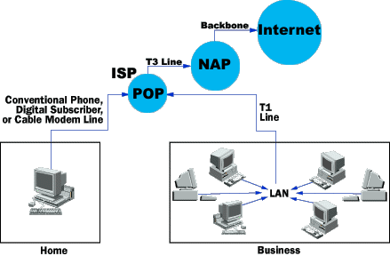
How Internet Works?

Slide 7
How Internet Works?
Every computer that is connected to the Internet is part of a network, even the one in your home.
For example, you may use a modem and dial a local number to connect to an Internet Service Provider(ISP).
At work, you may be part of a local area network (LAN), but you most likely still connect to the Internet using an ISP that your company has contracted with.
When you connect to your ISP, you become part of their network.

Slide 8
How Internet Works?
The ISP may then connect to a larger network and become part of their network. The Internet is simply a network of networks.
Most large communications companies have their own dedicated backbones connecting various regions.
In each region, the company has a Point of Presence (POP).
The POP is a place for local users to access the company's network, often through a local phone number or dedicated line.

Slide 9
How Internet Works?
The amazing thing here is that there is no overall controlling network.
Instead, there are several high-level networks connecting to each other through Network Access Points or NAPs.
All of these networks rely on NAPs, backbones and routers to talk to each other.
What is incredible about this process is that a message can leave one computer and travel halfway across the world through several different networks and arrive at another computer in a fraction of a second!

Slide 10
How Internet Works?
The routers determine where to send information from one computer to another.
Routers are specialized computers that send your messages and those of every other Internet user speeding to their destinations along thousands of pathways.
A router has two separate, but related, jobs:
  It ensures that information doesn't go where it's not needed. This is crucial for keeping large volumes of data from clogging the connections of "innocent bystanders."
  It makes sure that information does make it to the intended destination.

Slide 11
How Internet Works?
In performing these two jobs, a router is extremely useful in dealing with two separate computer networks.
It joins the two networks, passing information from one to the other.
It also protects the networks from one another, preventing the traffic on one from unnecessarily spilling over to the other.
Regardless of how many networks are attached, the basic operation and function of the router remains the same.

Slide 12
How Internet Works?
Internet Backbone:
The National Science Foundation (NSF) created the first high-speed backbone in 1987 called NSFNET, a T1 line that connected 170 smaller networks together and operated at 1.544 Mbps (million bits per second).
IBM, MCI and Merit worked with NSF to create the backbone and developed a T3 (45 Mbps) backbone the following year.
Backbones are typically fiber optic trunk lines.
The trunk line has multiple fiber optic cables combined together to increase the capacity.
Fiber optic cables are designated OC for optical carrier, such as OC-3, OC-12 or OC-48.

Slide 13
How Internet Works?
An OC-3 line is capable of transmitting 155 Mbps while an OC-48 can transmit 2,488 Mbps (2.488 Gbps).
Compare that to a typical 56K modem transmitting 56,000 bps and you see just how fast a modern backbone is.
Today there are many companies that operate their own high-capacity backbones, and all of them interconnect at various NAPs around the world.
In this way, everyone on the Internet, no matter where they are and what company they use, is able to talk to everyone else on the planet.
The entire Internet is a gigantic, sprawling agreement between companies to intercommunicate freely.

Slide 14
How Internet Works?
Internet Protocol:
IP Addresses:
  Every machine on the Internet has a unique identifying number, called an IP Address.
  The IP stands for Internet Protocol, which is the language that computers use to communicate over the Internet.
  A protocol is the pre-defined way that someone who wants to use a service talks with that service.
  The "someone" could be a person, but more often it is a computer program like a Web browser.
  To make it easier for us humans to remember, IP addresses are normally expressed in numeric form but computers communicate in binary form.

Slide 15
How Internet Works?
Internet Protocol:
Domain Name System:
When the Internet was in its infancy, it consisted of a small number of computers hooked together with modems and telephone lines.
But it became cumbersome as more and more systems came online.
In 1983, the University of Wisconsin created the Domain Name System (DNS), which maps text names to IP addresses automatically.

Slide 16
How Internet Works?
Internet Protocol:
Domain Name System:
When the Internet was in its infancy, it consisted of a small number of computers hooked together with modems and telephone lines.
But it became cumbersome as more and more systems came online.
In 1983, the University of Wisconsin created the Domain Name System (DNS), which maps text names to IP addresses automatically.

Slide 17
How Internet Works?
Uniform Resource Locator (URL)
  For example “http://www.yahoo.com” is a URL.
  Top-level domain names, also called first-level domain names, include .COM, .ORG, .NET, .EDU and .GOV. Within every top-level domain there is a huge list of second-level domains.
  Every name in the .COM top-level domain must be unique.

Slide 18
How Internet Works?
Internet Servers and Clients
  Internet servers make the Internet possible.
  All of the machines on the Internet are either servers or clients.
  The machines that provide services to other machines are servers.
  And the machines that are used to connect to those services are clients.
  There are Web servers, e-mail servers, FTP servers and so on serving the needs of Internet users all over the world.

Slide 19
How Internet Works?
Ports and HTTP
  Any server machine makes its services available using numbered ports -- one for each service that is available on the server. For example, if a server machine is running a Web server and a file transfer protocol (FTP) server, the Web server would typically be available on port 80, and the FTP server would be available on port 21.
  Clients connect to a service at a specific IP address and on a specific port number.
  Every Web server on the Internet conforms to the hypertext transfer protocol (HTTP).
  Networks, routers, NAPs, ISPs, DNS and powerful servers all make the Internet possible.

Slide 20
How Internet Works?
I think It is truly amazing when you realize that all this information is sent around the world in a matter of milliseconds!
The components are extremely important in modern life -- without them, there would be no Internet.
And without the Internet, life would be very different indeed for many of us.

Slide 21
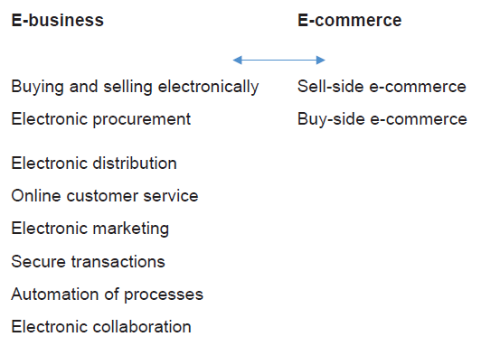
Relationship between e-business and e-commerce

Slide 22
Development of New Economy
Information Economy / Internet Economy / Digital Economy
Organizations are no longer viewed as single entities but a part of integrated network of organizations.
New forms of management and control
Characterized by changes in the competitive structure of industries.

Slide 23
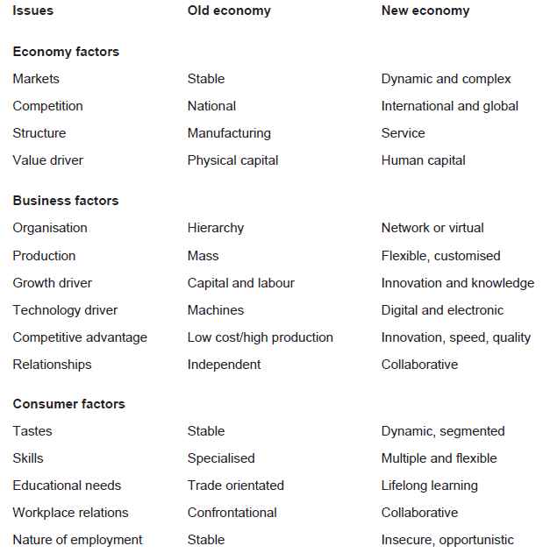
Development of New Economy

Slide 24
Summary
Historical events of electronic world
How Internet works?
Relationship between e-business and e-commerce
Development of new economy

