Slide 1
Lecture 18
Electronic Business (MGT-485)

Slide 2
Recap – Lecture 17
Building an e-Business: Design, Development and Management
  Introduction
  Getting Started
  Generating Business Ideas
  Business Plan Layout
  Growth of e-Business: Evaluating Risk
  Finding Funding and Going Public
  Putting your Plan into Action
  Choosing a Domain Name
  Supply Chain Management
  Website Hosting

Slide 3
Contents to Cover Today
Building an e-Business: Design, Development and Management
  Website Hosting
  Web Design
  Enhancing the User Experience
  Protecting your e-Business
  Streaming Media
  Preparing for New Technologies
  e-Business Solutions
    End-to-End e-Business Solutions
    Other e-Business Solutions
  Maintaining & Monitoring your Website
  e-Commerce Consulting

Slide 4
Web-Site Hosting
Web host
  Provides products, services and support for companies, organizations and individuals to help them create and maintain Web sites
  Offers customers space on a Web server where they can build a Web site
Dedicated server
  Assigned one specific purpose, ensuring that the function that the server was intended to manage is not interrupted by other responsibilities, offering consistent download times
Colocation
  Includes a dedicated Internet connection and protection from power outages, fire and other disasters

Slide 5
Web-Site Hosting
Web-hosting services
  Loudcloud
  Hostopia
  DedicatedHosting.com
  HostPro
  Global Crossing
  Exodus
  Digital Island
  Digex
  ValueWeb

Slide 6
Web-Site Hosting
Turnkey solutions
  Freemerchant
  Yahoo! Store
  BigStep.com
  Tripod.com
  Commerce One
  Virtual Spin
  AbleCommerce’s AuctionBuilder
  Bidland.com
  WebSiteForFree.com
  Homestead

Slide 7
Web Design
Web site should be easy to navigate
Content should be the foundation of the site and updated regularly
Design consistency
  Uniformity among the sections and pages
Examples of well-designed sites:
  Cooking.com
  Apple
  Crayola
  Amazon.com
  eBay

Slide 8
Web Design
Strong branding
Easily located contact information
Consistent appearance of logos and color scheme
Easily located products and prices
Low-switching costs
  The costs of changing vendors

Slide 9
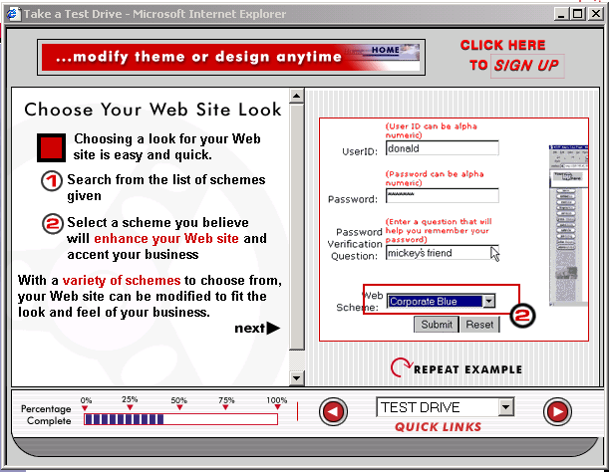
Web Design
WebSiteForFREE.com’s site design. (Courtesy of WebSiteForFREE.com)

Slide 10
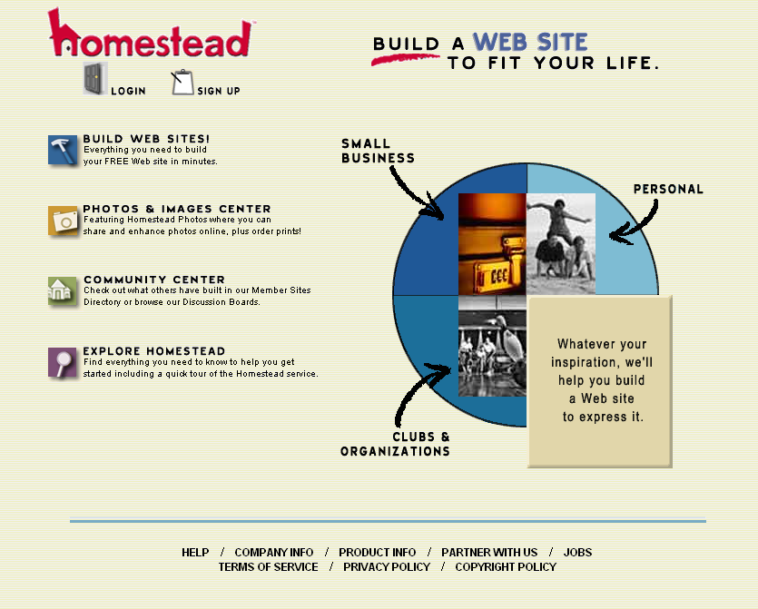
Web Design
Homestead site tour. (Courtesy of Homestead.com)

Slide 11
Enhancing the User Experience
Adding a search engine
  Freefind
Intelligent agents
  Software programs that communicate with end users and recognize the users’ preferences (Amazon.com)
Enhancing visual experience
  ZOOM Server software
  ImagePump
Community-building tools
  MyEvents.com
Frequently Asked Questions (FAQs)

Slide 12

Enhancing the User Experience
ImagePump Zoom Technology. (Courtesy of Xippix, Inc.)

Slide 13

Enhancing the User Experience
Enhanced view with the Magnifier. (Courtesy of Xippix, Inc.)

Slide 14
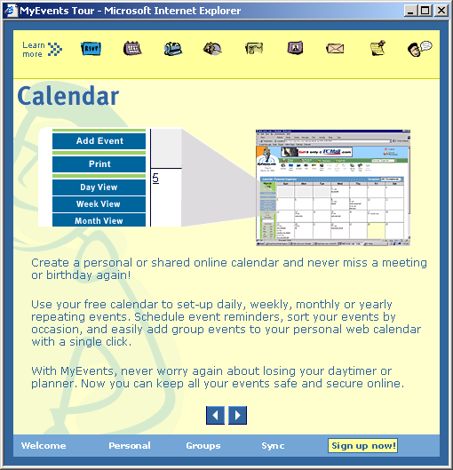
Enhancing the User Experience
MyEvents.com calendar feature. (Courtesy of MyEvents.)

Slide 15
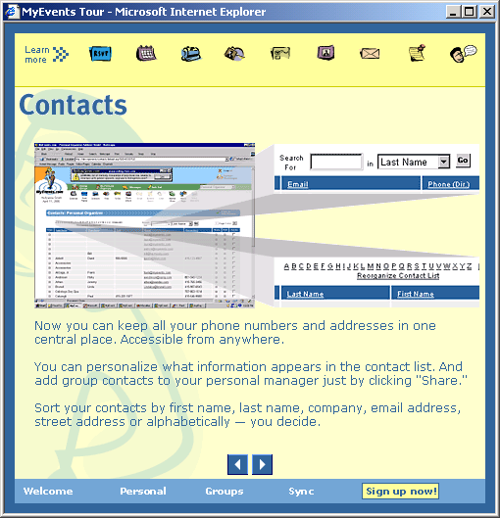
Enhancing the User Experience
MyEvents.com contacts feature. (Courtesy of My Events.)

Slide 16
Protecting Your e-Business
Timely shipping and effective personalization
Protection from mistakes and misunderstandings
  Egghead.com
Privacy policy
  Secure Assure
Disclaimers should be easy to locate and information should be presented in a clear and concise manner
  Offer protection against:
    Small spelling or editing errors
    Inaccurate statistics or product prices
    Dated information and inaccurate links

Slide 17
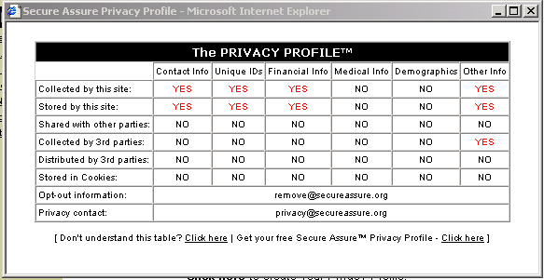
Protecting Your e-Business
Secure Assure’s example of a Privacy Profile™ (Courtesy of Secure Assure, LLC.)

Slide 18
Streaming Media
While multimedia such as streaming video and audio can enhance content, not all users have the capabilities to download this kind of information
Provide consumers with simpler Web pages
Test your Web site’s effectiveness by running trial downloads of your site through a standard dial-up connection prior to launch

Slide 19
Preparing for New Technologies
Keep up with new technology
Plan for new technologies during initial building stages
  Cell phone
  Pager
  Personal Digital Assistant (PDA)
Employ new technologies to make your e-business accessible to mobile devices

Slide 20
e-Business Solutions
Enable good managers and business owners to build, manage and maintain an e-business
Web-site building services
e-Consulting
Marketing

Slide 21
e-Business Solutions:
End-to-End e-Business Solutions
End-to-end solution provider
  Offers services to build Web sites from conception to implementation
Design, development and deployment services
Payment capabilities
Web-site monitoring services
Back-end adaptation
Fulfillment
Data management

Slide 22
e-Business Solutions:
End-to-End e-Business Solutions
End-to-end solution providers
  Webvision
  Microsoft’s bCentral
  ROIDirect’s Ecommerce
  Dell E Works
  Genuity
  Interland
  Appnet
  Sapient
  Scient
  Viant
  Proxicom
  Inforte

Slide 23
e-Business Solutions:
Other e-Business Solutions
Exist for e-business development, operation and management
Solution providers
  Openair.com
  Intacct
  BAport Accounting
  Netledger
  BizTone Financials
  Allaire Spectra
  Mediasurface
  InfoOffice
  ITKnowledge.comSM

Slide 24
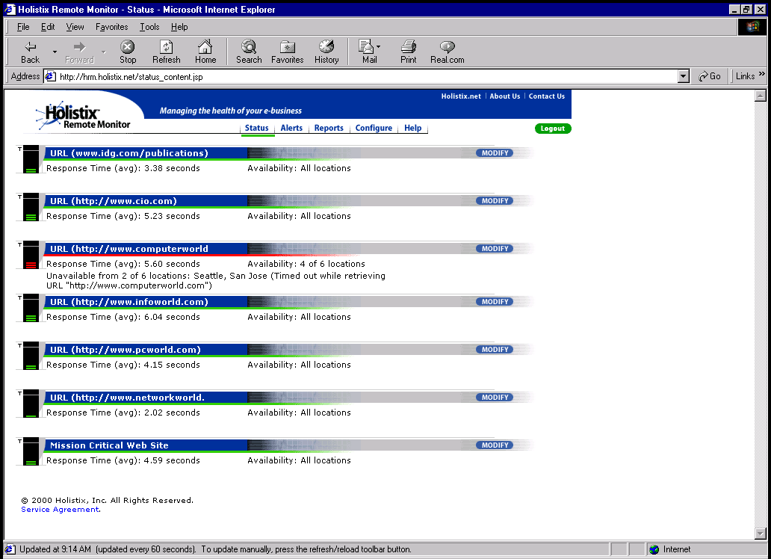
Maintaining & Monitoring Your Web Site
Holistix’s Web Manager. (Courtesy of Holistix, Inc.)

Slide 25
e-Commerce Consulting
Guide developing e-businesses
Consulting services
  Accenture (formerly Andersen Consulting)
  iPlanet
  SAP
  Sun Microsystems
  Kintana
  Xpedior
  Ernst & Young
  Deloitte & Touche
  eRunway
  Answerthink Consulting Group

Slide 26
Summary
Building an e-Business: Design, Development and Management
  Website Hosting
  Web Design
  Enhancing the User Experience
  Protecting your e-Business
  Streaming Media
  Preparing for New Technologies
  e-Business Solutions
    End-to-End e-Business Solutions
    Other e-Business Solutions
  Maintaining & Monitoring your Website
  e-Commerce Consulting

