Slide 1
Lecture 17
Electronic Business (MGT-485)

Slide 2
Recap – Lecture 16
E-Customer Relationship Management
  Intelligent Agents
  Personalization versus privacy
  Contact centers
  FAQs
  E-mail
  Online text chatting
  Speech Synthesis and Recognition; Natural Language Processing
  Microsoft Agent Feature
  Voice communication
  Sales force automation
  B2B e-CRM
  Complete e-CRM solutions

Slide 3
Contents to Cover Today
Building an e-Business: Design, Development and Management
  Introduction
  Getting Started
  Generating Business Ideas
  Business Plan Layout
  Growth of e-Business: Evaluating Risk
  Finding Funding and Going Public
  Putting your Plan into Action
  Choosing a Domain Name
  Supply Chain Management
  Website Hosting

Slide 4
Introduction
Turnkey solution
  A pre-packaged e-business
E-business templates
  Outline the basic structure, but allow the design to be determined by the owner
Project outsourcing
  Available to businesses with substantial funding, alleviates the need for businesses to complete projects in-house
Front-end system
  Portion of an e-business that is visible to consumers
Back-end system
  Database management, payment processing and logistics

Slide 5
Getting Started
Building, Managing and Maintaining
  Advertising
  Marketing
  Customer relationship management
  Content management
  Accepting online payments
  Recognizing cultural differences and legal parameters
  Providing security features

Slide 6
Generating Business Ideas
Products and services
  Discover what exists
  Decide how to improve it
Develop a business plan
  Enables you to envision your e-business on paper for evaluation purposes
  Serves as a presentation of your business’ objectives and long-term expectations

Slide 7
Business Plan Layout
Business plan layout
  Introduce your readers to the layout, what you will discuss and when you will discuss it
  Provide an overview of the business premise including the primary issues
  Headings and sub-headings should categorize the content
  Focus on what makes the e-business unique
Business plan services and software
  www.synrgistic.com/busplan/busplan.htm
  Mindspring Biz
  www.adarus.com/html/demos.html

Slide 8
Business Plan Layout
Primary Purpose
  Define the purposes of your business
  What do you intend to sell
  What services will you provide
Strategy
  Describe how your product or service fits in the market
  How is it different from existing products and services
  How will it be profitable
Business model
  What model will you implement
  How will you conduct transactions

Slide 9
Business Plan Layout
Support
  Provide evidence that supports the idea of your business
  How will you justify these as support to the idea
  Have you conducted research
  Who are your customers
  Who is on your management team and what are their credentials
  How will you generate revenue
  What are your expenses
Process
  List the steps necessary to build your e-business
  Does more research need to be conducted
  Inform investors of how money will be allocated

Slide 10
Growth of e-Business: Evaluating Risk
Many Internet companies have experienced rapid growth
Many others have struggled to get off the ground, find funding and make a profit
Technological advancements usually lead to growth in industry
The Internet has produced new industries and altered and enhanced existing industries
E-businesses that target a specific market first must be aware of the changing technologies and their costs

Slide 11
Finding Funding and Going Public
Building an e-business can be expensive and risky
Competition is intense
Determining a market niche and reaching a target audience often require significant financial backing
Internet incubator
  A company that specializes in the development of Internet businesses
  Often will serve as the financiers, as well as work with the development team
  Often receive a stake in the developing e-business

Slide 12
Finding Funding and Going Public
Internet incubators
  Camp Six
  eCorporation
  Idealab
  eHatchery
Venture capitalists
  Individuals or groups that generate the financial support of a growing enterprise, usually in exchange for ownership in the company
Angel investors
  Wealthy investors with business experience
Many e-businesses look to make an Initial Public Offering (IPO)
  Money generated from public investors can be used to grow the company and establish it at the forefront of its market

Slide 13
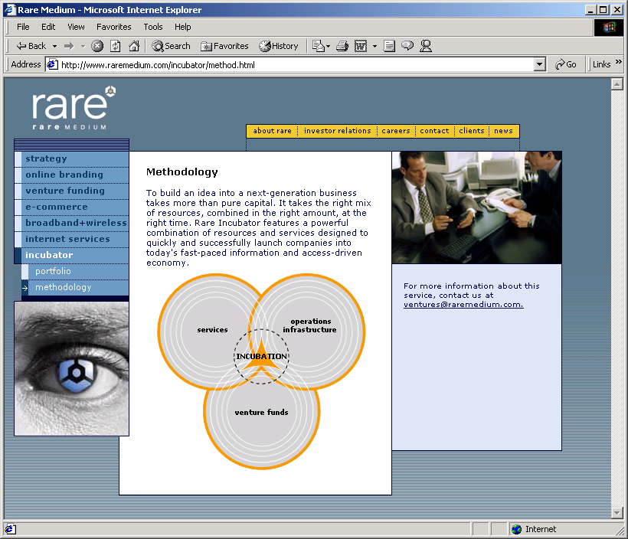
Finding Funding and Going Public
Rare Medium’s Incubation Methodology. (Courtesy of Rare Medium.)

Slide 14
Putting Your Plan Into Action
After generating ideas, building a business plan and finding funding, prepare to:
  Manage distribution
  Manage shipping
  Enhance the user experience through Web design
  Prepare for new technologies
  Purchase supporting hardware and software
  Accept online payment
  Market your Web site
  Manage your consumers

Slide 15
Choosing a Domain Name
Domain name
  The name used in the URL for a Web site
  Choose a concise name that people will be able to recognize and type easily
  Consider how a domain name will be interpreted in many different languages and cultures
Fully qualified host name
  The host name, the domain name and the top-level domain (TLD)
  Most Web servers use www as the host name
  A domain name is often the name of the company that owns a site or a word or phrase that otherwise describes the site
  The TLD usually describes the type of organization that owns the domain name (.com, .org, .gov)

Slide 16
Choosing a Domain Name
Available domain names with the dot-com (.com) extension are becoming rare
ICANN is considering the possibility of introducing new suffixes, such as .movie, .inc, .info and .web
Registering a domain name
  Network Solutions, Register.com, Domainit.com
Cost to register a domain name depends on extension
Usually, ownership of a domain name requires a one-time registration fee followed by recurring annual fees

Slide 17
Supply-Chain Management
Fulfillment
  Warehouse storage, shipping, inventory management and return procedures
Manufacturer
  The direct producer of the product
Distributor
  The supplier who acts as a middleman to manufacturers and vendors, often reducing the price of an item by buying in bulk
Allows businesses with Web-enabled supply chains to accept made-to-order requests (Dell)

Slide 18
Supply-Chain Management
Increased efficiency
  Web merchant can serve customers better by knowing the status of each order
  Web-based fulfillment mechanisms will demonstrate if the product is available, if it has left the warehouse or if it has been delivered and who signed for it
  Wireless Internet access allows fulfillment status to be checked from any location at any time
Supply-chain management services and software
  ChangePoint, GoCargo.com, Evolve, Atlas Commerce, SubmitOrder.com

Slide 19
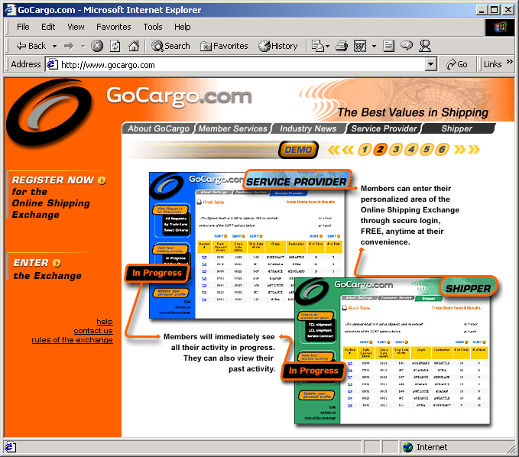
Supply-Chain Management
GoCargo.com shipping bid. (Courtesy of GoCargo.com)

