Slide 1
Lecture 15
Electronic Business (MGT-485)

Slide 2
Recap – Lecture 14
E-business Advertising
  Banner Advertising
  ValueClick Feature
Media Rich Advertising
Wireless Advertising
E-Business Public Relations

Slide 3
Contents to Cover Today
B2B Marketing on the Web
Search Engines
META Tags
Search Engine Registration
E-Customer Relationship Management
  Tracking and Analyzing Data
  Data Mining
  Customer Registration
  Cookies
  Personalization

Slide 4
Business-to-Business (B2B) Marketing on the Web
(B2B) marketing
  Consider distributors, resellers, retailers and partners
  Selling to someone who is not the direct user
  Usually more than one person involved in purchasing process
  Businesses making large purchases depend on suppliers and expect reliability and delivery of quality products and services on time
  Personalization
Intranets and extranets
Industry marketplaces
  Construction.com, Worldwideretailexchange.com
  Connect Inc, Concur Technologies and Ariba

Slide 5
Search Engines
Search-engine ranking important to bring consumers to a site
  Method used by search engines to rank your Web site will determine how "high" your site appears in search results
Make sure all Web pages have been published on the Web and linked correctly
By registering with search engines a company will increase traffic to its site

Slide 6
META Tags
META tag
  An HTML tag that contains information about a Web page
  Does not change how Web page is displayed
  Can contain description of page, keywords and title of page
Most search engines rank your site by sending out a spider to inspect the site
  The spider reads the META tags, determines the relevance of the Web page’s information and keywords and ranks the site according to that visit’s findings
Examine competitors’ sites to see what META tags they are using
Top ten results

Slide 7
Search-Engine Registration
Submit keywords and a description of business
Search engine will add information to its database
Registering will increase the possibility that a site will make an appearance in search-engine results
Many search engines do not charge a fee for registering
  AltaVista, Yahoo!, Lycos, Excite, Google and Ask Jeeves
    Ask Jeeves uses natural-language technology that allows people to enter their search subjects in the form of questions
Metasearch engines
  Aggregate results from a variety of search engines
  Metacrawler and FrameSearch.net

Slide 8
Search-Engine Registration
http://www.wordsinarow.com/wheretogo.html

Slide 9
E-Customer Relationship Management
Customer relationship management (CRM)
  Focuses on providing and maintaining quality service for customers, by effectively communicating and delivering products, services, information and solutions to address customer problems, wants and needs
  Can include:
    Call handling (the maintenance of outbound and inbound calls from customers and service representatives)
    Sales tracking (the tracking and recording of all sales made)
    Transaction support (the technology and personnel used for conducting business transactions)

Slide 10
Introduction
eCRM is the application of CRM to an e-business’ strategy
  Includes the personalization and customization of customers’ experiences and interactions with the e-business
Relationship between merchant and customers is distant
Less expensive to keep customers than to acquire new ones
Repeat customers have higher lifetime value than one-time buyers
  A customer’s lifetime value is the expected amount of profit derived from a customer over a designated length of time
Evaluate the potential to profit from a customer

Slide 11
Tracking and Analyzing Data
Employ tracking devices
  Personalize each visitor’s experience
  Find trends in customer use
  Measure the effectiveness of a Web site over time
  ID cards
    An ID card enables information to be sent to your computer from a Web site such as the numerical address of your PC on the Internet, your browser and your operating system
  Click-through banner advertisements
    Click-through advertisements enable visitors to view a service or product by clicking the advertisement
    Advertisers can learn what sites generate sales

Slide 12
Tracking and Analyzing Data
  Web Bugs, or clear GIFs
    A type of image file embedded in an image on the screen
    Site owners allow companies, especially advertising companies, to hide these information-collecting programs on various parts of their sites
    Every time a user requests a page with a Web bug on it, the Web bug sends a request to the Web bug’s company’s server, which then tracks where the user goes on the Web.
  Log-file analysis
  Data mining
  Customer registration
  Cookies

Slide 13
Tracking and Analyzing Data
Log-File Analysis
When visiting a site, you are submitting a request for information from the site’s server and the request is recorded in a log file
  Log files consist of data generated by site visits, including each visitor’s location, IP address, time of visit, frequency of visits and other information
  Log-file analysis organizes and summarizes the information contained in the log files
    Can be used to determine the number of unique visitors
    Can show the Web-site traffic effects of changing a Web site or advertising campaign

Slide 14
Tracking and Analyzing Data
WebTrends Feature
WebTrends provides solutions for tracking visitors
  User specifies source of log files, types of reports and location where data is stored
  The analysis is conducted automatically
Collected information can be used to evaluate e-commerce methods, customer service and Web-site design
Graphical interpretation of the log files can be presented
Can view demographic and geographic data, technical analysis of a Web site’s effectiveness and top-referring sites—sites that most frequently refer visitors to your site

Slide 15
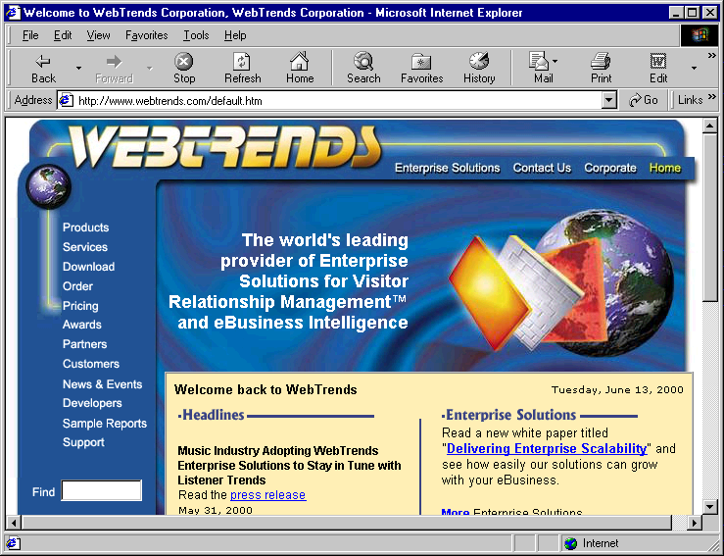
Tracking and Analyzing Data
WebTrends Feature
    WebTrends home page. (Courtesy of © 2000 WebTrends Corporation. All rights reserved. WebTrends is a registered trademark of WebTrends Corporation.)

Slide 16
Data Mining
Uses algorithms and statistical tools to find patterns in data gathered from customer visits
Costly and time consuming to go through large amounts of data manually
Use data-mining to analyze trends within their companies or in the marketplace
Uncovered patterns can improve CRM and marketing campaigns
Discover a need for new or improved services or products by studying the patterns of customers’ purchases
Data mining software
    HNC Software Data Distilleries Applied Metrix Data Instincts and SmartDrill

Slide 17
Customer Registration
Customer registration
  Requiring visitors to fill out a form with personal information that is then used to create a profile
  Recommended when it will provide a benefit to the customer
  When customers log on using usernames and passwords, their actions can be tracked and stored in a database
Require only minimum information
Give customers an incentive to register
  Free-trial run or a free demonstration to familiarize the user
After customer registration, send an e-mail including customer usernames and welcoming them to your Web site

Slide 18
Cookies
Cookie
  A text file stored by a Web site on an individual’s personal computer that allows a site to track the actions of a
  Information collected is intended to be an anonymous account of log-on times, the length of stay at the site, purchases made on the site, the site previously visited and the site visited next
  Does not interact with other information stored on the system
  Can only be read by the host that sets them on a person’s computer

Slide 19
Cookies
Benefits
  Record passwords for returning visitors
  Keep track of shopping-cart materials
  Register preferences
  Assist companies in address target markets with greater accuracy
Negatives
  Customer privacy
  Can be misleading to site that places cookie on a computer
    Different people may use the same computer to surf the Web, and the cookie will not be able to differentiate the users

Slide 20
Personalization
Personalization
  Uses information from tracking, mining and data analysis to customize a person’s interactions with ba company’s products, services, Web site and employees
    Allaire, Blaze Software, NetGenesis and Personify
Establish relationships that improve each time visitors return to site
Customers may enjoy individual attention and become more loyal

Slide 21
Personalization
Collaborative filtering
  Compares ratings of a present user’s interests and decisions with those of past users to offer content relative to the present user’s interests
Rules-based personalization
  The delivery of personalized content based on the subjection of a user’s profile to set rules or assumptions

Slide 22
Summary
B2B Marketing on the Web
Search Engines
META Tags
Search Engine Registration
E-Customer Relationship Management
  Tracking and Analyzing Data
  Data Mining
  Customer Registration
  Cookies
  Personalization

