Slide 1
Lecture 14
Electronic Business (MGT-485)

Slide 2
Recap – Lecture 13
Introduction to e-Marketing
Branding
Internet Marketing Research
E-mail Marketing
Promotions
E-business Advertising

Slide 3
Contents to Cover Today
E-business Advertising
  Banner Advertising
  ValueClick Feature
Media Rich Advertising
E-Business Public Relations

Slide 4
E-business Advertising
Traditional
  Television, movies, newspapers and magazines
Prime-time television slots most expensive times to air commercials
  (monster.com advertisement)
Establish and continually strengthen branding
  Brand is a symbol or name that distinguishes a company and its products or services from its competitors and should be unique, recognizable and easy to remember
Publicize URL on direct mailings and business cards
Online advertising
  Place links on other sites, register with search engines

Slide 5
Banner Advertising
Banner ads
  Located on Web pages, act like small billboards, usually contain graphics and an advertising message
  Benefits include:
    Increased brand recognition, exposure and possible revenue
  Side panel ads or skyscraper banners
    Advertisements that lie vertically on Web sites
  Banner advertisements are losing their effectiveness
    Industry has calculated click-through rates at around .5 percent
  Place logo on banners, enhancing brand recognition

Slide 6
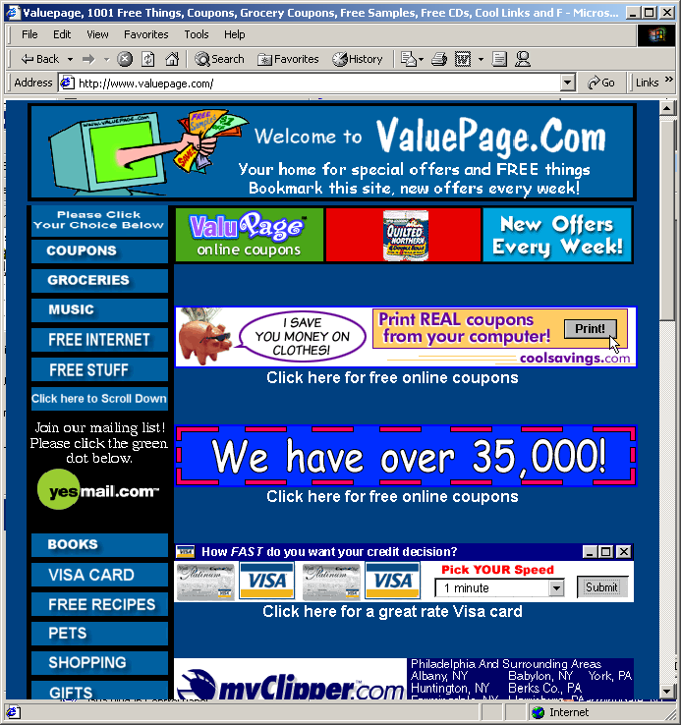

Banner Advertising
    Banner Advertisements.
    (Courtesy of GaryCohn.com Marketing.)
    Example of a panel ad. (Courtesy of Venture Capital Online, Inc.)

Slide 7
Banner Advertising
Inventive color schemes and movement
  Flashing, scrolling text, pop-up boxes and color changes
    Pop-up box is a window containing an advertisement that appears separate from the screen the user is viewing, pops up randomly or as a result of user actions (can have a negative effect due to their intrusive nature)
Determine the best position on sites for a banner
  Web sites cluttered with ads annoy visitors
Space can be more expensive during high traffic
Exchanging banners with another site
Adbility and BannerTips

Slide 8
Buying and Selling Banner Advertising
Buy advertising space on sites that receive a large number of hits and target a similar market
Selling ad space provides additional income
Monthly charges for online advertising rarely used
CPM (cost per thousand)
  A designated fee for every one thousand people who view the site on which your advertisement is located

Slide 9
Buying and Selling Banner Advertising
Unique visitors versus total number of hits
  Visiting any site registers one unique visit
  Hits are recorded for each object that is downloaded
  To determine the value of a Web site for advertising purposes, use the number of unique visitors, not total hits
Advertising payment options
  Pay-per-click: you pay the host according to the number of click-through to your site
  Pay-per-lead: you pay the host for every lead generated from the advertisement
  Pay-per-sale: you pay the host for every sale resulting from a click-through

Slide 10
Buying and Selling Banner Advertising
Selling advertising space
  Provide appropriate contact information on your Web site
  Register with organizations that will sell your space for you
    These companies typically charge a percentage of the revenue you receive from the advertisements placed on your site
    ValueClick, DoubleClick, AdSmart and LinkExchange

Slide 11
ValueClick Feature
ValueClick acts as a broker for people who want to buy and sell advertising space
Gives you the option of targeting specific markets
To buy advertising through ValueClick:
  Design a banner
  Contact a representative of ValueClick to determine what program best fits your advertising needs
  Pre-pay for the service based on the number of visitors you want to receive, a minimum fee is required

Slide 12
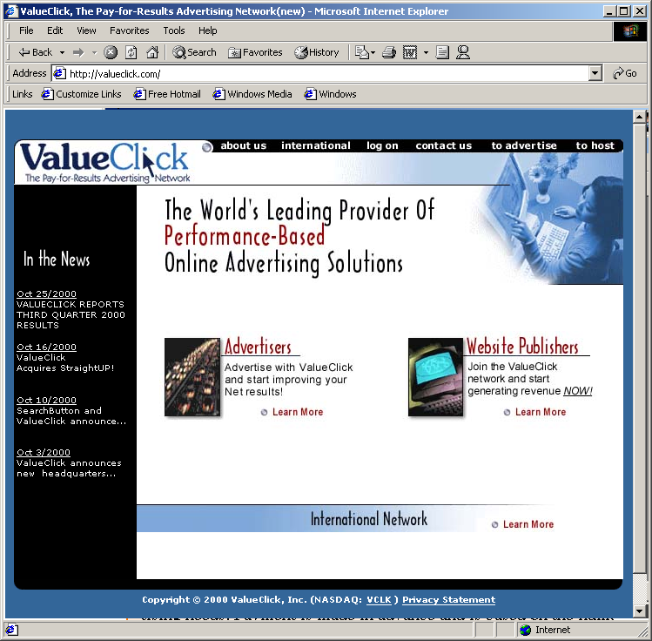
ValueClick Feature
    ValueClick’s home page. (Courtesy of ValueClick, Inc.)

Slide 13
ValueClick Feature
Offers many segmented markets for advertising
  Segmented markets are people or companies that are grouped together based on similar characteristics
Earnings depend on number of click-throughs resulting from the advertisements
Pays host monthly if revenues are greater than certain amount
Offers four options for publishing advertisements on your site
  ValueClick Affiliate, Premium, AdVantage and AdVantage Plus programs

Slide 14
Media-Rich Advertising
Webcasting
  Involves using streaming media to broadcast an event over the Web
  Streaming video simulates television, streaming delivers a flow of data in real time.
    Resource Marketing, Clear Digital, Navisite, Cyber-Logics, www.streamingmedia.com and Macromedia
  Many people have relatively slow Internet access
    The slower the connection, the more disconnected the video appears
  Victoria’s Secret Webcast most popular ever held on Web

Slide 15
Media-Rich Advertising
Bursting
  There is a substantial build up of content at the receiving end, causing a video to appear smoother
    Burst.com
Cross-media advertising or hybrid advertising
  Involves using a combination of rich media (such as audio, video, images and animations) and traditional advertising forms (such as print, television and radio advertisements) to execute an advertising campaign
  Involve consumers in the advertising process
    Nike
    WebRIOT, a game show on MTV
    H2O Design and Lot21

Slide 16
Media-Rich Advertising
Interactive television advertising
  Allows people viewing television to interact with what they are seeing on the screen
  Consumers have the ability to choose to learn more about an offer, make a purchase or even request that customer service representatives contact them
  RespondTV

Slide 17
e-Business Public Relations
Public relations (PR)
  Keeps customers and company current on latest information about products, services and internal and external issues such as company promotions and consumer reactions
Methods
  Chat sessions
  Bulletin board
  Special events or functions on Web site
  Trade shows and exhibitions
  Press releases (can be delivered over Web, PR Web)
    Printing and distribution, MediaMap
    Add link that connects to all press releases
  Video clips
    PR Newswire and Business Wire

Slide 18
e-Business Public Relations
Crisis management
  Another responsibility of PR, is conducted in response to problems the company is having
  Bridgestore/Firestone, Inc.
Outsourcing public relations

Slide 19
Summary
E-business Advertising
  Banner Advertising
  ValueClick Feature
Media Rich Advertising
Wireless Advertising
E-Business Public Relations

