Slide 1
Lecture 12
Electronic Business (MGT-485)

Slide 2
Recap – Lecture 11
E-Commerce Security Environment
Security Threats in E-commerce
Technology Solutions

Slide 3
Contents to Cover Today
Tools Available to Achieve Site Security
Encryption
  Symmetric key encryption
  Public key encryption
  Digital Envelopes
  Digital Certificates and Public Key Infrastructure (PKI)
Securing Channels of Communication
Protecting Networks
Protecting Servers and Clients
Management Policies, Business Procedures, and Public Laws
Developing an E-commerce Security Plan
How an Online Credit Transaction Works?

Slide 4
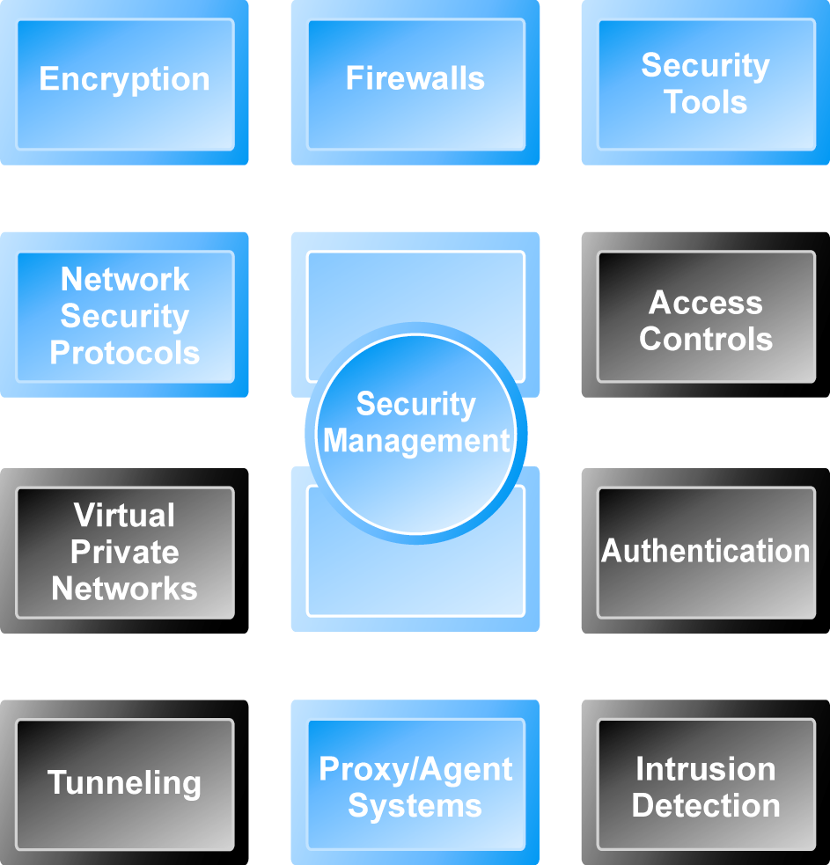
Tools Available to Achieve Site Security

Slide 5
Encryption
  Transforms data into cipher text readable only by sender and receiver
  Secures stored information and information transmission
  Provides 4 of 6 key dimensions of e-commerce security:
      Message integrity
      Nonrepudiation
      Authentication
      Confidentiality

Slide 6
Encryption
Symmetric Key Encryption
  Sender and receiver use same digital key to encrypt and decrypt message
  Requires different set of keys for each transaction
  Strength of encryption
    Length of binary key used to encrypt data
  Advanced Encryption Standard (AES)
    Most widely used symmetric key encryption
    Uses 128-, 192-, and 256-bit encryption keys
  Other standards use keys with up to 2,048 bits

Slide 7
Encryption
Public Key Encryption
  Uses two mathematically related digital keys
    Public key (widely disseminated)
    Private key (kept secret by owner)
  Both keys used to encrypt and decrypt message
  Once key used to encrypt message, same key cannot be used to decrypt message
  Sender uses recipient’s public key to encrypt message; recipient uses his/her private key to decrypt it

Slide 8
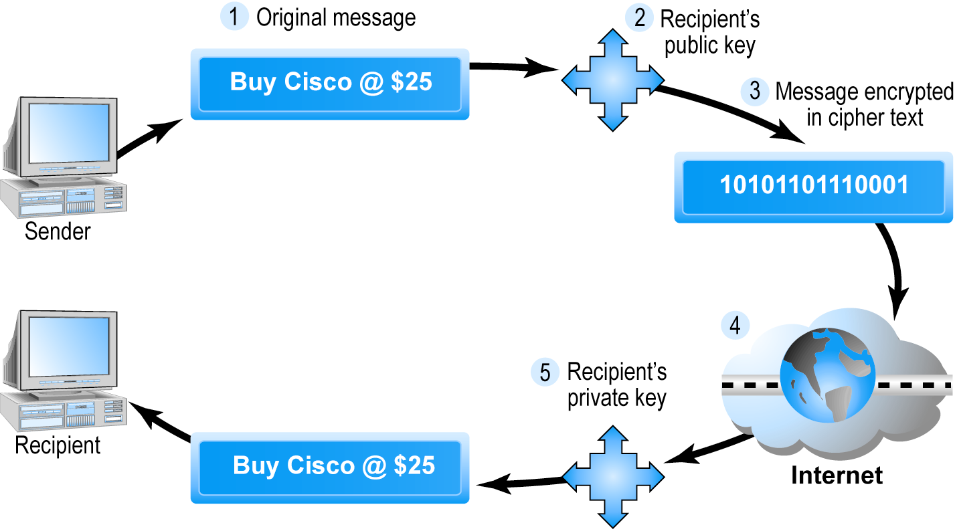
Public Key Cryptography—A Simple Case

Slide 9
Public Key Encryption Using Digital Signatures and Hash Digests
Hash function:
  Mathematical algorithm that produces fixed-length number called message or hash digest
Hash digest of message sent to recipient along with message to verify integrity
Hash digest and message encrypted with recipient’s public key
Entire cipher text then encrypted with recipient’s private key—creating digital signature—for authenticity, non-repudiation

Slide 10
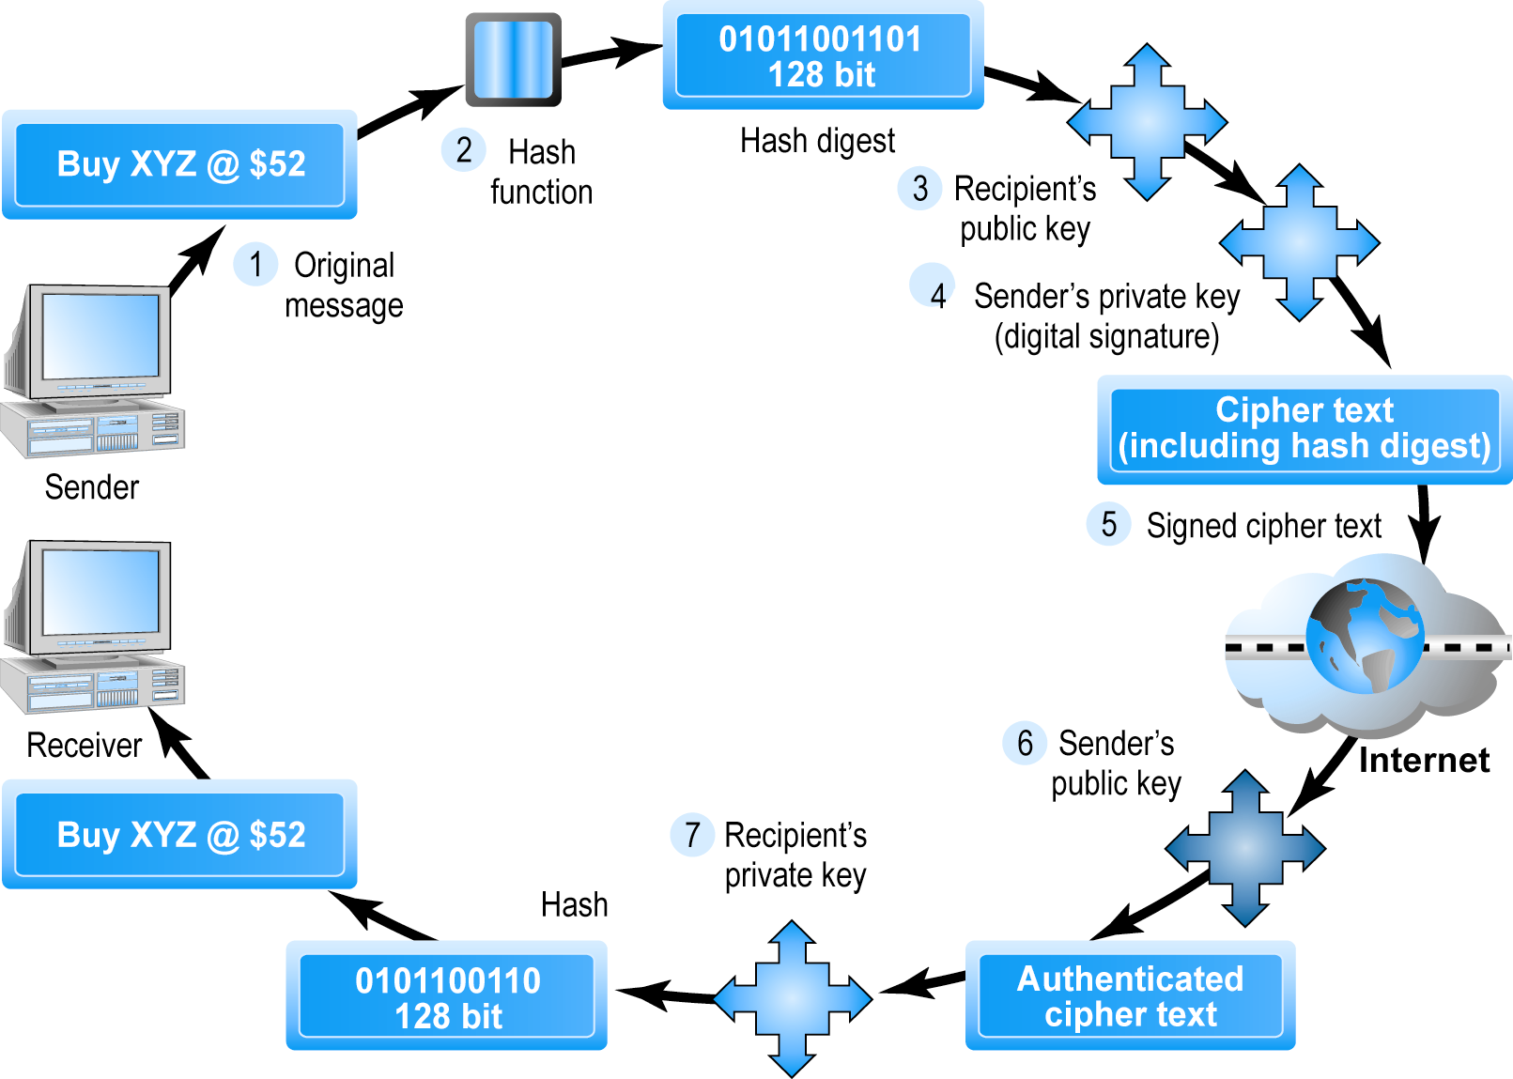
Public Key Cryptography with Digital Signatures

Slide 11
Digital Envelopes
Addresses weaknesses of:
  Public key encryption
    Computationally slow, decreased transmission speed, increased processing time
  Symmetric key encryption
    Insecure transmission lines
Uses symmetric key encryption to encrypt document
Uses public key encryption to encrypt and send symmetric key

Slide 12
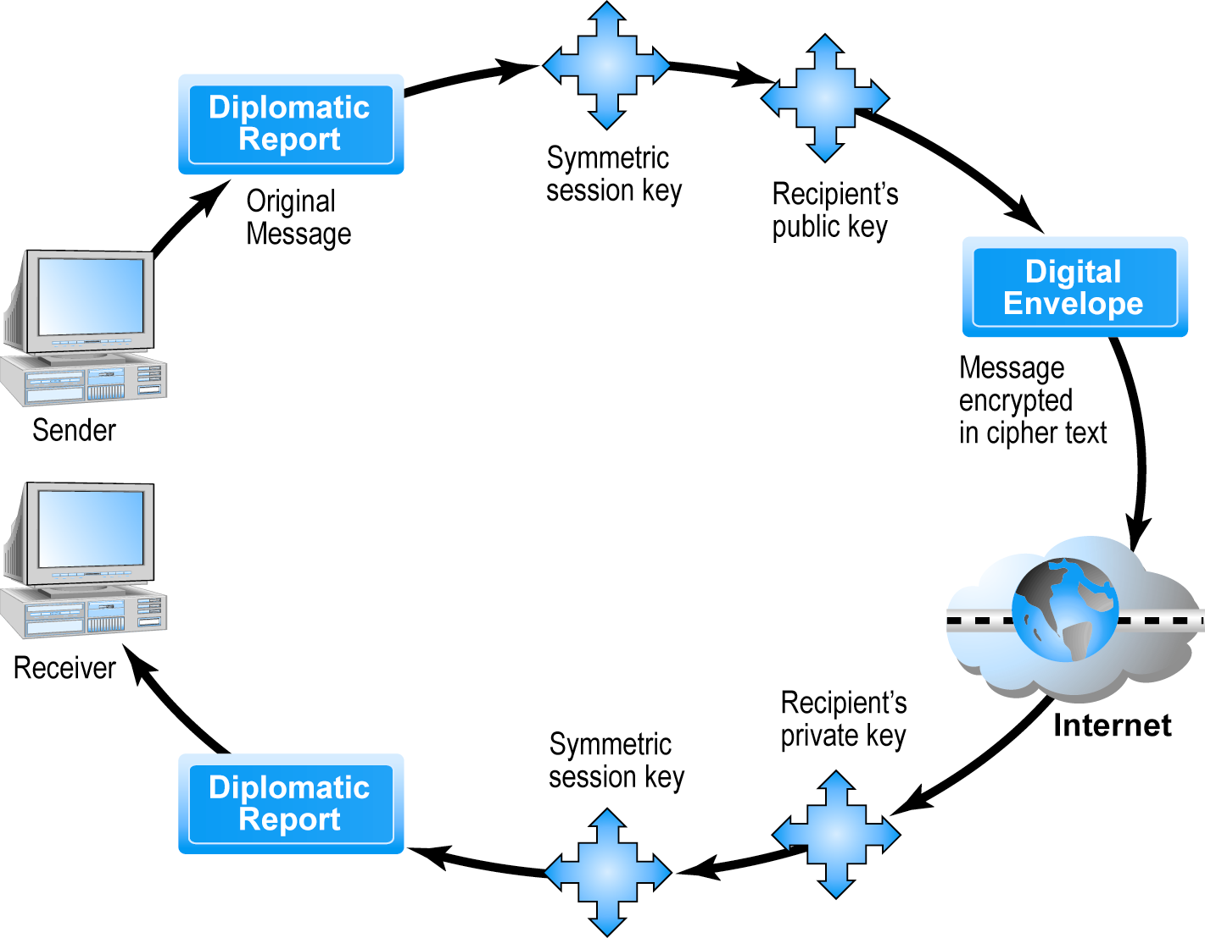
Creating a Digital Envelope

Slide 13
Digital Certificates and Public Key Infrastructure (PKI)
Digital certificate includes:
  Name of subject/company
  Subject’s public key
  Digital certificate serial number
  Expiration date, issuance date
  Digital signature of certification authority (trusted third party institution) that issues certificate
Public Key Infrastructure (PKI):
  CAs and digital certificate procedures that are accepted by all parties

Slide 14
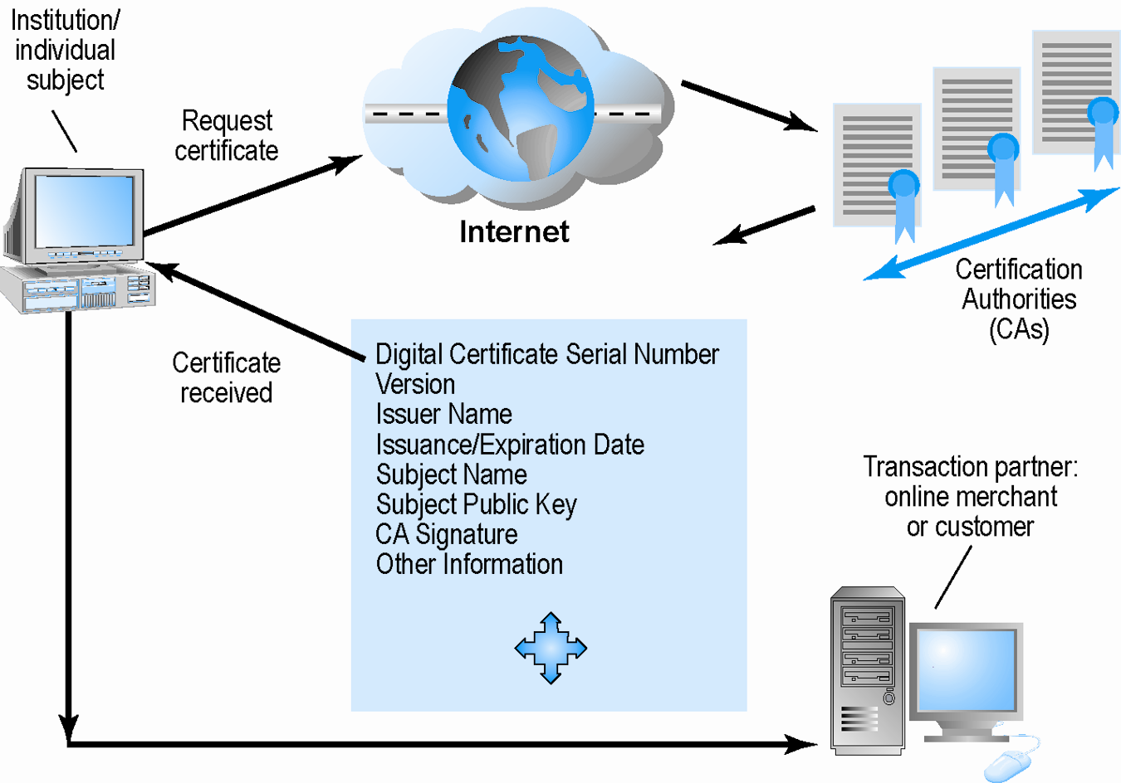
Digital Certificates and Certification Authorities

Slide 15
Limits to Encryption Solutions
Doesn’t protect storage of private key
  PKI not effective against insiders, employees
  Protection of private keys by individuals may be haphazard
No guarantee that verifying computer of merchant is secure
CAs are unregulated, self-selecting organizations

Slide 16
Securing Channels of Communication
Secure Sockets Layer (SSL):
  Establishes a secure, negotiated client-server session in which URL of requested document, along with contents, is encrypted
S-HTTP:
  Provides a secure message-oriented communications protocol designed for use in conjunction with HTTP
Virtual Private Network (VPN):
  Allows remote users to securely access internal network via the Internet, using Point-to-Point Tunneling Protocol (PPTP)

Slide 17
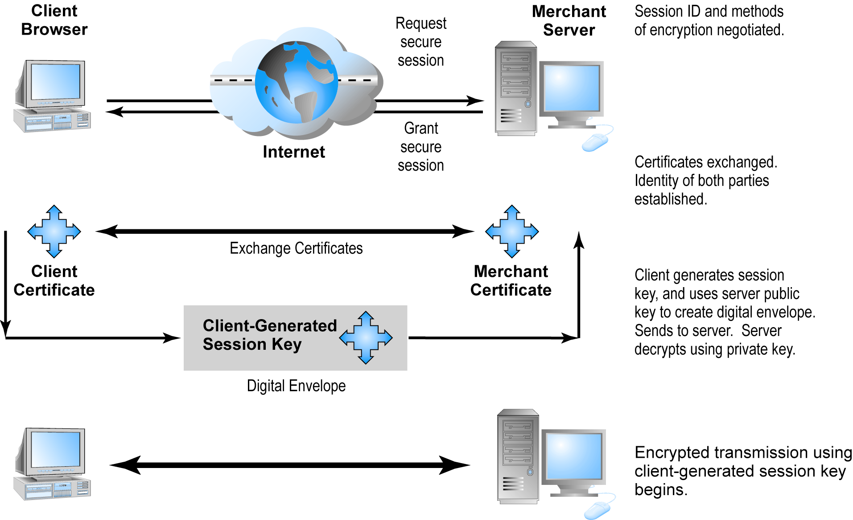
Secure Negotiated Sessions Using SSL

Slide 18
Protecting Networks
Firewall
  Hardware or software that filters packets
  Prevents some packets from entering the network based on security policy
  Two main methods:
    Packet filters
    Application gateways
Proxy servers (proxies)
  Software servers that handle all communications originating from or being sent to the Internet

Slide 19
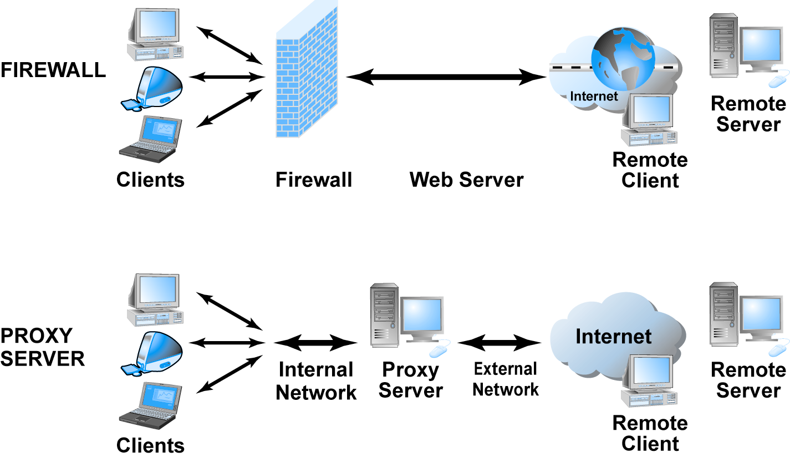
Firewalls and Proxy Servers

Slide 20
Protecting Servers and Clients
Operating system security enhancements
  Upgrades, patches
Anti-virus software
  Easiest and least expensive way to prevent threats to system integrity
  Requires daily updates

Slide 21
Management Policies, Business Procedures, and Public Laws
U.S. firms and organizations spend 12% of IT budget on security hardware, software, services ($120 billion in 2009)
Managing risk includes
  Technology
  Effective management policies
  Public laws and active enforcement

Slide 22
A Security Plan: Management Policies
Risk assessment
Security policy
Implementation plan
  Security organization
  Access controls
  Authentication procedures, including biometrics
  Authorization policies, authorization management systems
Security audit

Slide 23
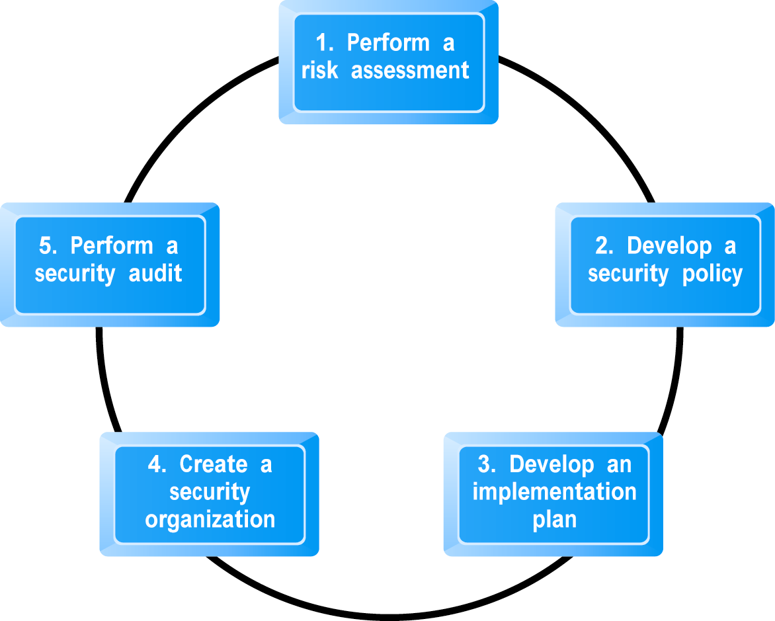
Developing an E-commerce Security Plan

Slide 24
The Role of Laws and Public Policy
Laws that give authorities tools for identifying, tracing, prosecuting cyber criminals:
  National Information Infrastructure Protection Act of 1996
  USA Patriot Act
  Homeland Security Act
Private and private–public cooperation
  Computer Emergency Readiness Team (CERT) Coordination Center
  US-CERT
Government policies and controls on encryption software
Organization for Economic Co-operation and Development (OECD) guidelines

Slide 25
E-commerce Payment Systems
Credit cards
  55% of online payments in 2009
Debit cards
  28% of online payments in 2009
Limitations of online credit card payment
  Security
  Cost
  Social equity

Slide 26
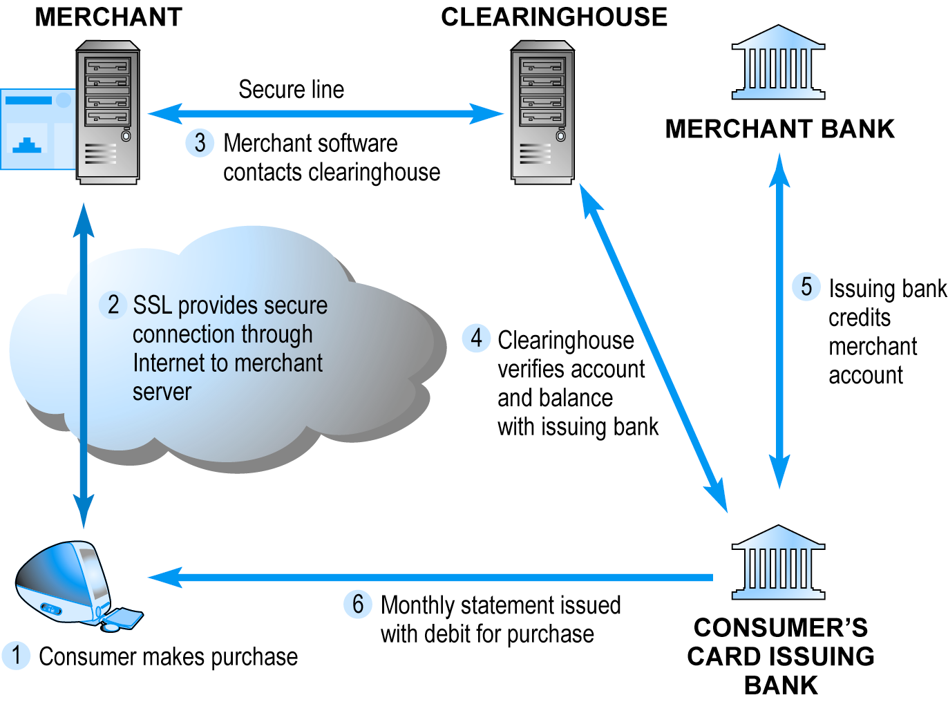
How an Online Credit Transaction Works?

Slide 27
Summary
Tools Available to Achieve Site Security
Encryption
Securing Channels of Communication
Protecting Networks
Protecting Servers and Clients
Management Policies, Business Procedures, and Public Laws
Developing an E-commerce Security Plan
How an Online Credit Transaction Works?

