Slide 1
Lecture 11
Electronic Business (MGT-485)

Slide 2
Recap – Lecture 10
Transaction costs
Network Externalities
Switching costs
Critical mass of customers
Pricing

Slide 3
Contents to Cover Today
E-Commerce Security Environment
Security Threats in E-commerce
Technology Solutions

Slide 4
The E-commerce Security Environment
Overall size and losses of cybercrime unclear
  Reporting issues
2008 CSI survey: 49% respondent firms detected security breach in last year
  Of those that shared numbers, average loss $288,000
Underground economy marketplace
  Stolen information stored on underground economy servers

Slide 5
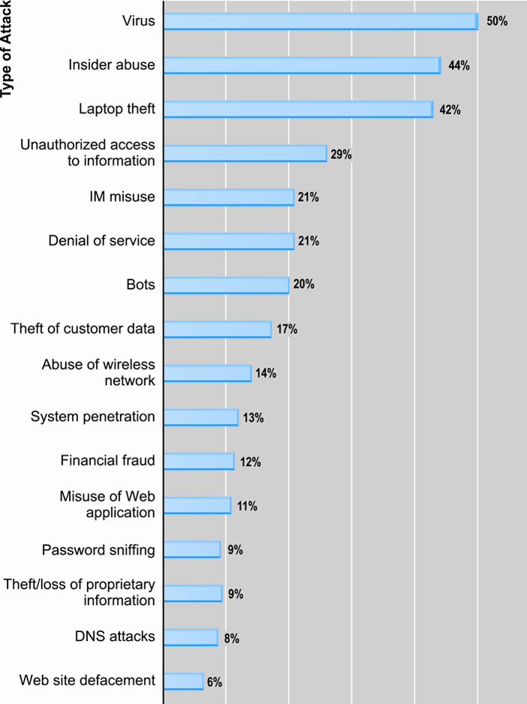
Types of Attacks Against Computer
Systems (Cybercrime)
Source: Based on data from Computer Security Institute, 2009.

Slide 6
What Is Good E-commerce Security?
To achieve highest degree of security
  New technologies
  Organizational policies and procedures
  Industry standards and government laws
Other factors
  Time value of money
  Cost of security vs. potential loss
  Security often breaks at weakest link

Slide 7
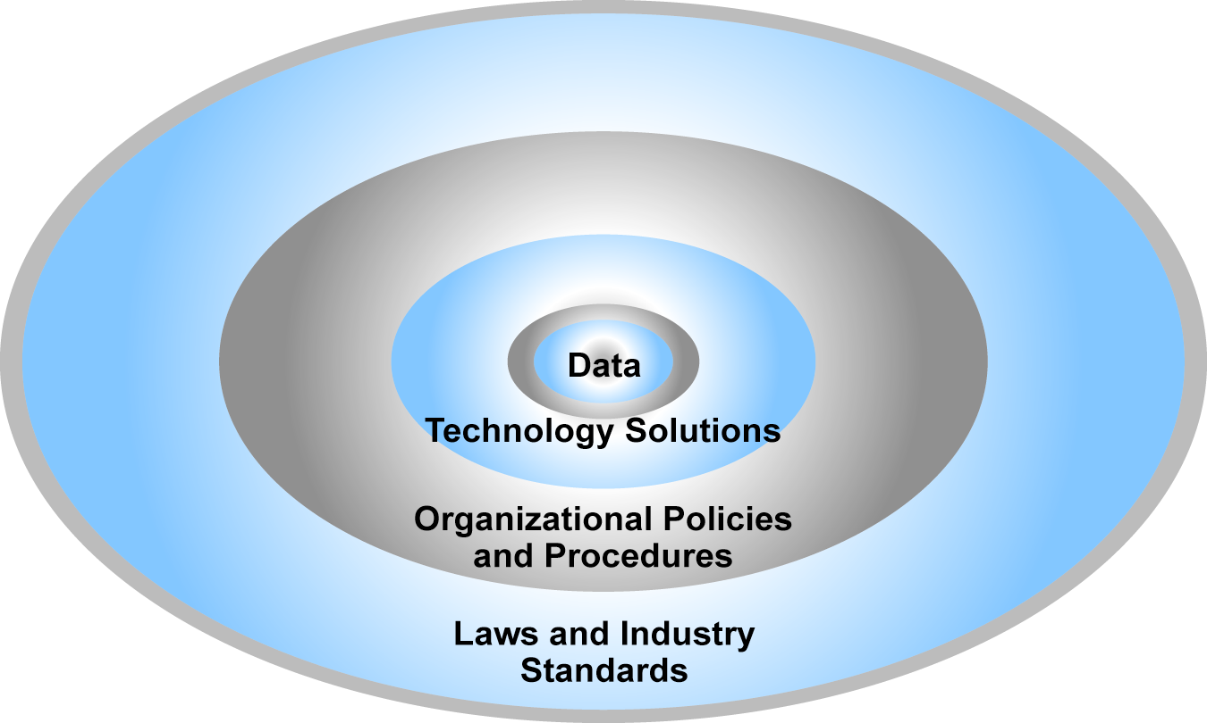
The E-commerce Security Environment

Slide 8
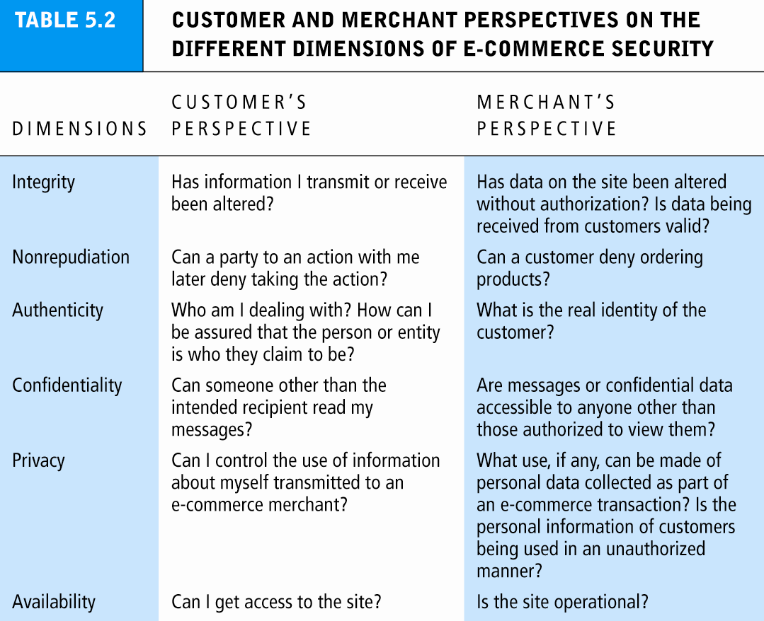
Table 5.2, Page 271

Slide 9
The Tension Between Security and Other Values
Security vs. ease of use
  The more security measures added, the more difficult a site is to use, and the slower it becomes
Security vs. desire of individuals to act anonymously
  Use of technology by criminals to plan crimes or threaten nation-state

Slide 10
Security Threats in the E-commerce Environment
Three key points of vulnerability:
  Client
  Server
  Communications pipeline

Slide 11
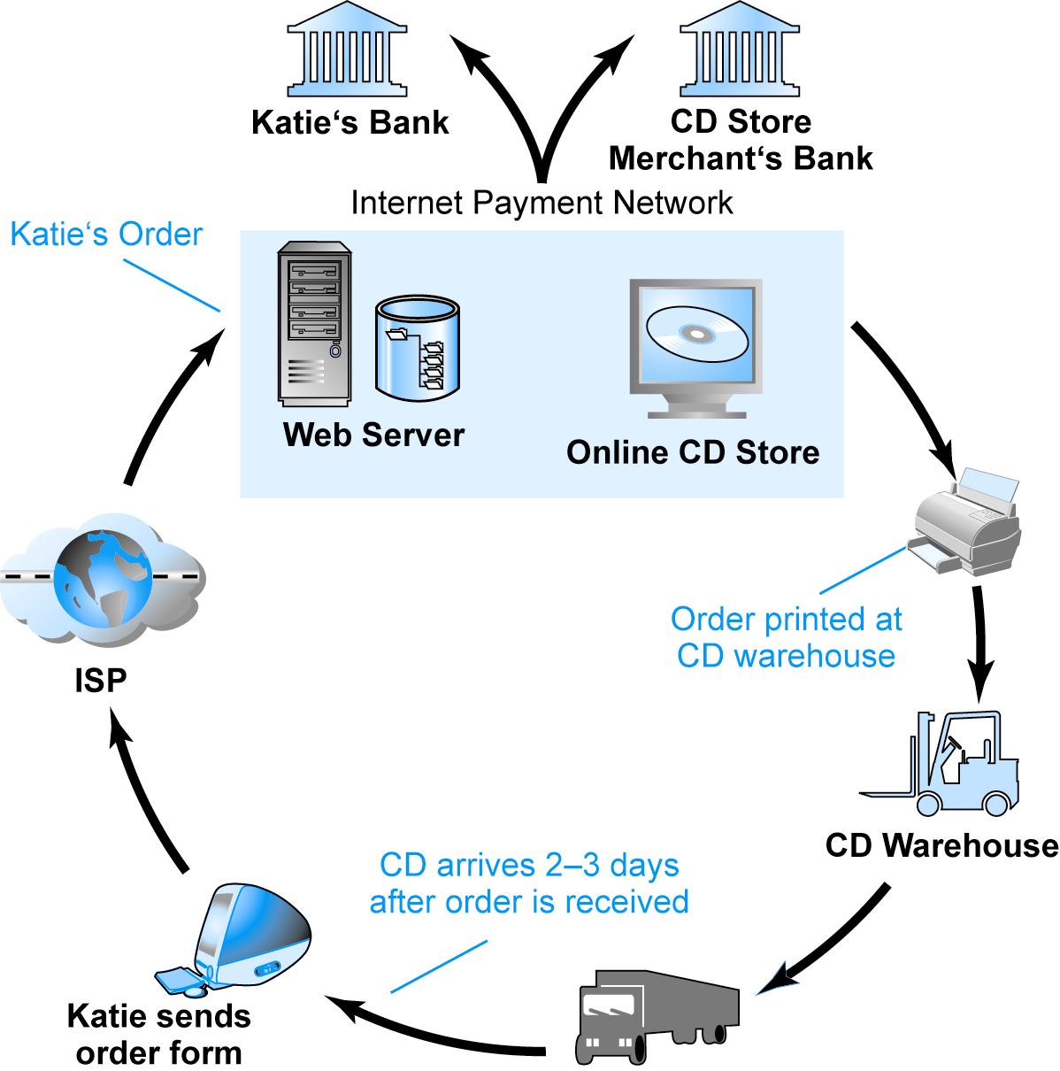
A Typical
E-commerce Transaction
SOURCE: Boncella, 2000.

Slide 12
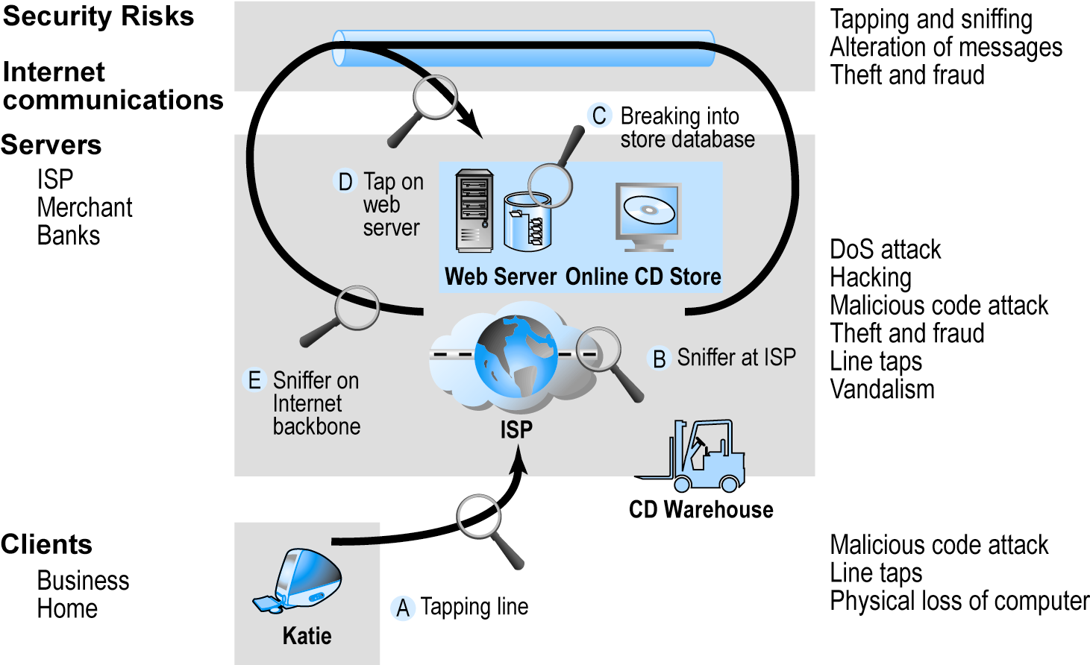
Vulnerable Points in an E-commerce Environment
SOURCE: Boncella, 2000.

Slide 13
Most Common Security Threats in the
E-commerce Environment
Malicious code
  Viruses
  Worms
  Trojan horses
  Bots, botnets
Unwanted programs
  Browser parasites
  Adware
  Spyware

Slide 14
Most Common Security Threats in the
E-commerce Environment
Phishing
  Deceptive online attempt to obtain confidential information
  Social engineering, e-mail scams, spoofing legitimate Web sites
  Use information to commit fraudulent acts (access checking accounts), steal identity
Hacking and cybervandalism
  Hackers vs. crackers
  Cybervandalism: intentionally disrupting, defacing, destroying Web site
  Types of hackers: white hats, black hats, grey hats

Slide 15
Most Common Security Threats in the
E-commerce Environment
Credit card fraud/theft
  Fear of stolen credit card information deters online purchases
  Hackers target merchant servers; use data to establish credit under false identity
  Online companies at higher risk than offline
Spoofing: misrepresenting self by using fake e-mail address
Pharming: spoofing a Web site
  Redirecting a Web link to a new, fake Web site
Spam/junk Web sites

Slide 16
Most Common Security Threats in the
E-commerce Environment
Denial of service (DoS) attack
  Hackers flood site with useless traffic to overwhelm network
Distributed denial of service (DDoS) attack
  Hackers use multiple computers to attack target network
Sniffing
  Eavesdropping program that monitors information traveling over a network
Insider jobs
  Single largest financial threat
Poorly designed server and client software

Slide 17
Technology Solutions
Protecting Internet communications (encryption)
Securing channels of communication (SSL, S-HTTP, VPNs)
Protecting networks (firewalls)
Protecting servers and clients

Slide 18
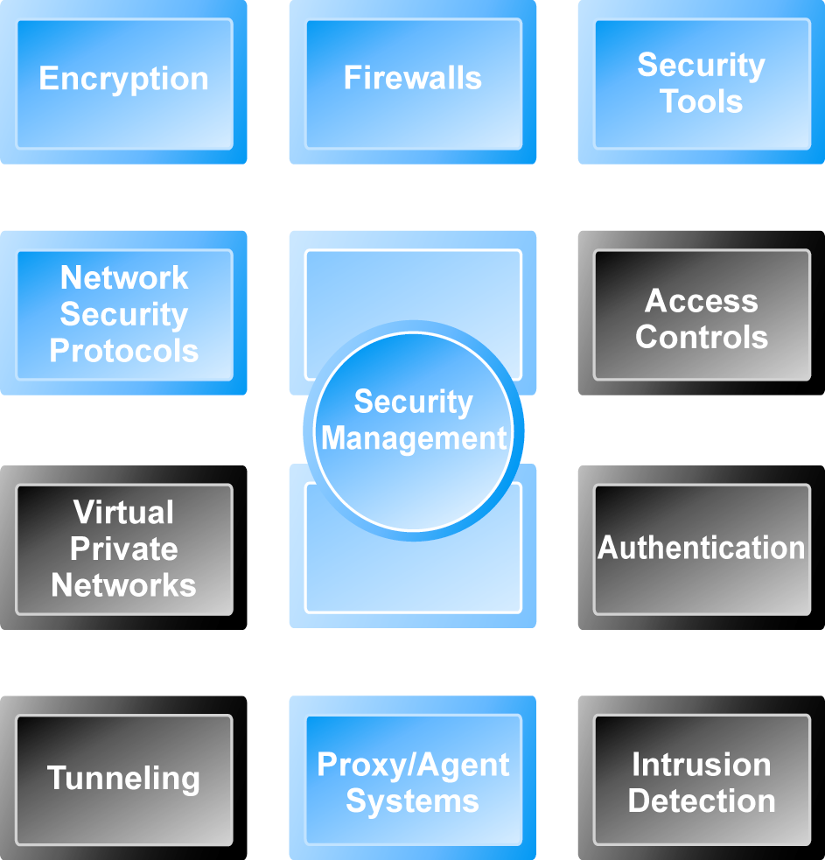
Tools Available to Achieve Site Security

Slide 19
Summary
E-Commerce Security Environment
Security Threats in E-commerce
Technology Solutions

