Slide 1
Lecture 32

Slide 2
Ethics in International Business
Notes:
Chapter 4: Ethics in International Business

Slide 3
Introduction
Ethics refers to accepted principles of right or wrong that govern the conduct of a person, the members of a profession, or the actions of an organization .
Business ethics are the accepted principles of right or wrong governing the conduct of business people.
Ethical strategy is a strategy, or course of action, that does not violate these accepted principles

Slide 4
Ethical Issues In
International Business
The most common ethical issues in business involve:
employment practices
human rights
environmental regulations
corruption
the moral obligation of multinational companies

Slide 5
Employment Practices
If work conditions in a host nation are clearly inferior to those in a multinational’s home nation, should companies apply:
home country standards
host country standards
something in between

Slide 6
Human Rights
In developed countries, basic human rights such as freedom of association, freedom of speech, freedom of assembly, and freedom of movement, are taken for granted.
In other countries, these rights may not exist

Slide 7
Environmental Pollution
Ethical issues arise when environmental regulations in host nations are far inferior to those in the home nation.
Environmental questions take on added importance because some parts of the environment are a public good that no one owns, but anyone can despoil.
The tragedy of the commons occurs when a resource held in common by all, but owned by no one, is overused by individuals, resulting in its degradation

Slide 8
Corruption
Some economists believe that in a country where preexisting political structures distort or limit the workings of the market mechanism, corruption in the form of black-marketeering, smuggling, and side payments to government bureaucrats to “speed up” approval for business investments may actually enhance welfare .
Other economists have argued that corruption reduces the returns on business investment and leads to low economic growth

Slide 9
Moral Obligations
Social responsibility refers to the idea that business people should take the social consequences of economic actions into account when making business decisions, and that there should be a presumption in favor of decisions that have both good economic and good social consequences.
Social responsibility can be supported for its own sake simply because it is the right way for a business to behave.
Advocates argue that businesses need to recognize their noblesse oblige (honorable and benevolent behavior that is the responsibility of successful companies) and give something back to the societies that have made their success possible

Slide 10
Ethical Dilemmas
Ethical dilemmas are situations in which none of the available alternatives seems ethically acceptable.
The ethical obligations of a multinational corporation toward employment conditions, human rights, corruption, environmental pollution, and the use of power are not always clear cut

Slide 11
The Roots Of Unethical Behavior
There is no clear cut reason why managers behave unethically
The causes of unethical behavior are complex and reflect:
Personal ethics
Decision-making processes
Leadership
Unrealistic performance expectations
Organizational culture

Slide 12
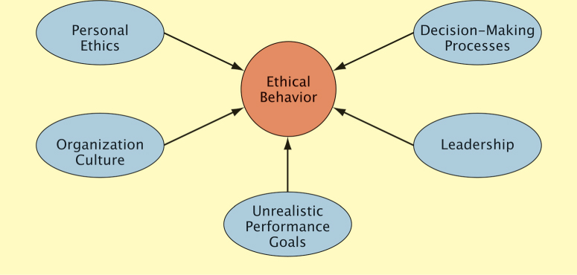
The Roots Of Unethical Behavior
Determinants of Ethical Behavior

Slide 13
Philosophical Approaches To Ethics
There are several different approaches to business ethics.
Some approaches deny the value of business ethics or apply the concept in an unsatisfactory way.
Others are favored by moral philosophers and are the basis for current models of ethical behavior

Slide 14
Rights Theories
Rights theories recognize that human beings have fundamental rights and privileges which go above national boundaries and cultures.
Rights theories establish a minimum level of morally acceptable behavior.
Moral theorists argue that fundamental human rights form the basis for the moral compass that managers should navigate by when making decisions which have an ethical component.

Slide 15
Rights Theories
The Universal Declaration of Human Rights specifies the basic principles that should always be adhered to irrespective of the culture in which one is doing business.
The declaration was prompted by the idea that some fundamental rights go above national borders and cultures

Slide 16
Justice Theories
Justice theories focus on the attainment of a just distribution of economic goods and services
A just distribution is one that is considered fair and equitable
One theory of justice that is particularly important was proposed by John Rawls who argued that all economic goods and services should be distributed equally except when an unequal distribution would work to everyone’s advantage

Slide 17
Justice Theories
According to Rawls, impartiality is guaranteed by the veil of ignorance (everyone is imagined to be ignorant of all his or her particular characteristics)
When these conditions exist:
each person is permitted the maximum amount of basic liberty compatible with a similar liberty for others
once equal basic liberty is assured, inequality in basic goods social goods are to be allowed only if they benefit everyone

Slide 18
Hiring And Promotion
Businesses should strive to identify and hire people with a strong sense of personal ethics
Companies should refrain from promoting individuals who have acted unethically
Prospective employees should find out as much as they can about the ethical climate in an organization prior to taking a position

Slide 19
Organization Culture And Leadership
To foster ethical behavior, businesses need to build an organization culture where:
the business explicitly articulates values that place a strong emphasis on ethical behavior, perhaps using a code of ethics (a formal statement of the ethical priorities a business adheres to) .
leaders in the business give life and meaning to the code of ethics by repeatedly emphasizing their importance, and then acting on them.
the business puts in place a system of incentives and rewards that recognize people who engage in ethical behavior and sanction those who do not

Slide 20
Decision-Making Process
To determine if a decision is ethical, managers can ask:
Does my decision fall within the accepted values of standards that typically apply in the organizational environment?
Am I willing to see the decision communicated to all stakeholders affected by it?
Would the people with whom I have significant personal relationships approve of the decision?

Slide 21
Decision-Making Process
Managers can also use a five step process to think through ethical problems:
Step1: Managers identify which stakeholders (the individuals or groups who have an interest, stake, or claim in the actions and overall performance of a company) a decision would affect and in what ways .
Internal stakeholders are people who work for or who own the business such as employees, the board of directors, and stockholders.
External stakeholders are the individuals or groups who have some claim on a firm such as customers, suppliers, and unions.
Step 2: Managers determine whether a proposed decision would violate the fundamental rights of any stakeholders

Slide 22
Decision-Making Process
Step 3: Managers establish moral intent (the business must resolves to place moral concerns ahead of other concerns in cases where either the fundamental rights of stakeholders or key moral principles have been violated).
Step 4: The company engages in ethical behavior.
Step 5: The business audits its decisions, reviewing them to make sure that they were consistent with ethical principles

Slide 23
Ethics Officers
To ensure ethical behavior in a business, a number of firms now have ethics officers
Ethics officers ensure:
all employees are trained in ethics
ethics is considered in the decision-making process
the company’s code of conduct is followed

Slide 24
Moral Courage
Moral courage:
enables managers to walk away from a decision that is profitable, but unethical.
gives an employee the strength to say no to a superior who instructs her to pursue actions that are unethical.
gives employees the integrity to go public to the media and blow the whistle on persistent unethical behavior in a company.
does not come easily and employees have lost their jobs when acting on this courage

Slide 25
Summary of Decision-Making Steps
In the end, there are clearly things that an international business should do, and there are things that an international business should not do.
But, not all ethical dilemmas have a clean and obvious solution

