Slide 1
Lecture 31

Slide 2
Differences in Culture

Slide 3
Introduction
Successful international managers need cross-cultural literacy - an understanding of how cultural differences across and within nations can affect the way in which business is practiced .
A relationship may exist between culture and the costs of doing business in a country or region
Notes:
Managers must be sensitive to trends in the evolution of a culture in order to maintain their effectiveness in the workplace.

Slide 4
What Is Culture?
Culture is a system of values and norms that are shared among a group of people and that when taken together constitute a design for living where
-values are abstract ideas about what a group believes to be good, right, and desirable (having money, the value of education, freedom of speech)
-norms are the social rules and guidelines that prescribe appropriate behavior in particular situations (wearing shoes etc)
Society refers to a group of people who share a common set of values and norms
Notes:
While culture is a characteristic of society as a whole, it shapes individual behavior by identifying appropriate and inappropriate forms of human interaction.
In a sense culture is the collective programming of the mind which distinguishes the members of one human group from another.

Slide 5
Values And Norms
Values provide the context within which a society’s norms are established and justified and form the bedrock of a culture.
Norms include folkways (the routine conventions of everyday life) and mores (norms that are seen as central to the functioning of a society and to its social life)
Notes:
Folkways are the routines conventions of everyday life, but generally have little moral significance.
Examples would be dress, eating habits, and social graces. An outsider can easily be forgiven for being ignorant of a folkway.
Timeliness is a good example.
(One way to reinforce the understanding of this concept is to ask individuals in the class what time they would choose to arrive at a party if the party invitation specified that the party starts at 8pm. It is not uncommon for different individuals in the class to have widely varying positions on the “right” time to arrive for an 8pm party. )
Mores are serious standards of behavior.
The term comes from the Latin mos (customs), and although mores are fewer in number than folkways, they are more coercive.
Negative mores are taboos, usually supported by religious or philosophical sanctions. Whereas folkways guide human conduct in the more mundane areas of life, mores tend to control those aspects connected with sex, the family, or religion.
Mores can vary greatly between countries: what in one country may be viewed as an innocent flirt in another may constitute a serious affront to someone's dignity or even harassment. While it is acceptable, and even expected, to consume alcohol with business associates in Japan, where evening business contacts often border on drunkenness, such actions would be disallowed in the United Arab Emirates.

Slide 6
Culture, Society, And The Nation-state
There is not a strict one-to-one relationship between a society and a nation state
Nation-states are political creations that can contain one or more cultures.
Similarly, a culture can embrace several nations

Slide 7
The Determinants Of Culture
The values and norms of a culture are the evolutionary product of a number of factors at work in a society including religion, political and economic philosophies, education, language, and social structure

Slide 8
Social Structure
Social structure refers to a society’s basic social organization
Two dimensions to consider:
the degree to which the basic unit of social organization is the individual, as opposed to the group
the degree to which a society is stratified into classes or castes

Slide 9
Individuals And Groups
A group is an association of two or more people who have a shared sense of identity and who interact with each other in structured ways on the basis of a common set of expectations about each other’s behavior.
Societies differ in terms of the degree to which the group is viewed as the primary means of social organization

Slide 10
Individuals And Groups
In many Western societies, there is a focus on the individual, and individual achievement is common.
This contributes to the dynamism of the US economy, and high level of entrepreneurship.
But, leads to a lack of company loyalty and failure to gain company specific knowledge, competition between individuals in a company instead of than team building, and less ability to develop a strong network of contacts within a firm

Slide 11
Individuals And Groups
In many Asian societies, the group is the primary unit of social organization .
This may discourage job switching between firms, encourage lifetime employment systems, and lead to cooperation in solving business problems.
But, might also suppress individual creativity and initiative
Notes:
While in earlier times the group was usually the family or the village, today the group may be a work team or business organization.
In a social setting, Asian employees may often say they work for Sony, while a Western employee may say he/she is an electrical engineer.
In Asia, the worth of an individual is more linked to the success of the group rather than individual achievement.

Slide 12
Social Stratification
All societies are stratified on a hierarchical basis into social categories, or social strata
While all societies are stratified to some extent, they differ by:
the degree of mobility between social strata.
the significance attached to social strata in business contacts

Slide 13
Social Stratification
Social mobility is the extent to which individuals can move out of the strata into which they are born.
A caste system is a closed system of stratification in which social position is determined by the family into which a person is born, and change in that position is usually not possible during an individual's lifetime.
A class system is a form of open social stratification in which the position a person has by birth can be changed through his or her achievement or luck
Notes:
The class of a person may be very important in some hiring and promotion decisions, particularly in sales organizations where the person will be dealing with customers that may also come from a particular class.

Slide 14
Social Stratification
The social stratification of a society is significant if it affects the operation of business organizations.
Class consciousness is a condition where people tend to perceive themselves in terms of their class background, and this shapes their relationships with others.
In cultures where class consciousness is high, the way individuals from different classes work together may be very prescribed and strained
Notes:
Why is social stratification important?
The social stratification of a society is significant if it affects the operation of business organizations
In cultures where there is a great deal of consciousness over the class of others, the way individuals from different classes work together (i.e. management and labor) may be very prescribed and strained in some cultures (i.e. Britain), or have almost no significance in others (i.e. Japan)
Class consciousness is a condition where people tend to perceive themselves in terms of their class background, and this shapes their relationships with others
The mobility permitted by culture affects whether individuals can move up in strata, and can limit the types of jobs and education available.
In the US individuals are very mobile ("anyone can become president"), in Britain there is less mobility, and the caste system in India used to limit mobility.
Despite the laws against it, the effects of the caste system in India still exist today, and are especially prevalent certain rural areas.

Slide 15
Religious And Ethical Systems
Religion is a system of shared beliefs and rituals that are concerned with the realm of the sacred.
Ethical systems are a set of moral principles, or values, that are used to guide and shape behavior.
Religion and ethics are often closely intertwined.
Four religions dominate society -Christianity, Islam, Hinduism, and Buddhism.
Confucianism is also important in influencing behavior and culture in many parts of Asia.
Notes:
Country Focus Islamic Capitalism in Turkey
Summary
This feature examines the business environment in Turkey. Turkey, a Muslim state, wants to join the European Union, a move many critics believe would not work. Discussion of the feature can revolve around the following questions:
1. Why are critics concerned about the possible entry of Turkey to the European Un ion? Do you agree? Why or why not?
Discussion Points: Critics worry that Western-style capitalism and Islam do not mix. Supporters however, claim that this notion may be incorrect. They point out that Kayseri, a city in Central Turkey, is often referred to as the “Anatolian Tiger” to recognize the number of thriving multinational enterprises it has produced. Local business leaders feel that the success of the region is due in part to the entrepreneurial spirit that has emerged.

Slide 16
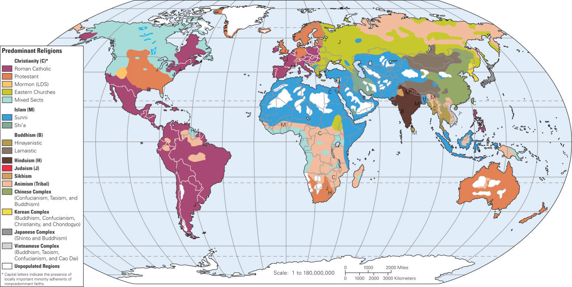
Religious And Ethical Systems
World Religions

Slide 17
Culture And The Workplace
Power distance focuses on how a society deals with the fact that people are unequal in physical and intellectual capabilities.
Individualism versus collectivism focuses on the relationship between the individual and his or her fellows.
Uncertainty avoidance measures the extent to which different cultures socialize their members into accepting ambiguous situations and tolerating ambiguity.
Masculinity versus femininity looks at the relationship between gender and work roles

Slide 18
Culture And Competitive Advantage
The connection between culture and competitive advantage is important because:
it suggests which countries are likely to produce the most viable competitors.
it has implications for the choice of countries in which to locate production facilities and do business

Slide 20
International Business Management 7e
by Charles W.L. Hill
Notes:
Welcome to International Business, Seventh Edition, by Charles W.L. Hill.

Slide 21
Chapter 4
Ethics in International Business
Notes:
Chapter 4: Ethics in International Business

Slide 22
Introduction
Ethics refers to accepted principles of right or wrong that govern the conduct of a person, the members of a profession, or the actions of an organization
Business ethics are the accepted principles of right or wrong governing the conduct of business people
Ethical strategy is a strategy, or course of action, that does not violate these accepted principles

Slide 23
Ethical Issues In
International Business
The most common ethical issues in business involve:
employment practices
human rights
environmental regulations
corruption
the moral obligation of multinational companies

Slide 24
Employment Practices
If work conditions in a host nation are clearly inferior to those in a multinational’s home nation, should companies apply:
home country standards
host country standards
something in between

Slide 25
Human Rights
In developed countries, basic human rights such as freedom of association, freedom of speech, freedom of assembly, and freedom of movement, are taken for granted
In other countries, these rights may not exist

Slide 26
Environmental Pollution
Ethical issues arise when environmental regulations in host nations are far inferior to those in the home nation
Environmental questions take on added importance because some parts of the environment are a public good that no one owns, but anyone can despoil
The tragedy of the commons occurs when a resource held in common by all, but owned by no one, is overused by individuals, resulting in its degradation

Slide 27
Corruption
Some economists believe that in a country where preexisting political structures distort or limit the workings of the market mechanism, corruption in the form of black-marketeering, smuggling, and side payments to government bureaucrats to “speed up” approval for business investments may actually enhance welfare
Other economists have argued that corruption reduces the returns on business investment and leads to low economic growth

Slide 28
Moral Obligations
Social responsibility refers to the idea that business people should take the social consequences of economic actions into account when making business decisions, and that there should be a presumption in favor of decisions that have both good economic and good social consequences
Social responsibility can be supported for its own sake simply because it is the right way for a business to behave
Advocates argue that businesses need to recognize their noblesse oblige (honorable and benevolent behavior that is the responsibility of successful companies) and give something back to the societies that have made their success possible

Slide 29
Ethical Dilemmas
Ethical dilemmas are situations in which none of the available alternatives seems ethically acceptable
The ethical obligations of a multinational corporation toward employment conditions, human rights, corruption, environmental pollution, and the use of power are not always clear cut

Slide 30
The Roots Of Unethical Behavior
There is no clear cut reason why managers behave unethically
The causes of unethical behavior are complex and reflect:
Personal ethics
Decision-making processes
Leadership
Unrealistic performance expectations
Organizational culture

Slide 31
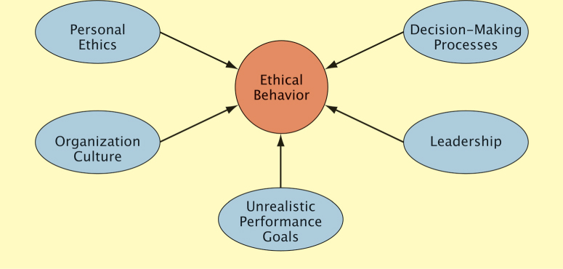
The Roots Of Unethical Behavior
Figure 4.1: Determinants of Ethical Behavior

Slide 32
Personal Ethics
Personal ethics (the generally accepted principles of right and wrong governing the conduct of individuals) influence business ethics
Expatriates may face pressure to violate their personal ethics because they are away from their ordinary social context and supporting culture, and they are psychologically and geographically distant from the parent company

Slide 33
Decision Making Processes
People may behave unethically because they rely on economic analysis when making decisions and fail to ask the relevant question:
Is this decision or action ethical?

Slide 34
Organizational Culture
Organization culture refers to the values and norms that are shared among employees of an organization
In firms with an organization culture that does not emphasize business culture, unethical behavior may exist

Slide 35
Unrealistic Performance Expectations
When the parent company sets unrealistic performance goals, managers may cut corners or act in an unethical manner
Organizational culture can legitimize unethical behavior or reinforce the need for ethical behavior

Slide 36
Leadership
Leaders help to establish the culture of an organization, and set the example that others follow
When leaders act unethically, subordinates may act unethically, too

Slide 37
Philosophical Approaches To Ethics
There are several different approaches to business ethics
Some approaches deny the value of business ethics or apply the concept in an unsatisfactory way
Others are favored by moral philosophers and are the basis for current models of ethical behavior

Slide 38
Straw Men
Straw men approaches offer inappropriate guidelines for ethical decision making in a multinational enterprise
There are four common straw men approaches:
The Friedman doctrine suggests that the only social responsibility of business is to increase profits, so long as the company stays within the rules of law
Cultural relativism argues that ethics are culturally determined and that firms should adopt the ethics of the cultures in which they operate, or in other words, “when in Rome, do as the Romans do”
The righteous moralist approach claims that a multinational’s home country standards of ethics should be followed in foreign countries
The naïve immoralist asserts that if a manager of a multinational sees that firms from other nations are not following ethical norms in a host nation, that manager should not either

Slide 39
Utilitarian And Kantian Ethics
Utilitarian approaches to ethics hold that the moral worth of actions or practices is determined by their consequences
Actions are desirable if they lead to the best possible balance of good consequences over bad consequences
Problems with utilitarianism include measuring the benefits, costs, and risks of an action, and the fact that the approach fails to consider justice
Kantian ethics are based on the philosophy of Immanuel Kant who argued that people should be treated as ends and never purely as means to the ends of others

Slide 40
Rights Theories
Rights theories recognize that human beings have fundamental rights and privileges which go above national boundaries and cultures
Rights theories establish a minimum level of morally acceptable behavior
Moral theorists argue that fundamental human rights form the basis for the moral compass that managers should navigate by when making decisions which have an ethical component

Slide 41
Rights Theories
The Universal Declaration of Human Rights specifies the basic principles that should always be adhered to irrespective of the culture in which one is doing business
The declaration was prompted by the idea that some fundamental rights go above national borders and cultures

Slide 42
Justice Theories
Justice theories focus on the attainment of a just distribution of economic goods and services
A just distribution is one that is considered fair and equitable
One theory of justice that is particularly important was proposed by John Rawls who argued that all economic goods and services should be distributed equally except when an unequal distribution would work to everyone’s advantage

Slide 43
Justice Theories
According to Rawls, impartiality is guaranteed by the veil of ignorance (everyone is imagined to be ignorant of all his or her particular characteristics)
When these conditions exist:
each person is permitted the maximum amount of basic liberty compatible with a similar liberty for others
once equal basic liberty is assured, inequality in basic goods social goods are to be allowed only if they benefit everyone

Slide 44
Ethical Decision Making
To ensure ethical issues are considered in business decisions, firms should:
favor hiring and promoting people with a well grounded sense of personal ethics
build an organizational culture that places a high value on ethical behavior
makes sure that leaders within the business not only articulate the rhetoric of ethical behavior, but also act in manner that is consistent with that rhetoric
put decision making processes in place that require people to consider the ethical dimension of business decisions
develop moral courage

Slide 45
Hiring And Promotion
Businesses should strive to identify and hire people with a strong sense of personal ethics
Companies should refrain from promoting individuals who have acted unethically
Prospective employees should find out as much as they can about the ethical climate in an organization prior to taking a position

Slide 46
Organization Culture And Leadership
To foster ethical behavior, businesses need to build an organization culture where:
the business explicitly articulates values that place a strong emphasis on ethical behavior, perhaps using a code of ethics (a formal statement of the ethical priorities a business adheres to)
leaders in the business give life and meaning to the code of ethics by repeatedly emphasizing their importance, and then acting on them
the business puts in place a system of incentives and rewards that recognize people who engage in ethical behavior and sanction those who do not

Slide 47
Decision-Making Process
To determine if a decision is ethical, managers can ask:
Does my decision fall within the accepted values of standards that typically apply in the organizational environment?
Am I willing to see the decision communicated to all stakeholders affected by it?
Would the people with whom I have significant personal relationships approve of the decision?

Slide 48
Decision-Making Process
Managers can also use a five step process to think through ethical problems:
Step1: Managers identify which stakeholders (the individuals or groups who have an interest, stake, or claim in the actions and overall performance of a company) a decision would affect and in what ways
Internal stakeholders are people who work for or who own the business such as employees, the board of directors, and stockholders
External stakeholders are the individuals or groups who have some claim on a firm such as customers, suppliers, and unions
Step 2: Managers determine whether a proposed decision would violate the fundamental rights of any stakeholders

Slide 49
Decision-Making Process
Step 3: Managers establish moral intent (the business must resolves to place moral concerns ahead of other concerns in cases where either the fundamental rights of stakeholders or key moral principles have been violated)
Step 4: The company engages in ethical behavior
Step 5: The business audits its decisions, reviewing them to make sure that they were consistent with ethical principles

Slide 50
Ethics Officers
To ensure ethical behavior in a business, a number of firms now have ethics officers
Ethics officers ensure:
all employees are trained in ethics
ethics is considered in the decision-making process
the company’s code of conduct is followed

Slide 51
Moral Courage
Moral courage:
enables managers to walk away from a decision that is profitable, but unethical
gives an employee the strength to say no to a superior who instructs her to pursue actions that are unethical
gives employees the integrity to go public to the media and blow the whistle on persistent unethical behavior in a company
does not come easily and employees have lost their jobs when acting on this courage

Slide 52
Summary of Decision-Making Steps
In the end, there are clearly things that an international business should do, and there are things that an international business should not do
But, not all ethical dilemmas have a clean and obvious solution

