Slide 1
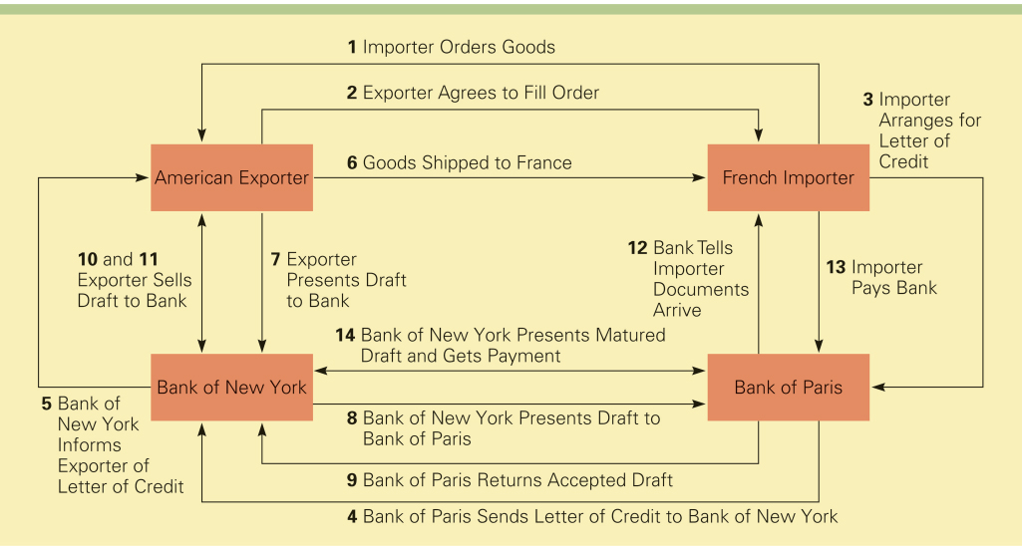
A Typical International Trade Transaction

Slide 2
Question
Which of the following is not a purpose of the bill of lading?
a) It is a contract
b) It is a document of title
c) It is a form of payment
d) It is a receipt
Notes:
The answer is c.

Slide 3
Export Assistance
There are two forms of government-backed assistance available to exporters:
Financing aid is available from the Export-Import Bank.
2. Export credit insurance is available from the Foreign Credit Insurance Association

Slide 4
Export-Import Bank
The Export-Import Bank (Eximbank) is an independent agency of the U.S. government.
It provides financing aid to facilitate exports, imports, and the exchange of commodities between the U.S. and other countries.
Unibank achieves its goals though various loan and loan guarantee programs

Slide 5
Export Credit Insurance
Export credit insurance protects exporters against the risk that the importer will default on payment
In the U.S., export credit insurance is provided by the Foreign Credit Insurance Association (FICA)
FICA provides coverage against commercial risks and political risks

Slide 6
Countertrade
When conventional means of payment are difficult, costly, or nonexistent, some firms may turn to countertrade.
Countertrade refers to a range of barter-like agreements that facilitate the trade of goods and services for other goods and services when they cannot be traded for money

Slide 7
The Incidence Of Countertrade
During the1960s, when the Soviet Union and the Communist states of Eastern Europe had nonconvertible currencies, countertrade emerged as a means purchasing imports.
During the 1980s, the technique grew in popularity among many developing nations that lacked the foreign exchange reserves required to purchase necessary imports.
There was a notable increase in the volume of countertrade after the Asian financial crisis of 1997
Notes:
It is estimated that about 8-10 percent of world trade is covered by some sort of countertrade arrangement.

Slide 8
The Incidence Of Countertrade
There are five distinct versions of countertrade:
1. barter
2. counterpurchase
3. offset
4. compensation or buyback
5. switch trading

Slide 9
The Incidence Of Countertrade
Barter is a direct exchange of goods and/or services between two parties without a cash transaction
Barter is the most restrictive countertrade arrangement
It is used primarily for one-time-only deals in transactions with trading partners who are not creditworthy or trustworthy
2. Counter purchase is a reciprocal buying agreement
It occurs when a firm agrees to purchase a certain amount of materials back from a country to which a sale is made

Slide 10
The Incidence Of Countertrade
3. Offset is similar to counter purchase insofar as one party agrees to purchase goods and services with a specified percentage of the proceeds from the original sale
The difference is that this party can fulfill the obligation with any firm in the country to which the sale is being made
4. A buyback occurs when a firm builds a plant in a country—or supplies technology, equipment, training, or other services to the country—and agrees to take a certain percentage of the plant’s output as a partial payment for the contract

Slide 11
The Incidence Of Countertrade
5. Switch trading refers to the use of a specialized third-party trading house in a countertrade arrangement
When a firm enters a counter-purchase or offset agreement with a country, it often ends up with what are called counter-purchase credits, which can be used to purchase goods from that country
Switch trading occurs when a third-party trading house buys the firm’s counter-purchase credits and sells them to another firm that can better use them

Slide 12
Question
Which type of countertrade arrangement involves the use of a specialized third-party trading house?
a) a buyback
b) an offset
c) a counterpurchase
d) switch trading
Notes:
The answer is d.

Slide 13
The Pros And Cons Of Countertrade
Countertrade is attractive because it gives a firm a way to finance an export deal when other means are not available
If a firm is unwilling to enter a countertrade agreement, it may lose an export opportunity to a competitor that is willing to make a countertrade agreement
In some cases, a countertrade arrangement may be required by the government of a country to which a firm is exporting goods or services

Slide 14
The Pros And Cons Of Countertrade
Countertrade is unattractive because it may involve the exchange of unusable or poor-quality goods that the firm cannot dispose of profitably.
It requires the firm to establish an in-house trading department to handle countertrade deals.
Countertrade is most attractive to large, diverse multinational enterprises that can use their worldwide network of contacts to dispose of goods acquired in countertrade deals

Slide 15
Question
Countertrade is attractive for all of the following reasons except
a) It may involve the exchange of unusable or poor-quality goods that the firm cannot dispose of profitably
b) It can give a firm a way to finance an export deal when other means are not available
c) It can be a strategic marketing weapon
d) It can give a firm an advantage over firms that are unwilling to engage in countertrade arrangements
Notes:
The answer is a.

Slide 16
Question
________ is the most restrictive countertrade arrangement.
a) counterpurchase
b) switch trading
c) barter
d) offset
Notes:
The answer is c.

