Slide 1
Lecture 23

Slide 2
Lecture Review
Large and small firms export
Exporting is on the rise thanks to the decline in trade barriers under the WTO and regional economic agreements such as the EU and NAFTA
Exporting firms need to
identify market opportunities
deal with foreign exchange risk
navigate import and export financing
understand the challenges of doing business in a foreign market
Notes:
Firms that do not export lose out on huge opportunities for growth and cost reduction.
Large firms tend to be pro-active in seeking foreign opportunities, while medium and small-sized firms are slow to respond.
Too busy with local side of business
Ignorant of potential opportunities
Intimidated by mechanics of exporting to a foreign country

Slide 3
Lecture Review
The Promise And Pitfalls Of Exporting
Improving Export Performance
Question
An International Comparison
Information Sources
Utilizing Export Management Companies

Slide 4
Export Strategy
To reduce the risks of exporting, firms should
hire an EMC or export consultant, to help identify opportunities and navigate through the tangled web of paperwork and regulations so often involved in exporting.
focus on one, or a few, markets at first.
enter a foreign market on a fairly small scale in order to reduce the costs of any subsequent failures.
recognize the time and managerial commitment involved.
develop a good relationship with local distributors and customers.
hire locals to help establish a presence in the market.
be proactive.
consider local production
Notes:
Management Focus: Exporting Strategy at 3M
Summary
This feature explores the Minnesota Mining and Manufacturing Company’s (3M) export strategy. 3M generates more than half its revenues from outside the United States. The company often uses exports to establish an initial presence in a foreign market, only building foreign production facilities once sales volume rises to a level where local production is justified. Discussion of the feature can begin with the following questions.
Suggested Discussion Questions
1. Discuss why 3M initially enters markets on a small scale. How does the firm’s strategy fit with the philosophy that exporting is not an end in itself, but merely a step on the road toward establishment of foreign production?
Discussion Points: The basic idea behind 3M’s strategy of entering markets on a small scale is that it allows the company to learn about the market before it risks making a big push into the country. Students will probably recognize that this approach allows the company to break its international expansion into a series of stages beginning with a test of the market going all the way to a complete foreign presence.
2. Explain the three principles that make 3M so successful. Why was it important for 3M to hire local personnel?
Discussion Points: 3M’s principles are central to its success in foreign markets. The company believes that it is important to be first to a market, learn about it and sell there before competitors do. Second, 3M likes to learn about a market by selling a single product. Only after it has proven to be successful, will the company enter the market on a larger scale. Third, 3M believes strongly because locals are more familiar with the market, local employees are essential to its success. In fact just 160 of its nearly 40,000 foreign employees are from the United States.
Another Perspective: To learn more about 3M and its international strategy, go to the company’s web site {http://www.3m.com/}.

Slide 5
Export And Import Financing
Over time, various mechanisms for financing exports and imports have evolved in response to a problem that can be particularly acute in international trade: the lack of trust that exists when one must put faith in a stranger
Notes:
Management Focus: Red Spot Paint & Varnish
Summary
This feature focuses on Red Spot Paint & Varnish, a company that produces paints for plastic components used in automobiles. The company relies on foreign markets for some 15-25% of its annual revenue. Generating its foreign sales has not been an easy task according to one employee. The company has found it difficult to hire managers with appropriate international experience and has also struggled with pressures to achieve quick results. The following questions provide a starting point for discussion of this feature.
Suggested Discussion Questions
1. How has the Internet made it easier for companies to not only get export assistance but also to find the experienced talent necessary to build an international staff? How has Red Spot Paint & Varnish been able to capitalize on foreign market opportunities while similar competitors have not?
Discussion Points: Students will probably point out that in many ways the Internet has made the world a smaller place. When Red Spot Paint & Varnish was beginning its international expansion in the 1960s, finding information on the process, or people with international experience, was significantly more difficult than it is today when companies can access resources such as the Department of Commerce and Small Business Association from their own offices, and advertise for personnel using Internet-based searches like Monster.com. Some students will attribute Red Spot Paint & Varnish’s success to its perseverance and forward-looking thinking. The company hired an expert to focus on international market development years ago, and despite the slow nature of the process, has allowed its international business to continue to grow.
2. In an era of “time is money,” how can the trusting relationships that are so often critical to the success of a foreign venture be achieved? How important was the establishment of trust between Red Spot Paint & Varnish and its local distributors and customers to the success of the company?
Discussion Points: Students should recognize that one of the key challenges to operating internationally is the development of relationships between buyers and sellers. Companies that focus on quick results may do so at the expense of relationships that may take longer to develop, but could prove to be more profitable in the long term. A longer term outlook has helped Red Spot Paint & Varnish develop a thriving international component to its business in a market where competitors have has little success in foreign markets.
Another Perspective: Go to Red Spot Paint & Varnish {http://www.redspot.com/} to explore the company’s operations in more depth. Click on “Global Alliance” to see what the company believes are the advantage of working with other firms.

Slide 6
Lack Of Trust
Many international transactions are facilitated by a third party (normally a reputable bank).
By including the third party, an element of trust is added to the relationship
Notes:
The lack of trust between international trading partners due to several factors:
Parties have never met
Language, cultural, and legal system differences
Difficulties in tracking down a party in case of default
The problem is resolved by using a third party trusted by both as an intermediary – normally a reputable bank.

Slide 7
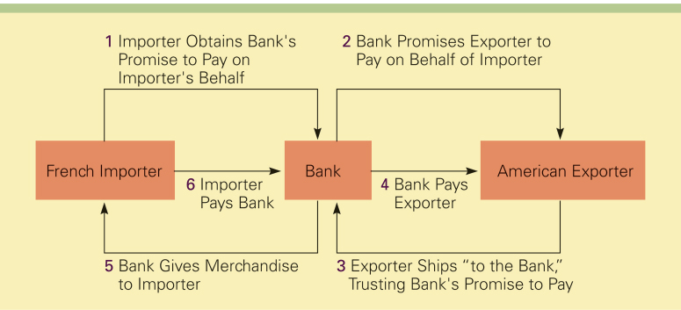
Lack Of Trust

Slide 8
Letter Of Credit
A letter of credit is issued by a bank at the request of an importer and states the bank will pay a specified sum of money to a beneficiary, normally the exporter, on presentation of particular, specified documents.
The main advantage of the letter of credit is that both parties to the transaction are likely to trust a reputable bank even if they do not trust each other
Notes:
The letter of credit is Issued by a bank at the request of the importer.
The bank pays a specified sum to a beneficiary, normally the exporter, on presentation of particular, specified documents.
The fee paid by importer for letter of credit.
May reduce borrowing ability of importer since the letter is a financial liability.

Slide 9
Draft
A draft, also called a bill of exchange, is the instrument normally used in international commerce for payment.
A draft is simply an order written by an exporter instructing an importer, or an importer's agent, to pay a specified amount of money at a specified time.
A sight draft is payable on presentation to the drawee while a time draft allows for a delay in payment - normally 30, 60, 90, or 120 days

Slide 10
Bill Of Lading
The bill of lading is issued to the exporter by the common carrier transporting the merchandise
It serves three purposes:
it is a receipt
it is a contract
it is a document of title
Notes:
The bill of lading is issued to the exporter by the common carrier transporting the merchandise.
It serves three purposes:
Receipt - merchandise described on document has been received by carrier
Contract - carrier is obligated to provide transportation service in return for a certain charge
Document of title – can be used to obtain payment or a written promise before the merchandise is released to the importer

Slide 11
Question
A _______ is an order written by an exporter instructing an importer to pay a specified amount of money at a specified time.
a) letter of credit
b) draft
c) bill of lading
d) confirmed letter of credit
Notes:
The answer is b.

