Slide 1
Exporting, Importing and Countertrade

Slide 2
Introduction
Large and small firms export
Exporting is on the rise thanks to the decline in trade barriers under the WTO and regional economic agreements such as the EU and NAFTA
Exporting firms need to
identify market opportunities
deal with foreign exchange risk
navigate import and export financing
understand the challenges of doing business in a foreign market
Notes:
Firms that do not export lose out on huge opportunities for growth and cost reduction.
Large firms tend to be pro-active in seeking foreign opportunities, while medium and small-sized firms are slow to respond.
Too busy with local side of business
Ignorant of potential opportunities
Intimidated by mechanics of exporting to a foreign country

Slide 3
The Promise And Pitfalls Of Exporting
Exporting is a way to increase market size--the rest of the world is usually much larger market than the domestic market.
Large firms often proactively seek new export opportunities.
Many smaller firms are reactive and wait for the world to come to them .
Many firms fail to realize the potential of the export market.
Smaller firms are often intimidated by the complexities of exporting and initially run into problems.
Notes:
Management Focus: FCX Systems
Summary
This feature explores FCX Systems’ move into the export market. FCX Systems, which manufactures power converters for the aerospace industry, realized that to continue to grow, the company would have to seek opportunities in foreign markets. The following questions can be helpful in directing the discussion.
1. FCX Systems’ entry into foreign markets was not an easy one. Reflect on the challenges facing small companies like FCX Systems as they pursue foreign opportunities. Why did FCX believe that foreign markets could be more profitable than its domestic market?
Discussion Point: Small companies beginning the export process can find it overwhelming. Not only do the companies have to deal with additional paperwork, but they also have to learn the local ways of doing business, how to finance exports, how to make contacts, and so on. Some firms, like FSX, hire local distributors to help with this process. However, if the distributor is not looking out for the best interests of the firm, the company, like FSX, may find it better to take on the process itself. FSX cites persistence and assistance as being particularly important elements to its success as an exporter. FSX president Don Gallion notes that especially in markets like China, personal relationships are important and may take time to establish. FSX’ efforts in China, which involved more than 100 trips by Gallion to the country since 1990, were recently rewarded with $2 million in contracts. Gallion believes that the network of trust that he has developed in that market will continue to pay off in the future. Gallion also notes that government agencies such as the U.S. Department of Commerce provided critical information on the rules and regulations of exporting that helped FSX with its international sales.
2. Why did FCX initially sign on with an in international distribution company? What made FCX decide to go it alone? How important was government assistance to FCX’s success?
Discussion Point: This question provides students with the opportunity to examine the services provided by various institutions such as the Small Business Association and the Department of Commerce in greater depth. Students may also wish to examine some of the services offered by profit-oriented organizations offering export assistance. FSX credits a number of federal and state agencies for providing assistance that helped the company become successful in foreign markets. Not only did the agencies provide help with the exporting process itself, they also gave FSX contact information. While the company started its exporting using an international distribution company, FSX became disillusioned with the distributor and took over the process itself in 1994. At the time, export sales accounted for just 12 percent of the company’s total sales, but now that figure is over 50 percent.
Another Perspective: Students may want to explore FCX Systems web site {http://www.fcxinc.com/ }for additional information on the company.

Slide 4
The Promise And Pitfalls Of Exporting
Common pitfalls include:
poor market analysis
poor understanding of competitive conditions
a lack of customization for local markets
a poor distribution program
poorly executed promotional campaigns
problems securing financing
a general underestimation of the differences and expertise required for foreign market penetration
an underestimation of the amount of paperwork and formalities involved

Slide 5
Improving Export Performance
There are various ways to gain information about foreign market opportunities and avoid the pitfalls associated with exporting
Some countries provide direct assistance to exporters
Export management companies can also help with the export process

Slide 6
Question
Which of the following is not a common pitfall of exporting?
a) a product offering that is customized to the local market
b) a poor understanding of competitive conditions in he foreign market
c) poor market analysis
d) problems securing financing
Notes:
The answer is a.

Slide 7
An International Comparison
A big impediment to exporting is the simple lack of knowledge of the opportunities available.
To overcome ignorance firms need to collect information.
Both Germany and Japan have developed extensive institutional structures for promoting exports.
Japanese exporters can also take advantage of the knowledge and contacts of sogo shosha, the country’s great trading houses.
In contrast, American firms have far fewer resources available
Notes:
Management Focus: Exporting with a Little Government Help
Summary
This feature describes the challenges faced by small firms as they seek to expand their sales through exports. The case notes that there are a number of agencies, institutions, and export management companies that provide assistance to small exporters. The following questions can be helpful in directing the discussion.
Suggested Discussion Questions
1. Foreign market expansion can be a daunting prospect, especially for a small company with no international experience. Discuss how Novi, Inc became such a success story in such a short time. What lessons can other companies learn from Novi’s experiences?
Discussion Points: When Novi began its international expansion, the company had no experience in foreign markets. The company relied on the Small Business Administration’s services and the Department of Commerce to help guide its international efforts. Students will probably agree that one of the key lessons other firms can learn from Novi’s experiences ins the importance of market research and using resources such as the Small Business Administration that are available, often free of charge.
2. As a small business owner facing saturated domestic markets, how would you approach foreign markets? Develop a strategic plan outlining how you would research markets, get your product to potential customers, handle the financing side of the business, and grow your sales. Include information on what resources are available to help with this process.
Discussion Points: Using an imaginary company (or a real one if one is available), ask students to develop a basic outline of how to expand into foreign markets. The outline should contain information on targeted markets, the information they would need on the market, how they would acquire it, and how it would help them enter a foreign market. The report could be formatted as an attempt to get funding for international expansion.

Slide 8
Information Sources
The U.S. Department of Commerce is the most comprehensive source of export information for U.S. firms.
The International Trade Administration and the United States and Foreign Commercial Service Agency can provide “best prospects” lists for firms.
The Department of Commerce also organizes various trade events to help firms make foreign contacts and explore export opportunities.
The Small Business Administration is also a source of assistance.
Local and state governments can also provide export support
Notes:
Trade Commissions are maintained by many large cities. They provide business counseling, information gathering, and financing.

Slide 9
Utilizing Export Management Companies
Export management companies (EMCs) are export specialists that act as the export marketing department or international department for client firms.
EMCs normally accept two types of export assignments:
they start exporting operations for a firm with the understanding that the firm will take over operations after they are well established.
they start services with the understanding that the EMC will have continuing responsibility for selling the firm’s products

Slide 10
Utilizing Export Management Companies
A good EMCs will help the neophyte exporter identify opportunities and avoid common pitfalls.
However, not all EMCs are equal—some do a better job than others.
Firms that rely on an EMC may not develop their own export capabilities

Slide 11
Export Strategy
To reduce the risks of exporting, firms should
hire an EMC or export consultant, to help identify opportunities and navigate through the tangled web of paperwork and regulations so often involved in exporting.
focus on one, or a few, markets at first.
enter a foreign market on a fairly small scale in order to reduce the costs of any subsequent failures.
recognize the time and managerial commitment involved.
develop a good relationship with local distributors and customers.
hire locals to help establish a presence in the market.
be proactive.
consider local production
Notes:
Management Focus: Exporting Strategy at 3M
Summary
This feature explores the Minnesota Mining and Manufacturing Company’s (3M) export strategy. 3M generates more than half its revenues from outside the United States. The company often uses exports to establish an initial presence in a foreign market, only building foreign production facilities once sales volume rises to a level where local production is justified. Discussion of the feature can begin with the following questions.
Suggested Discussion Questions
1. Discuss why 3M initially enters markets on a small scale. How does the firm’s strategy fit with the philosophy that exporting is not an end in itself, but merely a step on the road toward establishment of foreign production?
Discussion Points: The basic idea behind 3M’s strategy of entering markets on a small scale is that it allows the company to learn about the market before it risks making a big push into the country. Students will probably recognize that this approach allows the company to break its international expansion into a series of stages beginning with a test of the market going all the way to a complete foreign presence.
2. Explain the three principles that make 3M so successful. Why was it important for 3M to hire local personnel?
Discussion Points: 3M’s principles are central to its success in foreign markets. The company believes that it is important to be first to a market, learn about it and sell there before competitors do. Second, 3M likes to learn about a market by selling a single product. Only after it has proven to be successful, will the company enter the market on a larger scale. Third, 3M believes strongly because locals are more familiar with the market, local employees are essential to its success. In fact just 160 of its nearly 40,000 foreign employees are from the United States.
Another Perspective: To learn more about 3M and its international strategy, go to the company’s web site {http://www.3m.com/}.

Slide 12
Export And Import Financing
Over time, various mechanisms for financing exports and imports have evolved in response to a problem that can be particularly acute in international trade: the lack of trust that exists when one must put faith in a stranger
Notes:
Management Focus: Red Spot Paint & Varnish
Summary
This feature focuses on Red Spot Paint & Varnish, a company that produces paints for plastic components used in automobiles. The company relies on foreign markets for some 15-25% of its annual revenue. Generating its foreign sales has not been an easy task according to one employee. The company has found it difficult to hire managers with appropriate international experience and has also struggled with pressures to achieve quick results. The following questions provide a starting point for discussion of this feature.
Suggested Discussion Questions
1. How has the Internet made it easier for companies to not only get export assistance but also to find the experienced talent necessary to build an international staff? How has Red Spot Paint & Varnish been able to capitalize on foreign market opportunities while similar competitors have not?
Discussion Points: Students will probably point out that in many ways the Internet has made the world a smaller place. When Red Spot Paint & Varnish was beginning its international expansion in the 1960s, finding information on the process, or people with international experience, was significantly more difficult than it is today when companies can access resources such as the Department of Commerce and Small Business Association from their own offices, and advertise for personnel using Internet-based searches like Monster.com. Some students will attribute Red Spot Paint & Varnish’s success to its perseverance and forward-looking thinking. The company hired an expert to focus on international market development years ago, and despite the slow nature of the process, has allowed its international business to continue to grow.
2. In an era of “time is money,” how can the trusting relationships that are so often critical to the success of a foreign venture be achieved? How important was the establishment of trust between Red Spot Paint & Varnish and its local distributors and customers to the success of the company?
Discussion Points: Students should recognize that one of the key challenges to operating internationally is the development of relationships between buyers and sellers. Companies that focus on quick results may do so at the expense of relationships that may take longer to develop, but could prove to be more profitable in the long term. A longer term outlook has helped Red Spot Paint & Varnish develop a thriving international component to its business in a market where competitors have has little success in foreign markets.
Another Perspective: Go to Red Spot Paint & Varnish {http://www.redspot.com/} to explore the company’s operations in more depth. Click on “Global Alliance” to see what the company believes are the advantage of working with other firms.

Slide 13
Lack Of Trust
Many international transactions are facilitated by a third party (normally a reputable bank).
By including the third party, an element of trust is added to the relationship
Notes:
The lack of trust between international trading partners due to several factors:
Parties have never met
Language, cultural, and legal system differences
Difficulties in tracking down a party in case of default
The problem is resolved by using a third party trusted by both as an intermediary – normally a reputable bank.

Slide 14
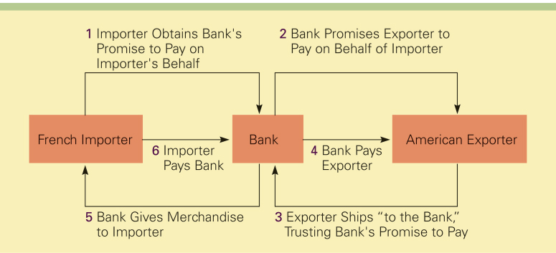
Lack Of Trust

Slide 15
Letter Of Credit
A letter of credit is issued by a bank at the request of an importer and states the bank will pay a specified sum of money to a beneficiary, normally the exporter, on presentation of particular, specified documents.
The main advantage of the letter of credit is that both parties to the transaction are likely to trust a reputable bank even if they do not trust each other
Notes:
The letter of credit is Issued by a bank at the request of the importer.
The bank pays a specified sum to a beneficiary, normally the exporter, on presentation of particular, specified documents.
The fee paid by importer for letter of credit.
May reduce borrowing ability of importer since the letter is a financial liability.

Slide 16
Draft
A draft, also called a bill of exchange, is the instrument normally used in international commerce for payment.
A draft is simply an order written by an exporter instructing an importer, or an importer's agent, to pay a specified amount of money at a specified time.
A sight draft is payable on presentation to the drawee while a time draft allows for a delay in payment - normally 30, 60, 90, or 120 days

Slide 17
Bill Of Lading
The bill of lading is issued to the exporter by the common carrier transporting the merchandise
It serves three purposes:
it is a receipt
it is a contract
it is a document of title
Notes:
The bill of lading is issued to the exporter by the common carrier transporting the merchandise.
It serves three purposes:
Receipt - merchandise described on document has been received by carrier
Contract - carrier is obligated to provide transportation service in return for a certain charge
Document of title – can be used to obtain payment or a written promise before the merchandise is released to the importer

Slide 18
Question
A _______ is an order written by an exporter instructing an importer to pay a specified amount of money at a specified time.
a) letter of credit
b) draft
c) bill of lading
d) confirmed letter of credit
Notes:
The answer is b.

Slide 19
Lecture 23

Slide 20
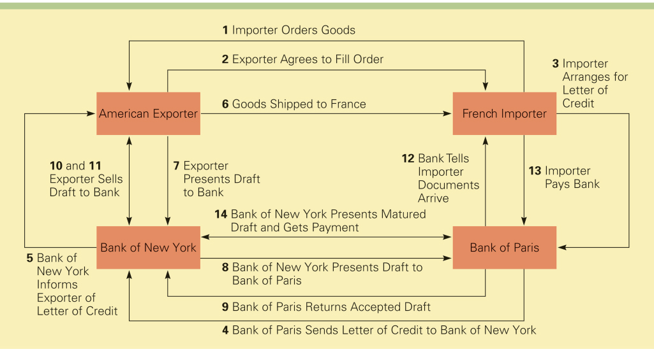
A Typical International Trade Transaction

Slide 21
Question
Which of the following is not a purpose of the bill of lading?
a) It is a contract
b) It is a document of title
c) It is a form of payment
d) It is a receipt
Notes:
The answer is c.

Slide 22
Export Assistance
There are two forms of government-backed assistance available to exporters:
Financing aid is available from the Export-Import Bank.
2. Export credit insurance is available from the Foreign Credit Insurance Association

Slide 23
Export-Import Bank
The Export-Import Bank (Eximbank) is an independent agency of the U.S. government.
It provides financing aid to facilitate exports, imports, and the exchange of commodities between the U.S. and other countries.
Unibank achieves its goals though various loan and loan guarantee programs

Slide 24
Export Credit Insurance
Export credit insurance protects exporters against the risk that the importer will default on payment
In the U.S., export credit insurance is provided by the Foreign Credit Insurance Association (FICA)
FICA provides coverage against commercial risks and political risks

Slide 25
Countertrade
When conventional means of payment are difficult, costly, or nonexistent, some firms may turn to countertrade.
Countertrade refers to a range of barter-like agreements that facilitate the trade of goods and services for other goods and services when they cannot be traded for money

Slide 26
The Incidence Of Countertrade
During the1960s, when the Soviet Union and the Communist states of Eastern Europe had nonconvertible currencies, countertrade emerged as a means purchasing imports.
During the 1980s, the technique grew in popularity among many developing nations that lacked the foreign exchange reserves required to purchase necessary imports.
There was a notable increase in the volume of countertrade after the Asian financial crisis of 1997
Notes:
It is estimated that about 8-10 percent of world trade is covered by some sort of countertrade arrangement.

Slide 27
The Incidence Of Countertrade
There are five distinct versions of countertrade:
1. barter
2. counterpurchase
3. offset
4. compensation or buyback
5. switch trading

Slide 28
The Incidence Of Countertrade
Barter is a direct exchange of goods and/or services between two parties without a cash transaction
Barter is the most restrictive countertrade arrangement
It is used primarily for one-time-only deals in transactions with trading partners who are not creditworthy or trustworthy
2. Counter purchase is a reciprocal buying agreement
It occurs when a firm agrees to purchase a certain amount of materials back from a country to which a sale is made

Slide 29
The Incidence Of Countertrade
3. Offset is similar to counter purchase insofar as one party agrees to purchase goods and services with a specified percentage of the proceeds from the original sale
The difference is that this party can fulfill the obligation with any firm in the country to which the sale is being made
4. A buyback occurs when a firm builds a plant in a country—or supplies technology, equipment, training, or other services to the country—and agrees to take a certain percentage of the plant’s output as a partial payment for the contract

Slide 30
The Incidence Of Countertrade
5. Switch trading refers to the use of a specialized third-party trading house in a countertrade arrangement
When a firm enters a counter-purchase or offset agreement with a country, it often ends up with what are called counter-purchase credits, which can be used to purchase goods from that country
Switch trading occurs when a third-party trading house buys the firm’s counter-purchase credits and sells them to another firm that can better use them

Slide 31
Question
Which type of countertrade arrangement involves the use of a specialized third-party trading house?
a) a buyback
b) an offset
c) a counterpurchase
d) switch trading
Notes:
The answer is d.

Slide 32
The Pros And Cons Of Countertrade
Countertrade is attractive because it gives a firm a way to finance an export deal when other means are not available
If a firm is unwilling to enter a countertrade agreement, it may lose an export opportunity to a competitor that is willing to make a countertrade agreement
In some cases, a countertrade arrangement may be required by the government of a country to which a firm is exporting goods or services

Slide 33
The Pros And Cons Of Countertrade
Countertrade is unattractive because it may involve the exchange of unusable or poor-quality goods that the firm cannot dispose of profitably.
It requires the firm to establish an in-house trading department to handle countertrade deals.
Countertrade is most attractive to large, diverse multinational enterprises that can use their worldwide network of contacts to dispose of goods acquired in countertrade deals

Slide 34
Question
Countertrade is attractive for all of the following reasons except
a) It may involve the exchange of unusable or poor-quality goods that the firm cannot dispose of profitably
b) It can give a firm a way to finance an export deal when other means are not available
c) It can be a strategic marketing weapon
d) It can give a firm an advantage over firms that are unwilling to engage in countertrade arrangements
Notes:
The answer is a.

Slide 35
Question
________ is the most restrictive countertrade arrangement.
a) counterpurchase
b) switch trading
c) barter
d) offset
Notes:
The answer is c.

