Slide 1
MGT 461
Project Management and NGOs
Ghazala Amin
1

Slide 2

Why Project Management
Every social organization – whether working on service delivery or process issue, undertakes projects. Projects come in many forms and can range from the very simple to the very complex. Every project is unique and presents unique challenges. Project Management is essential to manage projects.
Notes:
2

Slide 3
Examples of Project Oriented Industries
NASA and DOD (Department of Defense)
Construction, architecture, new product development
NGOs
Financial/Service Institutions
Banks, Insurance, Telecommunication
Manufacturing Units and Plants’ operation
3

Slide 4
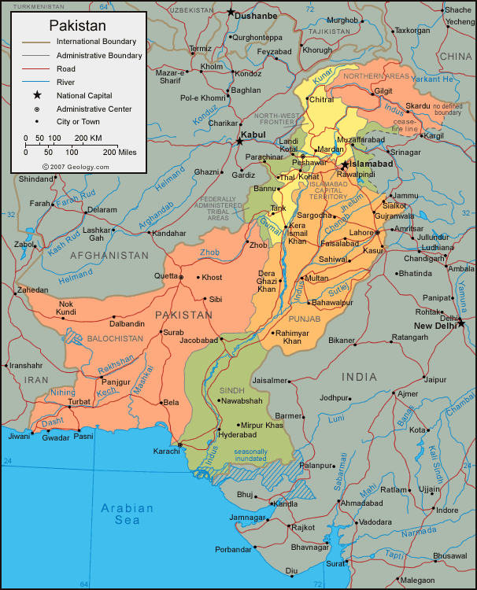
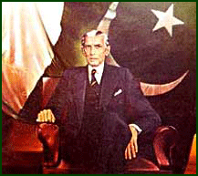

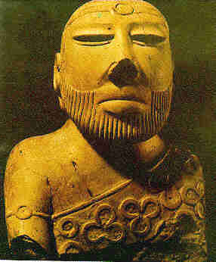





Examples of Major Projects in Pakistan
Tarbela Dam
Mangla Dam
Ghazi-Barotha
HUBCO
Jinnah International Airport
Allama Iqbal International Airport
Muslim Commercial Bank
National Stadium Karachi
Shah Faisal Mosque
Shaukat Khanum Memorial Hospital
JF-17 Sino-Pakistan Combat Aircraft
Notes:
4

Slide 5
Examples of Social Sector Projects in Pakistan
Voter Education Project
Constituency Relations Group
Tobacco Free Initiative
Polio Eradication Program
Family Planning Project
Governance Monitoring
Khuda Ki Basti
Orangi Pilot Project
Clean Drinking Water Project
Awaz
Youth Parliament
Diya
Iodine Use
Notes:
5

Slide 6
What is a Project ?
Need/ Scope / Requirement
Quality
Budget / Cost
Time / Schedule
6

Slide 7
Project Structure
Portfolio
Program
Project
Project
Project
Sub Project
7

Slide 8
Project Output & Outcome: Example
Project Phase
Project Life-Cycle
Concieving, Initiation, Planning, Implementation and Closure of the Project
Project Output
Short-term
Economic – Impact on investment, trade, local businesses, tourism, inflation, employment,, wealth accumulation and distribution
Medium-term
Selected
Project Outcomes
(+ and -)
Long-term
Environmental – Impact on fauna and flora, pollution levels, depletion of natural resources, waste accumulation and disposal
Social – Impact on services like democracy, governance, interfaith harmony, community capacity building, health and education, crime, social relations, communities‘ out-look and values
Notes:
Slide: „.....“
There may be benefits in other areas (for e.g. political) also which are not reviewed here.
8

Slide 9
Non-Governmental Organizations (NGOs)
NGOs claim to be ‘learning organizations’
They rely on both formal and informal processes to:
generate new learning,
reflect on past experience and
experiment with new approaches.
The learning organization is one which is “continuously expanding its capacity to create its future” (Peter Senge, The Fifth Discipline)
Notes:
9

Slide 10
NGOs and Results-Based Management (RBM)
RBM is a relatively new (1990’s) formal approach being ‘learned’ by NGOs
Donor agencies have played a vital role in the adoption of RBM by NGOs.
NGOs are adopting RBM to improve, for example:
governance
accountability
capacity development
Capacity reflects the abilities to meet the needs and demands of the stakeholders for whom they were established or to whom they are accountable.
Notes:
Same was true for Management by Objectives and zero- based budgeting in the 1970s , Total Quality Management (TQM) in the 1980’s and RBM a decade later.
The term “capacity” refers to the abilities, skills, understandings, attitudes, values, relationships, knowledge, conditions and behaviors that enable organizations, groups and individuals in a society to generate benefits and achieve their objectives over time. Capacity also reflects the abilities of these actors to meet the needs and demands of the stakeholders for whom they were established or to whom they are accountable. These attributes cover formal, technical and organizational abilities and structures and also the more human, personal characteristics that allow people to make progress.
Accountability can be defined as the right to be involved in all phases and levels of the performance management cycle of an entity (Murtaza 2011, p.4)
Accountability can also be defined as “the obligation to demonstrate and take responsibility for performance in light of agreed expectations” (Treasury Board, 2001a:33). Accountability is more than accountability for results. It also includes concern for other dimensions of accountability such as cost-effectiveness, prudence and compliance (Lavergne 2002, p.4)
10

Slide 11
What is RBM (History)?
Origins of RBM Method
Introduced as “management by objectives” by Peter Drucker (1954)
Grew out of the Logical Framework Approach (LogFrame, LFA) by Practical Concepts Inc
It developed as a result of globalization, competition and the entrepreneurial culture.
In the late 1990s, the UN system adopted RBM in its major agencies.
Practical Concepts Inc was an American firm that designed the Logframe for USAID.
Notes:
Management by objectives was mentioned by Peter Drucker in his book “ The Practice of Management”. It would further be developed by George O Odorne in his book Management by Objectives. It was a departure from the “bureaucracy model” of Weber.
Practical Concepts Inc was an American firm that designed the Logframe for USAID.
11

Slide 12
What is RBM?
It is a life-cycle approach since a programme under RBM focuses on results from planning and implementation to monitoring, evaluation and reporting.
Notes:
12

Slide 13
The RBM life cycle approach
Managing for results
Committing to results
Defining Results
Evaluating results
Reporting on results
Monitoring indicators and targets
Choosing indicators and targets
Strategizing + Acting for results
Trocaire, 2011
Notes:
13

Slide 14
What is a Result?
According to Peter Drucker (1990), a non-for-profit institution has had no results until the end “user” becomes a “doer” or is a changed human being.
It is a positive change happening in the life of people (in the community, in society) as a consequence of a project.
It is a describable or measurable development change resulting from a cause and effect relationship.
Notes:
14

Slide 15
3 Levels of Results in RBM
The 3 levels of results in RBM are based on the nature of the results involved and the timeframe over which they appear.
Impacts/Ultimate results
Outcomes/Intermediate Results
Outputs/Immediate Results
.
Notes:
Outputs/Immediate results are the immediate, tangible and visible consequences of the activity and actions of the project/program. Time frame is over one or two years (short term)
Outcomes/ intermediate results :. Outcomes are the cumulative product of immediate results; they are the unleashing of potential. Outcomes usually take place in families, organizations and communities that are influenced by the project.
Time frame : over three to five years (medium term)
Ultimate results/Impacts: they are the cumulative effects of outcomes. These usually describe 'big picture' changes that your project is working towards, but which you alone cannot bring about. Impacts illustrate the underlying goal of your work; they answer why your work is important. The ideal impact: a. Inspires people toward a certain future b. allows your project to demonstrate a contribution in the future with some kind of social, economic or environmental change.
Time frame: long term (5 to 10 years or more)
15

Slide 16
3 Levels of Results in RBM
Expected Impact: Rise in awareness of the potential of sustainable organic farming within Pakistani communities.
Outcome: Villagers apply new skills in growing vegetables
Output: trained villagers have new skills in growing vegetables
Notes:
16

Slide 17
Results Chain
A series of expected achievements linked by causality
Each link in the chain is characterized by:
– Increased importance of achievement with respect the program goal.
– Decreased control, accountability, and attribution.
Notes:
17

Slide 18
Results Chain
Vision/Values/ Key Principles
Inputs
Activities
Outputs
Outcomes
Impact
Mission
Objectives
Goal
Notes:
Inputs are the human, financial and physical resources required to undertake your planned activities. This is where you identify expertise, equipment and supplies. Having a good understanding of your input requirements allows you to draft a budget.
Activities: These are what you do with those ingredients - how you combine them. This is the 'what you do' each day to work towards that big goal. Typically, projects involve tens and hundreds of definable activities. You should group activities into between five and eight activity sets. Common headings for these sets include Promotion, Group Formation, Counseling, Networking, Advocacy, Training and Construction.
18

Slide 19
Inputs | Inputs are the human, financial and physical resources required to undertake your planned activities. This is where you identify expertise, equipment and supplies. Having a good understanding of your input requirements allows you to draft a budget.
Activities | Activities: These are what you do with those ingredients - how you combine them. This is the 'what you do' each day to work towards that big goal. Typically, projects involve tens and hundreds of definable activities. You should group activities into between five and eight activity sets. Common headings for these sets include Promotion, Group Formation, Counseling, Networking, Advocacy, Training and Construction.
Outputs | Outputs/Immediate results are the immediate, tangible and visible consequences of the activity and actions of the project/program. Time frame is over one or two years (short term)
Outcomes | Outcomes/ intermediate results :. Outcomes are the cumulative product of immediate results; they are the unleashing of potential. Outcomes usually take place in families, organizations and communities that are influenced by the project. Time frame : over three to five years (medium term)
Impacts | Ultimate results/Impacts: they are the cumulative effects of outcomes. These usually describe 'big picture' changes that your project is working towards, but which you alone cannot bring about. Impacts illustrate the underlying goal of your work; they answer why your work is important. The ideal impact: a. Inspires people toward a certain future b. allows your project to demonstrate a contribution in the future with some kind of social, economic or environmental change. Time frame: long term (5 to 10 years or more)
Notes:
Inputs are the human, financial and physical resources required to undertake your planned activities. This is where you identify expertise, equipment and supplies. Having a good understanding of your input requirements allows you to draft a budget.
Activities: These are what you do with those ingredients - how you combine them. This is the 'what you do' each day to work towards that big goal. Typically, projects involve tens and hundreds of definable activities. You should group activities into between five and eight activity sets. Common headings for these sets include Promotion, Group Formation, Counseling, Networking, Advocacy, Training and Construction.
19

Slide 20
Measuring Results
Instruments used to measure results in RBM, are called indicators.
Indicators are the evidence/proof needed to show progress towards outputs, outcomes and finally impact.
Notes:
20

Slide 21
Indicators
Quantitative Indicators (number, % or ratio)
Qualitative Indicators (reflect perceptions, opinions or level of satisfaction)

Slide 22
A Good Indicator is :
Valid
Reliable
Sensitive
Simple
Utilitarian
Feasible
Affordable
Notes:
22

Slide 23
RBM Framework
START: END: | PRIORITY(IES) | RESULT(S): | COUNTRY(IES):
Budget total / Total Budget: |  | OBJECTIVES: | GOAL(S):
ACTIVITIES | OUTPUTS | OUTCOMES | IMPACT(S)
 | PERFORMANCE INDICATORS
 | REACH
RISKS & ASSUMPTIONS
Notes:
23

Slide 24
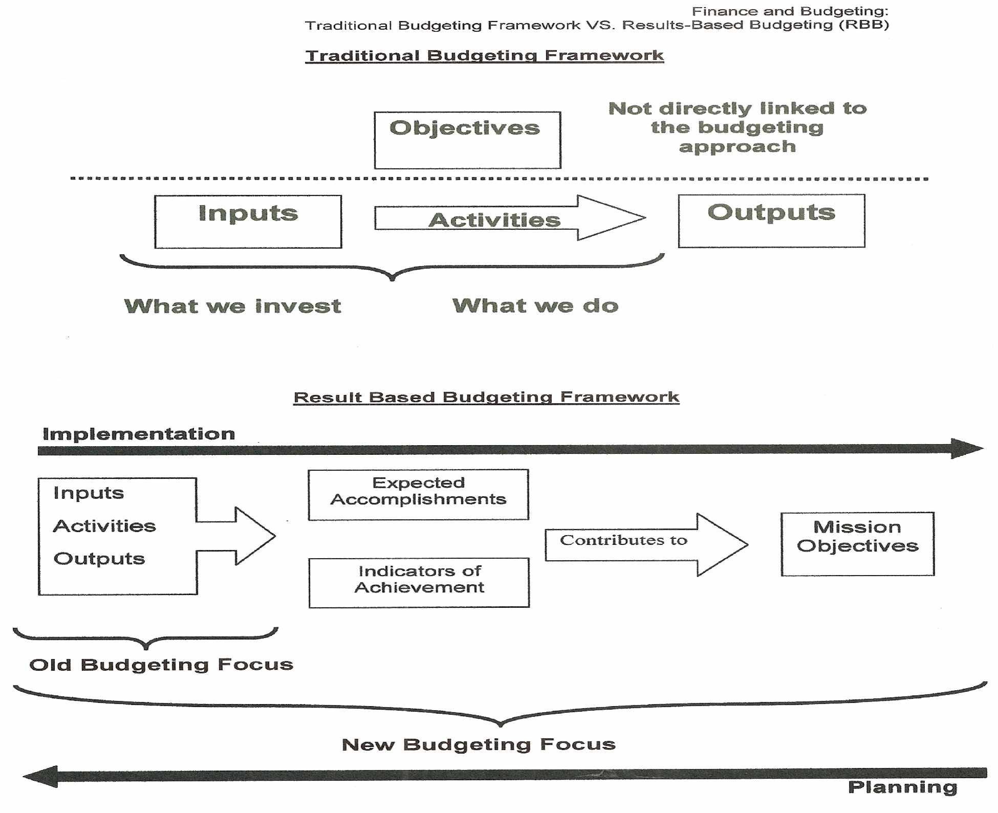
Results- Based Budgeting

Slide 25
RBM ..
Allows the project holder, implementer, coordinator to manage a project more effectively when used properly
Offers the benefits that come with any real system: rigor, depth and effectiveness
Allows NGOs to better communicate about the impacts of their work on people and societies.
Is a means to an end. Not an end!
Is not a “technical marvel” of development.
Notes:
RBM is not used properly when :
• completed activities are confused with outputs
• there are unclear linkages between the different levels of results so that it becomes hard to establish how a specific result has been achieved
• results are unrealistic (that are usually too ambitious!) given the resources at hand and the duration of the project
• there is too much reliance on quantitative indicators vs qualitative indicators
• indicators are confused with results
Not being sufficiently explicit in how the project will reduce gender gaps or constraints faced by women and/or men, boys and/or girls.
Is a means to an end and should not be considered as a replacement to work and thinking.
25

Slide 26
Project Phases and their relevance to Logical Project Implementation Flow
Political context, vision and mission statement | Conceiving/Initiation
Goal, Purpose (Outcome), Output (Result) and their Indicators | Planning
Goal, Purpose (Outcome), Output (Result) and their Indicators | Execution
Indicators of Goal, Purpose and Outputs | Monitoring and Evaluation
Goal and Outcome (Purpose) | Result Assessment (Post-project Assessment)
Goal and Outcome and Vision and Mission Statement | Sustainability Assessment

Slide 27
Some Essential Definitions
Goal | A more democratic governance
Purpose (Outcome) | Government institutions responding to public needs
Result (Output) | Health, education and sanitation departments responding to public demands
Indicator (Goal) | International Ranking of Pakistan on indices
Indicator (Purpose) | 50% of Pakistanis posing trust in departments where project is intervening
Indicator (Output) | 200 demands raised and at least 75 met by Project end with following distributions: First quarter: 10 demands raised, 2 met

Slide 28
Who is who in a Project?
Project Stakeholders are;
  Individuals directly involved in project deliverables or
  Individuals that are positively or negatively affected by the project
Project Stakeholders include;
  Project Manager
  Project Team Members
  Donors
  Government Agencies
  Media
  academia
  Performing organization
  Beneficiaries
  End Users and many others
28

Slide 29
Who is who in a Project?
Stakeholder | Responsibility
Donor | Provision of Funds
Organization | The entity that conceives and plans/implement the project
Partner organizations | The entities that collaborate with organization for implementation of the project
Core Project Team (Management) | Organization’s team that plans the project and its implementation besides monitoring and result assessment

Slide 30
Who is who in a Project?
Stakeholder | Responsibility
Project staff | The teams of professionals with organizations and/or partner organizations who actually implement the project components on ground
Auditor or external evaluator | The person(s) who is responsible for objective assessment of whether project is heading towards achieving its results or not
Beneficiaries | The target audience most commonly general public and groups like media, political parties, elected and public officials and institutions that will ultimately benefit from the results of project
Allies | The individuals or groups who facilitate and provides direction/feedback to the project staff on implementation of the project activities

Slide 31
Stakeholder Communication
Donor
Line Managers
Other Projects
Project
Leader
The
People
Project Team
Members
Auditors,
Govt
Service Providers
31

Slide 32
Project Life Cycle and the phases
Representative Project Life Cycle (typical)
  Initiation/Concept/Feasibility
  Planning/Development
  Execution/Implementation
  Control/Monitoring
  Close-out (Conclusion, Result Phase)/Termination/Finish
32

Slide 33
Interaction between the five Project phases
PM processes are divided into five phases or process groups
Initiating
Processes
Planning
Processes
Controlling
Processes
Executing
Processes
Closing
Processes
Professional Responsibility
33

Slide 34
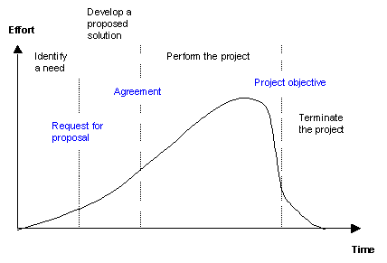
Project Life Cycle
34

